Slide 1
EEE MSc Project Guidance notes
Part 1/6

Slide 2
Contents:
Introduction, timeline, submission process, assessment, unfair means, getting started
Project/time management – Gantt chart, risk register
Interim report – structure, literature review
Final dissertation, scientific writing, structure
Oral and poster presentation skills
Experimental uncertainty

Slide 3
Recommended Books
Barrass , “Scientists Must Write”, Chapman and Hall
Sides, “How to Write and Present Technical Information”, CUP
Cain, “The Basics of Technical Communicating”, American Chemical Society
Cooper, “Writing Technical Reports” , Penguin
van Emden, “A Handbook of Writing for Engineers”, Macmillan
Turk , “Effective Speaking”, Chapman and Hall

Slide 4
English language skills
The following sessions taught by our English Language Teaching staff member specifically for our MSc students with poor English:
3 × 1.5 hour sessions on "Preparation for project Interim Report”
There will also be some Writing Advisory Sessions (1:1 appointment based sessions). Peter Judd will announce these in detail nearer the time.
Notes:
3 x 1.5 hour sessions for those non-native speakers who really struggle to write in English, not for those that are pretty much OK with writing in English.
1 to 1 sessions where you can take a section of your report along for advice on grammar etc.

Slide 5
More general English writing or speaking classes : http://shef.ac.uk/eltc/languagesupport/els
And the English Language Teaching Centre's Writing Advisory Service (one-to-one help with written work by appointment) is available: http://shef.ac.uk/eltc/languagesupport/writingadvisory

Slide 6
Assessment
Dissertation (50 marks):
Products (10 marks)
Processes (10 marks)
Evaluation (10 marks)
Use of sources and resources (10 marks)
Presentation (10 marks)
+ General ability (20 marks)
+ Interim report & presentation (10 marks)
+ Continuous assessment (10 marks)
+ Poster presentation (10 marks)
Nb: COM6915 marked slightly differently, but still 60 credits

Slide 7
Suggested marking guidelines – dissertation & poster

Slide 8
Project continuous assessment
2) 10 mark contribution to project module (supervisor only):
performance 5 marks
theory/methodology 5 marks
Notes:
Performance to date: Has the student demonstrated motivation, self-reliance and initiative? Any progress made towards the project objectives?
Theory/methodology: Has the student understood the required theoretical foundation and methodologies?
Assessed by supervisor

Slide 9
Supervisor’s assessment of ability (scaled to 20 marks)
Understanding: 10 marks
Understanding the problem and it’s requirements, grasp of the topic, theoretical approach
Practical skills: 10 marks
Approach to work, use of design tools, experimental verification, technical competence, application of engineering principles, elegance of solutions
Self-reliance & initiative: 10 marks
Diligence, time management, development of new ideas, application of novel engineering design principles

Slide 10
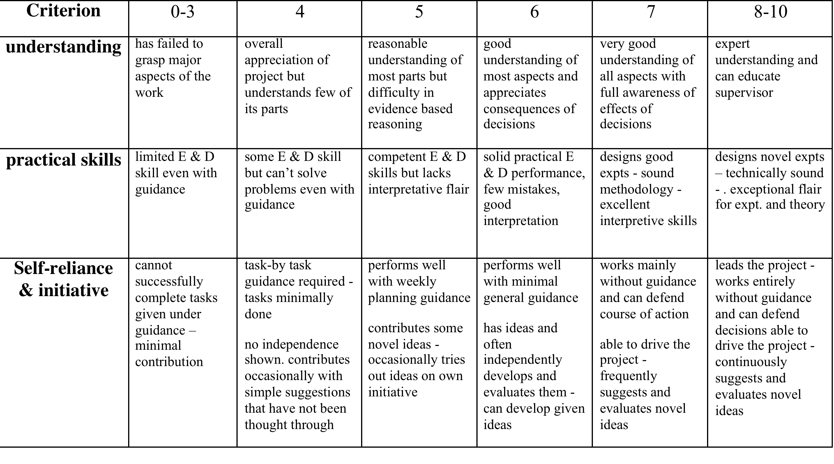
General ability

Slide 11
Interim stage mark scheme (10 marks) EEE only, not DCS
Supervisors interim report mark sheet:
(70% of interim marks)
A1) Literature review 40%
A2) Project plan 40%
A3) Overall presentation/structure 20%
2nd markers mark sheet:
(30% of interim marks)
C1) Oral presentation of project objectives/theory/context/progress (50%)
C2) Ability to answer questions posed (50%)
online marking, feedback via supervisor
Notes:
You will be able to access feedback on both elements of the interim assessment from your supervisor in early July.

Slide 12
Suggested marking guidelines

Slide 13
Submission process – interim and final report
1 hard copy of interim report and 2 hard copies of final thesis to be submitted to EEE office.
Late submission results in 5 marks being deducted per day!
Electronic copies of the interim report and the final dissertation should also be submitted to the EEE TurnItIn and online marking system before the deadline.
Failure to submit electronically → zero → no MSc!
Notes:
In case of illness or other such special circumstance, please discuss with supervisor ASAP.

Slide 14
Thoughts on interim report
Comprehensive literature review
Understand objectives of project
Background theory
Realistic time plan (Gantt chart)
Report to be marked by supervisor
If a student fails to submit their interim report they cannot proceed to the project

Slide 15
Thoughts on final report
A formal piece of substantial stand alone writing, presenting original data in support of a particular supposition
Structure (what to include?)
Scientific writing
Results/figures
Errors
Notes:
What to include – we will see that there is a standard template to follow for all technical reports.

Slide 16
Plagiarism
TurnItIn - pattern matching routine. Human interpretation required. Matched text highlighted, referenced to the source text. Click on the coloured section in the report to see the source in context, or click on a source to see that in full.
a number of matches to common English phrases like, “It can be seen from the graph that” are ignored.
What is the probability of a student coming up with exactly the same form of words by pure chance? If probability is very small then student has probably copied.
Length of matching passage a factor –using ‘technical’ terms is not a problem, but cutting-and-pasting sections is.
Copied passages which have been laundered – a few words changed to try to camouflage the origin of the passage.
http://hercules.shef.ac.uk/eee/teach/resources/info/departmental_policy_on_referencing-student.pdf

Slide 17
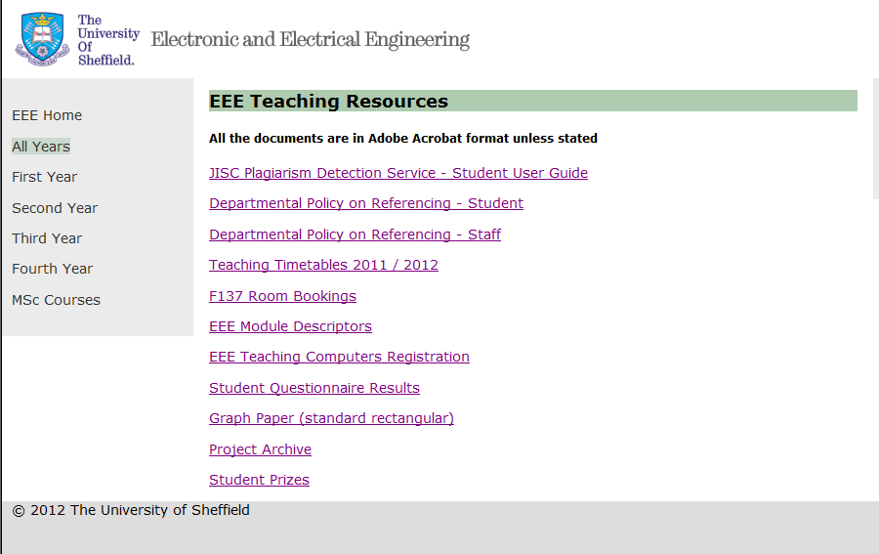
More on plagiarism
EEE homepage → Information for staff/students → EEE teaching resources →

Slide 18
Exercise: Writing a summary
Read the articles all the way through without making any notes. Gives an overview of the article’s content and structure.
Write one or two sentences outlining what the article is about.
Re-read the articles, noting down the main points in each one, in your own words, as you come to them. These points will often be supported by facts or arguments - note these as well.
Prioritise the points you have noted
Write summary in your own words.
It should have an introductory paragraph to tell the reader what the article is about.
Order the points and supporting arguments.
Draw ideas together with a brief conclusion

Slide 19
Project: Getting started
Familiarise yourself – labs, stores, key people (RAs, technicians), lab safety/evacuation procedures.
Maintain a proper lab book – keep good records of experiment/simulation. Write everything down (worked or not). Write all parameters used. Include thoughts/discussions.
Establish good reference keeping practices – keep a working bibliography (referencing).
Plot results/compile record of progress – helps supervision.
Deal with problems – Show initiative but seek guidance where appropriate (especially if expensive!)
Notes:
Similar to start of any project, whether that is PhD, MSc, or even in the outside world.
5) Supposed to show independent working including problem solving (some projects will essentially be a problem that needs to be solved). But if struggling don’t be afraid to seek guidance from supervisor, RA, PhD student – especially if involves expensive equipment.

Slide 20
Supervision
Supervision will be very different!
Amount/type of supervision depends on research group size:
Start up: young supervisor/new group – frequent intensive supervision. Over ambitious, simplify later. Ground breaking, but could be long set-up times.
Up and running: money to spare but supervisor has less time available. RAs/PhDs. Previous results. Impact.
Empire: very large group, several RAs/PhDs. May not see supervisor often. But lots of equipment, many fall back options.
Notes:
Supervision doesn’t always depend on the supervisor, or number of meetings with supervisor, but on the team in general. Each student/supervisor interaction level will be different with advantages/disadvantages of each pairing. So don’t worry about comparing with each other. RAs/PhDs may be the easiest day-to-day option in many cases.

