Slide 1

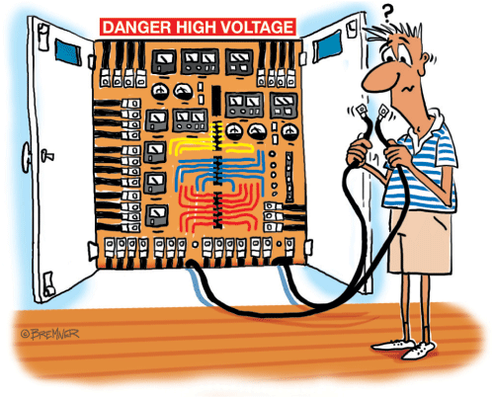
EEE 3rd Year Beng/Meng Welcome Academic Year: 2016-2017
EEE
Notes:
DIAMOND!!!

Slide 2
Overview
General Introduction and Structure
Chris Gould
Library Facilities
Emily Stock
Departmental Safety Policy
Dianne Webster
Beng Design Projects/Meng Research Projects
Jon Rigelsford
Plagiarism/PDP/IET and AOB
Chris Gould

Slide 3
3rd Year Staff
3rd Year Tutor:
Pastoral: Dr. Chris Gould (c.gould@shef.ac.uk)
3rd Year Project Coordinators:
Students: Dr. Jonathan Rigelsford (j.m.rigelsford@shef.ac.uk)
Staff: Mr. Andy Race (a.m.race@shef.ac.uk)
3rd Year Project Supervisors
Allocated member of staff – expert in field
3rd Year Administration
Sarah Kennedy (s.j.kennedy@shef.ac.uk)

Slide 4
Library

Slide 5
Course Structure
2 Semester Structure (12 weeks each)
120 Credits Total - 30 Credit Individual Project
20 Credit Module: ~24 weeks, final 3hr exam (5/8)
10 Credit Module: ~12 weeks, final 2hr exam (3/4)
Remember – 5hrs per module per week self-study

Slide 6
Available Degrees
Electrical Engineering (BEng/MEng)
Electronic Engineering (BEng/MEng)
Electronic & Communications Engineering (BEng/MEng)
Electrical & Electronic Engineering (BEng/MEng)
Digital Electronics (MEng only)
Microelectronics (MEng only)
Electronic & Electrical Engineering with a Modern Language (MEng only)
Change of degree programme is still possible in some cases up to week three of semester two of your third year

Slide 7
Degree Modules
Beng common modules
ACS342 (10), EEE360 (30), MGT388 (10)
Meng common modules
ACS342 (10), EEE371 (30), MGT388 (10), MAS381 (10)
3 core modules per degree (50)
Beng - 20 credits from optional modules
Meng - 10 credits from optional modules

Slide 8
EEE360/EEE371
Third Year Project (30 credits – 25% of year).
Must pass with 40% for Beng honours degree or Meng continuation.
Information about the allocation of marks can be found on the department’s teaching web pages.
http://www.shef.ac.uk/eee/info
EE Teaching Resources > Third Year > EEE360 or EEE 371

Slide 9
 | Timescale |  | Assessment | %
Progress Reporting | Oct ‘16 | Week 5 | Report 1 (PS) Initial Plan Literature Review Specification Risk Register | 10
Communication Skills | Nov ’16 | Week 7/8 | 2nd Marker Meeting (SM) | 5
Progress Reporting | Feb ’17 | Week 13 | Report 2 (PS & SM) Technical Content Presentational Quality Self-Reliance Understanding | 15
 |  |  | 1st Semester Total | 30
Communication Skills | March | Week 18 | 2nd Marker Viva (SM) | 10
Progress Reporting | March | Week 20 | Supervisor Assessment (PS) Self-Reliance Understanding | 10
Communication Skills | May | Week 21/22 | Symposia (Panel) Public Engagement (Panel) | 10 5
 |  |  | 2nd Semester Total | 35
Final Assessment | May | Week 23 | IEEE-style letter (PS & SM) | 35
 |  |  | Final total | 100

Slide 10
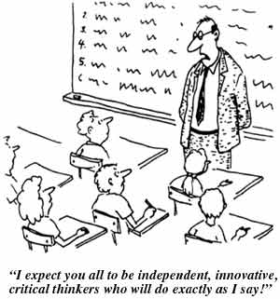
Rules of Engagement?

Slide 11
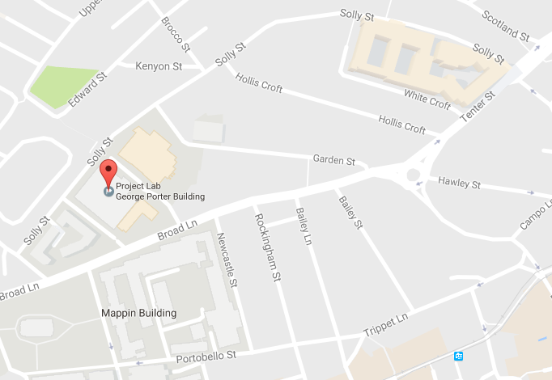
Projects & Safety
VELOCITY
F-floor - F13
KROTO
Closes at 5pm

Slide 12
Projects & Safety
Dianne Webster - Safety talk
Jon Rigelsford – Project allocation

Slide 13
Year Rep’s and Information Packs
We require a Student Representative for both Beng and Meng degrees
Take an active part in the way the degree is run
Looks good on CV!
2nd Yr Reps can continue
No Information packs given out this year
Third Year Handbook is now online (Teaching Resources)
Risk Assessment Form now online (RACIE)
You will need to collect a logbook to keep a COMPLETE record of your project work (marked)

Slide 14
Plagiarism
ALL WORK MUST BE YOUR OWN!
Make sure that you have read and understood what is meant by unfair means (Online Handbook - Academic Information)
Interim Report and Final Thesis MUST be submitted electronically to plagiarism detection software
You MUST NOT use quoted text in your reports unless previously agreed with your supervisor and signed off by your supervisor in your logbook
You MUST NOT use scanned diagrams

Slide 15
3rd Year Exams
Graduating with a Bachelors Degree:
You must accumulate at least 200 credits from years 2 and 3
You must have greater than a final weighted average of 45 for an Honours degree or 40 for a Pass degree.
Progression to Masters:
You must achieve an average 3rd year mark of 50% or more and 120 level 3 credits (with discretion down to 100 level 3 credits). You need to accumulate at least 320 credits from years 2, 3 and 4 in order to satisfy the credit hurdle that must be cleared for graduation
Degree Weightings:
For a BEng, the second and third year marks are combined with a weighting 1:2 respectively
For the MEng, the second, third and fourth year marks are combined with a 1:2:2 weighting respectively. The exception to this is MEng with a modern language (or other “year elsewhere” programmes) where the weighting for second third and fourth years is 1:1:2 respectively.

Slide 16
H.E.A.R.
(Higher Education Achievement Report)
EEE contact – Christina Murdoch (christina.murdoch@shef.ac.uk)
The HEAR is a nationally recognised degree transcript that the University is now giving to all undergraduates, to provide students with a comprehensive record of their university learning and experience – both academic and extra-curricular.
You can view your HEAR electronically via My Services in MUSE from Day 1 of your studies
You will be able to use our ShaRe (Sheffield Authorised Records) system to give employers and others access to your HEAR, to provide evidence of your university achievements.

Slide 17

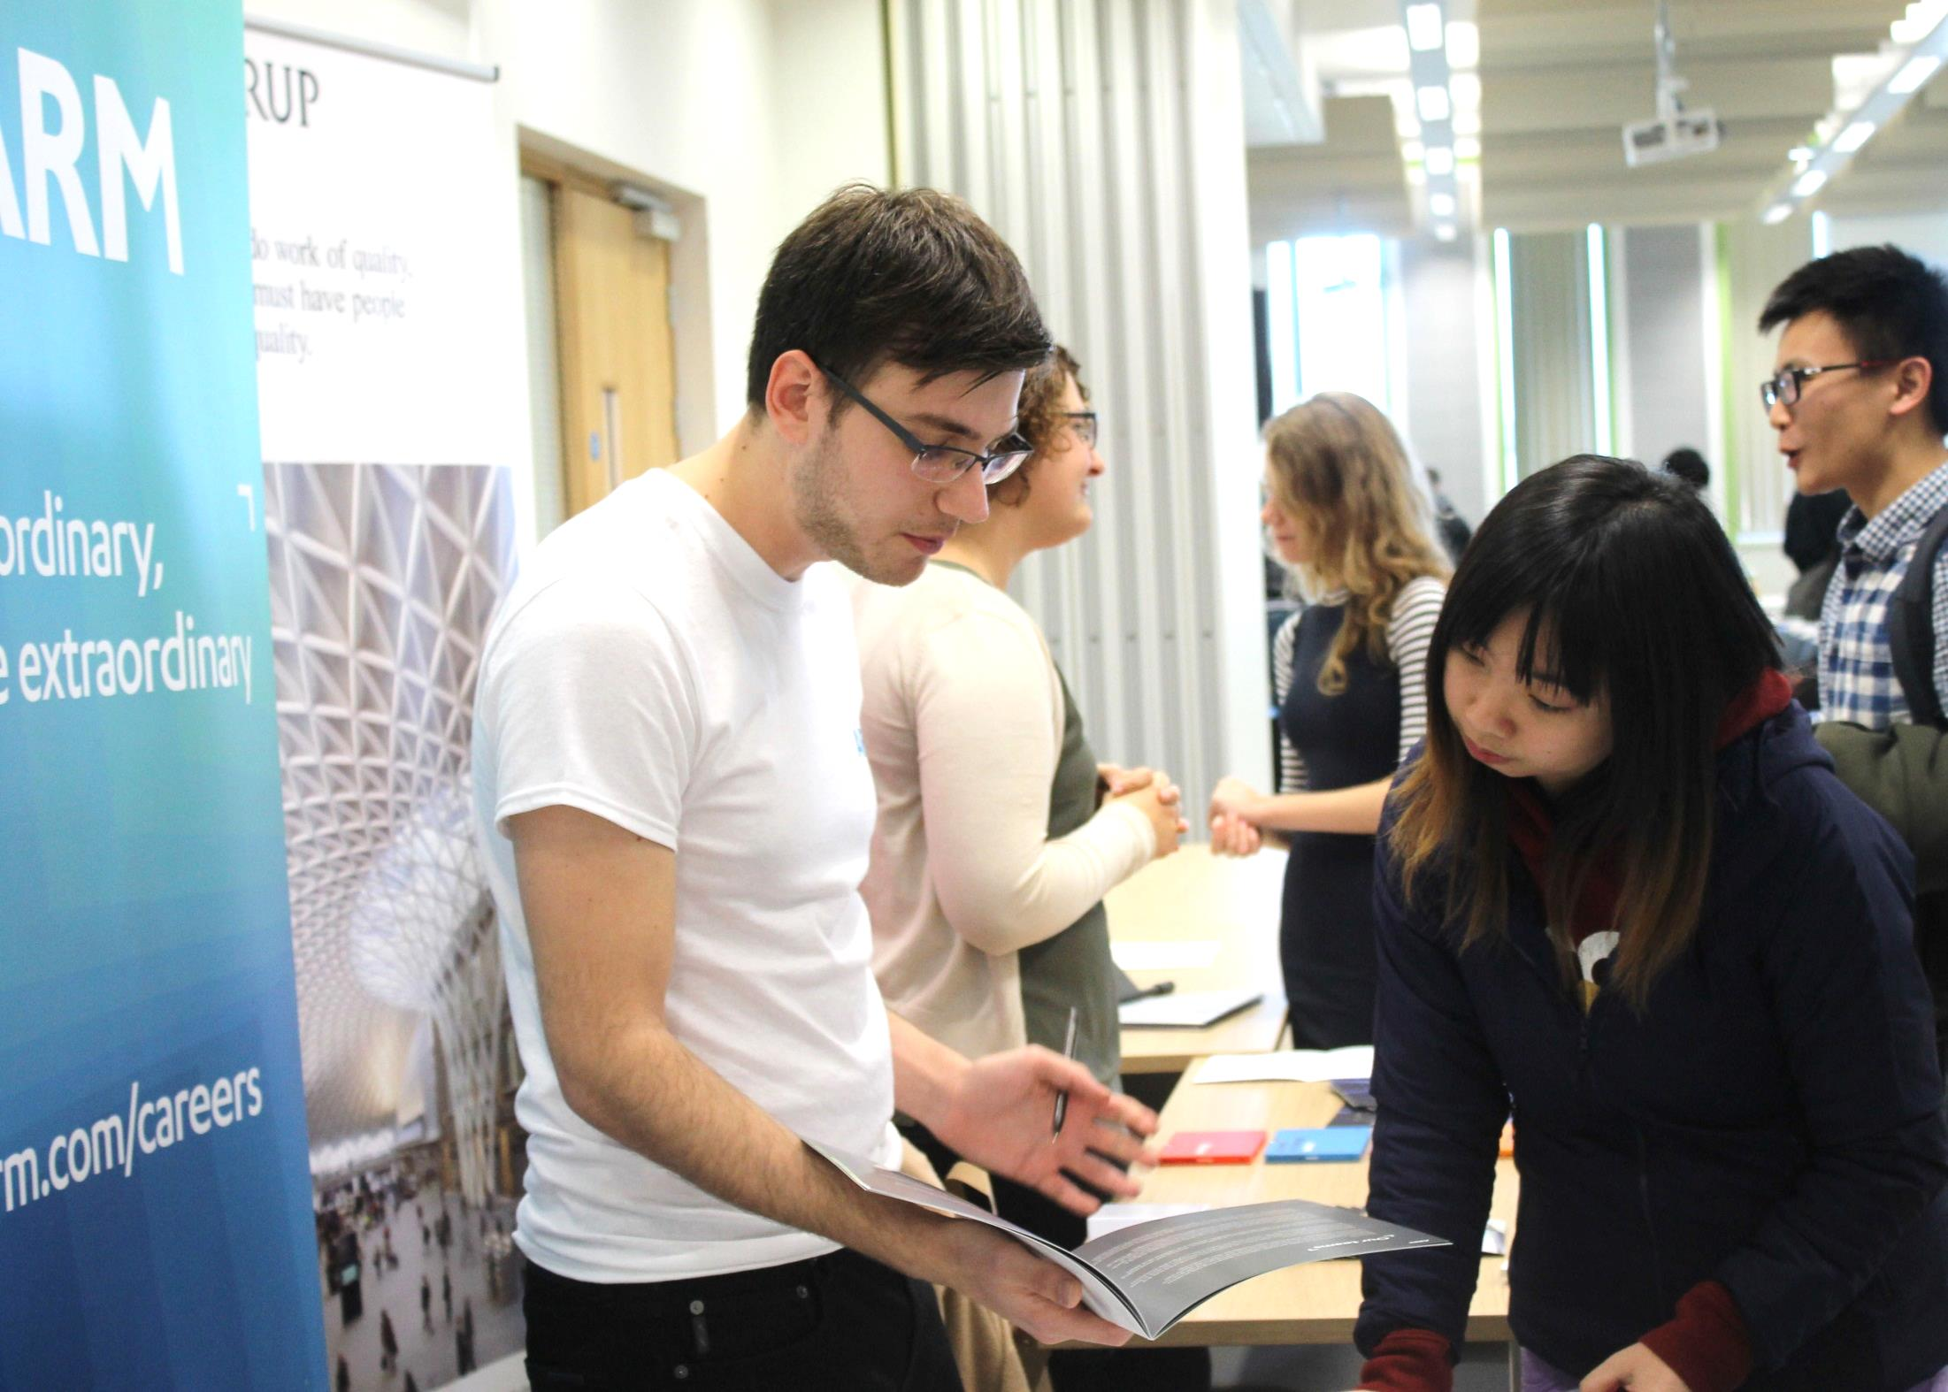










Department Of
Electronic &
Electrical Engineering.
Careers Day
^{Wednesday 12 October}
^{10:00-16:00}
^{Pam Liversidge Building, D05}
^{Morning Session 10:00-12:00}
Workshop sessions led by GE Aviation, Arup, NXP Semiconductors, Thales
^{Lunchtime Employer Exhibition}
Ideas Space, Robert Hadfield Building
^{Afternoon Session 13:45-16:00}
Workshop sessions led by Rolls Royce, Dyson
It’s your future…

Slide 18
Personal Development Planning
“Working towards a better future by reflecting on and learning from the past”

Slide 19
How we learn best - Kolb’s Learning Cycle:
Plan
Plan
Theorize
Experience
Reflect

Slide 20
The Reflective Cycle:
What have I done?
How could I do better?
Or what to do next?
What was I trying
to achieve?
Have I achieved
my objectives?

Slide 21
What is PDP?
Structured process integral to higher-level learning
About both academic and non-academic learning
Undertaken with guidance and support until it becomes self-sustaining

Slide 22
Specifically…
Personal records comprising:
self-reflection
target-setting
action planning
progress monitoring
Personal Statements, CV etc.

Slide 23
Why bother?
Help you stay focused - direction
Identify areas of weakness and plan how to address them – get better
Recognise skills gained – CV!
Make you more employable
Prepare you for Continuing Professional Development (CPD)

Slide 24
How?
Build your own personal record:
Self Reviews
Skills Audits
Development plans
CV etc.
Evidence/Examples
Personal Tutorial System – support
MUSE portal

Slide 25
3rd Year
Now:-
Think, what lessons can I learn from last year’s experiences?
So what plans and objectives should I set for myself for this new academic term? – Action Plan!
Think: Opportunity, Possibility, Determination, Focus
At end of week 13:-
As part of interim project assessment – you’ll be asked to write statements on:
What new skills have I learnt (transferable skills)?
What do I need to develop & focus on in the future?”

Slide 26
SWOT analysis
Strengths Good at Machines and EM fields | Opportunities Recruitment event coming up for Motors company IET skills event on giving presentations
Weaknesses Poor at stand-up talks Bit lazy, go out when should study Didn’t start design exercise early enough | Threats If mess up project presentation lose marks If don’t work hard enough might not get 2.1

Slide 27
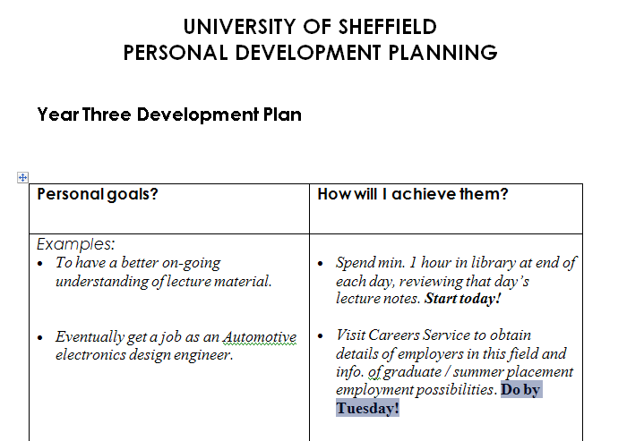
Development Plan

Slide 28
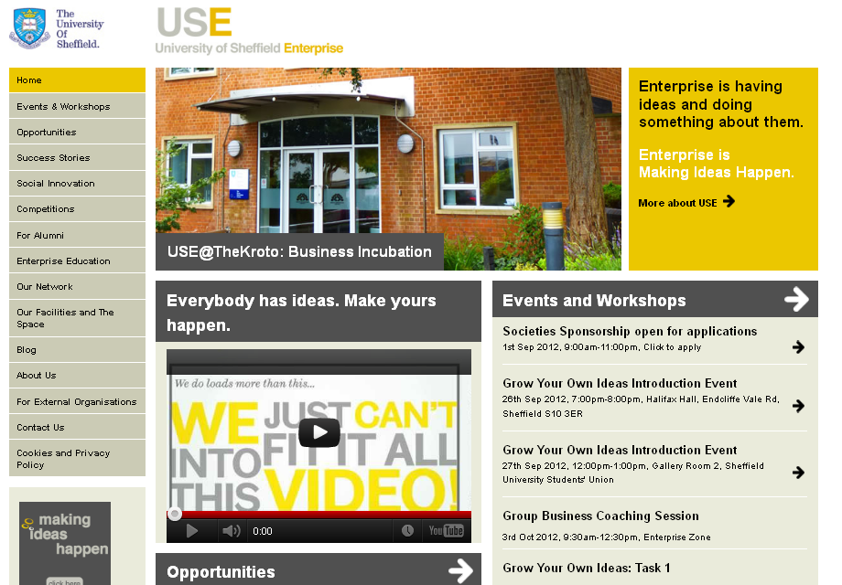
University of Sheffield Enterprise
http://enterprise.shef.ac.uk

Slide 29

Useful IET resources: www.theiet.org/student/

Slide 30
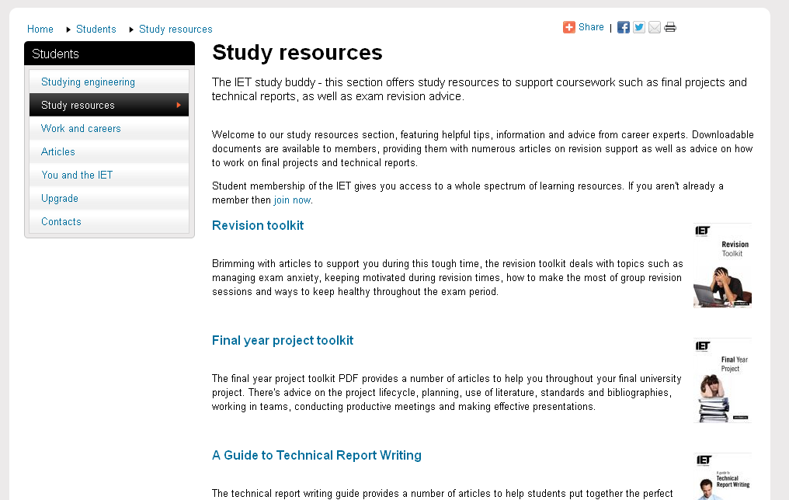
IET student study resources

Slide 31
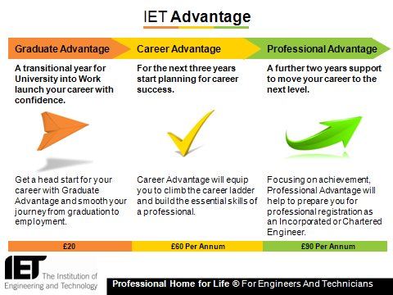

Slide 32




Professional Registration
your academic qualifications
demonstrate you can learn
your professional registration
demonstrates that you have
become a professional in
your field
Notes:
The IET offer four professional qualifications
Chartered Engineer
Incorporated Engineer
Engineering Technicain
ICT Technician
These build on your academic qualification and demonstrate you have put this into practice and further developed your skills as a working professional.

Slide 33
Being A Registered Engineer
recognition as a professional
self motivation
career opportunities
salary prospects
employability
Notes:
In becoming a registered engineer you have clearly demonstrated you abilities to provide solutions to the issues which faces the modern world. You will be recognised as a professional in your field. In achieving this you will gain more opportunity to progress you career, this will in turn improve your salary prospects.
It is true that you do not need to be a professional engineer to practice, however recent salary survey’s suggested that engineers with professionally registered status earn on average £6k per year more than there colleague who do not have the level of recognition for doing exactly the same job.

Slide 34
Route to Chartered Engineer Status
Educational Requirement
An accredited M.Eng Degree (√)
Or
An accredited B.Eng Degree (√) + a further year of study (An approved MSc? A range of activities?)
Then…
Minimum of 4 years of learning and experience in Industry
A completed Professional Development Record
http://www.theiet.org/careers/profreg/
http://www.engc.org.uk/ukspec

Slide 35
Is CEng relevant to overseas students?
Engineers work in a world market.
Many big Engineering companies operate worldwide.
To offer engineering services to UK overseas companies with engineers holding CEng demonstrate competence and capability that some UK customers demand.
IET has significant presence in China, India etc.

Slide 36

http://www.shef.ac.uk/eltc

Slide 37
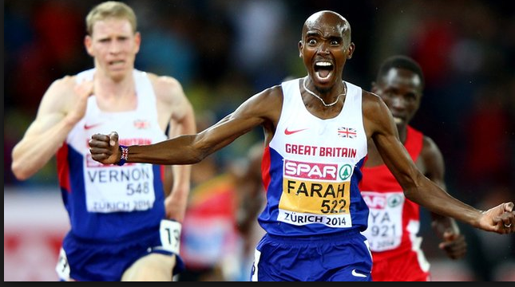
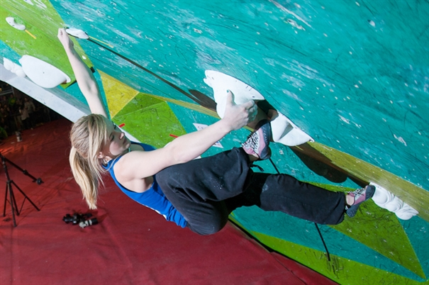
Aim high & don’t give up!
Top image “borrowed” from the BBC
Bottom image “borrowed” from The BMC

Slide 38
Personal Development Planning is worth it…
…it’s about helping you get more out of your time here: to build a better future!

Slide 39
Questions?
Reps?
Logbooks!

