Slide 1
EEE MSc Project Guidance notes
Part 3/6

Slide 2
Content
Structure of interim report
The literature review
ISI Web of Knowledge and University Library holdings

Slide 3
Structure of interim report
NB. Assume the reader is a well educated graduate engineer, but not an expert on the subject of the project
Maximum 20 pages long
Abstract – 2 to 3 paragraphs. Summary of aims & obj., approaches taken, achievements so far
Intro – Scope. Outline topic area, aims & obj. in detail, purpose, brief description of remaining sections, findings.

Slide 4
Background (literature review) – Review general field, set scene, technique, set-ups, approaches, set / understand the wider context. Why is the work needed? What are it’s applications?
Outline structure of literature review
Be focused, concise
Demonstrate good understanding of background theory
Organise in a useful way (not random collection of refs.)
Use up to date literature
Describe and criticise (justify)
Design based projects: explore existing design options (pros and cons)

Slide 5
Literature review
Research based –
Why is the work being done?
Critical review of state of the art
How did ideas evolve to where they are now?
Key players and their opinions
Design based –
Why is design necessary?
Critical review of existing design approaches

Slide 6
Structure of interim report
Research methods –
What the project involves
Project plan (& discussion) and evaluation plan.
Is the plan realistic? Is scope reasonable or is too much being attempted? Is sufficient time included for write-up?
May need to apply new methodology (technique, experiment, design methodology, programming)
Agree with supervisor what needs to be investigated

Slide 7
Structure of interim report
Project planning (last week)
Aims & objectives – how going to achieve?
What are your deliverables? How will you evaluate these?
Gantt chart
Risks and possible remedies (risk register)
Conclusions
References

Slide 8
4a. Research based –
theory (but don’t repeat from textbooks), measurements, methods – sufficient to enable continuation or comparison
4b. Design based –
creation of specification
creative thinking
options available in terms of cost, complexity tradeoffs
risks and alternative strategies
design choices and justification
use of simulation or prototypes
evaluation of performance

Slide 9
Literature search
Science is not conducted in a vacuum
Impossible to read everything – be selective
Aim of lit. search:
Increase knowledge of a topic
Identify useful articles/books
Critical appraisal – identify valid studies, dominant consensus
Summarise and discuss literature
Notes:
Even if you have some background in the field you must do this. Generally speaking, in any project, time in the library will save time in the lab. Don’t want to do the same work and same mistakes somebody else has. Science is not conducted in a vacuum – read and benefit from research findings of others.
It is impossible to read all relevant papers in your field, and you can quickly become overwhelmed - Be selective!

Slide 10
Literature search
Which sources to use?
Formally peer-reviewed sources: books, academic journals, most conference articles, review articles.
Non-peer-reviewed sources: Technical reports, white papers, talks, tutorials, newspaper/magazine articles
Beware of the internet
Peer review – editor selects 2-3 independent reviewers to assess correctness, novelty, importance
Conference papers given shorter review (novelty, importance)
Notes:
Academic literature reviews typically focus on 1, but 2+3 useful for locating references.

Slide 11
Peer review is not foolproof –
Reviewer not always expert in field (only 2-3)
Quality of conference proceeding varies greatly
Vested interest, incompetence, media can influence review
Publication doesn’t imply reproducibility, support of community
Compare evidence for established and new hypotheses

Slide 12
Determine quality of an article –
Quality of publication (impact factor, conf. ranking, authors standing in field)
How cited? (reproduce results or think it incorrect)
Impact factor – average number of citations per article per year
Subject specific (compare within disciplines)
View in ISI WoK impact over last 5 years.
Conference proceedings don’t usually have impact factor

Slide 13
Process
University resources (later)
Google scholar (mixes peer-reviewed and non-peer reviewed. Difficult to find relevant articles)
Search engine – useful for finding articles or reviews with references
Researcher webpages (usually archive pubs, presentations, posters, articles)

Slide 14
Process
Don’t read complete paper unless you have to
Abstract ~ 1min
Intro ~ 5mins
Conclusion/discussion ~10mins
Figures/captions ~10mins
Whole paper ~ hours
Notes:
Extract the signal from the noise
Don’t read whole paper start to finish unless of central importance to project (or a short letter).
Some papers very brief (1-3 pages) some much longer >10pages.

Slide 15
Process
Find recent review articles (hard work done for you!)
Understand chronology of the topic
Check researcher’s webpages for unpublished works, papers, talks with most recent literature reviewed
Identify most recent articles
Skim each and prepare brief summary. Assess for strengths/weaknesses, exp setup, method, procedures, data and analysis.
Notes:
Review articles not always available – depends on how long research going on
Crucial to understand the chronology of the topic to see how current knowledge of your field developed

Slide 16
Organising references
e.g. endnote in MS Word – allows to rearrange text and auto order refs, cross reference
Summary sheet – authors, title, journal, year
Statement of problem
Hypothesis
Theories/assumptions
Research methods
Tools/procedures
Research design
Methods
Interpretation (did data support hypothesis?)
Conclusions

Slide 17
References
References are cited to give due credit to originator and to guide the reader to detailed information.
Provide references wherever required. Properly referenced material is a sign of a good report.
(use IEEE or Harvard referencing)
http://hercules.shef.ac.uk/eee/teach/resources/index.html

Slide 18
Referencing
Journal paper –
Author(s), title, name of journal, volume, pages or article number, year
Book –
Author(s), title, edition, publisher and year of publication. Number of chapter or page.
Data sheet, application notes, technical reports –
Company, title, edition, date.
Web page –
Authors(s) or organisation, title, full URL and date of viewing

Slide 19
Journal search
Log in to muse
Select library
Subject databases
Star – search in title box
Library’s ejournals
Alphabetical table
Findit@sheffield
Web of Knowledge
Show holdings, Findit
Search by topic, author, publication
Findit

Slide 20
Final thoughts
Supervisor
will give scientific/technical guidance, advice on planning, read/comment on work
will not tell you exactly what to do, exactly what to read, micro-manage your project
Include write-up time in Gantt chart
but how long?
base it on how long it takes interim report write up and scale accordingly
Good scientific writing / good figures take a long time
Useful to factor in feedback

Slide 21
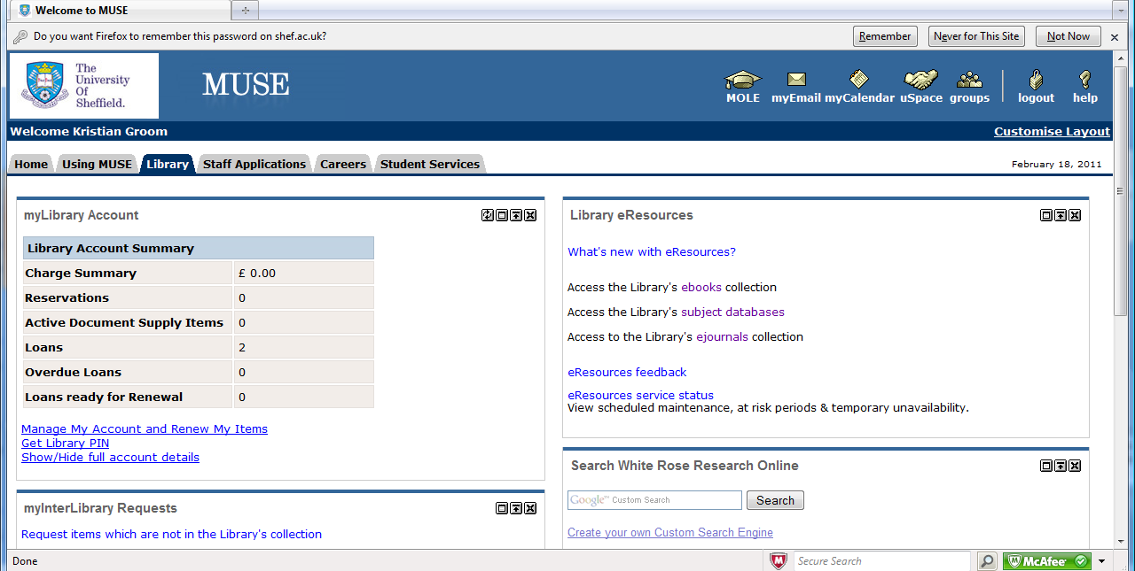
Examples of University library resources – demonstration given in seminar

Slide 22
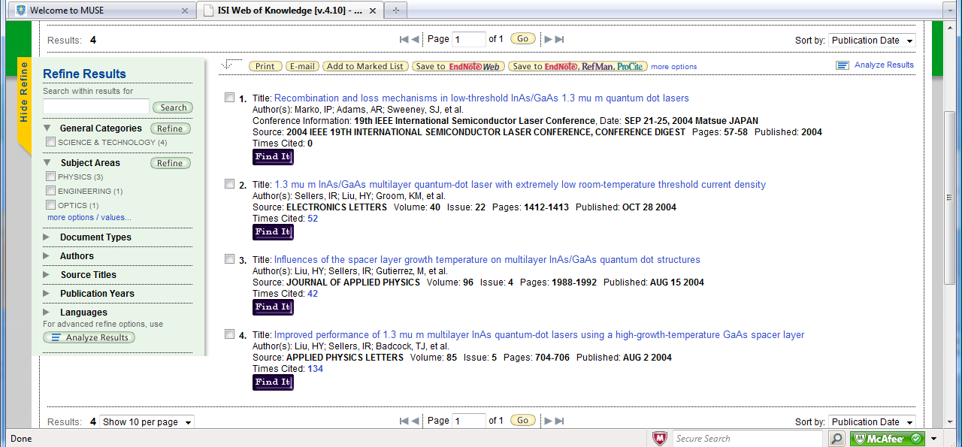

Slide 23
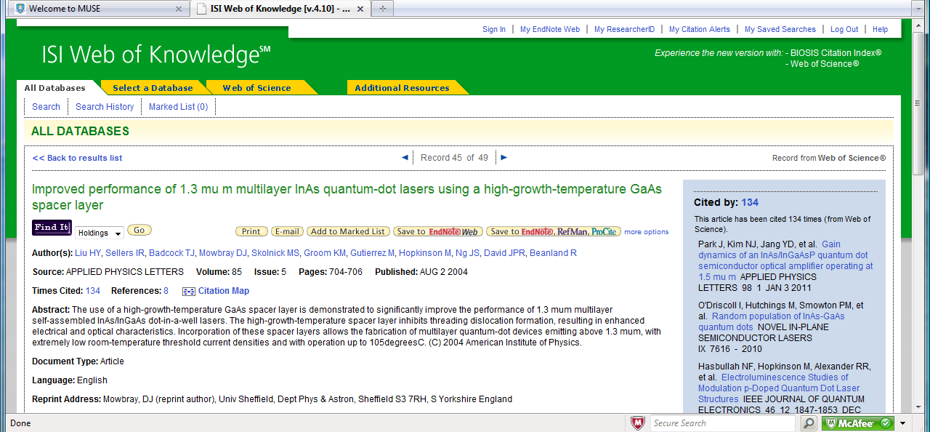

Slide 24
