Slide 1
Arup - Grid infrastructure
By Chun,Hamish,Ka,Seif

Slide 2
What are the problems?

Slide 3
Generation systems(Chun)
Control of demand(Ka)
Energy storage(Hamish)
Reduction of carbon(Seif)

Slide 4
Generation Systems
Getting energy into the grid
etc...
By Chun Lo

Slide 5
Nuclear energy
The UK nuclear power generates about 24.8% of the country electricity in 2017 with the data collected from March to May. There are 15 active operational nuclear reactor at 7 plants (14 advanced gas-cooled reactors (AGR) and one second generation pressurised water reactor (PWR)) but almost half for them will be decommissioned by 2025. There are two units of European Pressurized Reactor (EPR) at Hinkley Point C in the United Kingdom have received final approval in September 2016 and are expected to be completed by 2025.

Slide 6
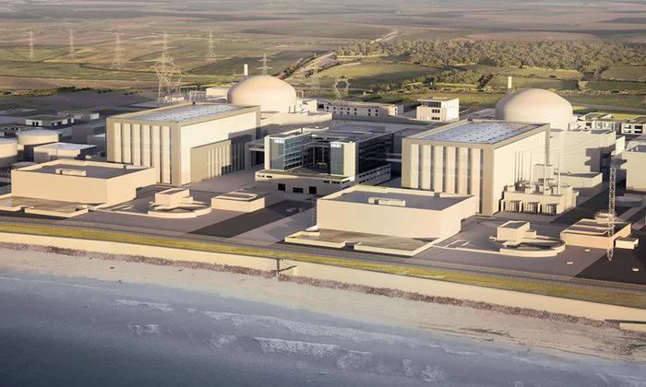
European Pressurized Reactor - EPR is a third generation pressurized water reactor (PWR) design. It is most powerful and safest reactor in the world. It has an electrical production capacity of more than 1,650MW which can provide 1.5 million people. The EPR is based on tried-and-tested technology. It has 4 extra safety systems and a concrete, metal-lined containment shell to protect the reactor which provide external resistance to plane crashes and earthquakes vibrations. This low-carbon reactor also reduces the amount of long-living radioactive waste by around 30% per kWh. It uses around 17% less uranium per unit of electricity generated than the older version of PWR. The EPR has about 60 years lifespans and total cost of the power station is likely to be £19.6 billion or more. The two new EPRs are expected to provide 7% of the UK electricity needs within its lifetime.

Slide 7
Advantages
Most concentrated form of energy
various choice of fuels - 5% enriched uranium oxide fuel, reprocessed uranium fuel and 100% mixed uranium plutonium oxide fuel
Plants do not give off greenhouse gases
High reliability
High level of safety - active and passive safety system
Output can be controlled between 60% and 100%
Higher environmental protection - reduced radioactive waste
Disadvantages
Need to maintain high water pressure in the system
Disposal cost is still high
Decommission cost - retired reactors take up valuable land space for a long time
Cannot mass produce
Water pollution

Slide 8
Wind power
The UK wind farm generates about 11% of the electricity in 2016. UK is considered one of the best location for wind power generation in the world. There are 6,565 onshore wind turbines and 1,502 offshore wind turbines in UK. The UK government has also made a commitment to invest and support in offshore wind energy for generations. In addition, the world’s first floating wind farm has started delivering electricity to the grid in September at the off coast of Scotland. The five 6MW turbines can provide 20,000 Scottish homes.

Slide 9
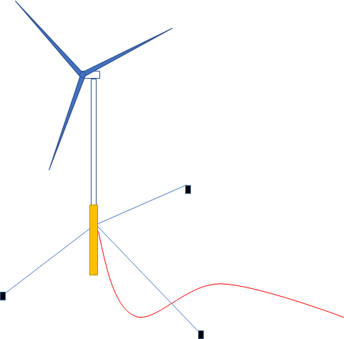
Floating wind turbines (Hywind) - The main differences between a bottom fixed turbine and a hywind turbine is the floating substructure. It is ballasted by 5000 tonnes of iron ore and moored to 3 lines which are connected to giant suction anchors on the seabed. The turbine tower extend 176m above the water and 78m below it. Hywind turbine also has a software to pitches the blades to certain direction to reduce unwanted motion and stabilize the floater for increasing the power production. The generated electricity are running through a cable undersea to a power station onshore. The Hywind Scotland project cost about £200 million to construct. In the future, these floating wind farm can be built more faster and cheaper.

Slide 10
Advantages
The further out offshore turbines, the steadier and faster the wind
No community arguments about noise pollution
low operational cost and maintenance
high potential - overall cost are decreasing
Adjustable
Components can be delivered by sea rather than land
Disadvantages
Manufacturing and installation of wind turbines requires heavy upfront investments
Threat to wildlife
Community arguments over clean ocean view
Occupy sea space

Slide 11
Wave and tidal power
The waves in the ocean contain a large amount of kinetic energy. These kinetic energy can be harnessed to generate electricity to provide the entire planet. The ocean is such a rich resource due to water has 1000 times the density of air. UK currently is one of the global leader in the marine energy sector. Recently, a quarter-scale prototype wave energy device WaveSub which is developed by Marine Power System (MPS) was launched on October 13, 2017, in Wales, UK.

Slide 12
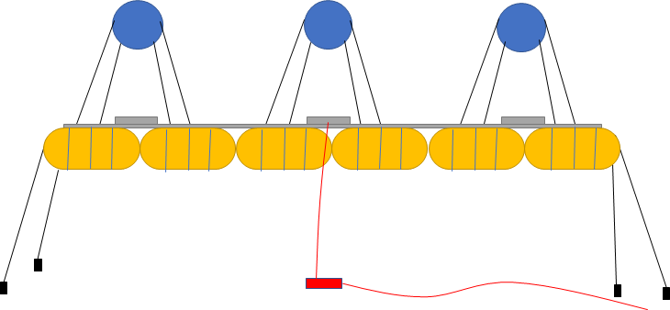
WaveSub - The device is a wave energy converter, which is a barge and floating sphere tied together by cables. It is designed to generate power from the relative motion of the sphere that reacts to the orbital subsurface flow of the waves by the hydraulic generators. The hydraulic circuit smooths and use the hydraulic energy to turn an electrical generator for electricity outputs. The transportation barge make the the device can be easily transport to access services and maintenance. The device also has a floating surface configuration and a submerged operating configuration. The device would sink below the water surface by using ballast tank. It is able to adjust its depth and cable lengths depending on the sea condition. The device can descend completely onto the seabed to protect itself from storm. A full scaled 100m long WaveSub can generate 5MW thought the undersea cable and can power around 5000 homes. A grid connected wave farm will be begin installation by 2020 as the company said.

Slide 13
Advantages
immense efficiency in power generation, construction and installation
Green
Long lifespans
Effective on low speed
Adjustable
Easy to transport
Disadvantages
Can only operation on coast
New technology - still in developing

Slide 14
Control of Demand
Lowering the power needed to be supplied
etc...
By Ka Wu

Slide 15
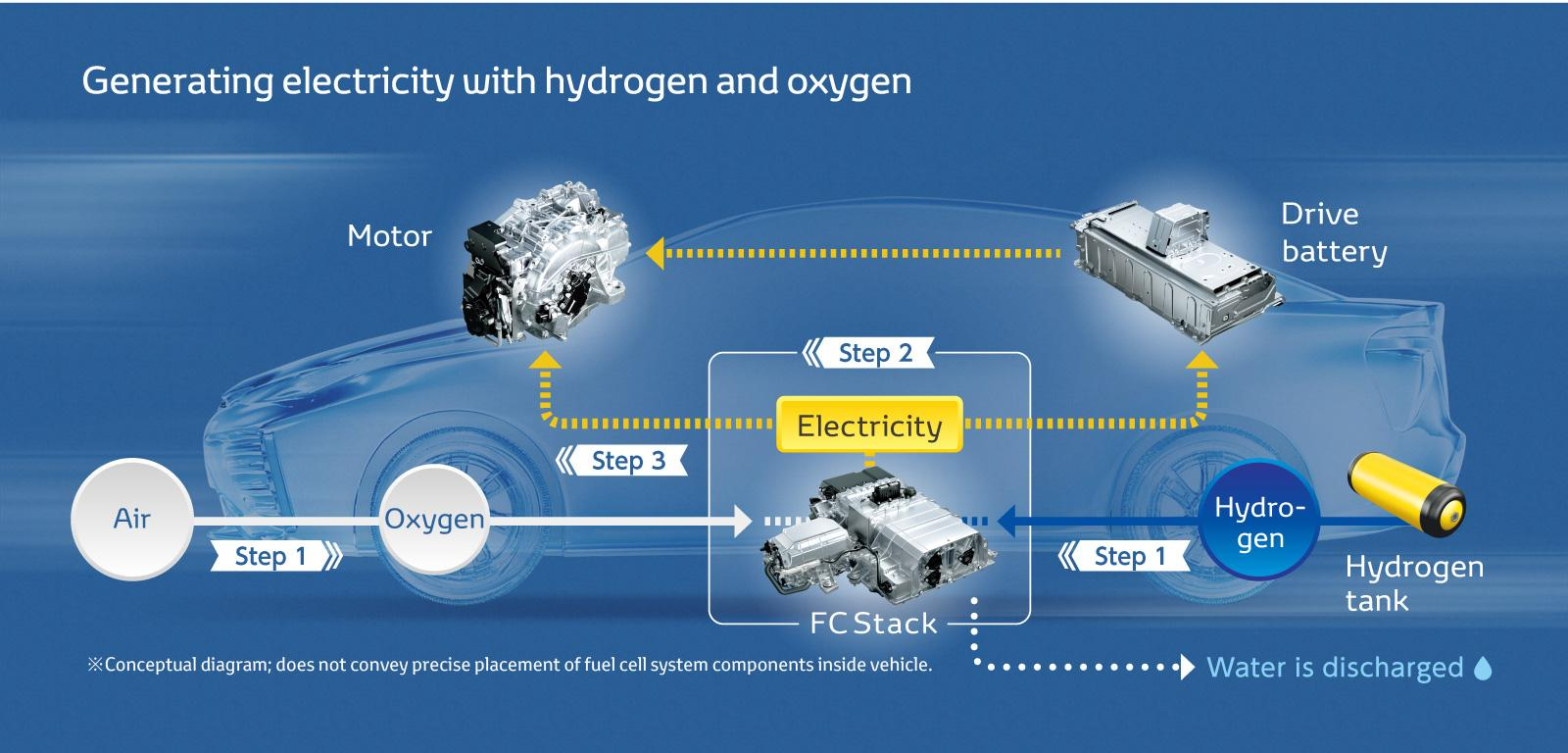
Fuel Cell Vehicles
Electric vehicles that use hydrogen as power source.
Advantages
High efficiency conversion
Almost zero carbon emission
Reduce greenhouse gas
Disadvantages
High capital cost
High fuel cost
TOYOTA. (2017). [FCV Fuel Cell Vehicle] [Digital image]. Retrieved from http://www.toyota-global.com/innovation/environmental_technology/fuelcell_vehicle/

Slide 16
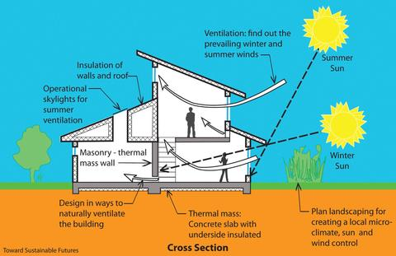
Passive Solar Building Design
A design that takes advantage of building structure, materials and climate to minimize the energy use by condition system.
Advantages
Take advantages of sunlight
Reduce the amount of heating required
Economic efficiency at long run
Disadvantages
Higher capital cost than conventional building
Not suitable in all regions
Banks, M. (2015). [BETTER VENTILATION WITH PASSIVE SOLAR DESIGN][Digital image]. Retrieved from https://www.grandbanksbp.com/blogs/blog/37111173-better-ventilation-with-passive-solar-design

Slide 17
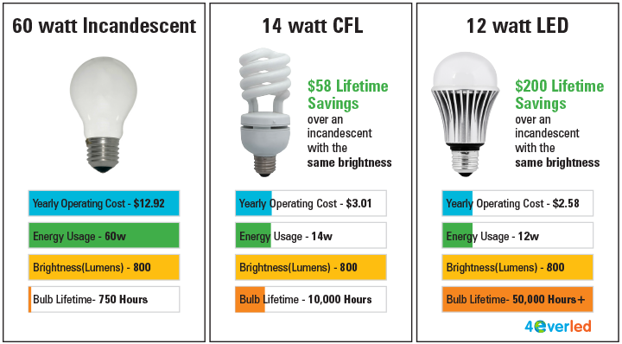
LED Lamps
The best replacement for the Compact fluorescent lamp (CFL) and Incandescent lamp
Advantages
Energy efficiency
Reduce carbon emission
Economic efficiency at long run
Environmental friendly
Disadvantages
High capital cost
Light pollution hazard
Energyearth. (2017). [How To Buy LED or CFL Bulbs for Your Home][Digital image]. Retrieved from https://www.energyearth.com/general/categories/lighting/learn-more

Slide 18
Motion Sensor
Motion sensors automatically turn lights on when they detect motion and turn them off after a short period
Advantages
Electrical Efficiency
Reduce light pollution
Disadvantages
Installation cost

Slide 19
Energy
Storage
Storing power during surplus and sourcing power during deficit.
By Hamish Sams

Slide 20
Storage regulation techniques
Capacity firming
Load levelling
Frequency regulation

Slide 21
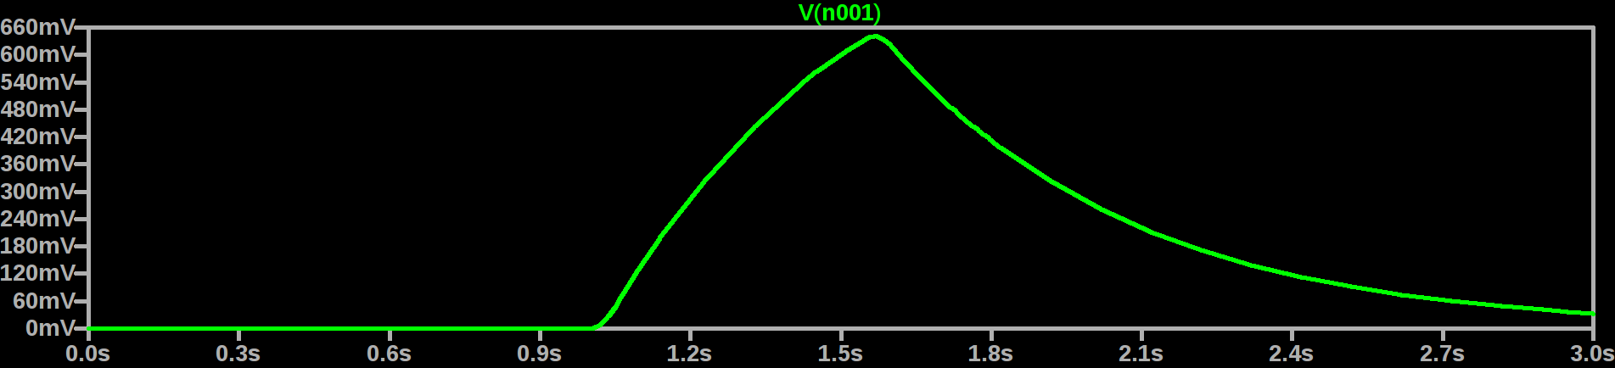
Capacity firming

Slide 22
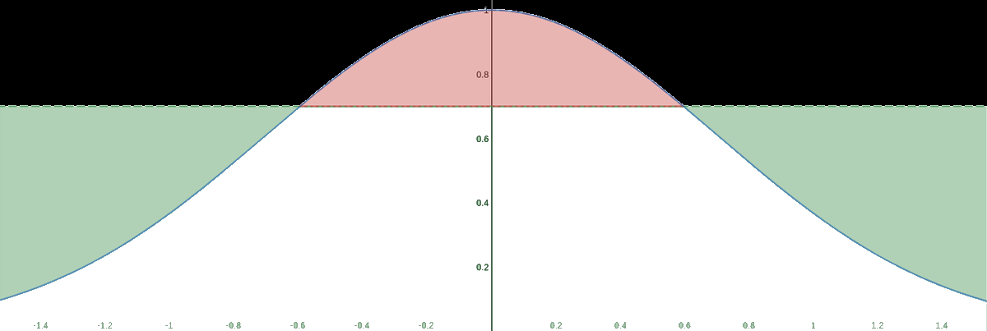
Load Levelling

Slide 23
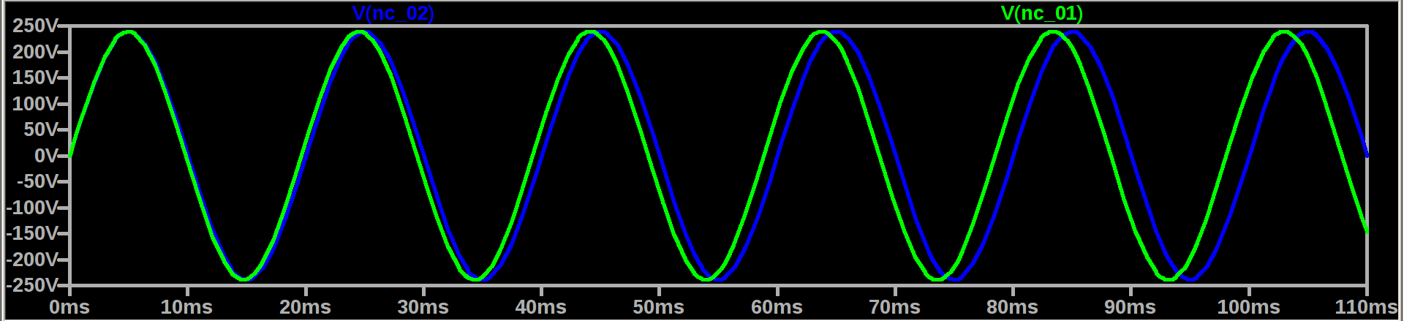
Frequency regulation

Slide 24
Chemical storage
Lithium-Ion
Lead acid
Nickel cadmium

Slide 25
Mechanical storage
Flywheel
Molten Salt storage
Compressed air
Pumped hydro

Slide 26
Reduction of Carbon
Lowering the amount of carbon released during production of power
etc...
By Seif Khalil

Slide 27
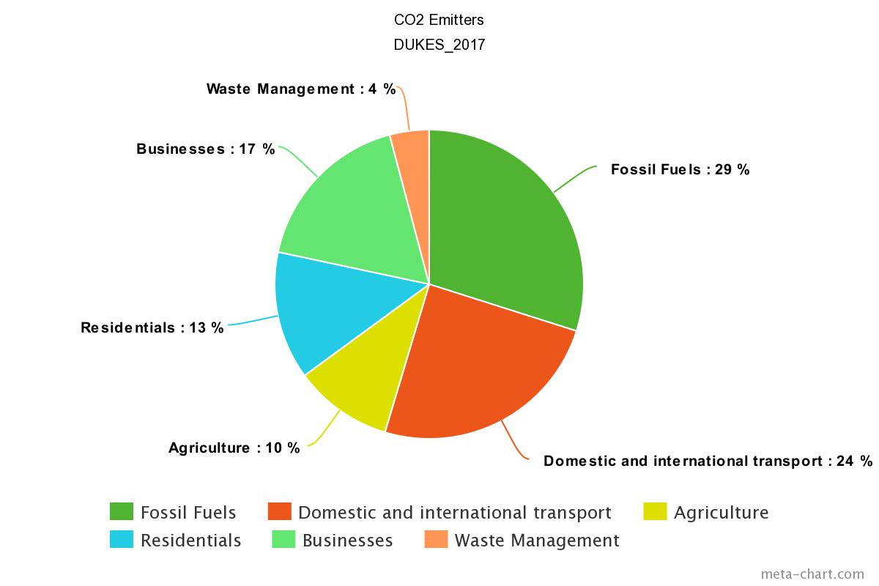
Main Carbon Emitters
Fossil fuels.
Transport.
Agriculture.
Residentials.
Businesses.
Waste Management.

Slide 28
Reduction of CO2 Emissions
Change In CO2 Emissions
Year | Total MtCO2 | % Change Since 1990
2010 | 495.8 | -16.4%
2011 | 452.6 | -23.7%
2012 | 472.1 | -20.4%
2013 | 463.3 | -21.8%
2014 | 422.0 | -28.8%
2015 | 404.7 | -31.7%
2016 | 381.1 | -35.7%
Gases that need to be reduced.
Carbon reduction targets.
Who monitors these targets?

Slide 29
Reduction of Fossil Fuels
Change In CO2 Emissions By Fossil Fuel, Year-By-Year %
Year | Coal | Oil | Gas
2010 | 2.7% | -1.0% | 8.5%
2011 | -1.2% | -3.4% | -17.1%
2012 | 26.8% | -1.2% | -6.1%
2013 | -5.5% | -1.3% | -0.8%
2014 | -20.0% | -0.5% | -9.4%
2015 | -21.9 | 1.4% | 3.0%
2016 | -50.1% | 1.6% | 12.5%

Slide 30
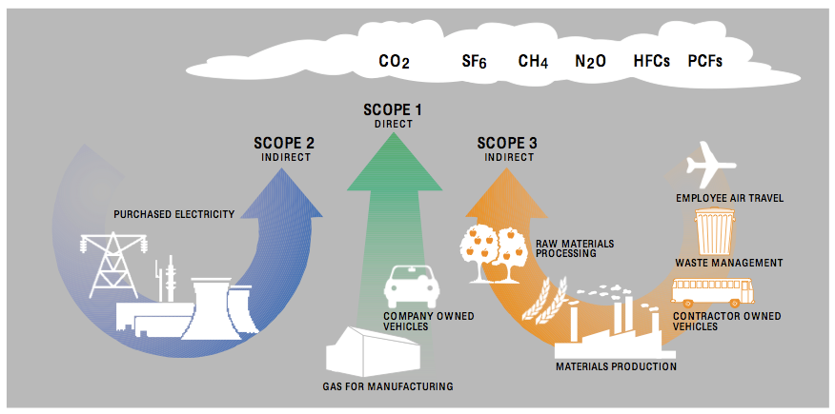
Other Carbon Emitters
Domestic and international transport (aeroplanes, cars, trucks).
Agriculture (mainly cows and other livestock).
Residentials (houses, hotels etc).
Businesses (factories, companies etc).

Slide 31
Solution Recommendation

Slide 32
Wind - (Generation)
Substituting fossil fuels with renewables(Carbon)
Li-Ion storage - (Storage)
Fuel cell vehicles - (Demand)

Slide 33
Wind
Advantages
Near 0 Carbon Emissions
No greenhouse gasses
High potential in the UK
Cost decreasing
Technology improving
Cheap maintenance
Disadvantages
Heavy upfront investment
Threat to wildlife
Expensive cable laying
Boat crashing hazard

Slide 34
Substituting fossil fuels with renewables
Advantages:
Almost zero carbon emissions.
Sustainable energy with very high potential.
Coal mining was very dangerous.
Cleaner environment.
Less maintenance.
Better health for workers.
Less conflicts with countries as fossil fuels are becoming scarce.
Disadvantages:
Jobs lost.
Loss of a major source of energy.
Loss of an efficient source of energy.
Loss of a cost-effective supply.
Renewable energy stations can be confined to certain locations.
Intermittent supply

Slide 35
Lithium-Ion storage
Advantages
High energy density
Fast response time
Widely available
Well researched
Cheap for the density
Disadvantages
Low current draw
Fire hazard
Complex charging circuitry
Short lifespan if used harshly

Slide 36
Fuel cell vehicles
Advantages
High efficient
Almost zero carbon emission
Reduce greenhouse gas
Technology improving
Disadvantages
High capital cost
High fuel cost
Explosive hazard

Slide 37
Questions
Solution:
Wind
Substituting fossil fuels with renewables
Li-Ion storage
Fuel cell vehicles

