Slide 1
LAB IOT Cloud Platforms
Mohammed Hammoud
Prof. Anton Stepanov
Prof. Andrey Somov

Slide 2
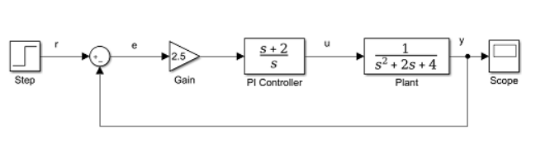
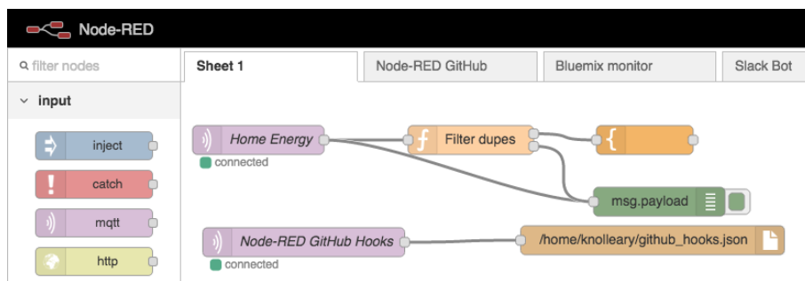
Flow-programming
Flow-programming: Exchange data across predefined connections by message passing.
Examples: Matlab Simulink, LabVIEW, Node-Red.
https://flows.nodered.org/

Slide 3
Node-RED
An open-source, Browser-based flow-based programming tool built on Node.js.
Low-code programming for event-driven applications.
Visually wire together hardware devices, APIs, and online services.
Allows users to create workflows (called "flows") by connecting pre-built or custom nodes.
Lightweight.
Easy to use and Rapid Prototyping
Scalability
Real-Time Data Processing
Automation
Popular choice for IoT development and automation tasks.

Slide 4
Node-RED installation
Method1: local installation.
https://nodered.org/docs/getting-started/
Method2: using virtual environment and script (follow instruction in unstruction.txt

Slide 5
JavaScript Object Notation (JSON)
{ “msg”:
{
“payload”:12,
“timestamp”: 123456,
“list”:[1,2,3,4],
“bme280”:
{
“temp”:30.0,
“humidity”:50,
}
}
}
msg.payload -> 12

Slide 6
Node-RED
Browser-based flow editing

Slide 7
Report
One team = one report.
Do not forget upload your reports and source files to Canvas!:
Task1: flow1
Task2: flow2
Task3: flow3
Homework1: HW1
Homework2: HW2
Folder:
flow files (.json).
Pdf report, list steps briefly done to solve each task. Add screenshots.

Slide 8
Task | Score
1.2 UDP: Sender and receiver locally in Node-red. | 5
1.3 TCP: TCP sender and receiver inside Nod-Red. | 10
1.1 HTTP: HTTP Get Request to www.example.com API to receive data with HTPP in node (Endpoint). HTTP POST Request to Node-RED from Node-Red. HTTP POST Request to Node-RED from cURL command. | 10
2.1 Formate the numbers(round) | 2.5
2.2Toggle led if Temp > 30; | 5
2.3 Scale the water level from [0, 3.3] to [0,100]. | 2.5
2.4 Save timestamp, temperature, humidity, and water level to csv file. | 5
3.1 MQTT publish/subscribe | 5
3.2 Send data from Node-Red to initialstate | 10
3.3 Send data from Node-Red to Ubidots | 10
Homework1: 4.1 Capture image and save it. | 10
Homework2: 5. Telegram bot | 20

Slide 9
Hypertext Transfer Protocol (HTTP)
HTTP is one of protocols supported by curl command (run in command line)
curl -iX GET "https://httpbin.org/get" -d ‘{“v1”:100}’ -H "accept: application/json“
curl -iX POST "https://httpbin.org/post" -d ‘{“v1”:100}’ -H "accept: application/json“
curl -iX GET "https://www.example.com" -H "accept: application/json“
curl -iX POST "https://www.example.com" -d '{"v1":100}' -H "accept: application/json“
Python implementation of HTTP – requests
Installation: pip install requests
Import requests
r = requests.get("https://httpbin.org/get", data = payload)
print(r.status_code, r.content, r.text)
-i: display the response headers (e.g., status code, content type) along with the response body .
-X Flag (Specify HTTP Method)
Servers:
https://httpbin.org/
https://www.example.com
https://curl.se/docs/manpage.html

Slide 10
Variable types in Node-Red
// Set a flow variable
flow.set("temperature", 25);
// Get a flow variable
let temp = flow.get("temperature");
Flow Variables
// Set a global variable
global.set("systemStatus", "active");
// Get a global variable
let status = global.get("systemStatus");
Global Variables

Slide 11
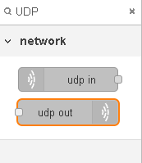
Task1
Locally in Node red:
Send and receive data using UDP (two direction: UDP in and UDP out).
Send and receive data using TCP (two direction: TCP in, TCP out, and TCP request).
IP: 127.0.0.1
Port: 60000

Slide 12
Task1
Locally in Node red:
Send and receive data using HTTP (two direction):
Send HTTP Request to https://www.example.com
Create http API (listener = POST) in NodeRed, with http in node: setlevel.
Post data locally from HTTP node-red client to the listener.
Send data from laptop with curl command.
127.0.0.1:1880/setlevel
curl -iX POST "http://localhost:1880/setlevel" \
-H "accept: application/json" \
-H "Content-Type: application/json" \
-d '{"v1":100}'

Slide 13
Task2
Create a dashboard in Node-Red (indicators, chart).
Send dat from Laptop (TCP client in Node-Red or from py script provided in the materials) to Node-Red (TCP server).
Formate the numbers(round).
Toggle led if Temp > 30;
Scale the water level from [0, 3.3] to [0,100].
Save timestamp, temperature, humidity, and water level to csv file (use csv node).
Visualize temp, water level, and humidity.
One chart: temperature.
Two indicator ( humidity, water level).
Use sender_protocols.py
install dashboard: npm install node-red-dashboard
install math nodes: npm install node-red-contrib-calc

Slide 14
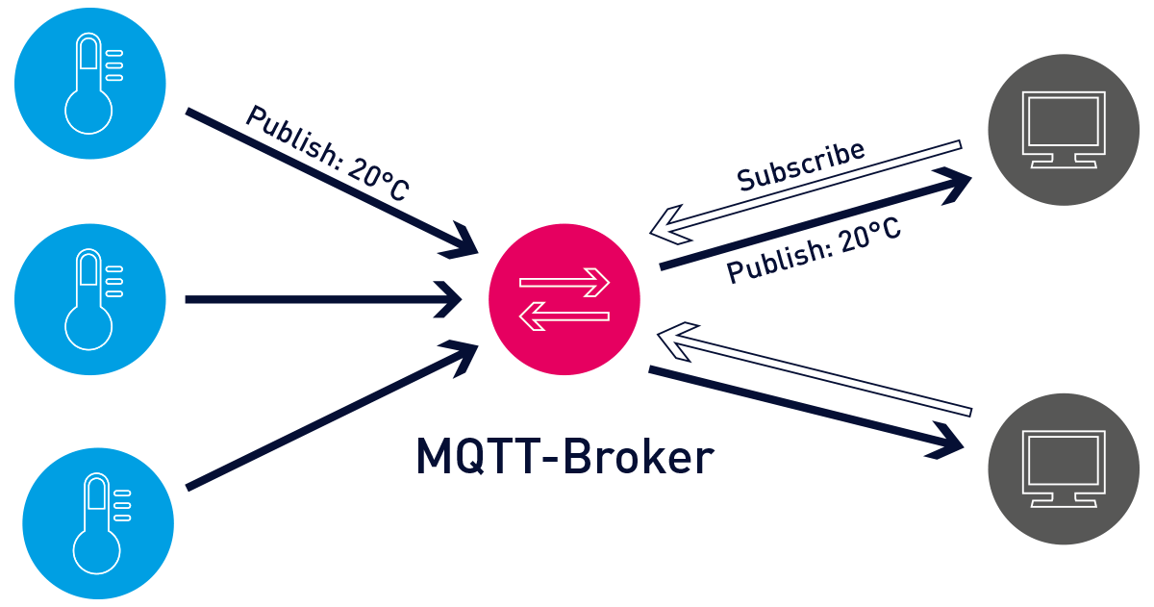
Message Queuing Telemetry Transport (MQTT).
Publish-subscribe network protocol.
Publishers and subscribers not directly connected with zero dependency.
Broker: filters incoming messages and distributes them to subscribers.
Last will and testament (LWT): handle abnormal client disconnection.
Retained messages: store the last last known good value.
Lightweight, efficient for Constrained devices.
Real-Time Communication
Scalability.
Machine-to-machine (M2M) and IoT.
Or Server
Public broker: https://www.hivemq.com/
Image source: https://www.switchdoc.com/2020/01/tutorial-using-mqtt-on-switchdoc-labs-ourweather-station/mqtt-architecture/
Notes:
MQTT uses Publish/Subscribe model or pattern. Publishers publish messages.
Subscribers receive messages if they have subscribed to the same.
publishers and subscribers don't communicate to each other directly.
There's an intermediate central Server or Broker that mediates in between.
the publisher and subscribers don't need to know each other
They are not dependent on each other for initialization and synchronisation.
Broker filters all incoming messages and distributes them to subscribers accordingly. Publishers and subscribers are also called Clients.
Message delivery is one-to-many and can scale with respect to subscribers without burdening publishers.
Handle abnormal client disconnection: Using what is called Last Will and Testament (LWT), if a client is not sending anything for some time, broker will automatically publish a message. For example, this can be useful to inform subscribers that an IoT device (publisher) is not reachable.
Retained messages: The last published message (with retained flag set to true) is stored at the broker so that new subscribers can immediately obtain last known good value rather than wait for the next update from publisher.
The structure of the published data is not known to the subscriber. This information should be shared or known beforehand. When topic-based filtering is used, publisher and subscribers must know the right topics to use.
The delivery of a message is not confirmed as there is no automatic confirmation from the recipient. Moreover, the publisher also does not know if there are any subscribers.
MQTT uses TCP, which needs complex handshaking and is not easy on memory and power requirements. Standard states that TCP is a suitable transport and UDP is not. MQTT can also use TLS or WebSocket.
Broker is centralized. This is not only a single point of failure but also can limit scalability. However, real-world implementations overcome this by managing a distributed broker cluster that clients see as a single logical broker. Examples of such cluster implementations are HiveMQ, VerneMQ, and EMQ.
MQTT has no built-in security. Developers need to implement security on their own.
TLS/SSL security and payload encryption can be used. The IANA has assigned port 8883 for MQTT over SSL, or secure MQTT over TCP or UDP. Incidentally, port 1883 is for MQTT over TCP or UDP We should note that SSL is not exactly lightweight and adds significant overhead.
MQTT clients for testing:
MQTT.fx, MQTTLens (desktop)
MQTT Dashboard, MQTT Dash, MQTTool

Slide 15
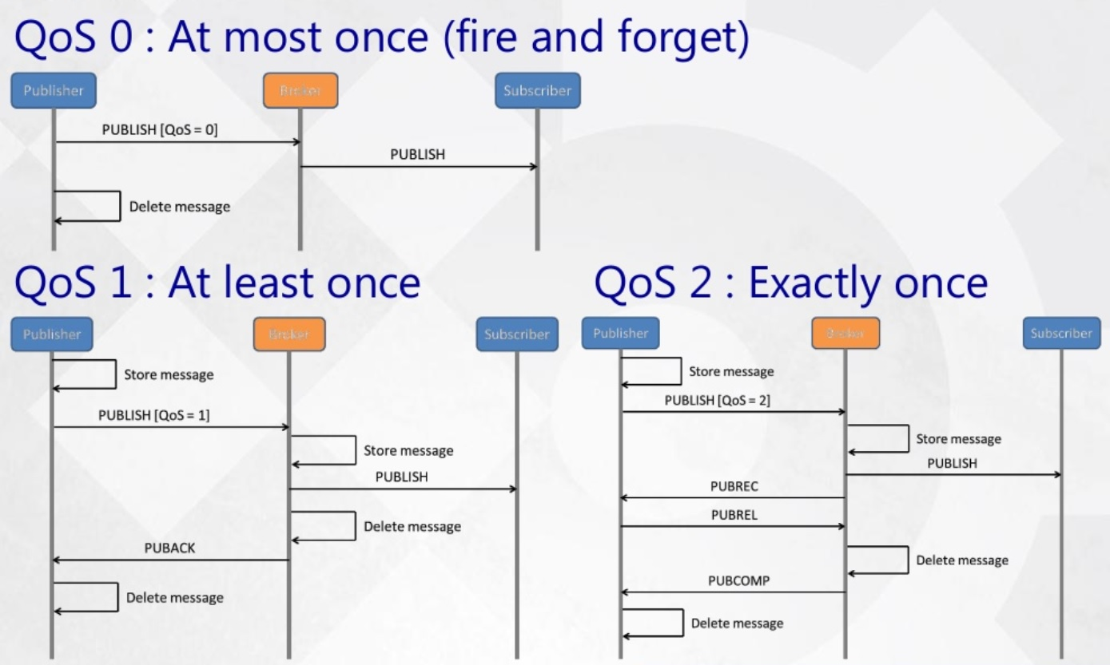
Message Queuing Telemetry Transport (MQTT).
Image source: https://devopedia.org/mqtt

Slide 16


Task3
Starting from task2, send only one value (for example v1).
Sending measurements to initialstate (https://www.initialstate.com/ ).
Sending measurements to ubidots (https://ubidots.com/ ): use Ubidots out
In ubidots website, create new device, and get the TOKEN.
Add ubidots and set TOKEN in Node-Red.
Add dashboard in Ubidots.
Don’t forget to report links to the dashboards
node-red-contrib-initialstate
ubidots-nodered

Slide 17
Task3
Sending measurements to MQTT.
MQTT in(subscribe), MQTT out (publish).

Slide 18
Homework1
Door bell system: Passive infrared sensor (PIR) + Camera.
In case the PIR is activated:
take image from the camera, show the image in the node Red (in flow, not GUI).
Save the image with file name represented by date and time.
Support:
PIR is simulated with inject node.
Nodes: usbcamera, write file, image
Install:
node-red-contrib-usbcamera
node-red-contrib-image-output

Slide 19
Homework2
Starting from task2, add telegram bot for reporting about any abnormal data values (higher than threshold of 30).
Support:
Install telegrame inside node Red (from node Red or command line)
npm install node-red-contrib-telegrambot --save
https://flows.nodered.org/node/node-red-contrib-telegrambot
@BotFather: create bot telegram

Slide 20
Grading
 | Score | 1 | 2 | 3 | 4 | 5 | 6 | 7
1.1 UDP: Sender and receiver locally in Node-red. | 10 | 10 | 10 | 10 | 10 | 10 | 10 | 10
1.2 TCP: TCP sender and receiver inside Nod-Red. | 10 | 8 | 10 | 8 | 10 | 10 | 8 | 8
1.3 HTTP: HTTP Get Request to www.example.com API to receive data with HTPP in node (Endpoint). HTTP POST Request to Node-RED from Node-Red. HTTP POST Request to Node-RED from cURL command. | 10 | 10 | 10 | 10 | 10 | 10 | 10 | 10
2.1 Formate the numbers(round) | 5 | 5 | 5 | 5 | 5 | 5 | 5 | 5
2.2 Scale the water level from [0, 3.3] to [0,100]. | 5 | 5 | 5 | 5 | 5 | 5 | 5 | 5
2.3 Toggle led if Temp > 30; | 5 | 5 | 5 | 5 | 5 | 5 | 5 | 5
3.1 Send data from Node-Red to initialstate | 15 | 15 | 15 | 15 | 15 | 15 | 15 | 15
3.2 Send data from Node-Red to Ubidots | 10 | 10 | 10 | 10 | 10 | 10 | 10 | 10
Homework1: Capture image and save it. | 15 | 15 | 10 | 15 | 15 | 15 | 15 | 15
Homework2: Telegram bot | 15 | 15 | 15 | 15 | 15 | 15 | 15 | 15

Slide 21
Basic nodes
Inject
Debug
Function
Change
Variable
Complete
Link in/out
Switch
Range
Trigger
Delay
Status
Template
Split
Join

Slide 22
IoT cloud platforms
Node-Red
InitialState
Ubidots
ThingSpeak
Arduino cloud
Blynk

Slide 23
External links
https://nbdime.readthedocs.io/en/latest/nodevenv.html
https://flows.nodered.org/
https://httpbin.org/
https://curl.se/docs/manpage.html
https://flowfuse.com/node-red/learn/

Slide 24
Thank you

Slide 25
Support

Slide 26
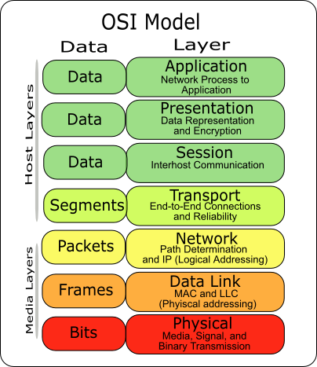
Network basics
Open Systems Intercommunication (OSI)
Levels:
Device:
Protocol:
Address:
7
http/https
www
6
5
4
tcp/udp
port
3
Router
icmp
ip
2
Switch
arp
mac
1
https://networkaffairs.wordpress.com/2013/10/24/the-osi-model-broken-down-into-fragments-and-the-headers/

Slide 27
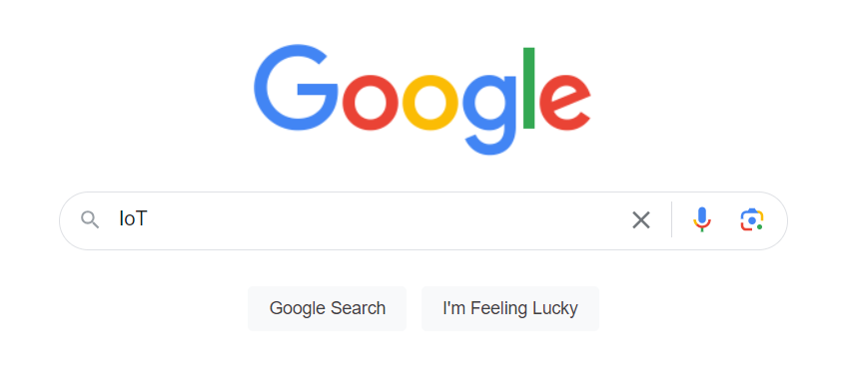
Hypertext Transfer Protocol (HTTP)
It's an application protocol, meant to offer ways for clients to retrieve and operate with hypertext objects and components (including HTML pages, PNG images, and so on). HTTP is an application protocol - which means that it is directly consumed by applications.
https://www.google.com/search?q=IoT&oq=IoT&gs_lcrp=EgZjaHJvbWUyBggAEEUYOTIGCAEQRRg7MgYIAhBFGDwyBggDEEUYPDIGCAQQRRhBMgYIBRBFGEEyBggGEEUYQdIBCDI4MzFqMGo5qAIAsAIA&sourceid=chrome&ie=UTF-8

Slide 28
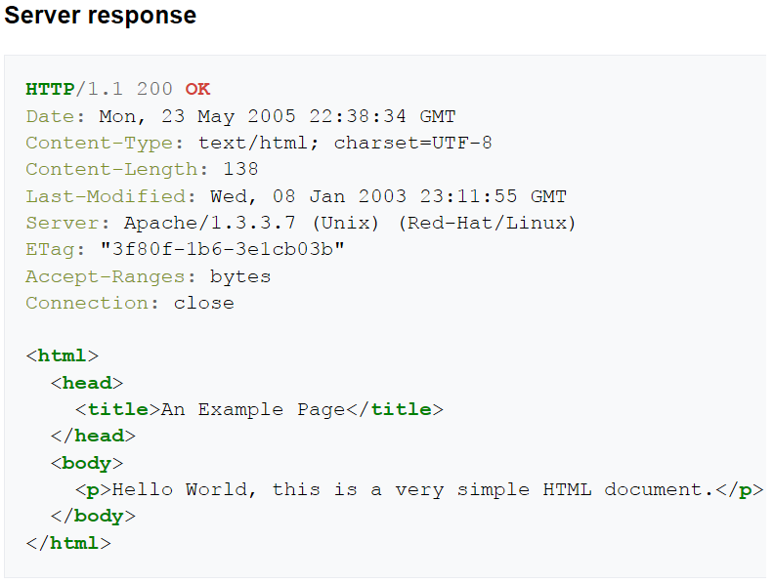
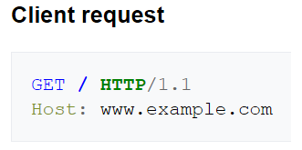
Hypertext Transfer Protocol (HTTP)
HTTP/1.1
GET / HEAD / POST / PUT / DELETE …
Status codes
Informational 1XX
Successful 2XX
Redirection 3XX
Client Error 4XX
Server Error 5XX
Check https://httpbin.org/

Slide 29
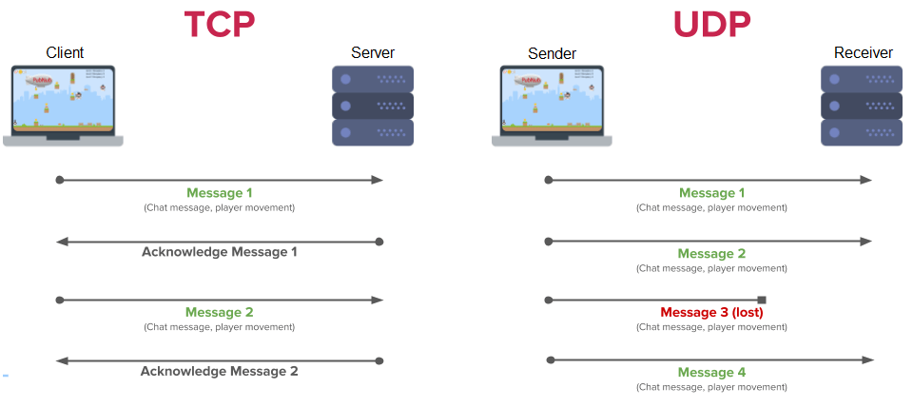
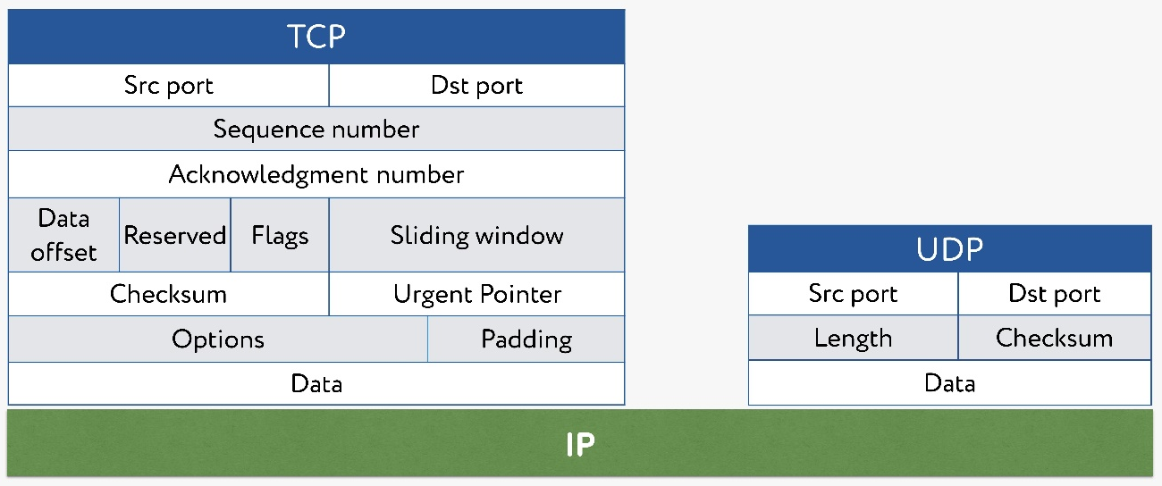
Transmission Control Protocol(TCP) vs User Datagram Protocol (UDP)

Slide 30
Transmission Control Protocol(TCP) vs User Datagram Protocol (UDP)
UDP | TCP
No handshake | handshake
does not guarantee delivery NOR order. No congestion control. | guarantee delivery and order
UDP is simpler and more efficient (speed). | Heavyweight. TCP handles reliability and congestion control. detect packet losses and adjust transmission speed accordingly.
Applications: time-sensitive communications where occasionally dropping packets is better than waiting. Streaming media applications such as movies. Online multiplayer games Voice over IP (VoIP) | Applications: World Wide Web(HTTP) E-mail (SMTP TCP) File Transfer Protocol (FTP) Secure Shell (SSH) remote administration

Slide 31
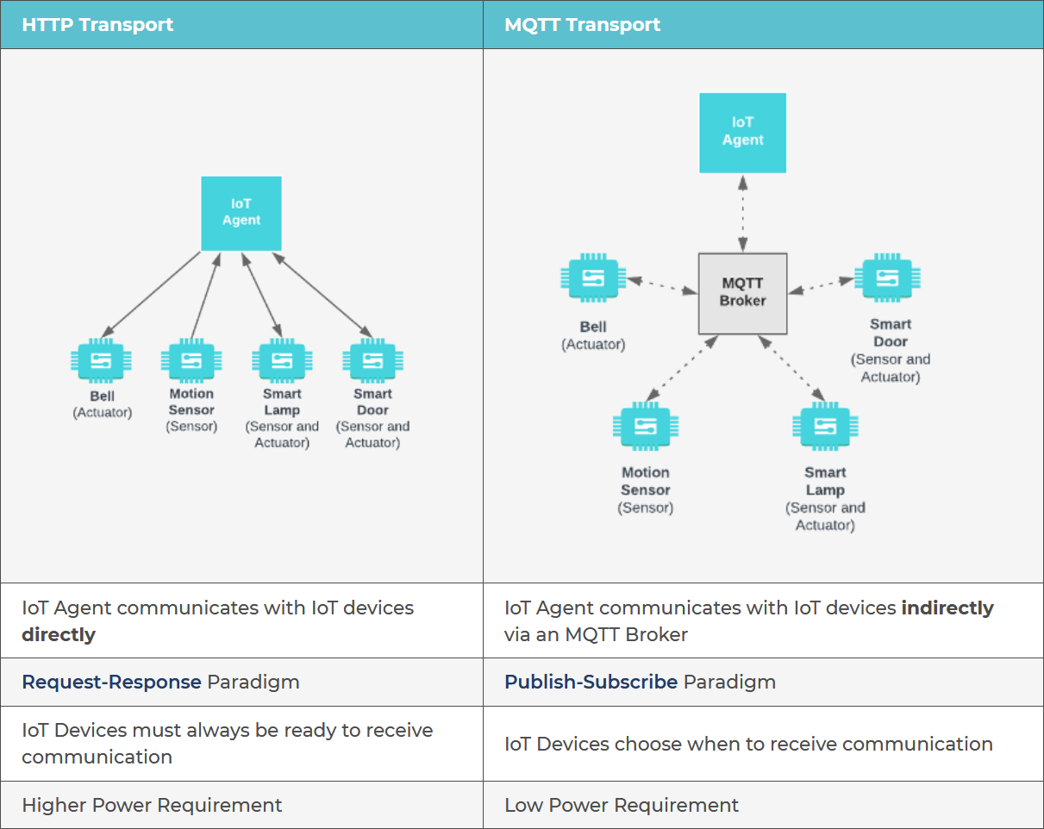
HTTP vs. MQTT
Notes:
HTTP is not suitable for small data packets typical in IoT.
HTTP is document-centric whereas MQTT is data-centric. HTTP is a complex protocol. It's textual and therefore parsing HTTP is not trivial.
MQTT is binary and encoding/decoding MQTT packets is a lot easier.
Because of its publish-subscribe model, data distribution is one-to-many in MQTT whereas in HTTP it's limited to one-to-one.
MQTT uses less battery power, can send more messages per hour and send them more reliably than HTTPS.
MQTT uses more battery power to initiate a connection but this quickly compensated by gains as the connection stays open longer.

Slide 32
Hypertext Transfer Protocol (HTTP)
HTTP is one of protocols supported by curl command (run in command line)
curl -iX GET "https://httpbin.org/get" -d ‘{“v1”:100}’ -H "accept: application/json“
curl -iX POST "https://httpbin.org/post" -d ‘{“v1”:100}’ -H "accept: application/json“
curl -iX GET "https://www.example.com" -H "accept: application/json“
curl -iX POST "https://www.example.com" -d '{"v1":100}' -H "accept: application/json“
Python implementation of HTTP – requests
Installation: pip install requests
Import requests
r = requests.get("https://httpbin.org/get", data = payload)
print(r.status_code, r.content, r.text)
Servers:
https://httpbin.org/
https://www.example.com
https://curl.se/docs/manpage.html

Slide 33
UDP/TCP implementation in python
UDP sender
import socket
import json
UDP_IP = "127.0.0.1"
UDP_PORT = 60000
while True:
msg = input("message")
m = {"type":"info", "id": 2, "name": "abc", "msg":msg} # a real dict
data = json.dumps(m)
with socket.socket(socket.AF_INET, socket.SOCK_DGRAM) as s:
s.connect((UDP_IP, UDP_IP))
s.sendall(bytes(data,encoding="utf-8"))
time.sleep(0.5)

Slide 34
UDP/TCP implementation in python
UDP reciever
import socket
UDP_IP = "127.0.0.1"
UDP_PORT = 60000
sock = socket.socket(socket.AF_INET, # Internet
socket.SOCK_DGRAM) # UDP
sock.bind((UDP_IP, UDP_PORT))
while True:
data, addr = sock.recvfrom(1024) # buffer size is 1024 bytes
print("received message: %s" % data)
# Sending a reply to client
sock.sendto(str.encode("recieved"), addr)

Slide 35
UDP/TCP implementation in python
TCP server
import socket
with socket.socket(socket.AF_INET, socket.SOCK_STREAM) as s:
s.bind(("127.0.0.1" , 65432))
while True:
s.listen()
conn, addr = s.accept()
with conn:
print(f"Connected by {addr}")
while True:
data = conn.recv(1024)
if not data:
break
print("recieved", data)
conn.sendall(data)

Slide 36
UDP/TCP implementation in python
TCP client
import socket
Import json
while True:
msg = input("message")
m = {"type":"info", "id": 2, "name": "abc", "msg":msg} # a real dict
data = json.dumps(m)
with socket.socket(socket.AF_INET, socket.SOCK_STREAM) as s:
s.connect(("127.0.0.1", 65432))
s.sendall(bytes(data,encoding="utf-8"))
data = s.recv(2048)
print(f"Received {data!r}")

Slide 37
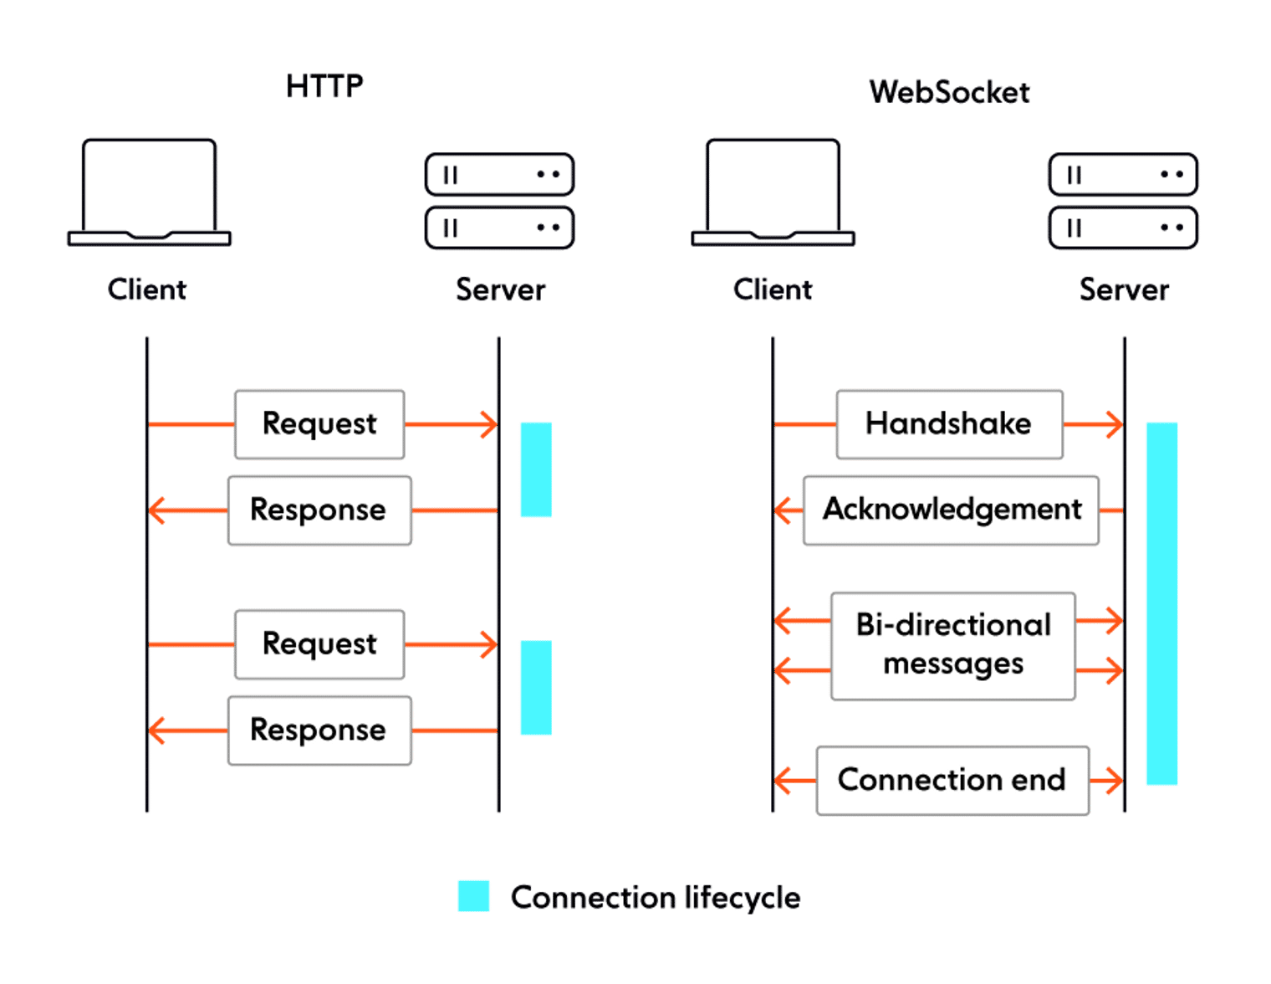
HTTP vs. Websocket

