Slide 1

Gentle Intro to Locust i/o
A Crush course in Performance Testing
Who are we?
Sandra Kambo / Clovis Mugaruka

Slide 2

Performance testing is a type of testing that focuses on how a system behaves/performs under a particular load.
Faster sites result in more engaged users, more sales, and increased traffic.

Slide 3
Performance testing jargon
Latency/Response time is a measure of how fast a server responds to requests from the client.
Throughput is how many requests the server can handle during a specific time interval, usually reported as requests per second.
Percentiles are a way of grouping results by their percentage of the whole sample set. If your 50th percentile response time is 100ms, that means 50% of the requests were returned in 100ms or less.

Slide 4
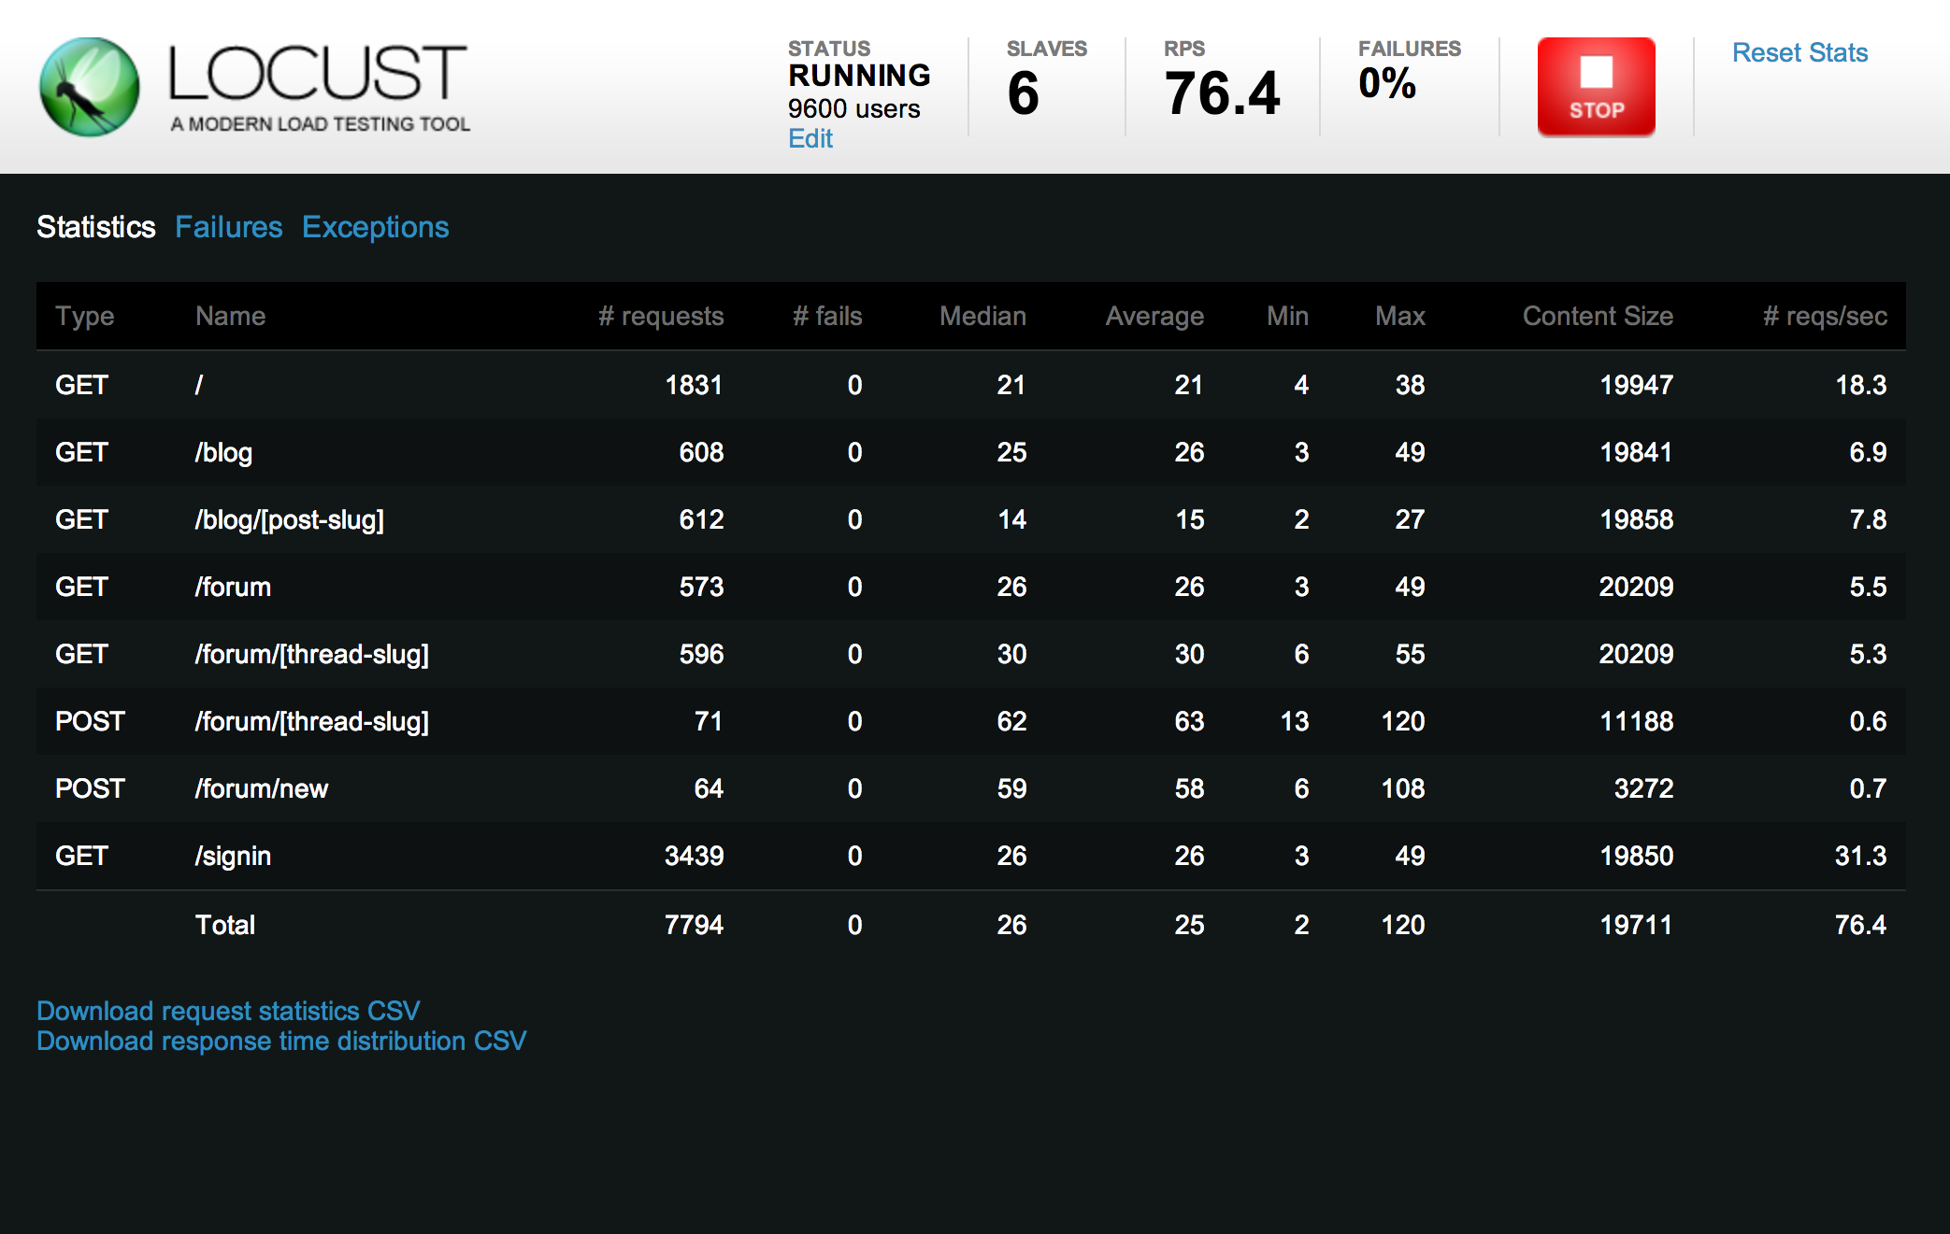
What is locust?
Locust is an easy-to-use, distributed, user load testing tool written in python.

Slide 5


Why locust?
(1) ’cause life is too short for over complicated performance tools
(2) ‘cause of Python
(3) Locust lets you focus on the user behaviour
There exist locust’s drivers for other programming languages i.e Boomer (Golang) and Locust4j (Java)

Slide 6
A bit of Locust.. (all you need to know, really!)
from locust import HttpLocust, TaskSet, task
class UserAction(TaskSet):
@task(3)
def task1(self):
pass
@task(1)
def task2(self):
pass
class User(HttpLocust):
task_set = UserAction
min_wait = 1000 # default
max_wait = 1000 # default
A TaskSet class can optionally declare an on_start method, this method is called before a simulated user executes his/her task(s), a sort of setUp method but only called once (when the user is created and about to start his/her tasks).
weight: execution ratio

Slide 7
How to…
Web:
locust -f app.py --host=http://0.0.0.0:9300
No-web/CLI:
locust -f app.py --host=http://0.0.0.0:9300 --no-web -c 100 -r 50 -t 30s

Slide 8
Useful links..
Official Locust i/o Documentation
Using Locust with Taurus
THE END

