Slide 1
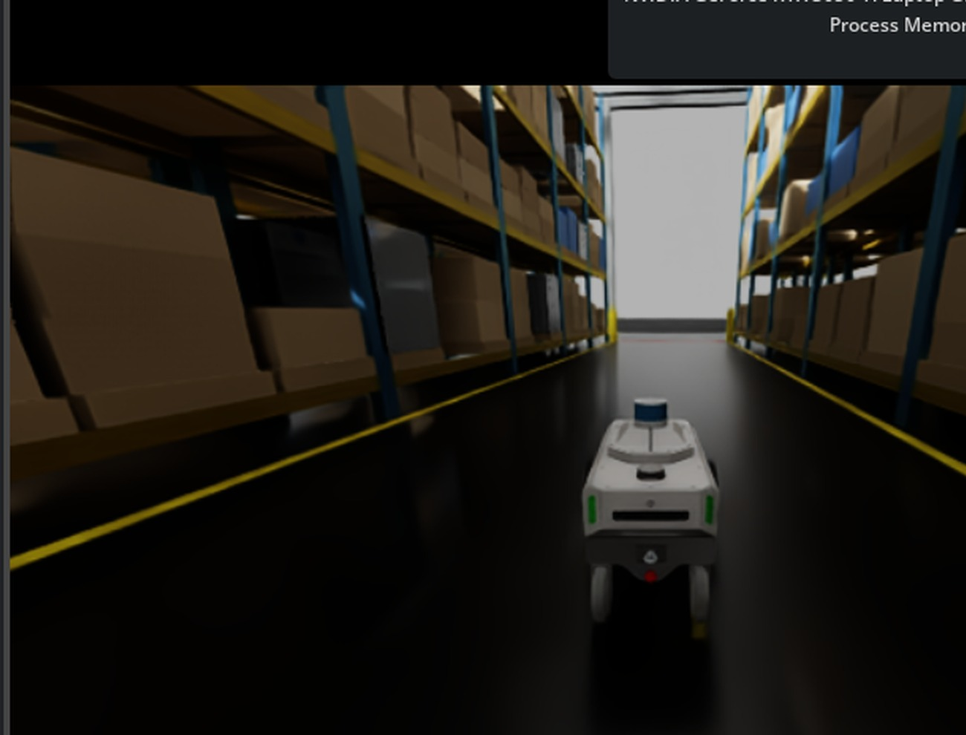
WAREHOUSE ROBOTICS / FINAL PROJECT PRESENTATION
CONTROL &
NAVIGATION
From our first robot to tested warehouse navigation
NVIDIA Isaac Sim 5.1.0 · Python · MobilityGen exploration
Manual control → Autonomous planning → Carter navigation

Slide 2
CONTROL & NAVIGATION
Our responsibility
Make a warehouse robot reach selected destinations with controlled movement.
ROBOT SETUP
KNOW THE MAP
PLAN A ROUTE
CONTROL MOTION
VERIFY ARRIVAL
We focus on path planning, waypoint tracking, movement commands, and navigation feedback—not on claiming full perception or SLAM.
02

Slide 3
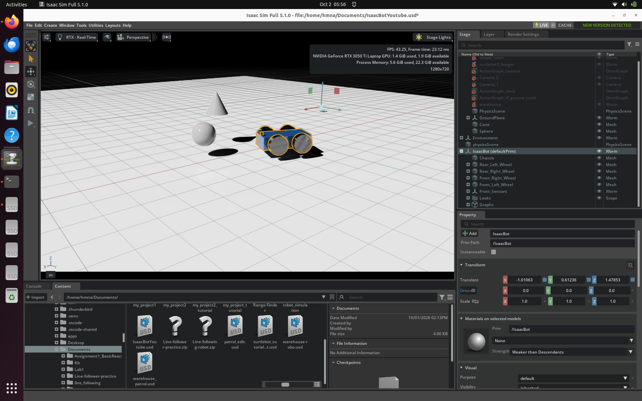
CONTROL & NAVIGATION
01 | We started with our own robot
Our first milestone was a robot that could move reliably in simulation.
Custom four-wheel robot setup
Keyboard controls: W / A / S / D
Movement through Isaac Sim control graph
03

Slide 4
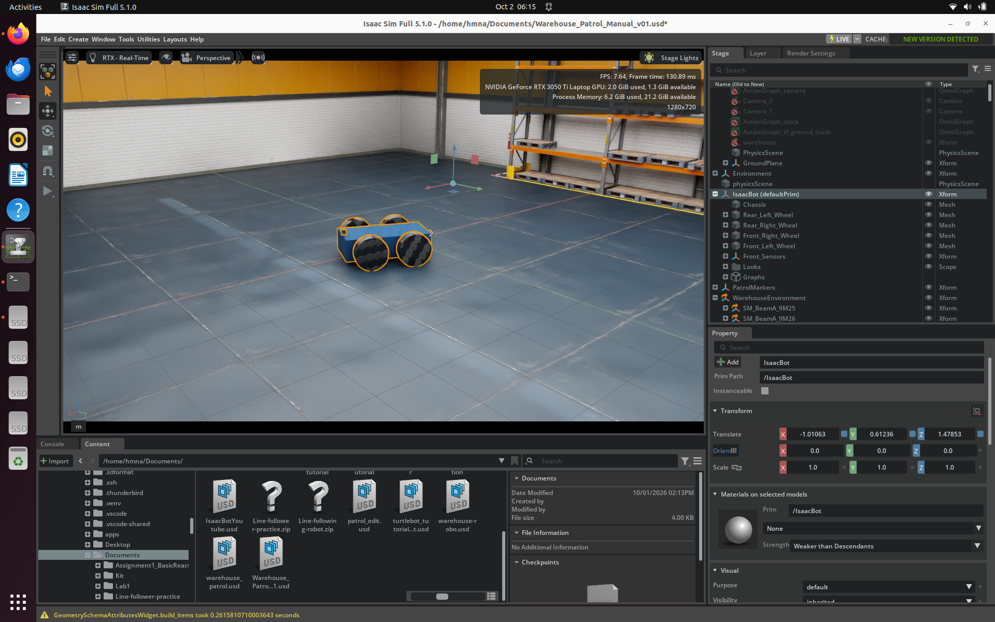
CONTROL & NAVIGATION
02 | We integrated the warehouse
Moving from a simple test scene to a realistic warehouse layout.
Loaded the supplied warehouse USD
Placed and tested the robot in the scene
Worked through startup, placement and alignment issues
04

Slide 5
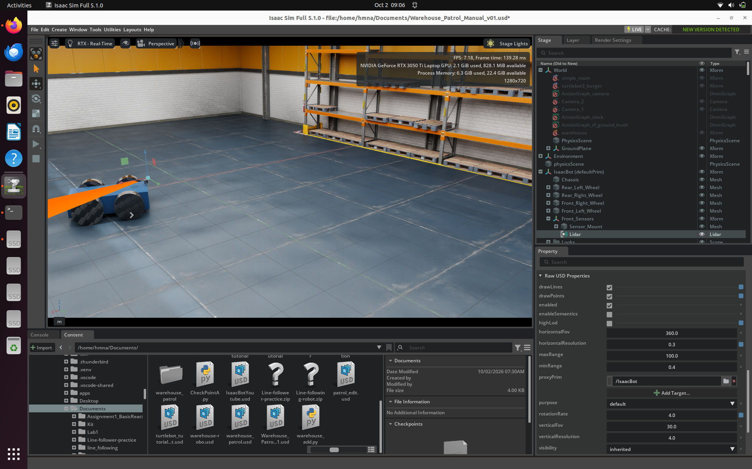
CONTROL & NAVIGATION
03 | We explored camera and LiDAR
Sensor visualization was an early integration milestone.
Camera: robot/environment view
LiDAR: visible range rays and object interaction
These views were not yet used for automatic obstacle avoidance
05

Slide 6
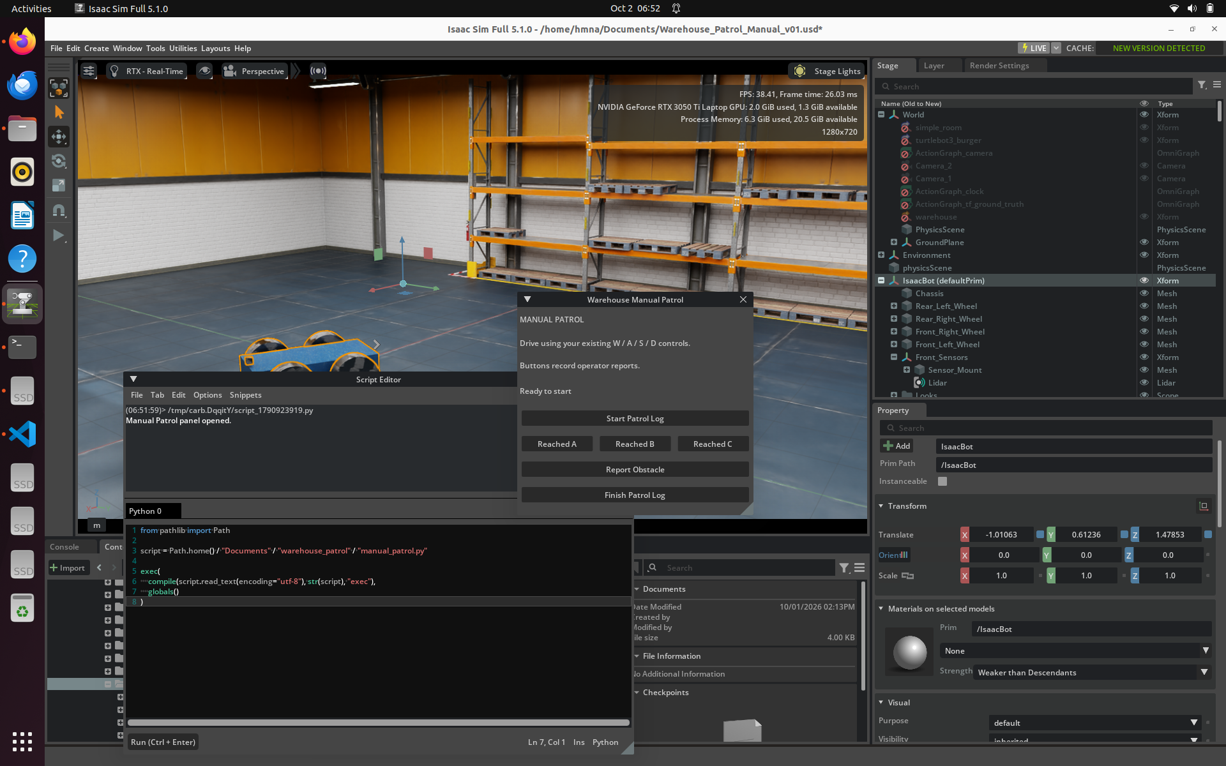
CONTROL & NAVIGATION
04 | We added a Python dashboard
A first interface for controlling and documenting manual patrol work.
VS Code + Isaac Sim Python workflow
Patrol start/finish and checkpoint reports
Timestamped operator event log
06

Slide 7
CONTROL & NAVIGATION
05 | The challenge: autonomous movement
Manual driving worked; autonomous commands needed additional engineering.
Wheel actuation was incomplete
Keyboard and Python could compete for wheel control
Straight-line goals could intersect warehouse racks
OUR RESPONSE
Four-wheel actuation
Exclusive control ownership
Static-map A* route planning
07

Slide 8
CONTROL & NAVIGATION
06 | We improved the original controller
Autonomous motion required coordinated wheel speeds and feedback.
ROBOT POSE
HEADING ERROR
LINEAR + ANGULAR SPEED
WHEEL COMMANDS
The original IsaacBot used four-wheel skid-steer commands, speed limits, corner alignment, braking, and a clear switch between manual and autonomous modes.
08

Slide 9
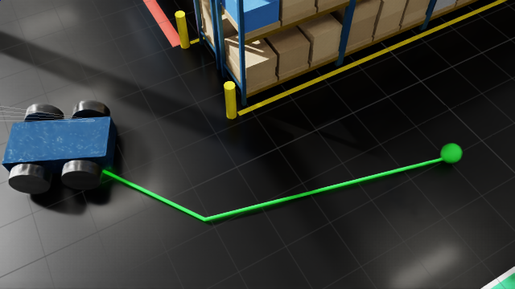
CONTROL & NAVIGATION
07 | We built A* navigation
Plan around known obstacles rather than driving directly toward a goal.
Read static collision geometry from the USD scene
Create a navigable grid with obstacle clearance
Generate and follow safe waypoints
09

Slide 10
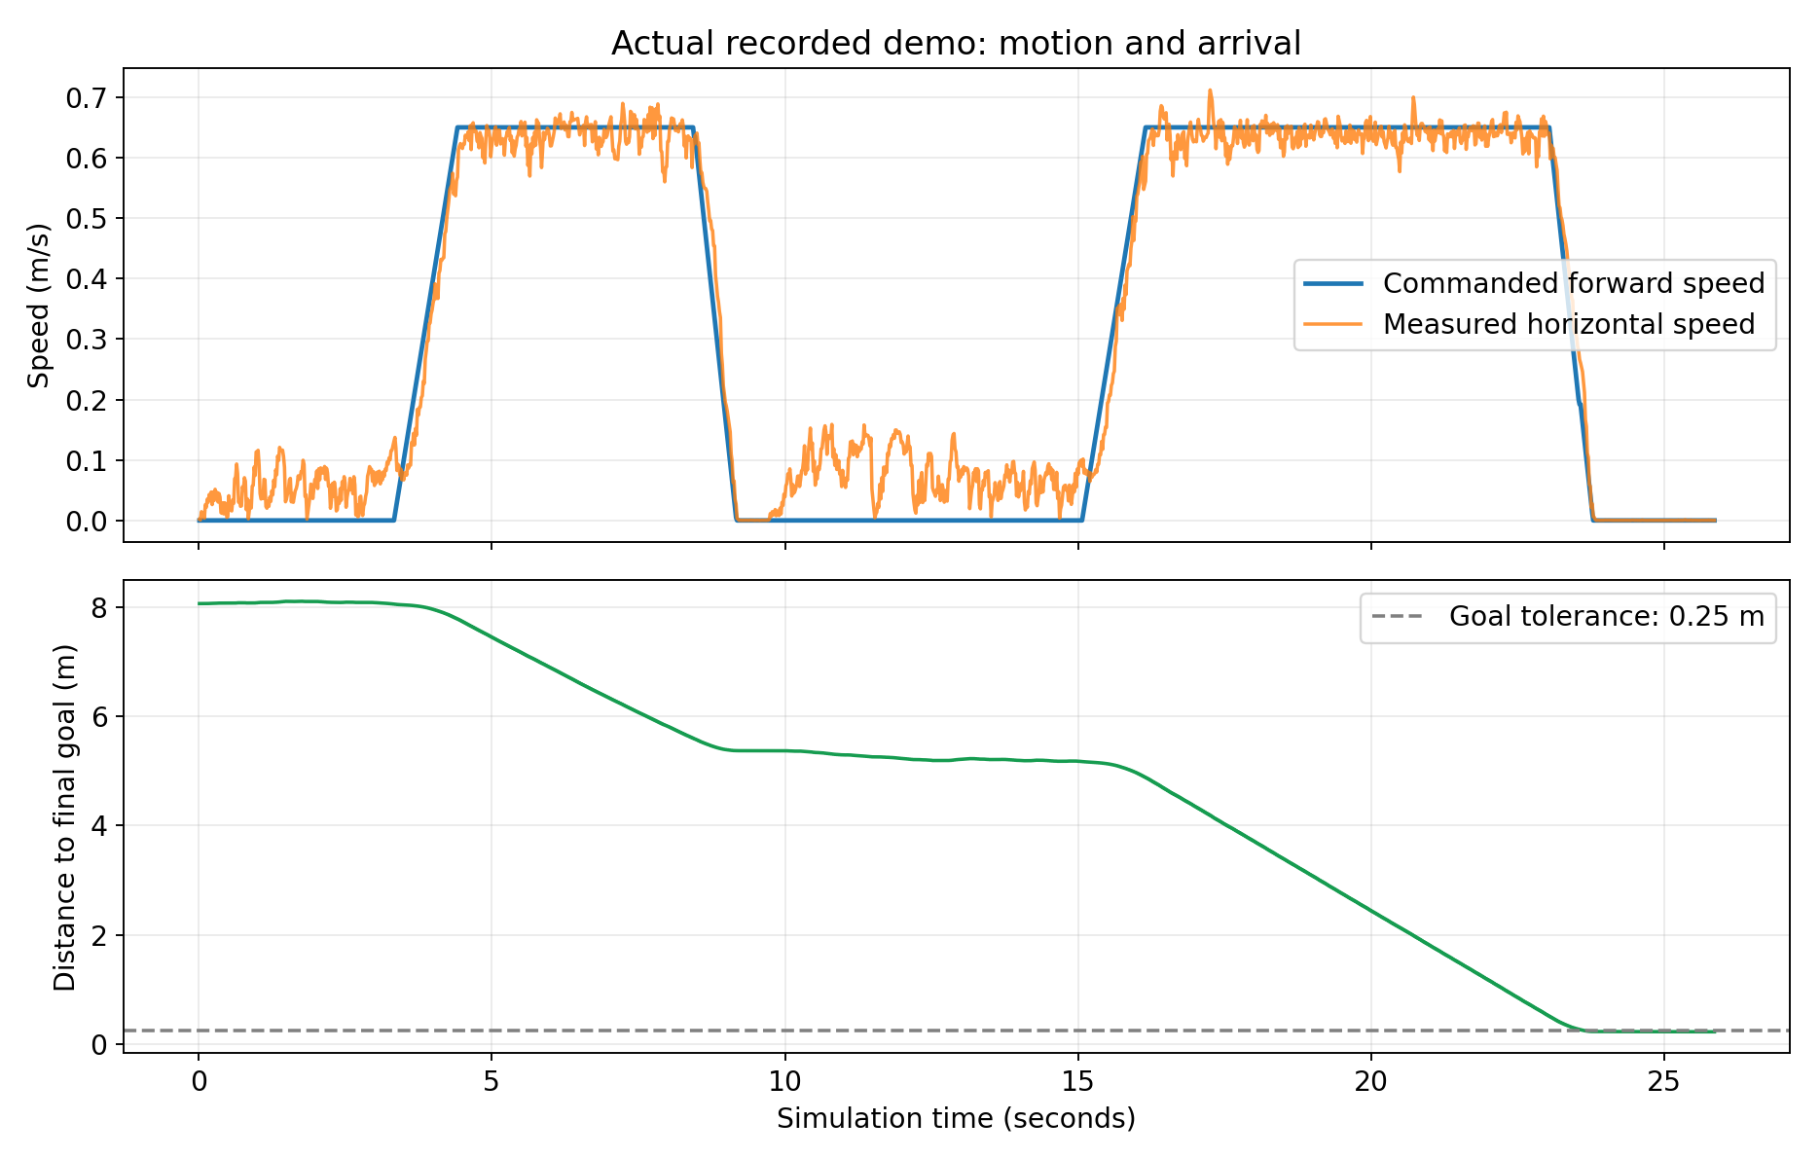
CONTROL & NAVIGATION
08 | Original robot: measured result
A separate, tested autonomous-navigation milestone.
2 / 2
waypoints reached
0.231 m
final goal error
12 / 12
unit tests passed
These figures belong to the original IsaacBot implementation, not the later Carter setup.
10

Slide 11
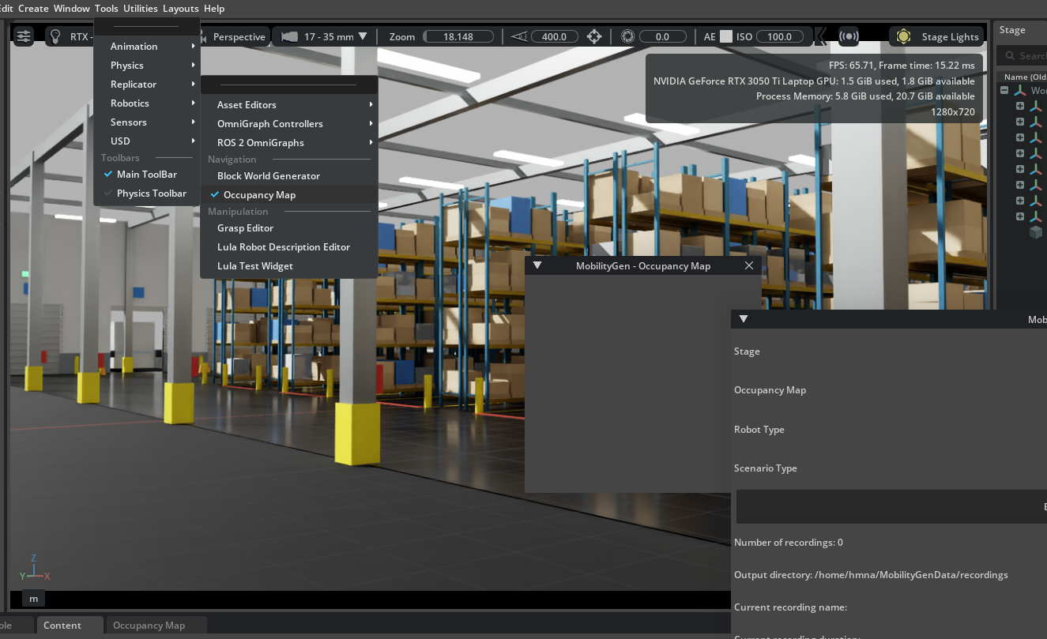
CONTROL & NAVIGATION
09 | We transitioned to MobilityGen / Carter
Following the team lead's direction, we explored NVIDIA's mobility workflow.
Moved beyond our initial custom robot setup
Integrated a Carter-based robot into the warehouse
Used mobility/map-related tools as a starting point
11

Slide 12
CONTROL & NAVIGATION
10 | We also tried the official ROS 2 tutorial
A parallel experiment with ROS 2, Nav2 and RViz2.
ISAAC SIM
ROS 2 BRIDGE
NAV2
RVIZ2
We followed NVIDIA's Isaac Sim 5.1.0 ROS 2 Navigation tutorial and displayed the warehouse occupancy map in RViz2. Full goal navigation was not validated.
12

Slide 13
CONTROL & NAVIGATION
11 | Why we did not use Nav2 in the final demo
Integration issues made the ROS 2 route difficult to demonstrate reliably.
RViz2 repeatedly froze or became unresponsive.
Isaac Sim and RViz2 together placed a heavy load on the laptop.
Simulation-clock synchronization was intermittently unreliable.
We preserved that experiment and continued with a working in-simulator approach.
13

Slide 14
CONTROL & NAVIGATION
12 | Our current working architecture
Custom Python navigation directly in Isaac Sim; ROS 2 Nav2 is not in this loop.
SELECT GOAL
OCCUPANCY MAP
A* PLANNER
MOTION CONTROL
CARTER
The controller uses simulator-provided robot pose as feedback and adjusts linear velocity (forward speed) and angular velocity (turning).
14

Slide 15
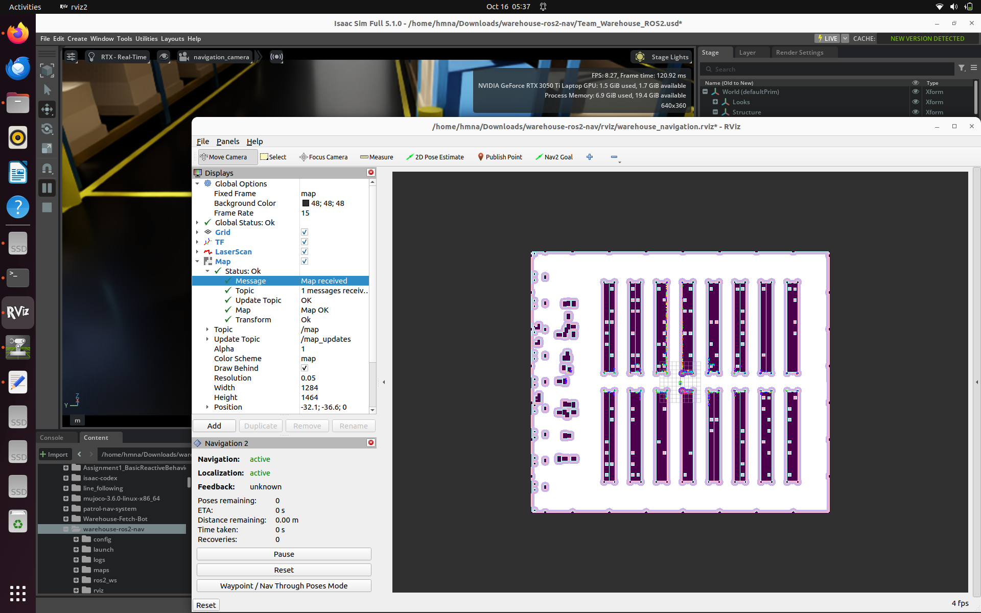
CONTROL & NAVIGATION
13 | Known warehouse occupancy map
Black: racks/obstacles · White: available space · Green: planned route
The map represents the warehouse from above
The planner routes through available aisles
This is known-map navigation, not live SLAM
15

Slide 16
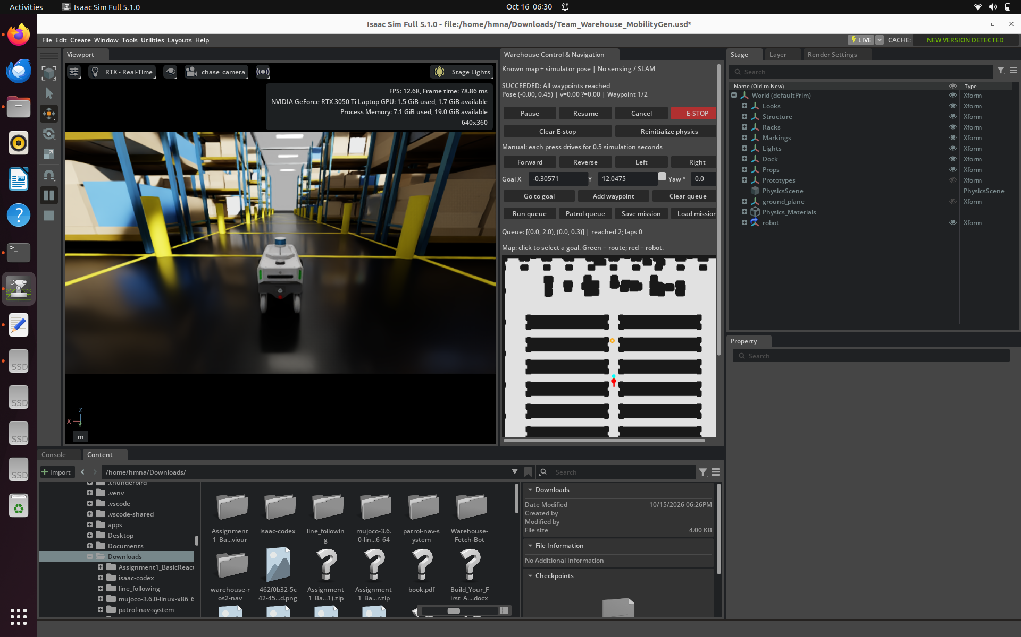
CONTROL & NAVIGATION
14 | Control & Navigation interface
One panel to set goals, execute missions and see progress.
Go to goal / add waypoint
Run queue / save and load mission
Pause, resume, cancel, E-STOP
Live pose, speed and route display
16

Slide 17
CONTROL & NAVIGATION
15 | Test A: waypoint mission completed
The Carter-based navigation controller reached both requested waypoints.
Two goals in a queue
Robot rotated, moved and stopped
UI reported: SUCCEEDED — all waypoints reached
17

Slide 18
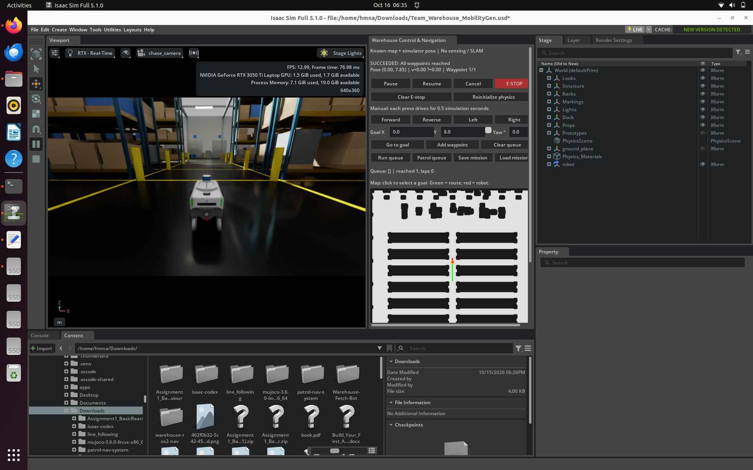
CONTROL & NAVIGATION
16 | Test B: longer-distance movement
Goal at Y = 8.0 m, with successful completion shown in the interface.
Moved beyond the short initial test
Followed the aisle toward the goal
Stopped near the destination
18

Slide 19
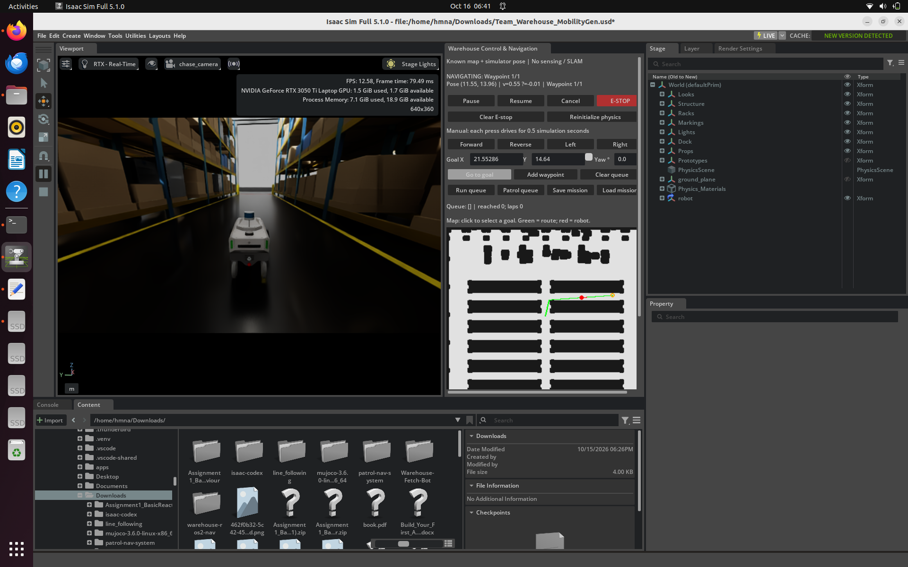
CONTROL & NAVIGATION
17 | Test C: route between racks
A more realistic warehouse route with a visible turn.
Selected a goal between warehouse racks
Green path turns through available space
Robot observed following the planned route
Screenshot documents navigation in progress; final arrival for this run is not shown.
19

Slide 20
CONTROL & NAVIGATION
18 | What we demonstrated — and what we did not
Accurate technical scope for the final review.
IMPLEMENTED / OBSERVED
NOT VALIDATED
• Manual robot movement
• Earlier IsaacBot A* navigation
• Carter map-based goal navigation
• Completed waypoint missions
• Longer-distance movement
• Navigation interface + monitoring
• Full ROS 2 Nav2 goal execution
• Live LiDAR obstacle avoidance
• SLAM or sensor-based localization
• Dynamic obstacle replanning
• Continuous patrol endurance
• VLA policy integration
20

Slide 21
CONTROL & NAVIGATION
19 | Final project takeaway
Our Control & Navigation contribution, end to end.
BUILD
INTEGRATE
DEBUG
PLAN
DEMONSTRATE
We progressed from a manually driven robot to tested map-based autonomous navigation, explored MobilityGen and ROS 2, and delivered a working Carter navigation demonstration in Isaac Sim.
21

Slide 22
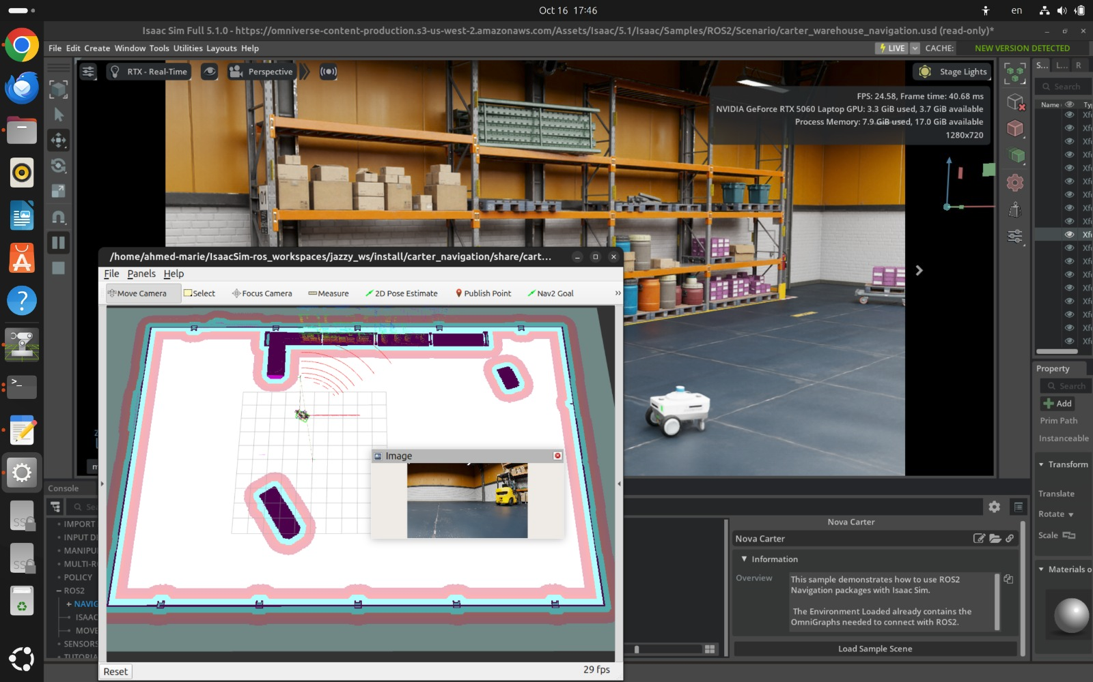
CONTROL & NAVIGATION / LATEST ROS 2 RESULT
Last-minute progress: ROS 2 sample running
Isaac Sim 5.1.0 + RViz2 + Nova Carter
WHAT IS VISIBLE
• Official ROS 2 sample scene
• Nova Carter in Isaac Sim
• RViz2 occupancy map
• LiDAR visualization
• Camera image feed
Verified here: ROS 2 visualization and sample integration. Nav2 goal completion is not shown in this screenshot.

Slide 23
CONTROL & NAVIGATION
References & implementation notes
Technical documentation and the project repository.
NVIDIA Isaac Sim 5.1.0 — ROS 2 Navigation Tutorial
https://docs.isaacsim.omniverse.nvidia.com/5.1.0/ros2_tutorials/tutorial_ros2_navigation.html
GitHub — warehouse-control-navigation
https://github.com/Hamna12/warehouse-control-navigation
Source material: Control_Navigation_Progress1, Control_Navigation_Progress2, and latest Carter demonstration screenshots.
22

