Slide 1
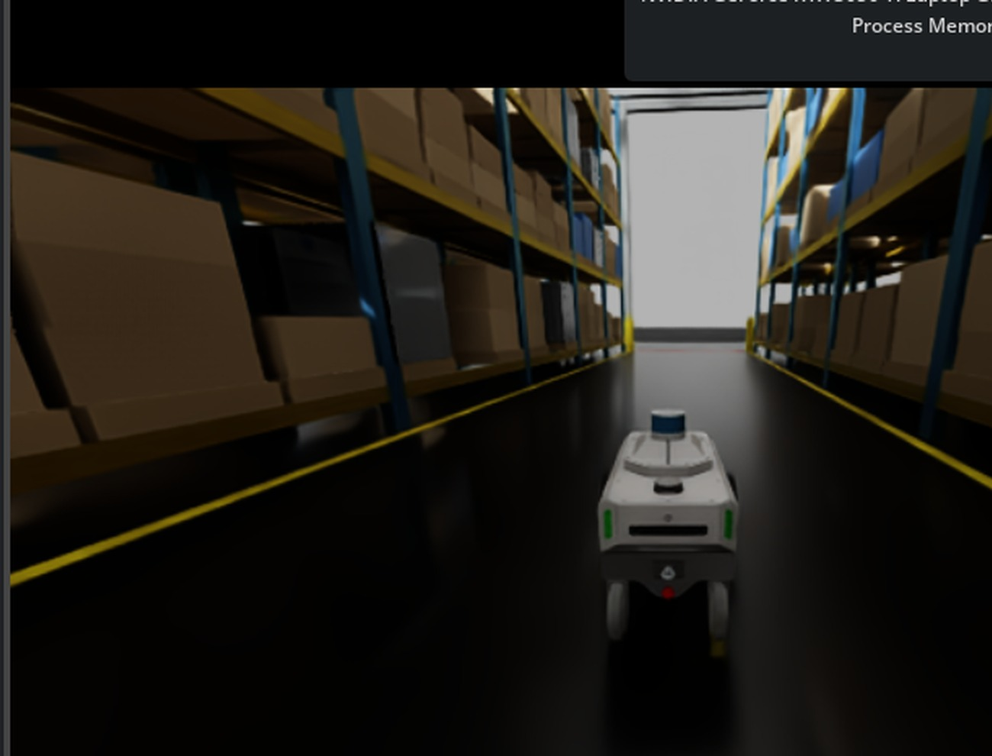
WAREHOUSE ROBOTICS / FINAL PROJECT UPDATE
CONTROL &
NAVIGATION
From robot setup to autonomous
warehouse route following
KNOWN MAP → ROUTE PLANNING → ROBOT MOTION
REAL SIMULATION / WAREHOUSE AISLE NAVIGATION
NVIDIA ISAAC SIM 5.1.0 • CARTER ROBOT
01

Slide 2
Our responsibility
What the Control & Navigation team is building
• Move the robot toward selected warehouse destinations.
• Plan routes through free space between storage racks.
• Control forward speed and turning.
• Track progress, stop at goals, and manage missions.
CONTROL & NAVIGATION • ISAAC SIM 5.1.0
02

Slide 3
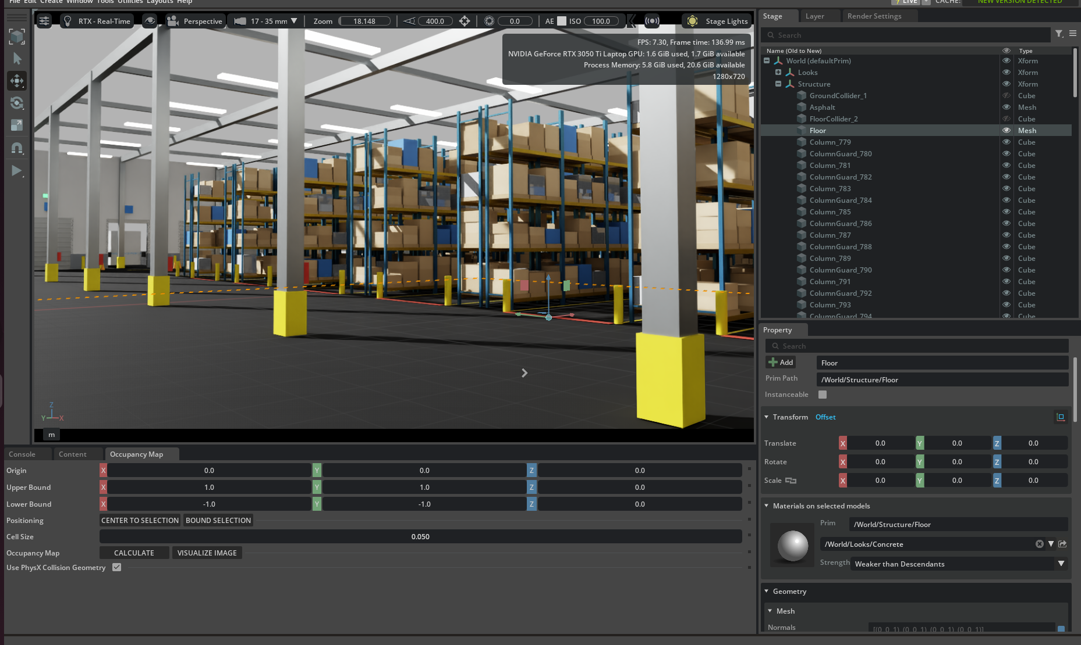
Starting point | Warehouse scene
Existing team environment brought into Isaac Sim
• Warehouse racks and aisles
• Carter robot integration
• Physics and movement setup
CONTROL & NAVIGATION • ISAAC SIM 5.1.0
03

Slide 4
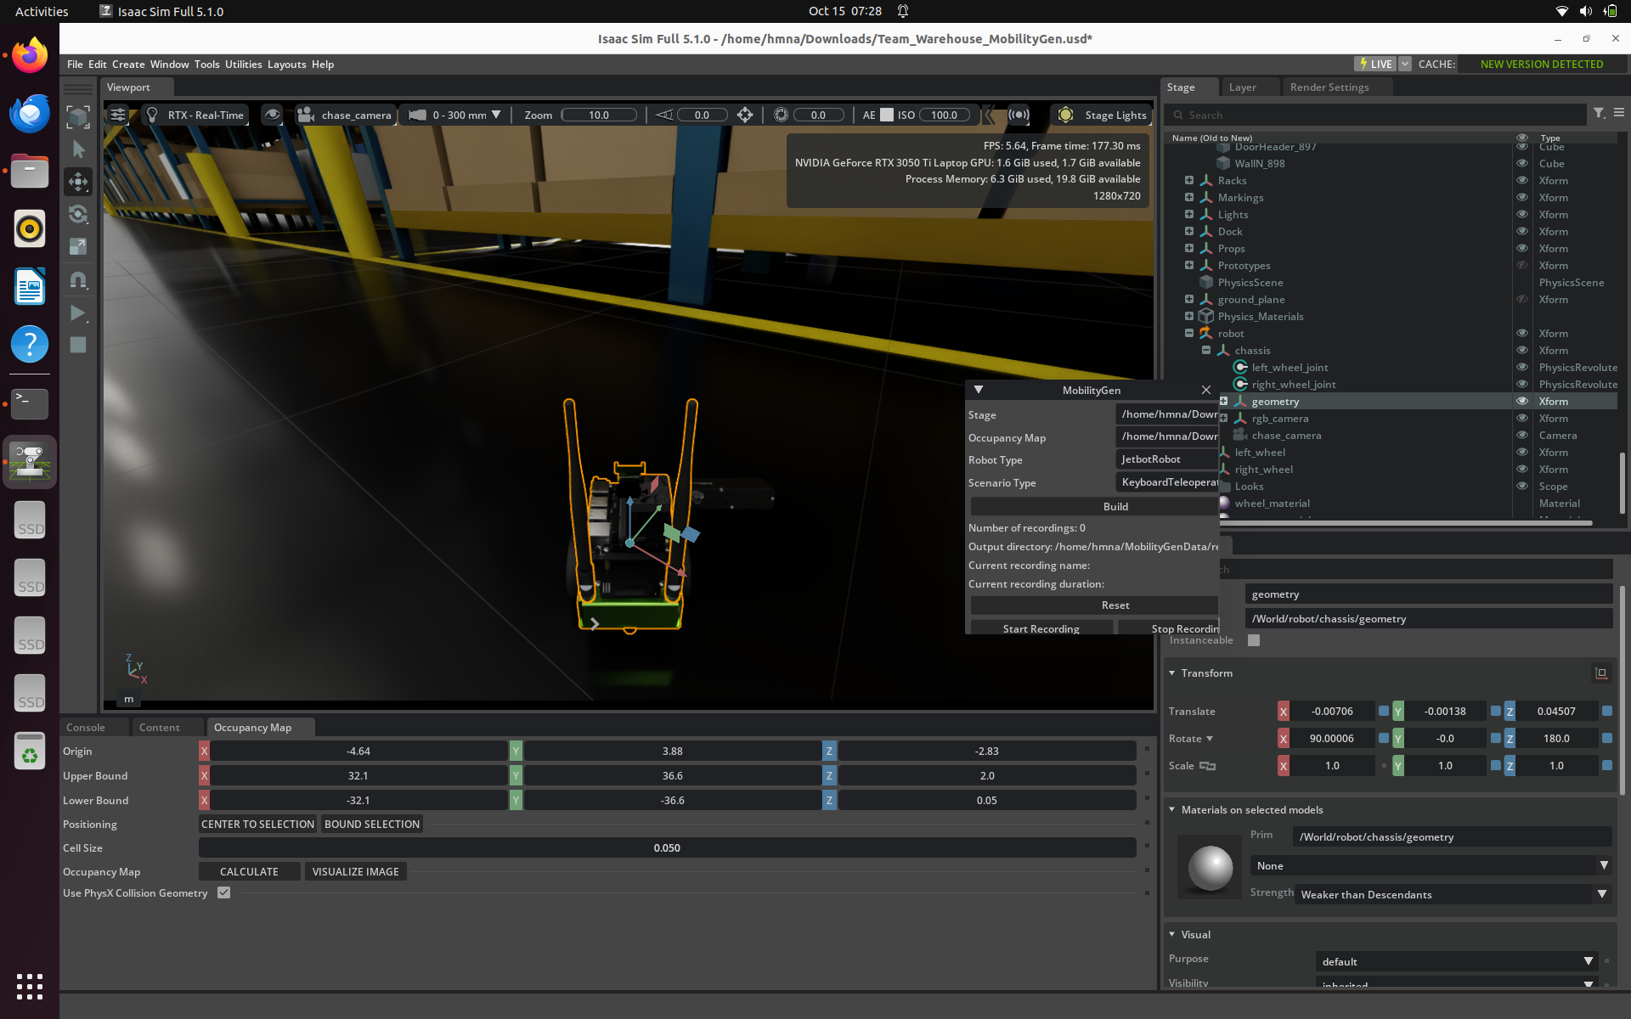
Step 1 | Robot and scene setup
First: our own robot and movement logic in Isaac Sim
• Loaded the warehouse USD scene.
• Built our initial robot and tested its movement logic.
• Then moved to the MobilityGen/Carter setup for navigation.
CONTROL & NAVIGATION • ISAAC SIM 5.1.0
04

Slide 5
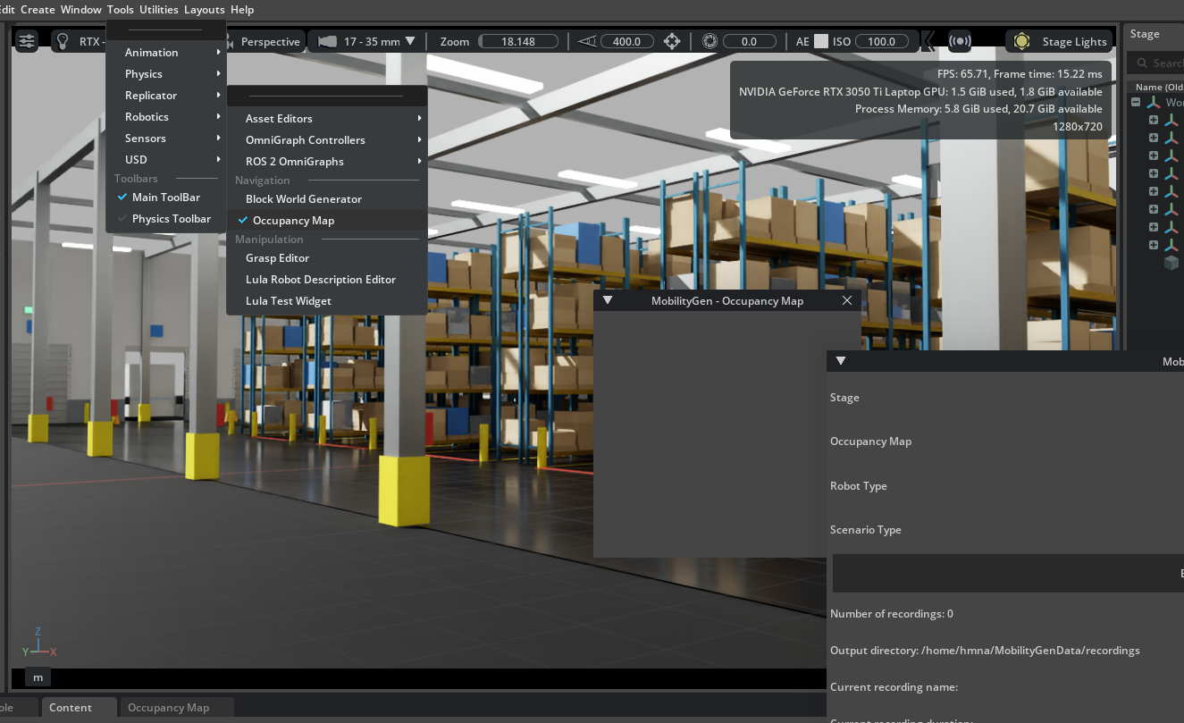
Step 2 | MobilityGen exploration
Switched from our own robot to MobilityGen/Carter
• Explored NVIDIA MobilityGen and its mobility workflow.
• Integrated the Carter robot setup into our warehouse scene.
• Used the known-map workflow; wrote navigation logic separately.
CONTROL & NAVIGATION • ISAAC SIM 5.1.0
05

Slide 6
Parallel experiment | ROS 2 + Nav2
Followed the NVIDIA tutorial shared by our team lead
ISAAC SIM
→
ROS 2 BRIDGE
→
NAV2 / RVIZ2
• Followed the Isaac Sim 5.1.0 ROS 2 Navigation tutorial.
• Built a separate ROS 2 workspace; displayed the map in RViz2.
• Attempted ROS 2 bridge and Nav2 navigation integration.
CONTROL & NAVIGATION • ISAAC SIM 5.1.0
06

Slide 7
ROS 2 setup | Issues encountered
Issues while following the shared NVIDIA ROS 2 tutorial
• Isaac Sim and RViz2 together put heavy load on the laptop.
• RViz2 froze or became unresponsive during testing.
• Intermittent /clock communication issues after restarts.
• End-to-end Nav2 goal navigation was not reliably validated.
Decision: keep the ROS 2 experiment separate and demonstrate the working MobilityGen/Carter + custom navigation setup.
CONTROL & NAVIGATION • ISAAC SIM 5.1.0
07

Slide 8
Current approach | Custom navigation
MobilityGen/Carter robot + our own Python planning and control
GOAL
→
KNOWN MAP + A*
→
ROUTE
→
CARTER
• Carter integrated in our warehouse; goals set in our custom panel.
• Our A* planner and velocity controller handle route and movement.
• Simulator pose supplies position feedback.
• Known-map navigation: no live sensing or SLAM.
CONTROL & NAVIGATION • ISAAC SIM 5.1.0
08

Slide 9
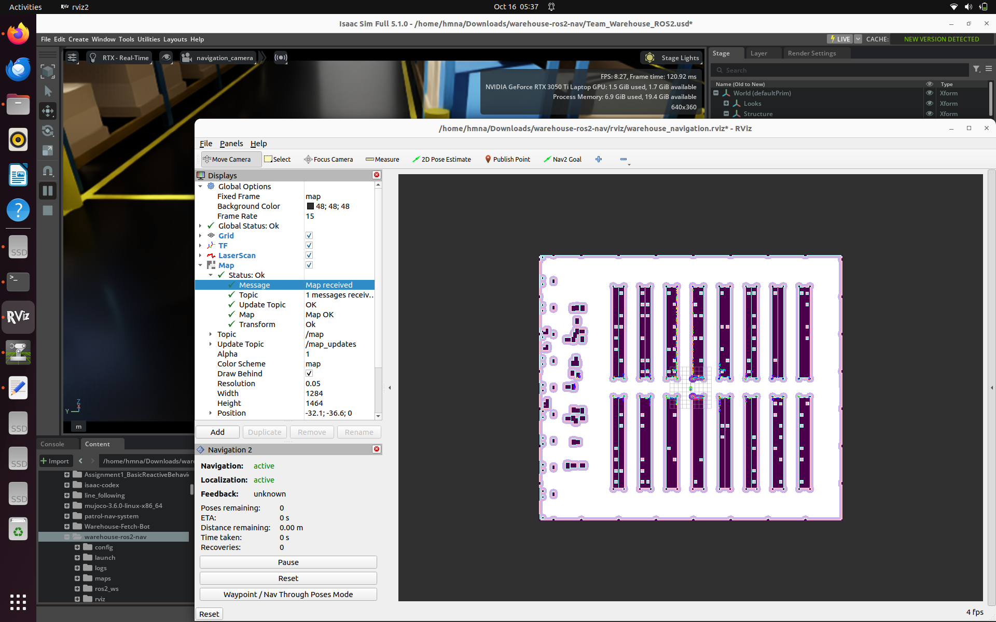
Step 3 | Occupancy map
Black = obstacles • White = free space • Green = planned route
• Racks are represented as blocked regions.
• Goals are selected in free space.
• The planner searches for a navigable route.
CONTROL & NAVIGATION • ISAAC SIM 5.1.0
09

Slide 10
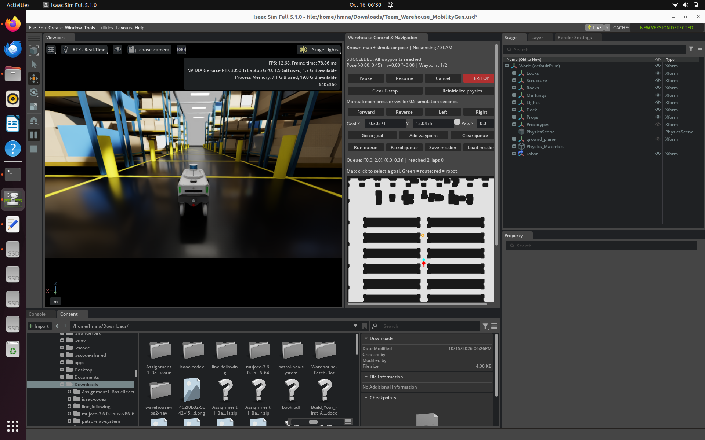
Step 4 | Navigation control panel
One interface to plan, move, and monitor
• Go to goal / Add waypoint
• Run queue / Patrol queue
• Pause / Resume / Cancel / E-STOP
• Position, velocity, and mission status
CONTROL & NAVIGATION • ISAAC SIM 5.1.0
10

Slide 11
Test 1 | Two-waypoint mission
Completed: both selected waypoints reached
• Robot aligned with the route.
• Moved between two short-distance goals.
• Controller reported mission success.
CONTROL & NAVIGATION • ISAAC SIM 5.1.0
11

Slide 12
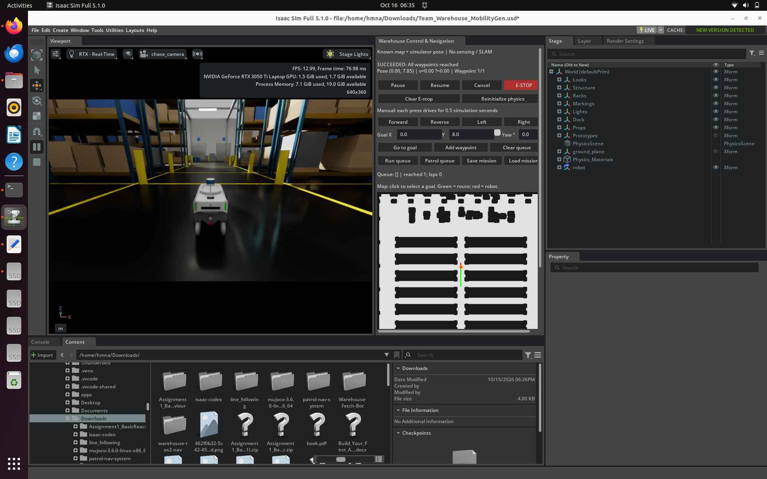
Test 2 | Longer-distance goal
Completed: destination Y = 8.0 m
• Goal: (0.0, 8.0)
• Final pose: approximately (0.0, 7.85)
• Status: SUCCEEDED
• Stopped within about 0.15 m of goal
CONTROL & NAVIGATION • ISAAC SIM 5.1.0
12

Slide 13
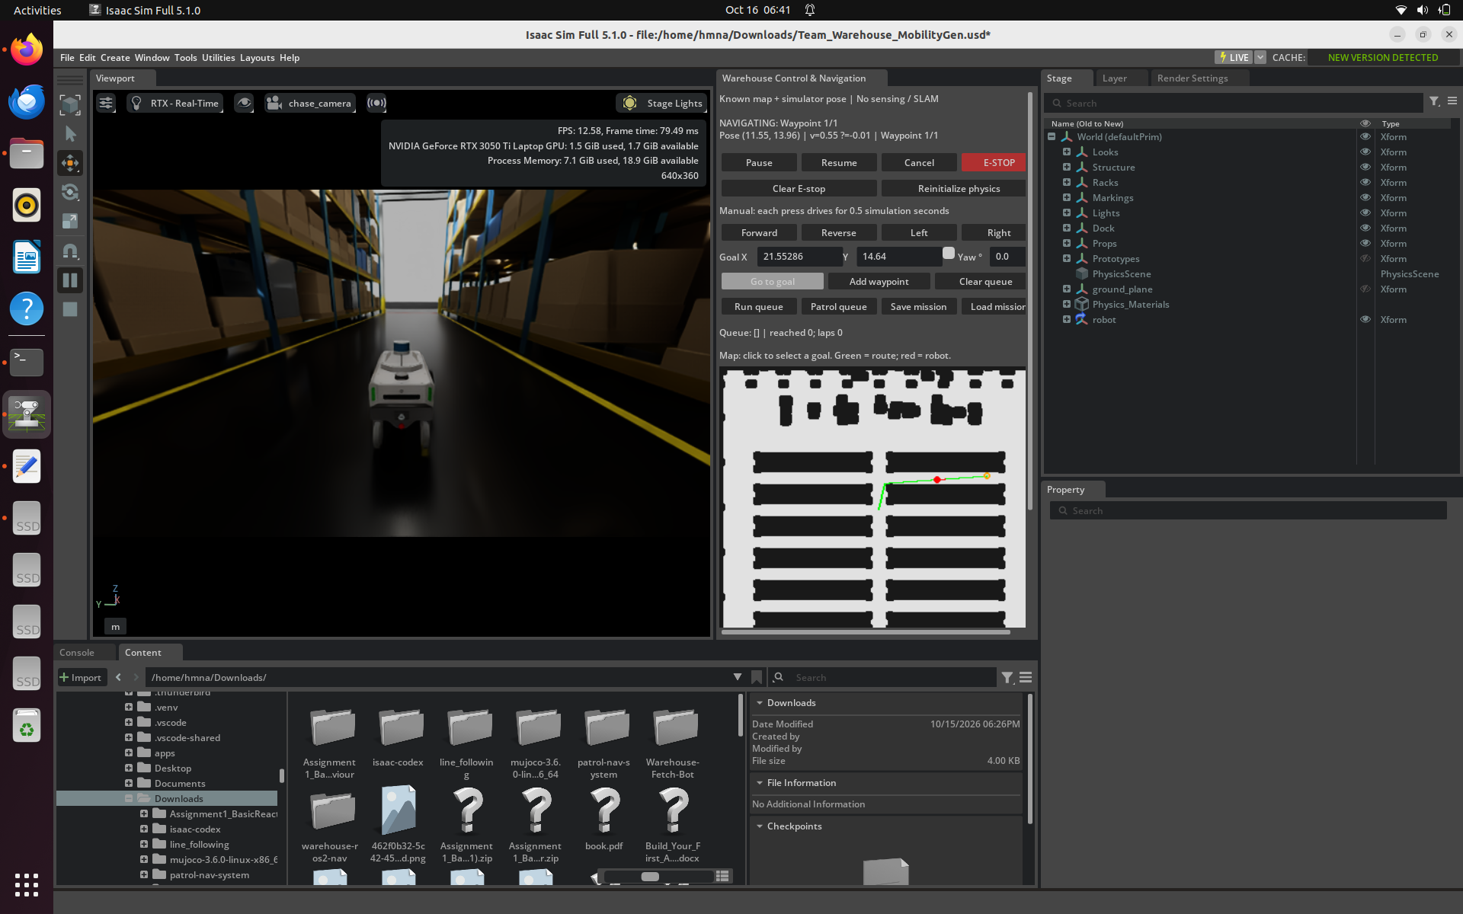
Test 3 | Route between racks
Observed: robot following a route with a turn
• Goal placed between storage racks.
• Green route bends around rack geometry.
• Robot observed moving along the route.
• Screenshot shows NAVIGATING; arrival not yet verified.
CONTROL & NAVIGATION • ISAAC SIM 5.1.0
13

Slide 14
What is implemented vs. still to validate
Clear separation between working features and next tests
IMPLEMENTED / TESTED
NEXT TESTS / FUTURE WORK
• Goal-based navigation
• Complete multi-aisle mission and patrol loop
• Two-waypoint mission completion
• Pause, resume, and emergency-stop validation
• Longer-distance goal completion
• Live obstacle handling / sensor localization
• Route following between racks (in progress)
• Optional ROS 2 Nav2 integration
CONTROL & NAVIGATION • ISAAC SIM 5.1.0
14

Slide 15
Final takeaway
Control & Navigation team progress
From our own robot → MobilityGen/Carter → tested map-based navigation.
• Carter receives a goal and follows a planned route.
• The controller manages movement and tracks progress.
• Short and long navigation missions have succeeded.
• Rack-to-rack routing is being tested in the real warehouse layout.
Final demo scope: custom navigation in Isaac Sim; ROS 2 Nav2 remained a separate experiment.
CONTROL & NAVIGATION • ISAAC SIM 5.1.0
15

Slide 16
Reference and technical scope
NVIDIA Isaac Sim 5.1.0 — ROS 2 Navigation tutorial
https://docs.isaacsim.omniverse.nvidia.com/5.1.0/ros2_tutorials/tutorial_ros2_navigation.html
• We followed the shared tutorial but encountered RViz, /clock, and performance issues.
• Current demo: MobilityGen/Carter setup with custom A* and motion control in Isaac Sim.
• Current localization is simulator pose, not sensor-based localization.
CONTROL & NAVIGATION • ISAAC SIM 5.1.0
16

