Slide 1
Blueprint
Group 5

Slide 2
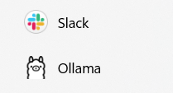

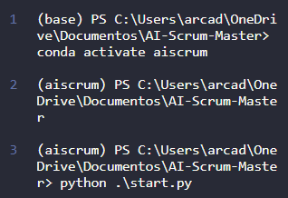
Run these apps
The main purpose of this code is to define and map system prompts for different AI roles, enabling them to perform specific tasks related to Scrum and Jira management effectively.
system_prompt.py
slackbot/bot.py
The main purpose of this code is to manage a Slack bot that facilitates team meetings, sends scheduled reminders, and interacts with users through commands and messages, utilizing a language model for processing conversations and handling Jira-related queries.
The main purpose of this code is to interact with the Jira API, enabling functions such as retrieving issues and projects, and assigning issues to users.
projmgr/jira.py
slackbot/slackuser.py
The main purpose of this code is to track and manage user conversations across different Slack channels.
model/llm.py
The main purpose of this code is to manage and interact with a language model (LLM), handle Jira-related queries, and log the runtime of specific operations.
tokens.py
The main purpose of this code is to provide authentication tokens, API credentials, and configuration settings required for connecting to Slack, Jira, and securing a Flask application.
start.py
The code's main purpose is to start both a Flask web application and a Slack bot, while logging the process.
flaskapp/app.py
The code creates a Flask web application with API endpoints for managing and processing conversation data, embeddings, and Jira issues, running concurrently in a separate thread.
The main purpose of this code is to process and parse Slack events by extracting bot IDs, downloading and converting audio files to text, and compiling the complete message content.
slackbot/
attachment.py
slackbot/event_parse.py
The main purpose of this code is to download files from authenticated URLs and provide a placeholder for future audio file parsing functionality.

Slide 3

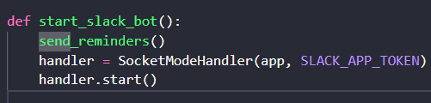

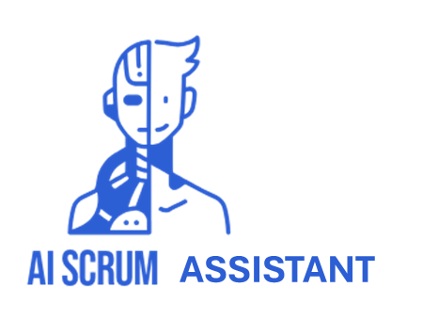
Run these apps
slackbot/bot.py
system_prompt.py
Imports and Setup
Load Configuration
Send Reminders
Meeting Timer
Slack Commands
Jira Integration
Bot Events
Role Definitions
System Prompts Creation
Mapping Roles to Prompts
projmgr/jira.py
bot.py
model/llm.py
slackbot/slackuser.py
slackbot/event_parse.py
model/llm.py
Model Initialization
Runtime Logging
Chat Interaction
Jira Integration
Embeddings
projmgr/jira.py
slackbot/slackuser.py
Jira Tools Definition
Issue Retrieval by Assignee
Issue Assignment
Retrieve All Issues
Retrieve All Projects
Authentication and Requests
User Management
Conversation Retrieval
projmgr/jira.py
model/system_prompt.py
start.py
Logging Setup
Start Flask and Slack Apps
Main Execution
slackbot/
event_parse.py
slackbot/
attachment.py
File Download Function
Audio Parsing Stub
tokens.py
Token Import and Audio Processing
Bot ID Retrieval
Audio Message Handling
Message Parsing
slackbot/bot.py
flaskapp/app.py
slackbot/event_parse.py
flaskapp/app.py
tokens.py
Flask App Initialization
Session to Text Conversion
API Endpoints
Embedding Request Handling
Conversation Summary
tokens.py
slackbot/attachment.py
Token and Credential Storage
Secret Key Definition
bot.py
slackbot/attachment.py
projmgr/jira.py
Any Flask app files
projmgr/jira.py
tokens.py

