Slide 1
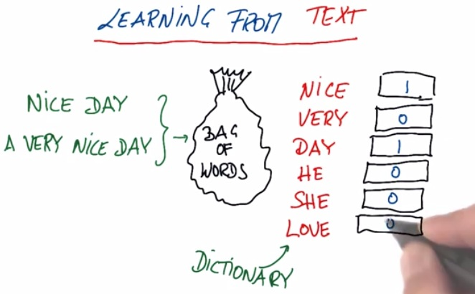
Text Feature Extraction
Student Name: Hamoud Alhazmi
Convenor: Dr. Mohammad Abu Alsheikh
ID: U3154228

Slide 2
Agenda
Text Feature Extraction
Bag of Words (BoW)
TFIDFTransformer & TFIDFVectorizer
Text – Count Vectorizer
Text – TF - IDF

Slide 3
Text Feature Extraction
Machines are not capable of understanding sentences and words in the same manner as humans do. In order to make documents more palatable to computers, they must first be converted into some numerical structure. There are a few techniques to achieve that and one of them is Bag of Words (BoW).
The methods of BoW comprise of:
1- Splitting the documents into tokens by following some sort of pattern
2- Assigning a weight to each token proportional to the frequency
3- Creating a document-term matrix with each row represents a document and each column addresses a token
The scikit-learn vectorizer objects allow us to perform all the above steps at once efficiently:
A – Count Vectorizer: it counts the number of times a token shows up in the document and uses this value as its weight
B – Hash Vectorizer: it is designed to be as memory efficient as possible.
C- TF-IDF Vectorizer: it means the weight assigned to each token not only depends on its frequency in a document but also how recurrent that term is in the entire corpus.

Slide 4
Bag of Words (BoW)
Text analysis is a major application field for machine learning algorithms. However the raw data, a sequence of symbols cannot be fed directly to the algorithms themselves as most of them expect numerical feature vectors with a fixed size rather than the raw text documents with variable length.
Scikit-Learn provides utilities for the most common ways to extract numerical features from text content as follow:
Tokenizing is the process of breaking a stream of text up into words called tokens. It converts a string like “My favorite color is red” to a list of array like [‘my’, ’favorite’, ’color’, ’is’, ’red’]
Stemming is a process of removing and replacing suffixes to get to the root form of the word, which is called stem (e.g. wolves -> wolv, talked -> talk, cats -> cat) nltk.stem.prterstemmer
Lemmatization returns the base or dictionary form of a word, which is known as the lemma (e.g. feet -> foot, talked -> talked, wolves -> wolf) nltk.stem.WordNetLemmatizer
Counting method counts how many times an element has occurred in a list and returns it
Normalizing and weighting with diminishing importance tokens that occue in the majority of samples/documents

Slide 5
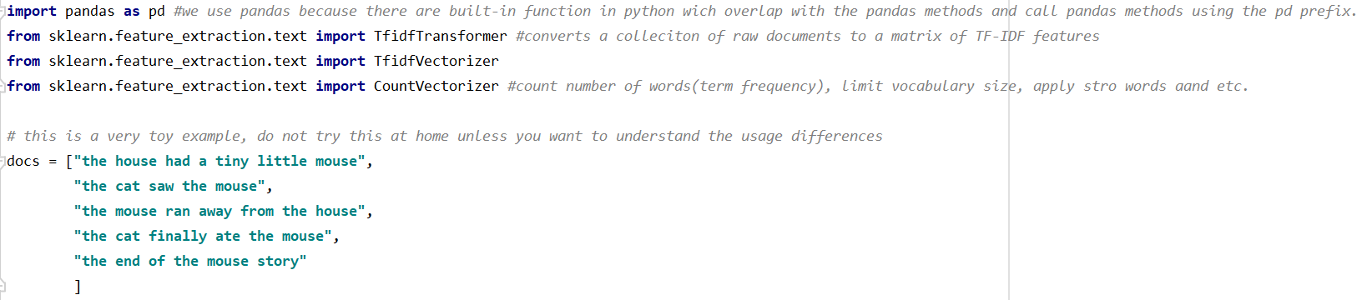
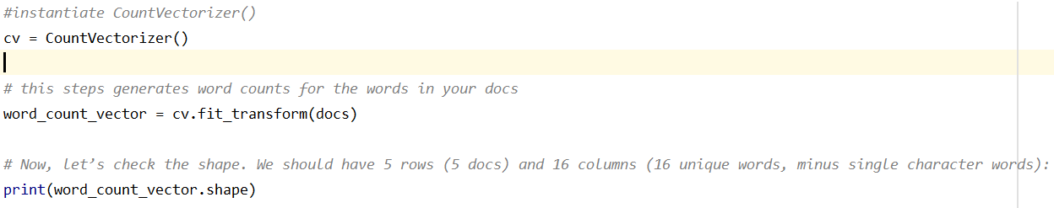
Tfidftransformer & TfidfVectorizer
They aim to do the same thing, which is to convert a collection of raw documents to a matrix of TF-IDF features.
A- The usage of Tfidftransformer:
1- Dataset and Import
2- Initialize CountVectorizer
output
Notes:
1- 5 toy documents. We are going to use this toy dataset to compute the tf-idf scored of words In these documents
2- In order to start using TfidfTransformer you will first have to create a CountVectorizer to count the number of words (term frequency).

Slide 6
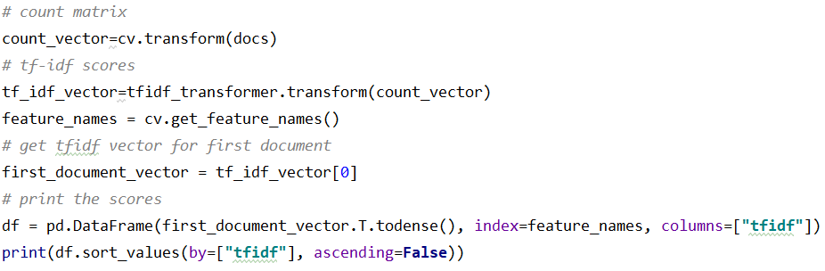
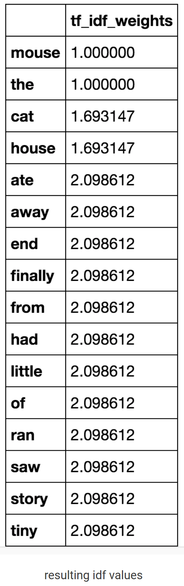

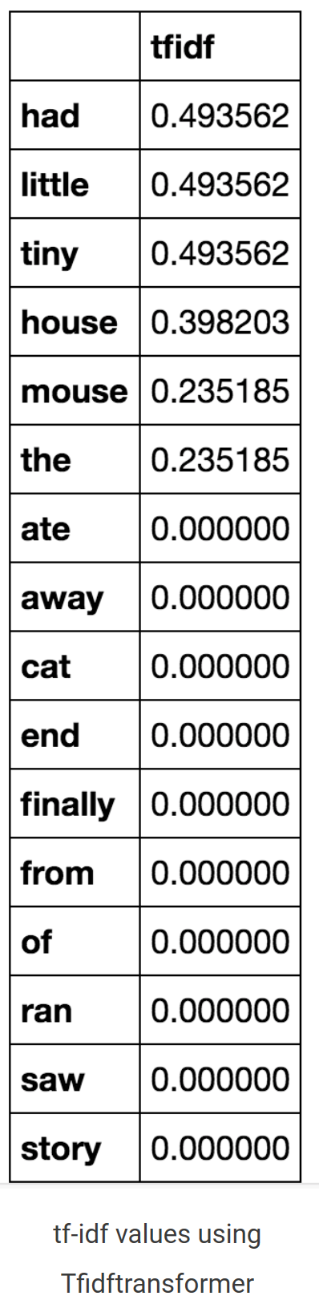
Tfidftransformer & TfidfVectorizer
3- Computer the IDF Values
4- Computer the TFIDF score of your documents
Notice that the word ‘mouse’ and ‘the’
has the lowest IDF values. This is expected as these words appear in each document in our collection.
The lower the IDF value of a word, the less unique it is to any particular document.
The first line above gets the word counts for the document in a sparse matrix form. In practice, we will be computing tf-idf scores on a set of new unseen documents. In this case, we will use first cv.transform(your_new_docs) to generate the matrix of word counts. Then, by invoking tfidf_transformer.transform(count_vector) we will compute the tf-idf scores of the docs. It computes the tf * idf multiplication where the term frequency is weighted by its IDF values. The more common the word across documents, the lower its score and the more unique a word is to our first document ‘had’ and ‘tiny’ has a higher score.
Notes:
Now it is time to computer IDFs.
3- Now we are going to compute the IDF values by calling tfidf_transformer.fit(word_count_vector) on the word counts we computed earlier. To get a glimpse of how the IDF values look, we are going to print it by placing the IDF values in a python Dataframe. The values will be sorted in ascending order.
Important note: In practice, your IDF should be based on a large corpora of text.
4- Now, let’s print the tf-idf values of the first document to see if it makes sense. What we are doing below is, placing the tf-idf scores from the first document into a pandas data frame and sorting it in descending order of scores. Notice that only certain words have scores. This is because our first document is “the house had a tiny little mouse” all the words in this document have a tf-idf score and everything else show up as zeroes. Notice that the word “a” is missing from this list. This is possibly due to internal pre-processing of CountVectorizer where it removes single characters.

Slide 7
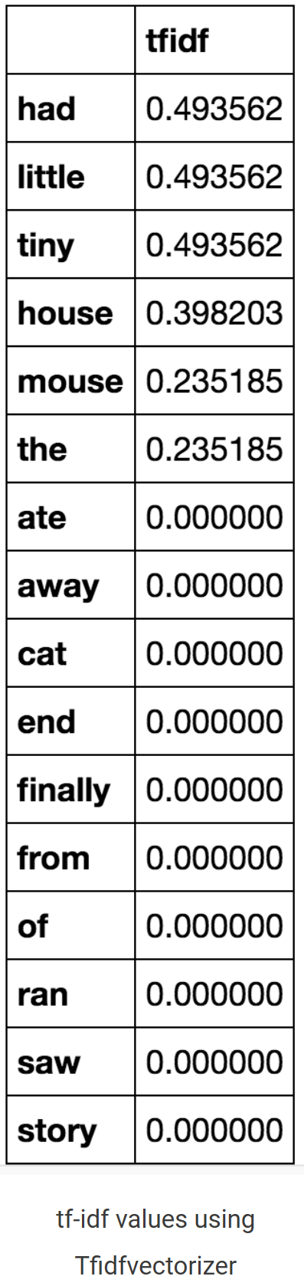
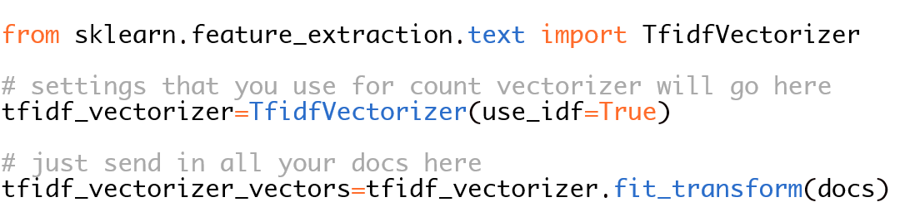
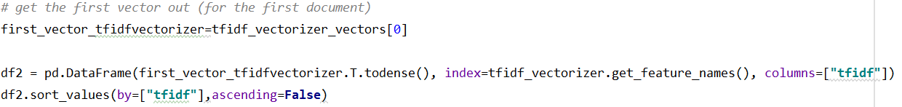
Tfidftransformer & TfidfVectorizer
B- The usage of Tfidfvectorizer :
We will do the same thing as we did for Tfidftransformer, but this is much shorter. With Tfidfvectorizer you compute the word counts, idf and tf-idf values all at once.
Now let’s print the tfidf values for the first document from our collection. Notice that these values are identical to the ones from Tfidftransformer, only thing is that it’s done in just two steps.
In a summary, the main differences between the two modules are as follows:
A – with Tfidftransformer we will systemically compute word counts using CountVectorizer and then compute IDF values and
only then compute the Tf-idf scores.
B – with Tfidfvectorizer we will do all three steps at once. It computes the word counts, IDF values, and Tf-idf scores all using
The same dataset.

Slide 8
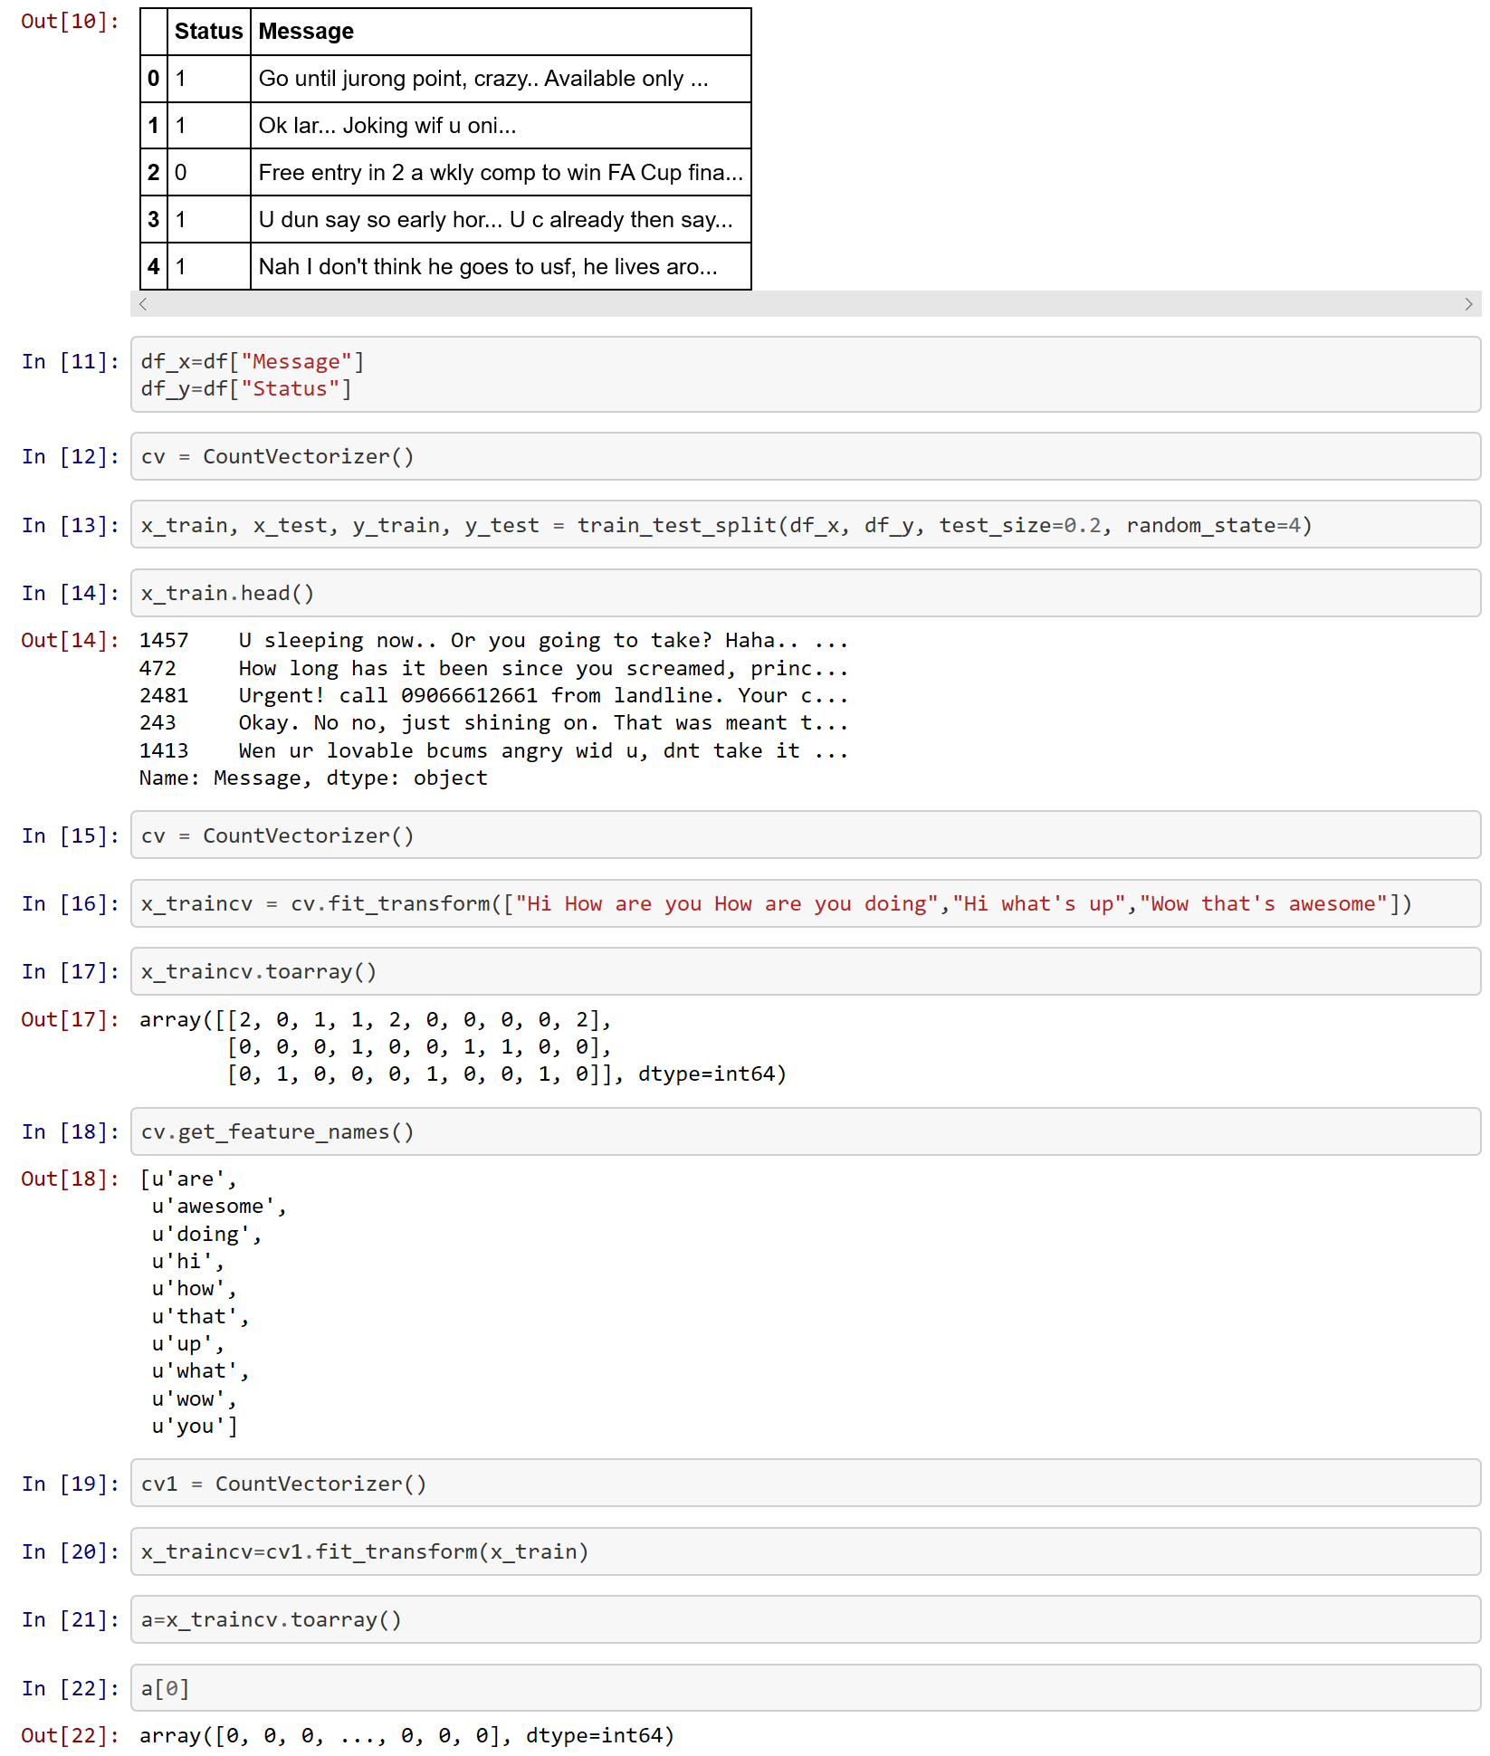
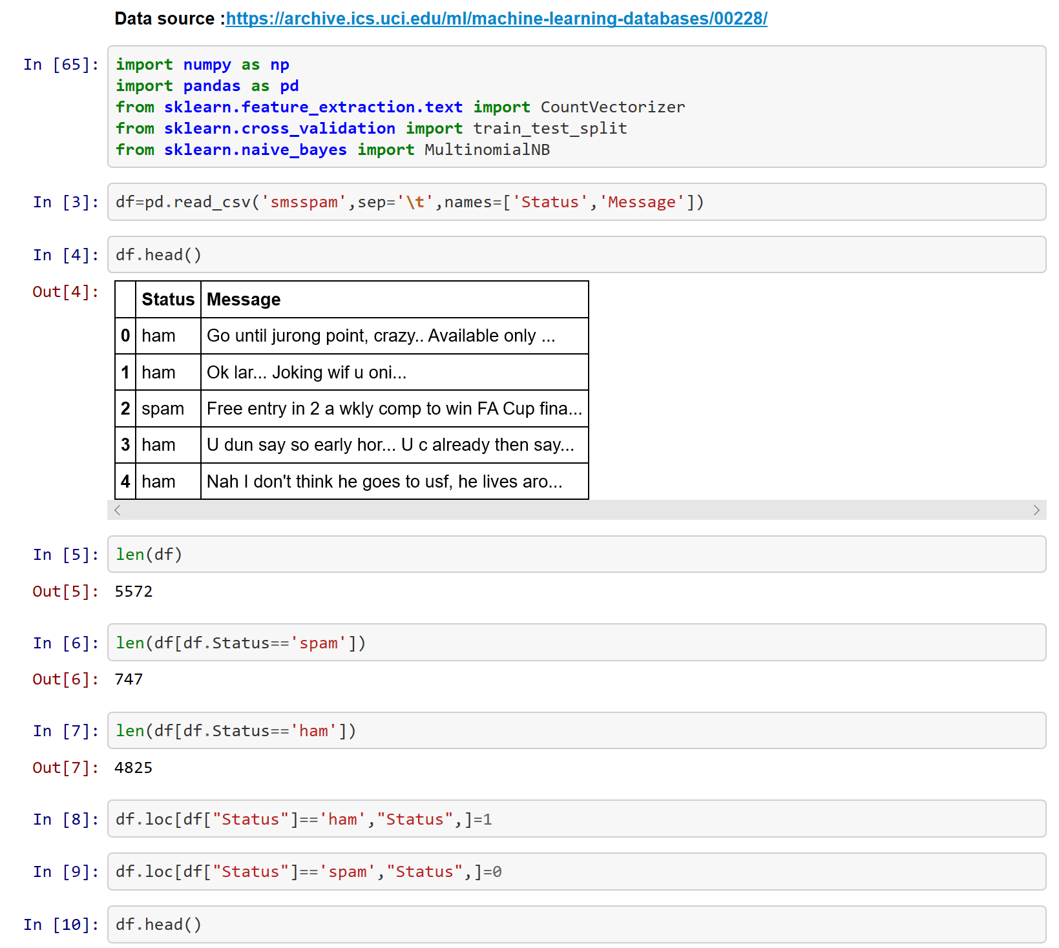
Text – Count Vectorizer

Slide 9
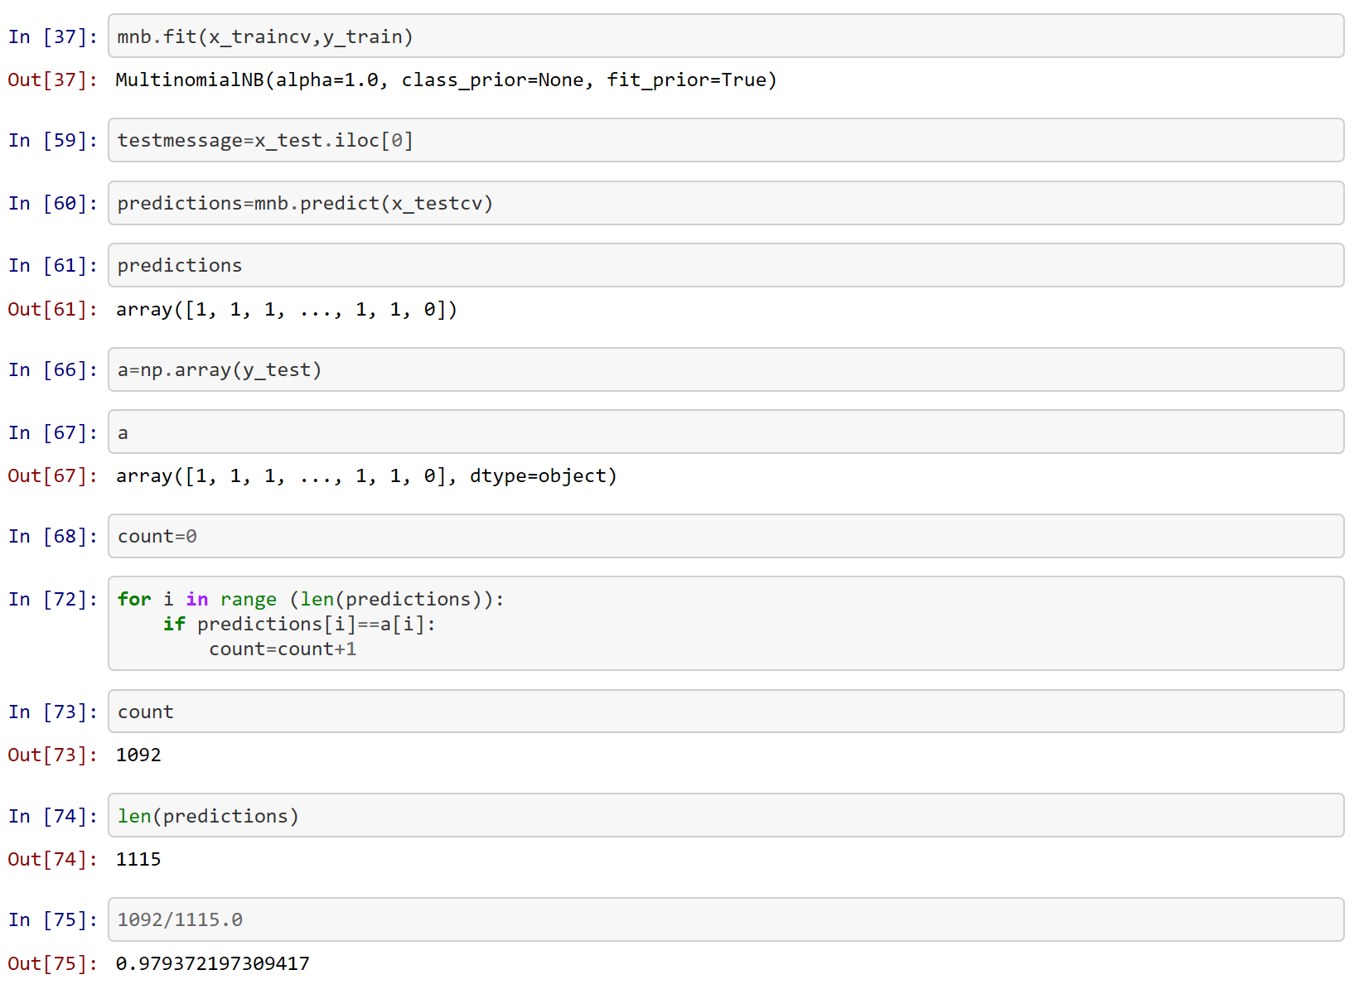
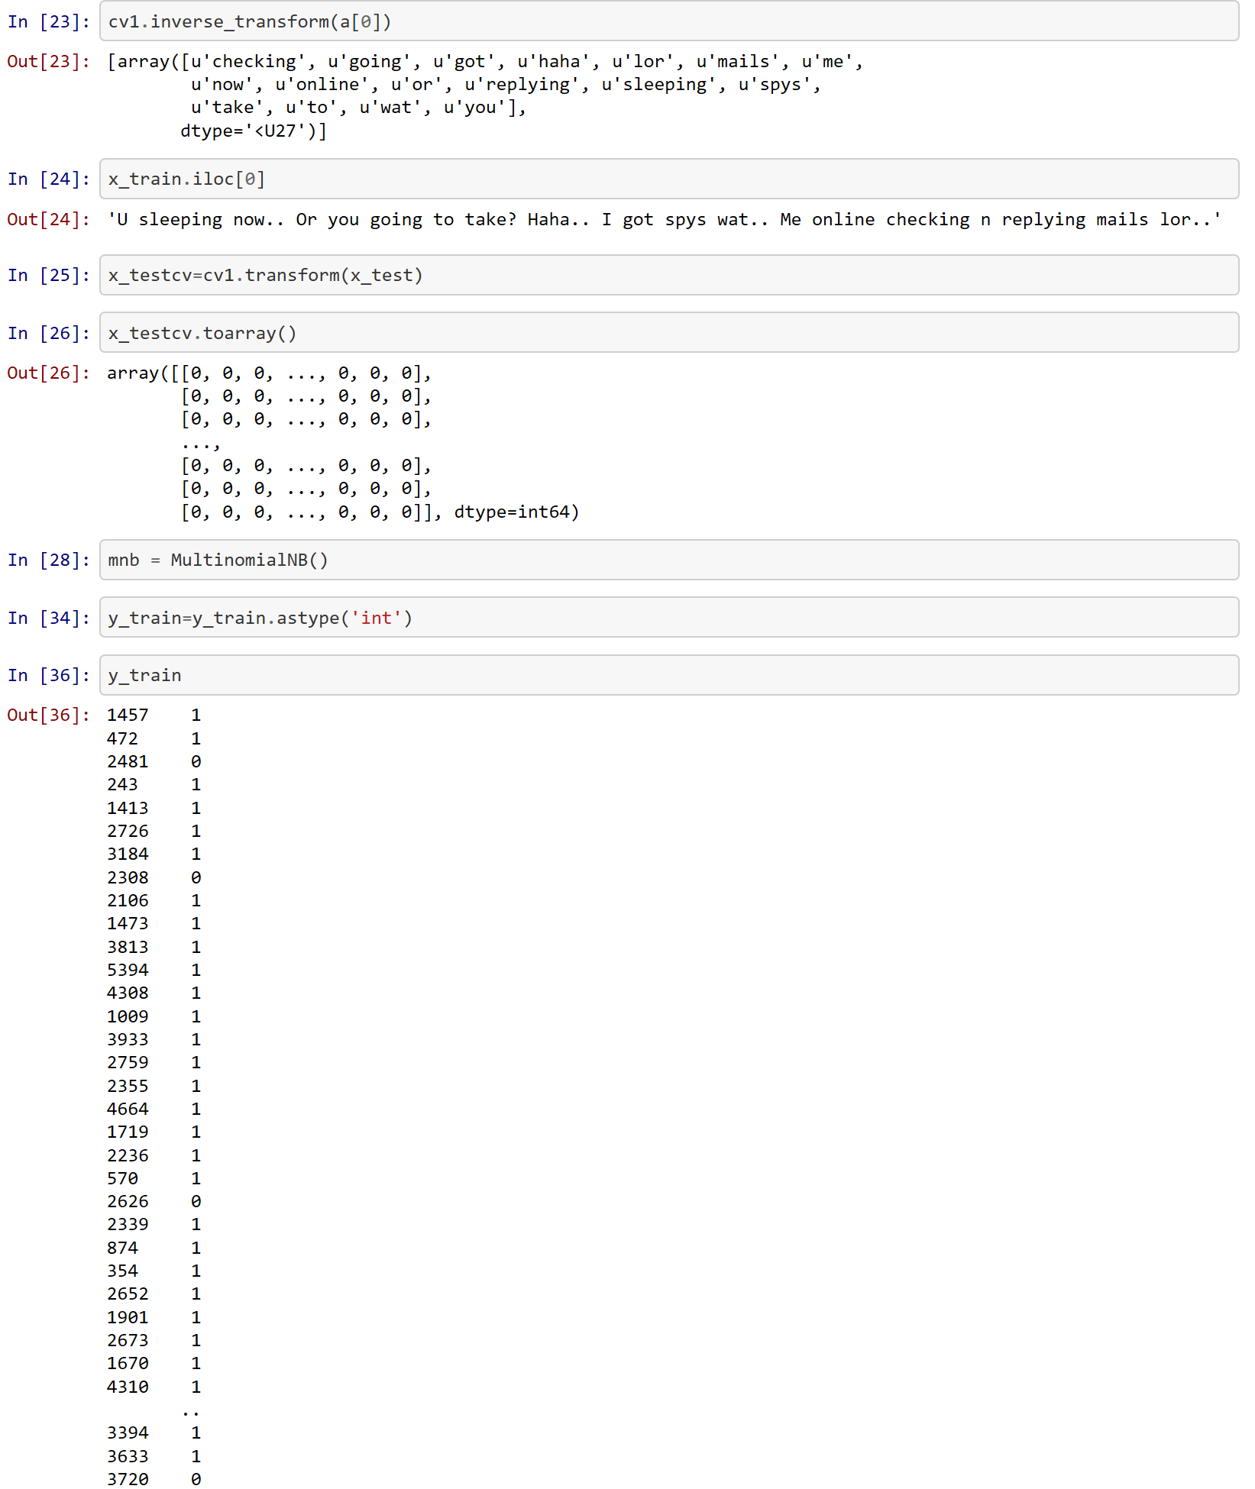
Text – Count Vectorizer

Slide 10
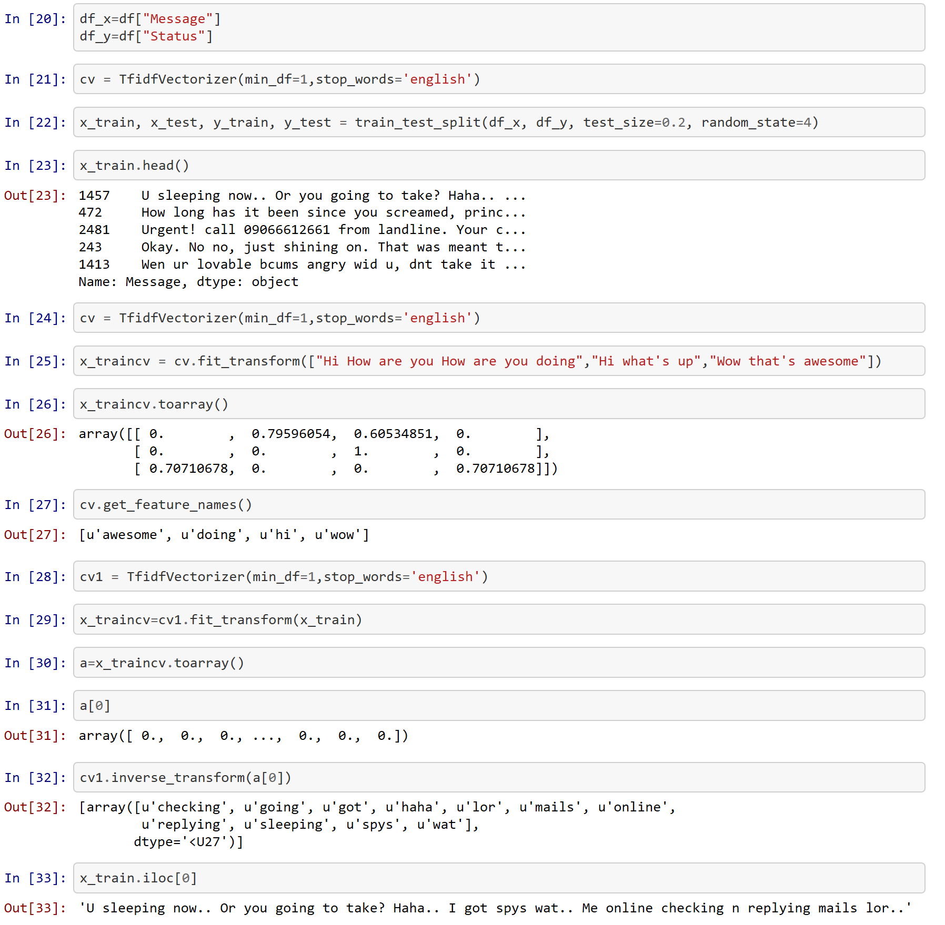
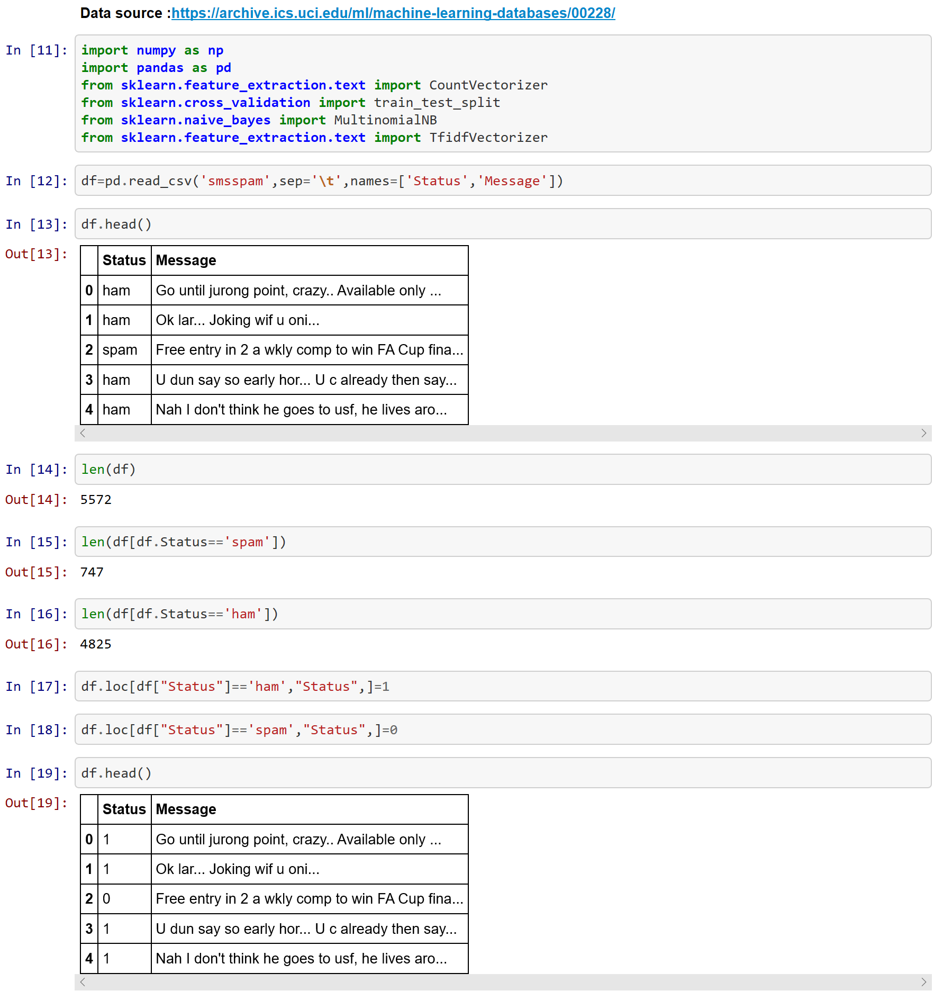
Text – TF - IDF

Slide 11
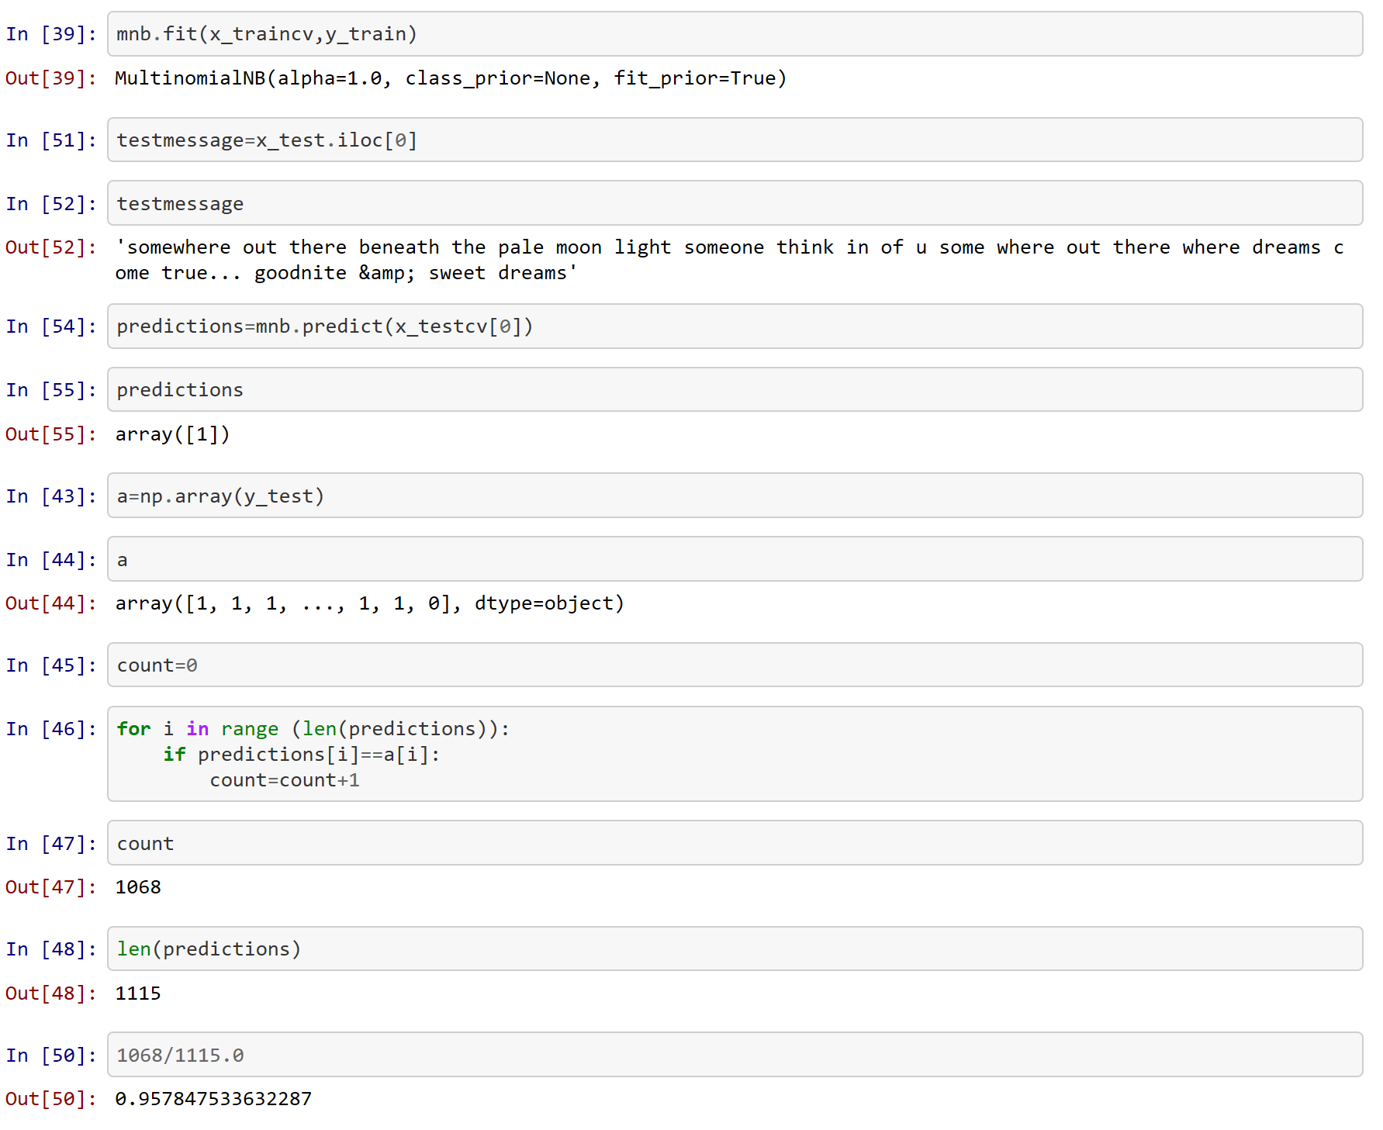
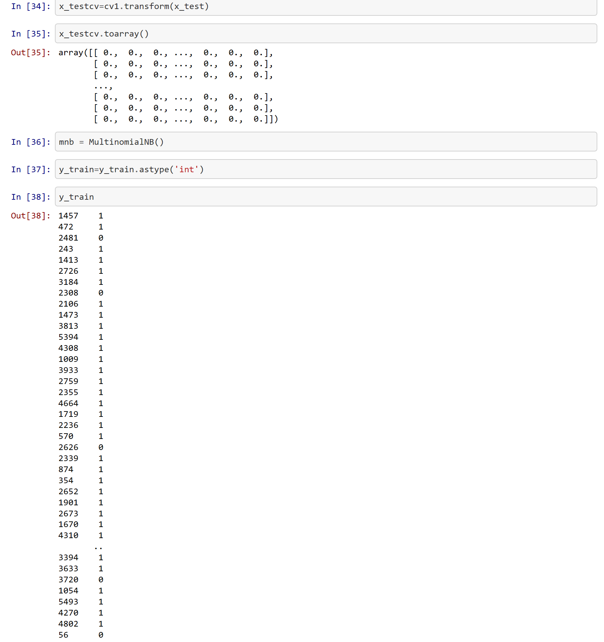
Text – TF - IDF

Slide 12
References
https://scikit-learn.org/stable/modules/feature_extraction.html#text-feature-extraction
https://github.com/shreyans29/thesemicolon
https://github.com/kavgan/nlp-in-practice/blob/master/tfidftransformer/TFIDFTransformer%20vs.%20TFIDFVectorizer.ipynb

