Slide 1



Let’s Have Some Fun!
Young Coders at Meriden
John Holden

Slide 2
Index
Code Club Quiz - kahoot
Scratch Challenges
Draw a square
Create a simple quiz

Slide 3
Scratch Challenge - Shapes
https://create.kahoot.it/details/code-club-quiz2/41b8be9f-2027-4d1f-b723-754d8cec404d
https://kahoot.it for students:
https://create.kahoot.it/login (teacher login)

Slide 4
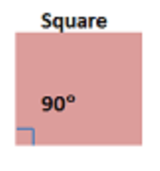
Code Club Quiz
Can you draw a square?

Slide 5
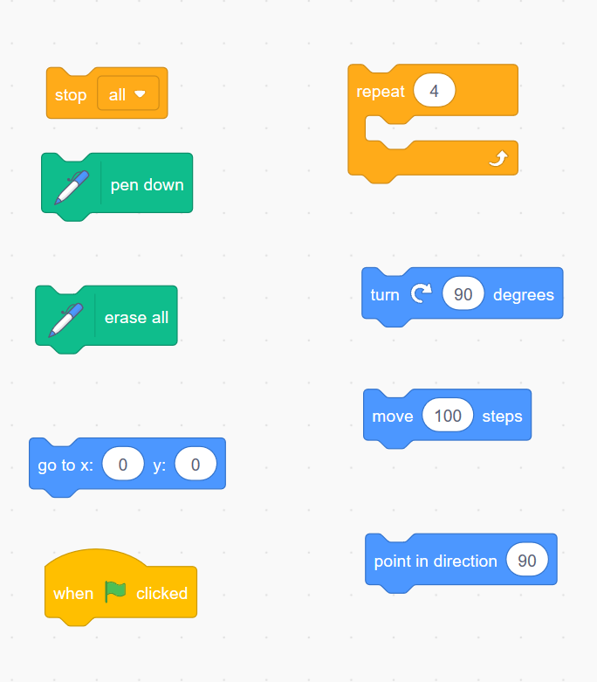
Can you draw a square?

Slide 6
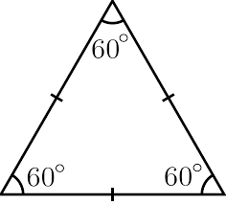
Can you a triangle?

Slide 7
Scratch Challenge - Quiz
Can you create a simple quiz?
.. Ask 2 + 2
.. Tell the user if they have got it right

Slide 8
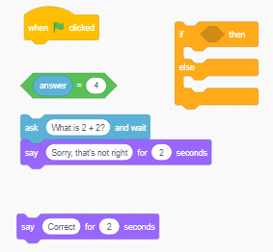
Scratch Challenge - Quiz
Put the blocks in the correct order to create a simple quiz

