Slide 1




FAKE NEWS
DETECTION
ON SOCIAL MEDIA
USING TRANSFORMER-BASED MODELS
Presented By: Hams , Randa
Supervised By: Dr: Passent Elkafrawy
CS3072
Get Started

Slide 2



problem Explanation
Problem
  The rise of social media has led to an explosive spread of information — both accurate and misleading.
  Fake news has become a major global problem, influencing public opinion, politics, health decisions, and social behavior.
  Identifying false information manually is slow, difficult, and not scalable.
  This project aims to build an automated Fake News Detection System using transformer-based machine learning models.
  By analyzing news headlines and text, the system classifies each article as REAL or FAKE with high accuracy.

Slide 3


Dataset Description
Datasets Used
For this fake news detection project, two primary datasets are utilized:
  Fake.csv: Contains articles labeled as fake news. (23,481 rows, 4 columns)
  True.csv: Contains articles labeled as true news. (21,417 rows, 4 columns)
Common Columns:
  title: The headline or title of the news article.
  text: The main body or full content of the news article.
  subject: The general topic or category of the news (e.g., 'News', 'politicsNews').
  date: The publication date of the news article.
Rationale for Selection:
These datasets were chosen because they provide a clear, labeled ground truth, essential for training and evaluating supervised machine learning models to distinguish between credible and misleading content.

Slide 4



MACHINE LEARNING MODELS

Slide 5

Model 1: TF-IDF + Logistic Regression (Baseline)
This served as our initial baseline model. Text data was transformed into numerical features using TF-IDF which quantifies the importance of words. These features were then fed into a Logistic Regression classifier, a traditional and interpretable machine learning model.
Results on Validation Set:
  Accuracy: 0.9909
  Precision: 0.9946
  Recall: 0.9881
  F1 Score: 0.9913
  Confusion Matrix: [[3194 19], [42 3480]] (19 False Positives, 42 False Negatives)
Interpretation:
This simple baseline model performed remarkably well, indicating that the dataset is highly separable and TF-IDF features effectively capture differences between real and fake news. This set a high bar for subsequent, more complex models.

Slide 6
Model 2: LSTM (Deep Baseline)
We implemented a Long Short-Term Memory (LSTM) neural network, a type of Recurrent Neural Network (RNN) particularly effective for sequential data like text. The LSTM model processes text word-by-word, capturing long-range dependencies and context.
  Training: The model was trained for 3 epochs using binary_crossentropy loss and the adam optimizer.
Results on Validation Set:
  Accuracy: 0.9987
  Precision: 0.9983
  Recall: 0.9991
  F1 Score: 0.9987
  Confusion Matrix: [[3207 6], [3 3519]] (6 False Positives, 3 False Negatives)
Interpretation:
LSTM significantly improved upon the baseline, demonstrating its ability to understand the sequential nature of text and further reduce classification errors. Its high performance confirmed the value of deep learning for this task.

Slide 7
Model 3: BERT (Transformer-based)
We fine-tuned BERT (Bidirectional Encoder Representations from Transformers), a state-of-the-art model that processes text bidirectionally to learn deep contextual relationships between words. This allowed for a much richer understanding of linguistic nuances.
  Training: The model was trained for 2 epochs using a custom optimizer and SparseCategoricalCrossentropy loss.
Results on Validation Set:
  Accuracy: 0.9991
  Precision: 0.9989
  Recall: 0.9994
  F1 Score: 0.9991
  Confusion Matrix: [[3209 4], [2 3520]] (4 False Positives, 2 False Negatives)
Interpretation:
BERT achieved outstanding performance, surpassing the LSTM model with the highest accuracy and lowest number of false predictions. This highlights the superior capability of pre-trained transformer models in grasping complex language patterns for highly accurate classification.

Slide 8
Model 4: RoBERTa (Optimized Transformer)
RoBERTa (Robustly Optimized BERT Pretraining Approach), an optimized version of BERT, was also fine-tuned. RoBERTa improves upon BERT's pre-training by using modified hyperparameters and larger training batches, often leading to even better performance.
  Training: The model was trained for 2 epochs with a custom optimizer and SparseCategoricalCrossentropy loss.
Results on Validation Set:
  Accuracy: 0.9985
  Precision: 0.9983
  Recall: 0.9989
  F1 Score: 0.9986
  Confusion Matrix: [[3207 6], [4 3518]] (6 False Positives, 4 False Negatives)
Interpretation:
RoBERTa also performed exceptionally well, very close to BERT's performance. While slightly trailing BERT in this specific validation scenario, it reinforced the effectiveness of advanced transformer architectures for fake news detection.

Slide 9
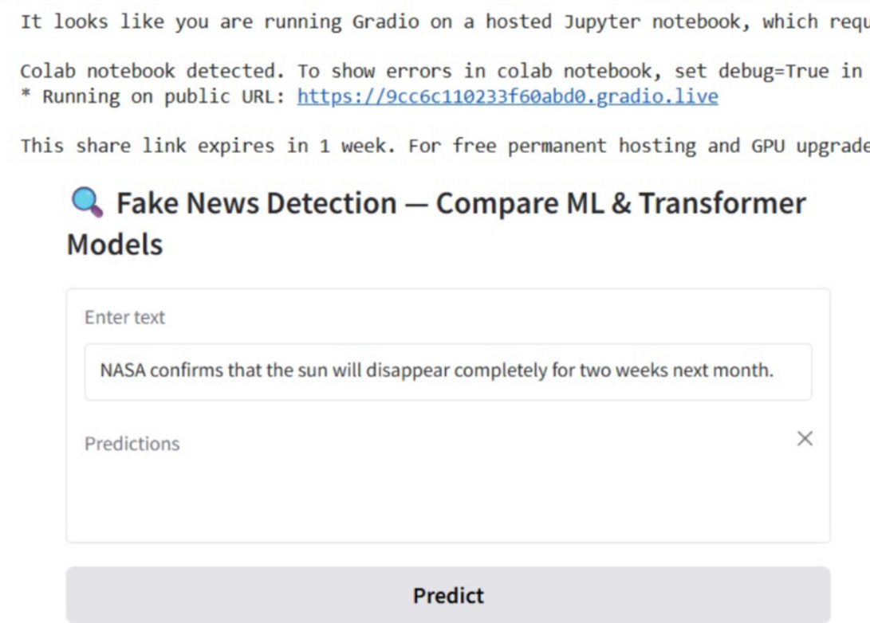
Interface
What it Is:
We developed a user-friendly interactive interface using the Gradio library. This tool allows anyone to test our trained models in real-time, providing an accessible platform for immediate fake news detection.
How Users Can Use It:
  Input Text: Users simply type or paste any news article or social media post into a designated text box.
  Predict: Upon clicking the 'Predict' button, the input text undergoes cleaning and is then simultaneously processed by all four trained models (Logistic Regression, LSTM, BERT, and RoBERTa).
  View Results: The interface instantly displays the predictions from each model (classified as 'REAL' or 'FAKE') side-by-side. This allows users to:
    Experience real-time detection.
    Compare how different models classify the same content.
    Validate the robustness of our solutions in a practical setting.

Slide 10
Problem
Outcomes and Results
  Model achieved high accuracy on validation and test data.
  Loss decreased steadily during training.
  Precision and recall show strong performance for both classes.
  Confusion matrix shows the model correctly differentiates REAL vs FAKE.
  Outcome: A reliable and scalable fake-news detection system.

Slide 11

THANK YOU

