Slide 1

GUI Library system
Hams Ali
CS 2132
Dr. Mohammad Nauman

Slide 2
Project discerption
The Simple Library Management System simplifies library operations, allowing easy book and patron management. It ensures data accuracy, offers intuitive interfaces, and uses Object-Oriented Programming principles. Future plans involve database integration for scalability and data persistence.

Slide 3

This program will solve :
1. Sorting Algorithm : used to arrange books alphabetically by title or author, enabling efficient browsing for patrons.
2. Book Recommendation Algorithm : suggests books to patrons based on their interests and borrowing history, enhancing their library experience.
benefits of the library management system program
Efficient book management: Add, remove, and check book availability.
Patron registration: Keep track of patrons borrowing books.
Easy-to-use interface for both librarians and patrons.
Scalable to accommodate various library sizes.
Error handling for smooth operation.

Slide 4
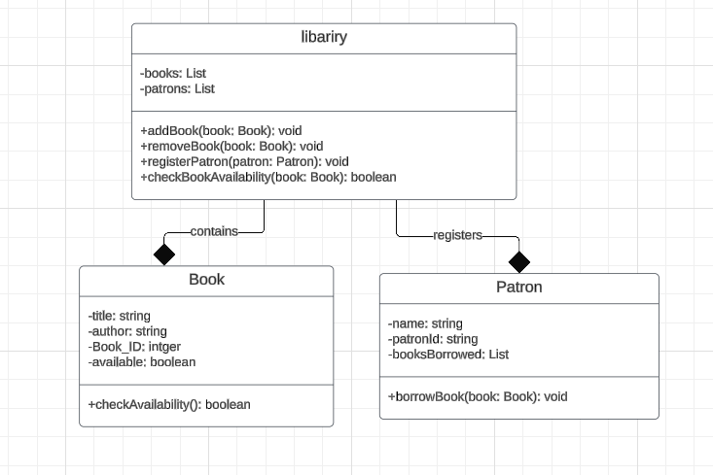
IMPLEMENT CLASSES FOR THE FOLLOWING ENTITIES
Book: Represents a book with attributes such as title, author, Book ID , etc.
Patron: Represents a library patron with attributes such as name, ID, etc.
Library: Represents the library itself, responsible for managing books, patrons,.

Slide 5
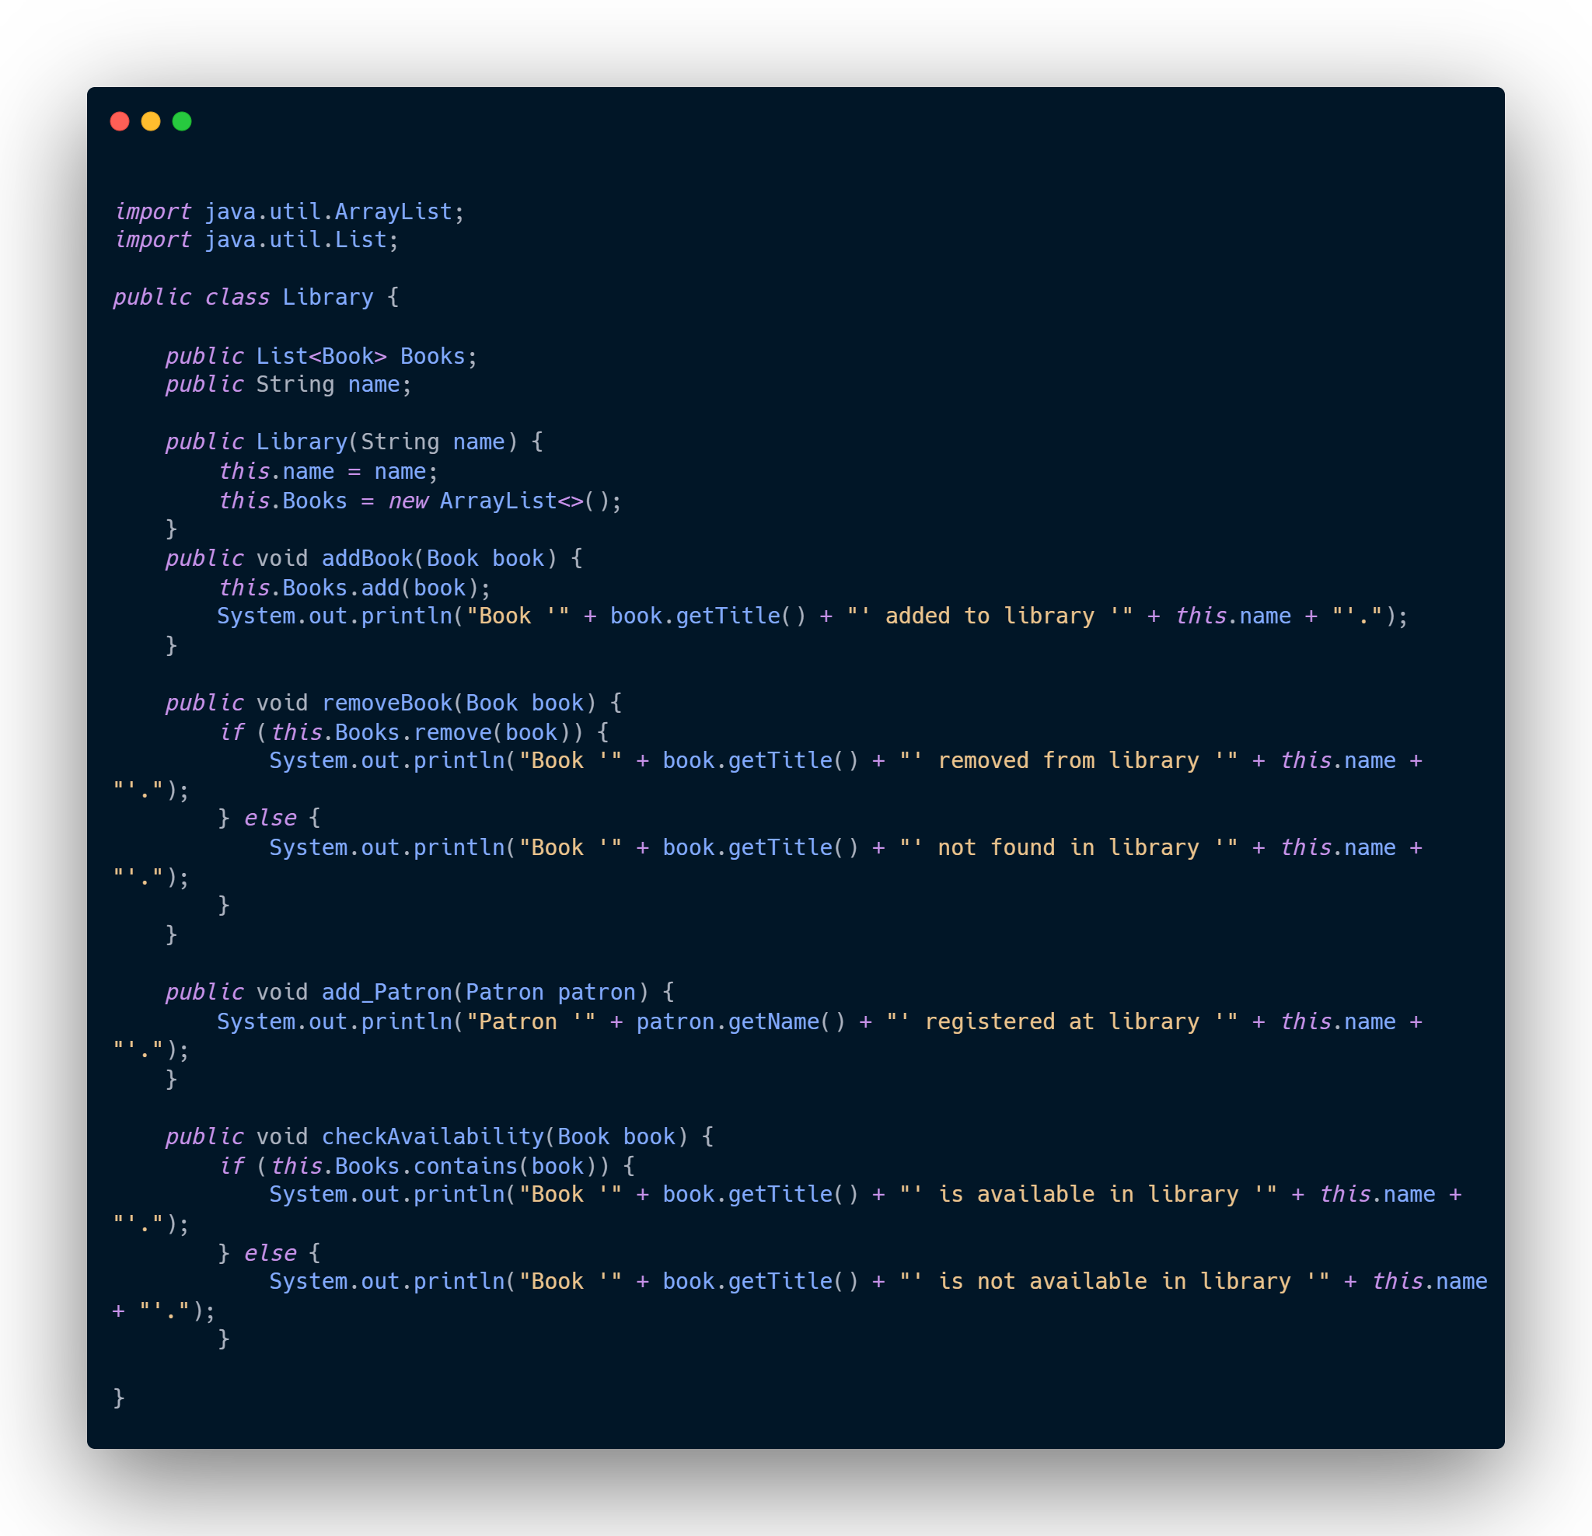
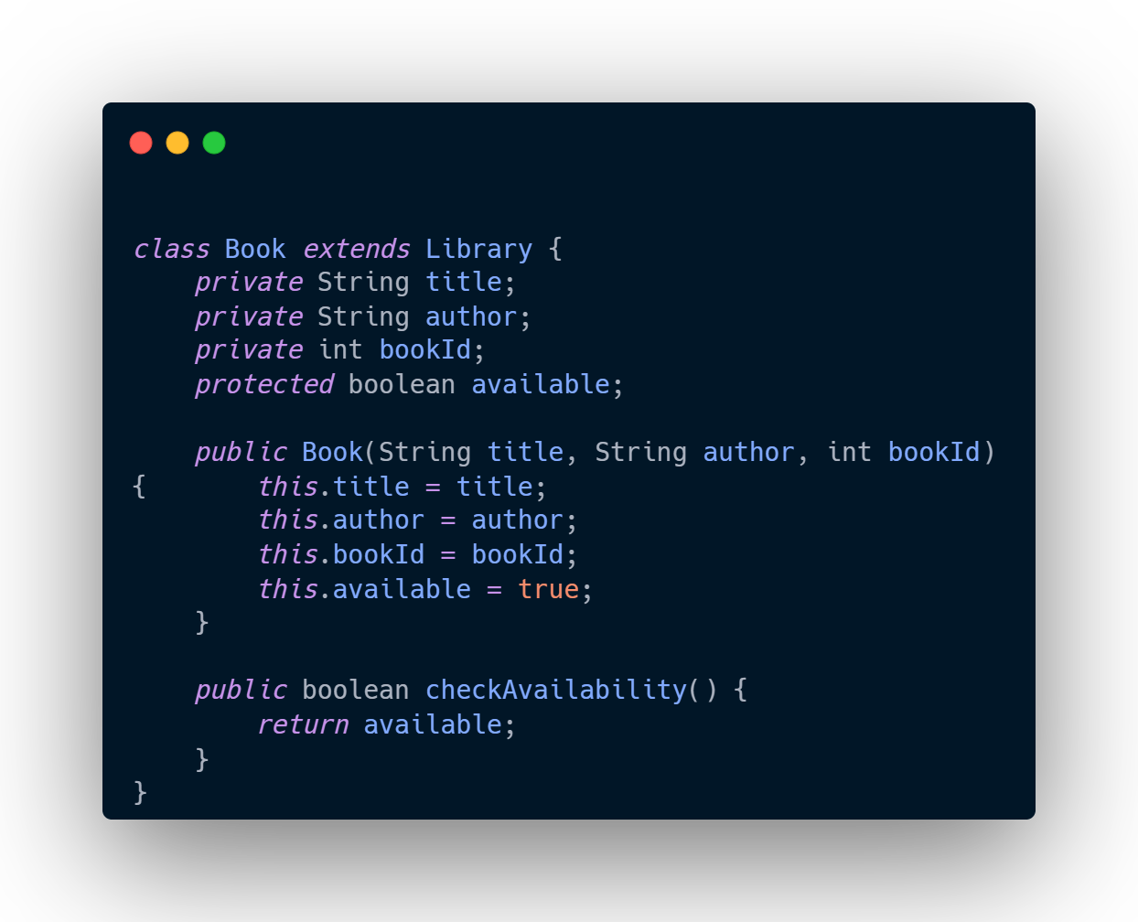
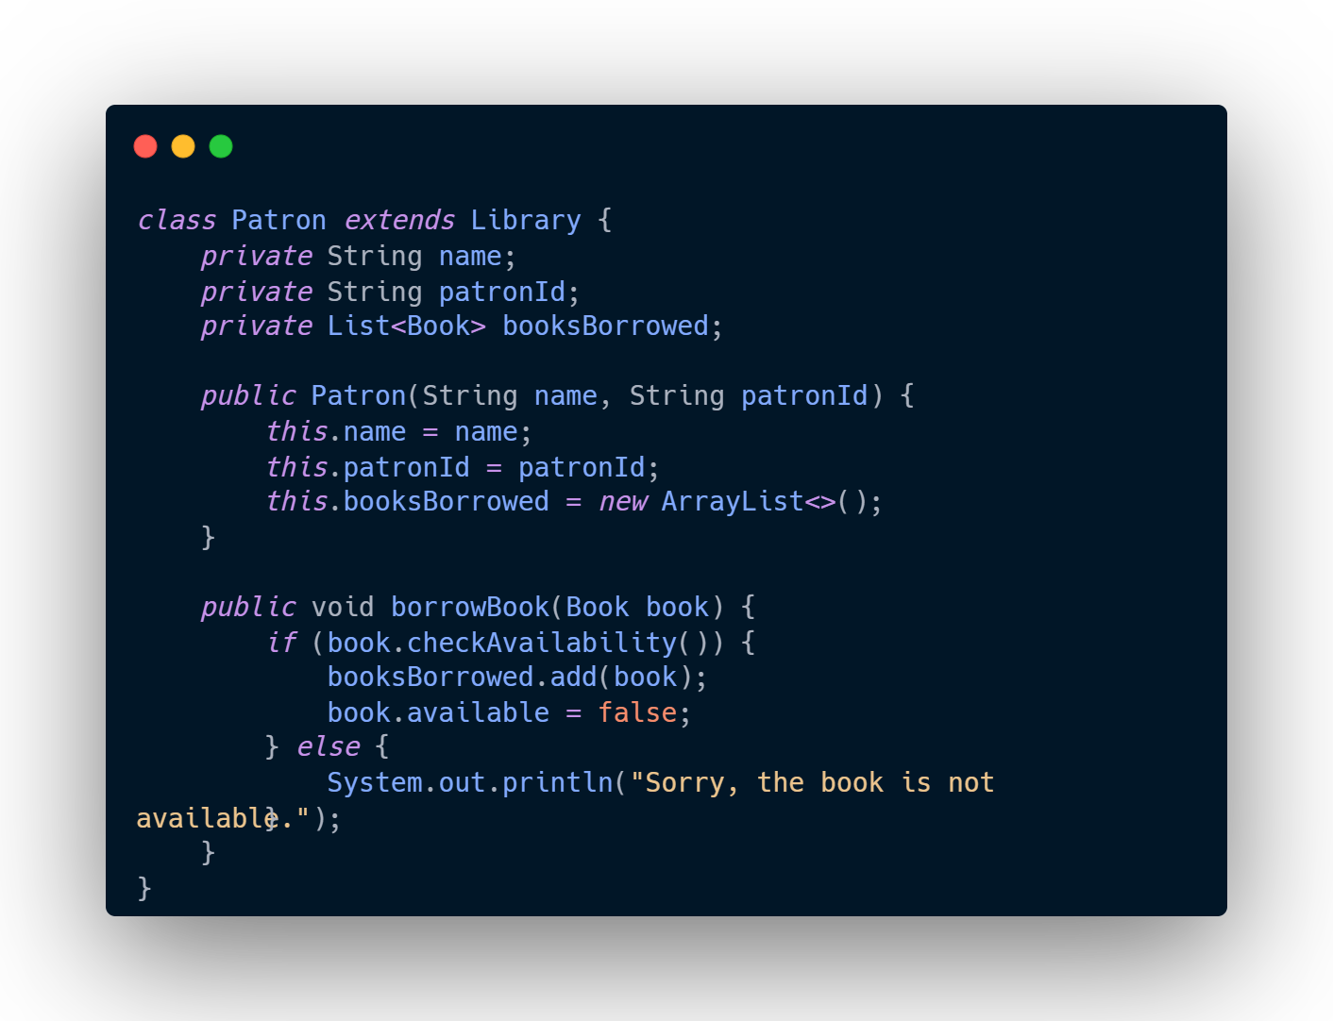
Implements the class before the GUI

Slide 6
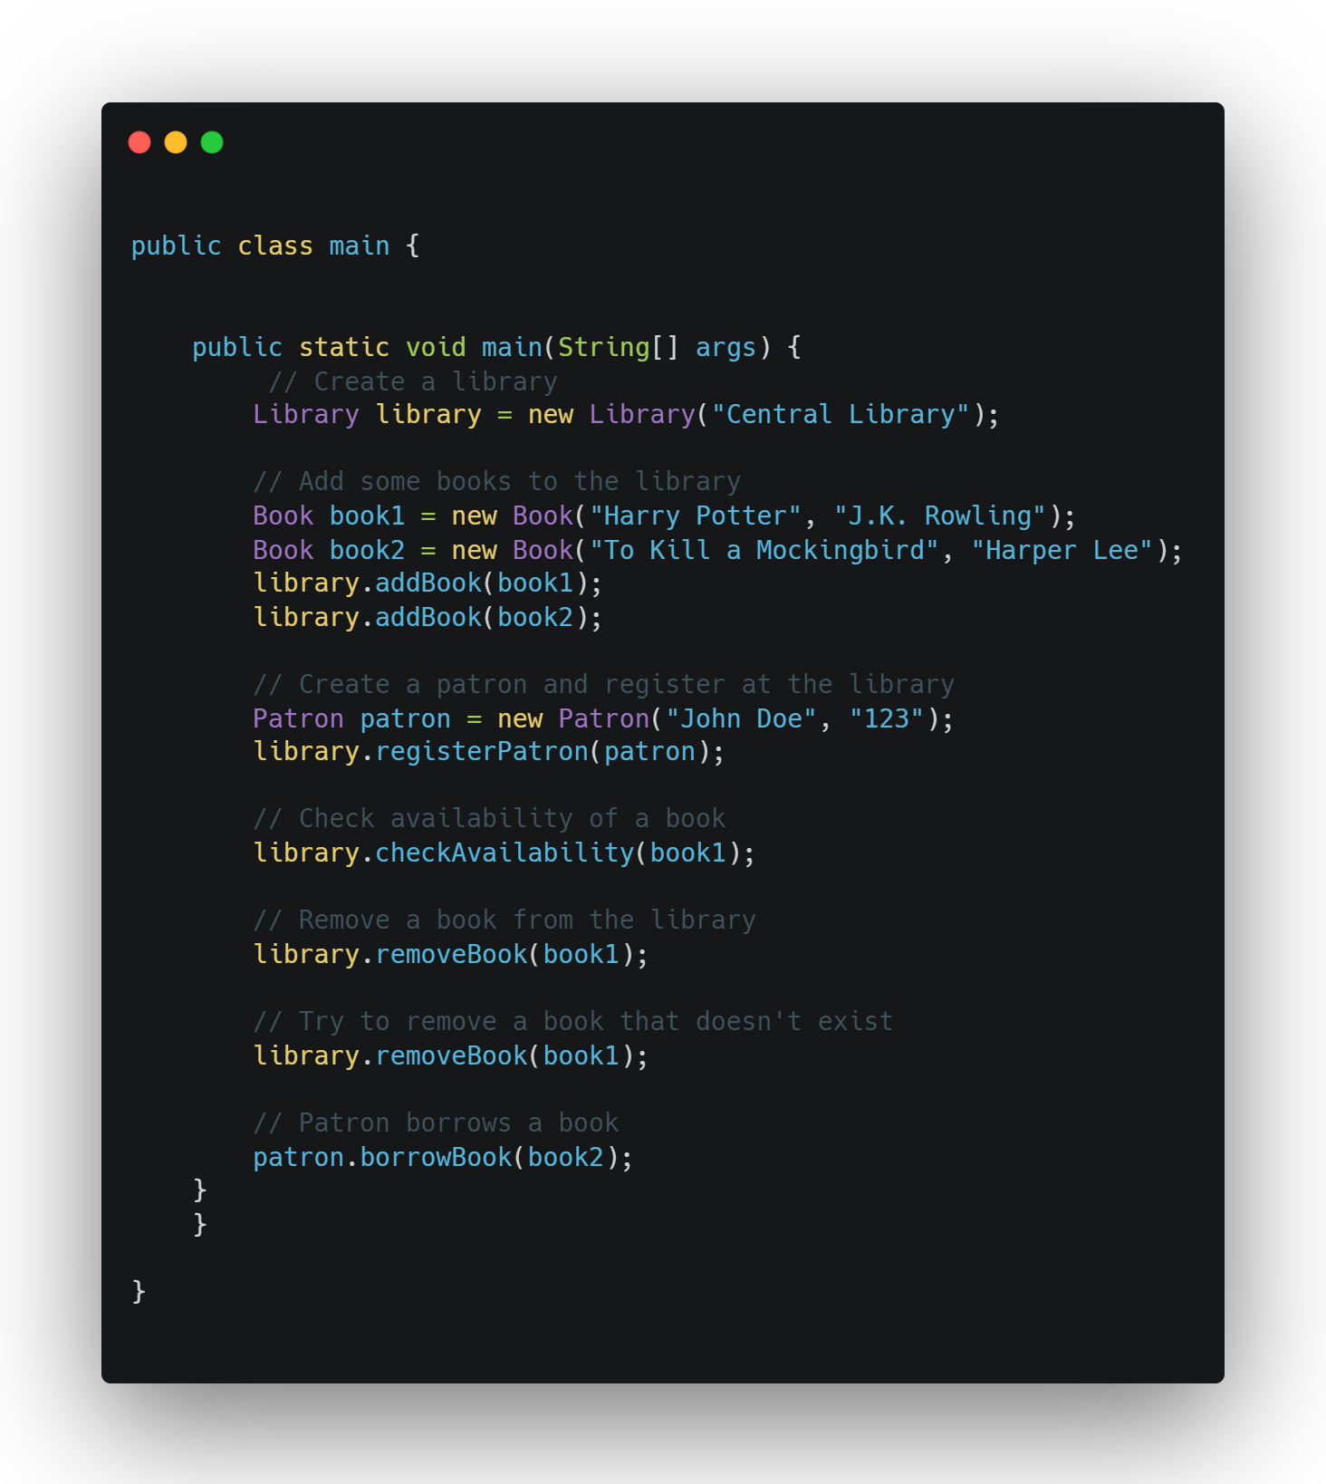
Main class
The Main class will collect all the classes and create an object. Here we notice that we have created a new object from the library.

Slide 7
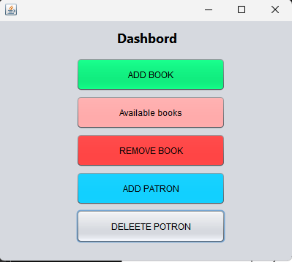
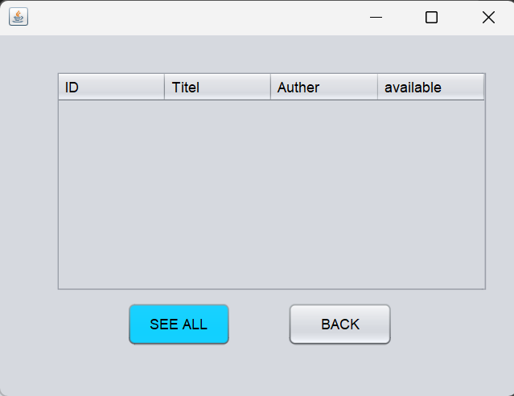
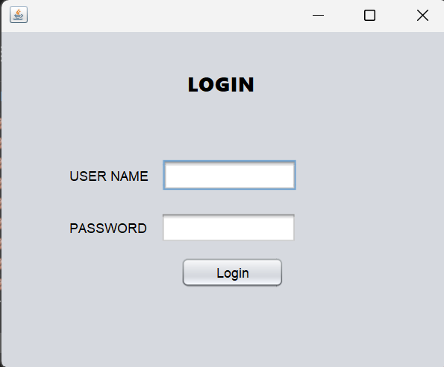
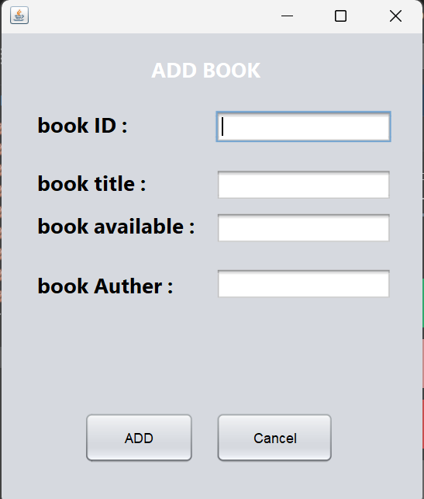
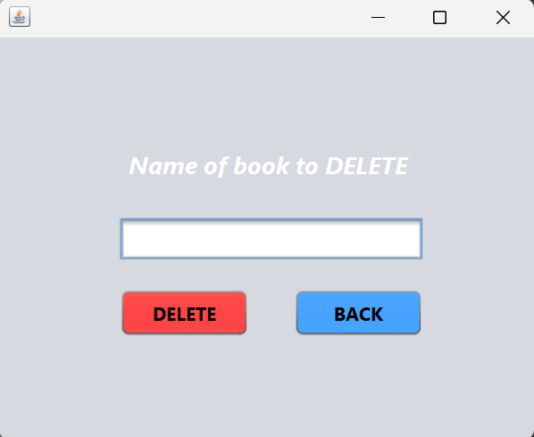
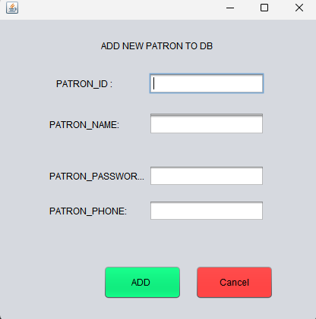
Some OF GUI FRAME Desain
some pictures of graphical interfaces and how they are interconnected

Slide 8
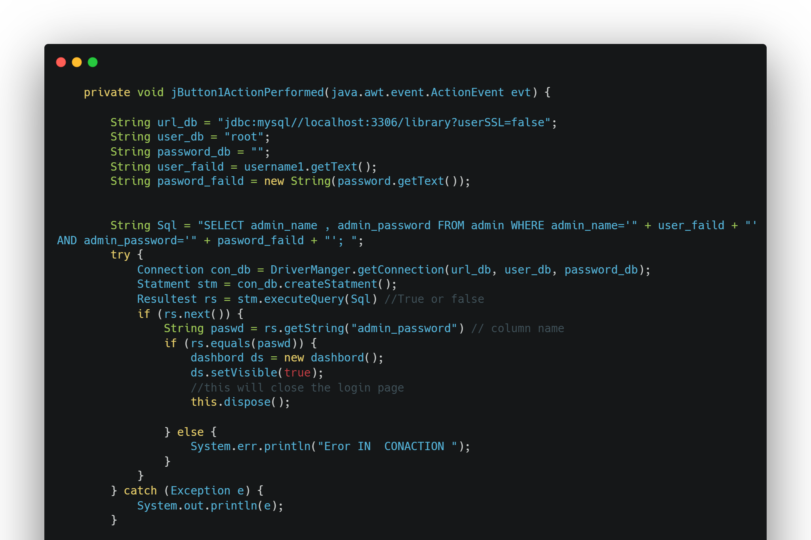
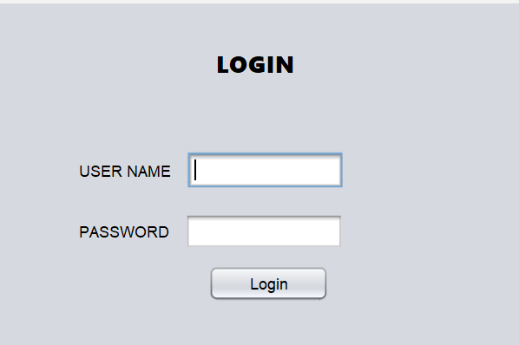
Login functionality :
When the user clicks on login, it takes the two values from the user and executes the query that verifies the admin name and password in the database.

Slide 9
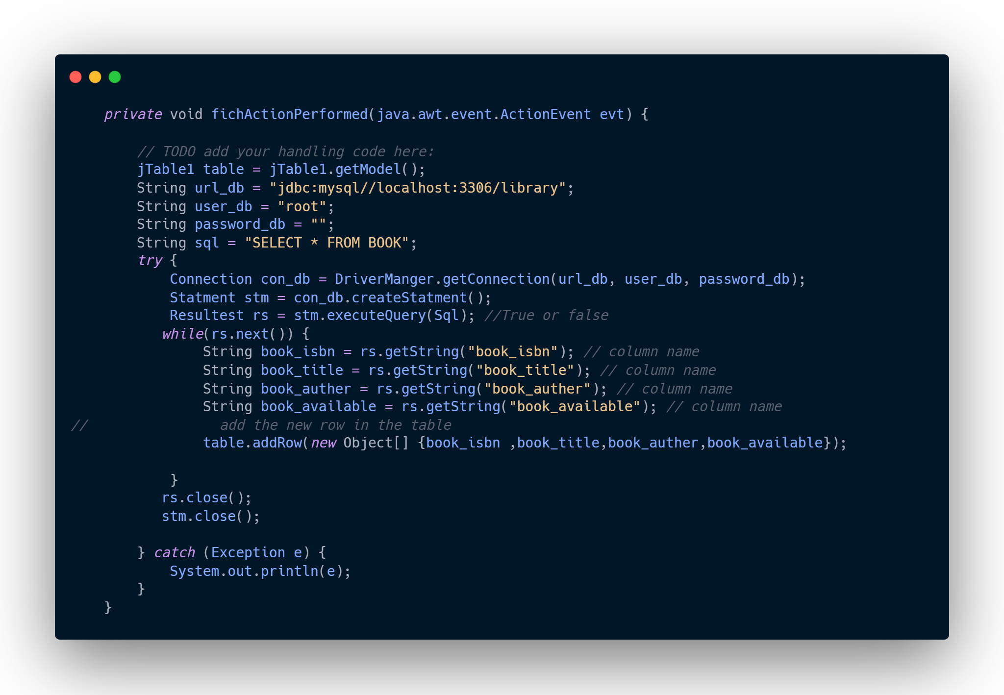
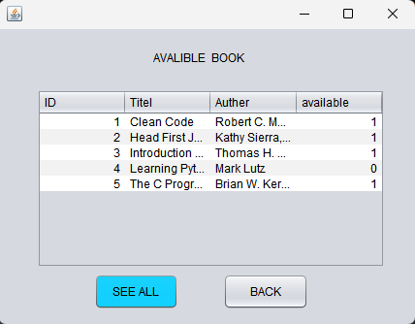
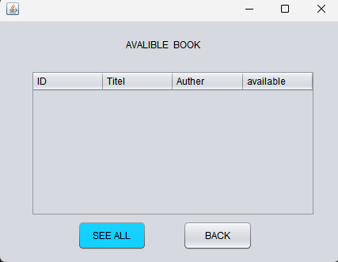
Book Available functionality
To find the available books and their details, we click on the button and then we fetch the details of the books from the database from the books table, then we store the data in the table object .

Slide 10
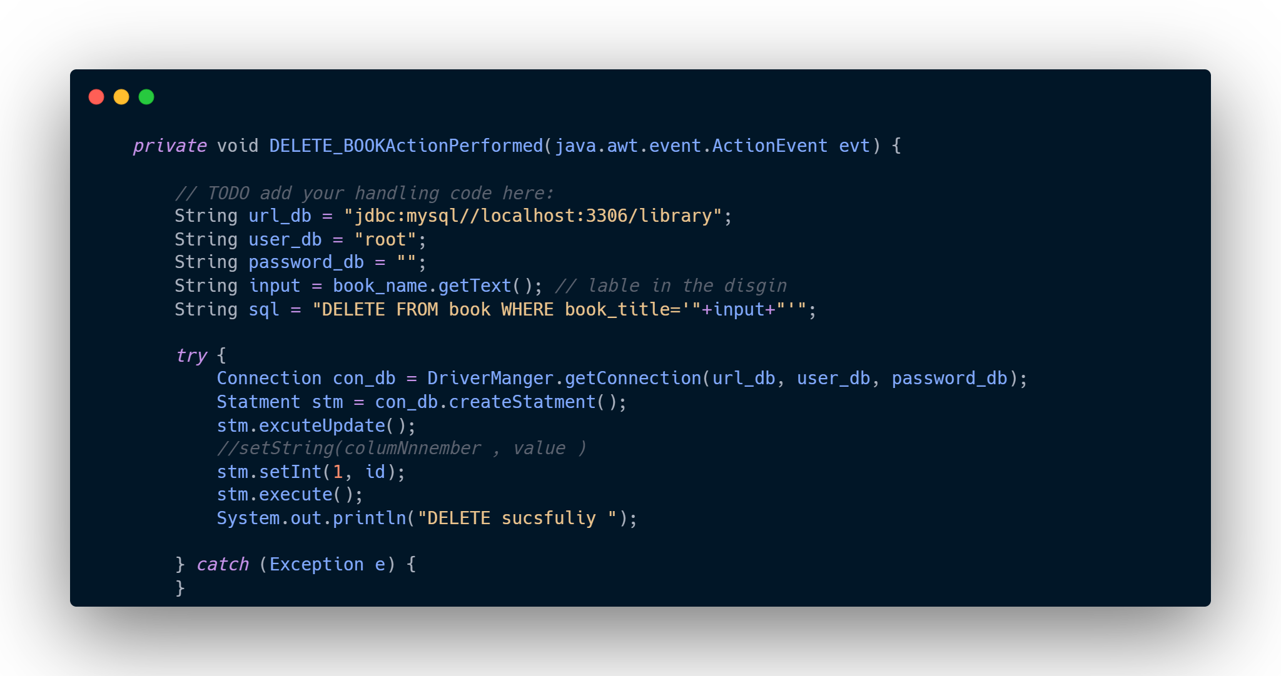
When we press the delete button, the program will see that it takes the value from the field and searches the database for the book that needs to be deleted. If it finds it, it will delete it.
Book DELETE functionality

Slide 11
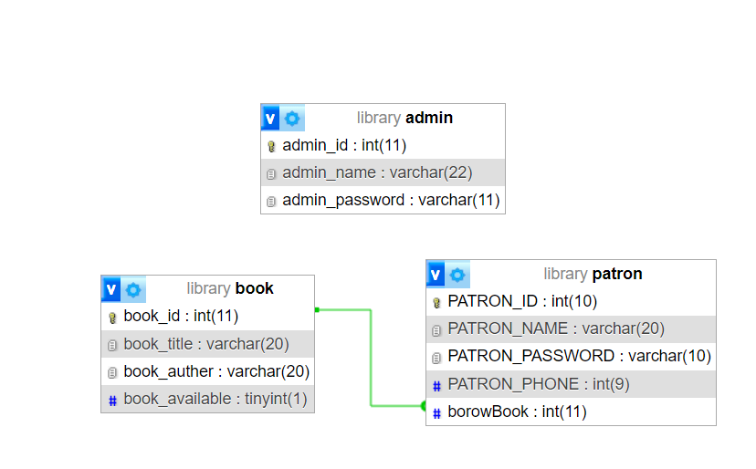

Database TABLES

Slide 12
Thank you

