Slide 1

RAG Beyond the Demo
How we turned a promising retrieval-augmented generation prototype into a insurance claims adjudication system — with the evaluation, guardrails, and operational patterns that actually made it work.

Slide 2
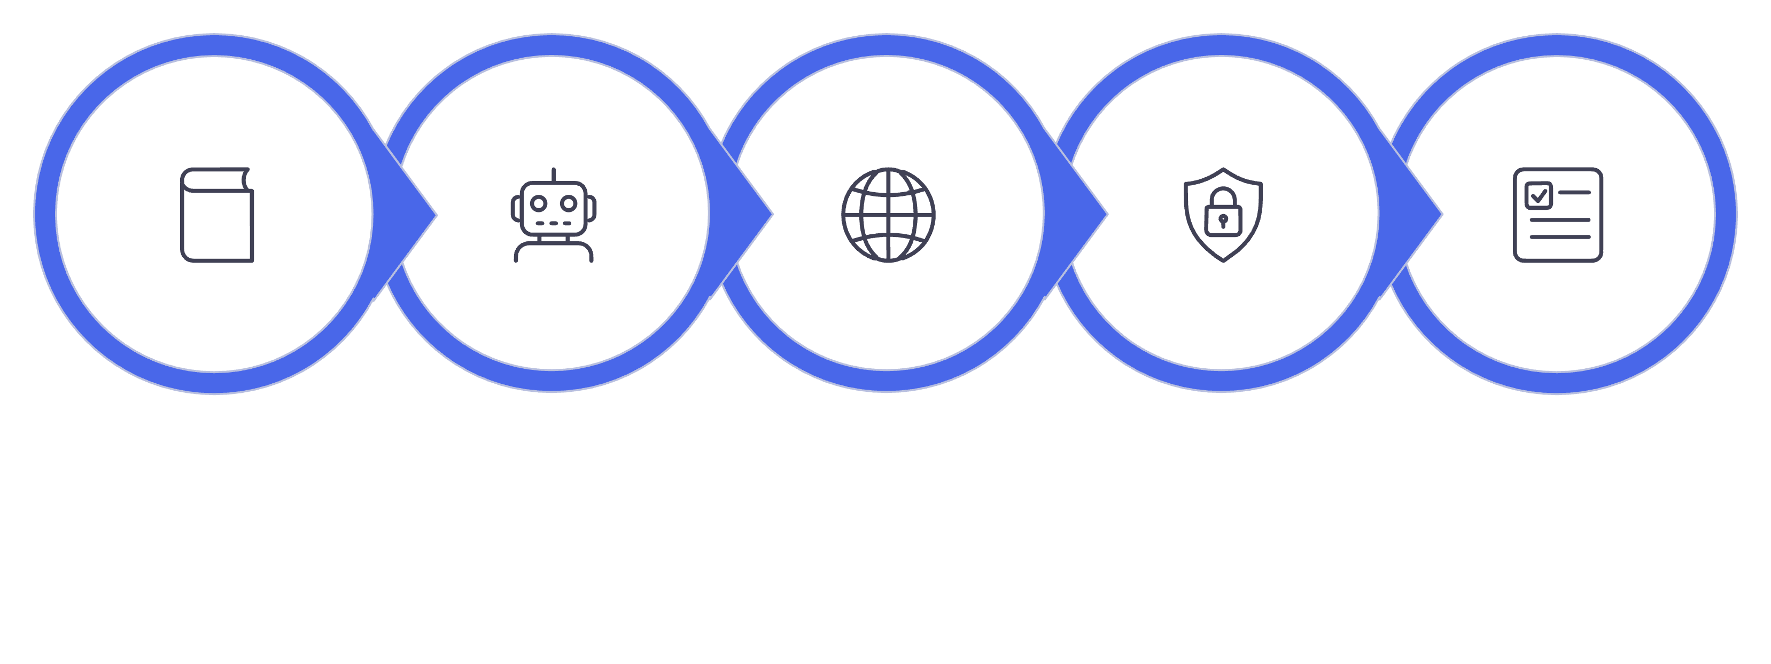
AGENDA
Agenda
Inside Domain Copilot
RAG Foundations
Real-World RAG
Security & Access
Evaluation & Lessons

Slide 3
Case Study
Domain Copilot: RAG in Insurance Claims Adjudication
Today, we’ll explore how Retrieval-Augmented Generation (RAG) operates within a real-world insurance claims adjudication system.We’ll meticulously follow the journey from:
Document Ingestion & Retrieval · Grounded Answers · Failures & Debugging · Security & Guardrails
Instead of just theoretical discussions, we will dive into the real bugs we encountered and the real fixes we implemented to ensure system reliability and accuracy.

Slide 4
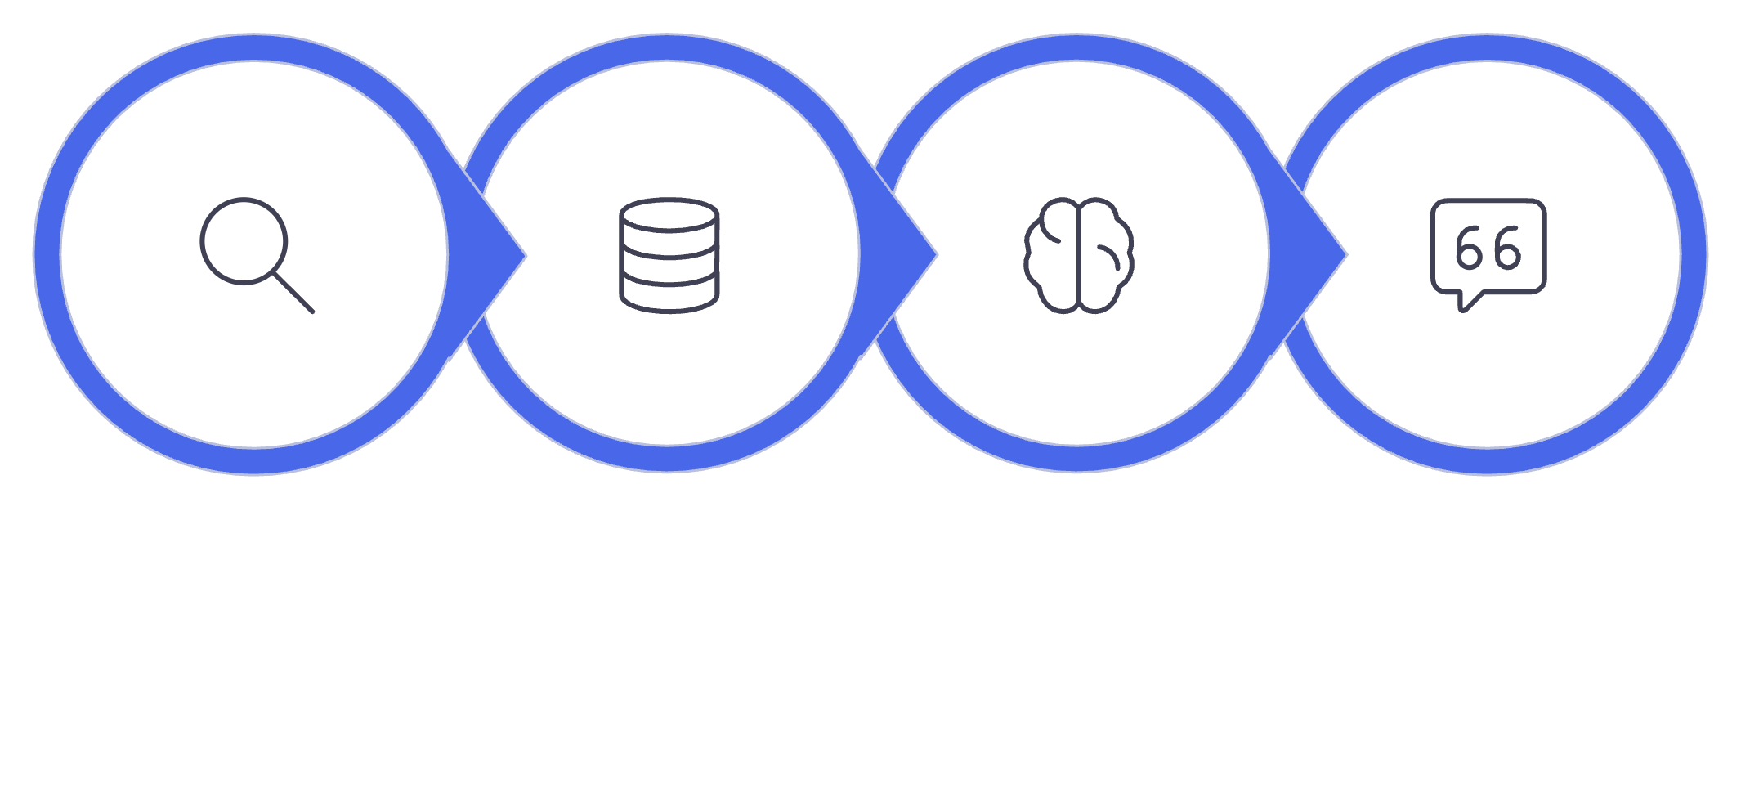
What RAG Actually Is
Retrieval-Augmented Generation means: first retrieve the most relevant text, then generate an answer constrained by that text. The LLM does not "know" your documents in advance — you surface the right context at query time. There are no weight changes and no fine-tuning required.
Key insight: RAG is really about separation of concerns. The retriever is responsible for finding useful context; the LLM is responsible for reasoning over it. That division is powerful, but it also means production RAG can fail in many places: retrieval quality, chunking, ranking, context limits, and generation all matter.
Query
Retrieve
Generate
Return
The retriever acts like a librarian, finding the right pages. The LLM acts like a subject-matter expert, reading those pages and answering the question in context.

Slide 5

Why the Basic RAG Isn't Enough
A demo retrieves something relevant once, on a clean query. Production is a different discipline entirely.
Document drift
Wrong policy versions, superseded clauses, conflicting endorsements
Adversarial queries
Users who phrase questions to bypass grounding constraints
Partial evidence
When the corpus genuinely lacks an answer, "I don't know" is the correct response
Concurrent load
Multiple users, streaming outputs, shared vector stores under real traffic

Slide 7
RAG vs. LLM-Only Generation
Dimension | LLM-Only | RAG
Grounding | None — trained knowledge only | Retrieved document text
Confidence | High, even when wrong | Constrained by evidence quality
Policy limits | May confidently state wrong figures | Cited from actual clauses
Payout math | LLM calculates (risky) | Deterministic Python only
The Key Architectural Decision
Use the LLM for reasoning over evidence — not for deterministic business logic.
calculate_payout() performs the actual payout calculation in Python, independently of the LLM.
RAG grounds the decision. Deterministic code controls the numbers.

Slide 8
Chunking: Why It Matters Here
Numbered-heading chunking
Chunks are split by numbered section heading — "1. Declarations", "5. Exclusions" — not by fixed token windows. Citations must map to a real policy clause, not an arbitrary text span.
heading_match = HEADING_RE.match(line)
if heading_match: current_section_num = heading_match.group(1) current_section_title = ( f"{current_section_num}. {heading_match.group(2).strip()}" ) clause_counter = 0
Real bug discovered
A PDF line-wrap placed "0026. Policy Period: from…" at the start of a visual line. The regex matched it as a section heading, creating a spurious chunk boundary. Fixed by tightening the heading pattern to require a word boundary and a substantive title.

Slide 9

Embeddings: What They Actually Represent
A vector encoding semantic similarity — not understanding, not fact-checking. Two embedding models are deliberately decoupled from the completion model.
OpenAI text-embedding-3-small
Ollama nomic-embed-text
1,536 dimensions — used when OpenAI is the active EMBEDDING_PROVIDER
768 dimensions — local, self-hosted alternative with a different vector space
EMBEDDING_PROVIDER and LLM_PROVIDER are independent settings. Swapping one does not require changing the other — but dimension mismatches will break ingestion.

Slide 10
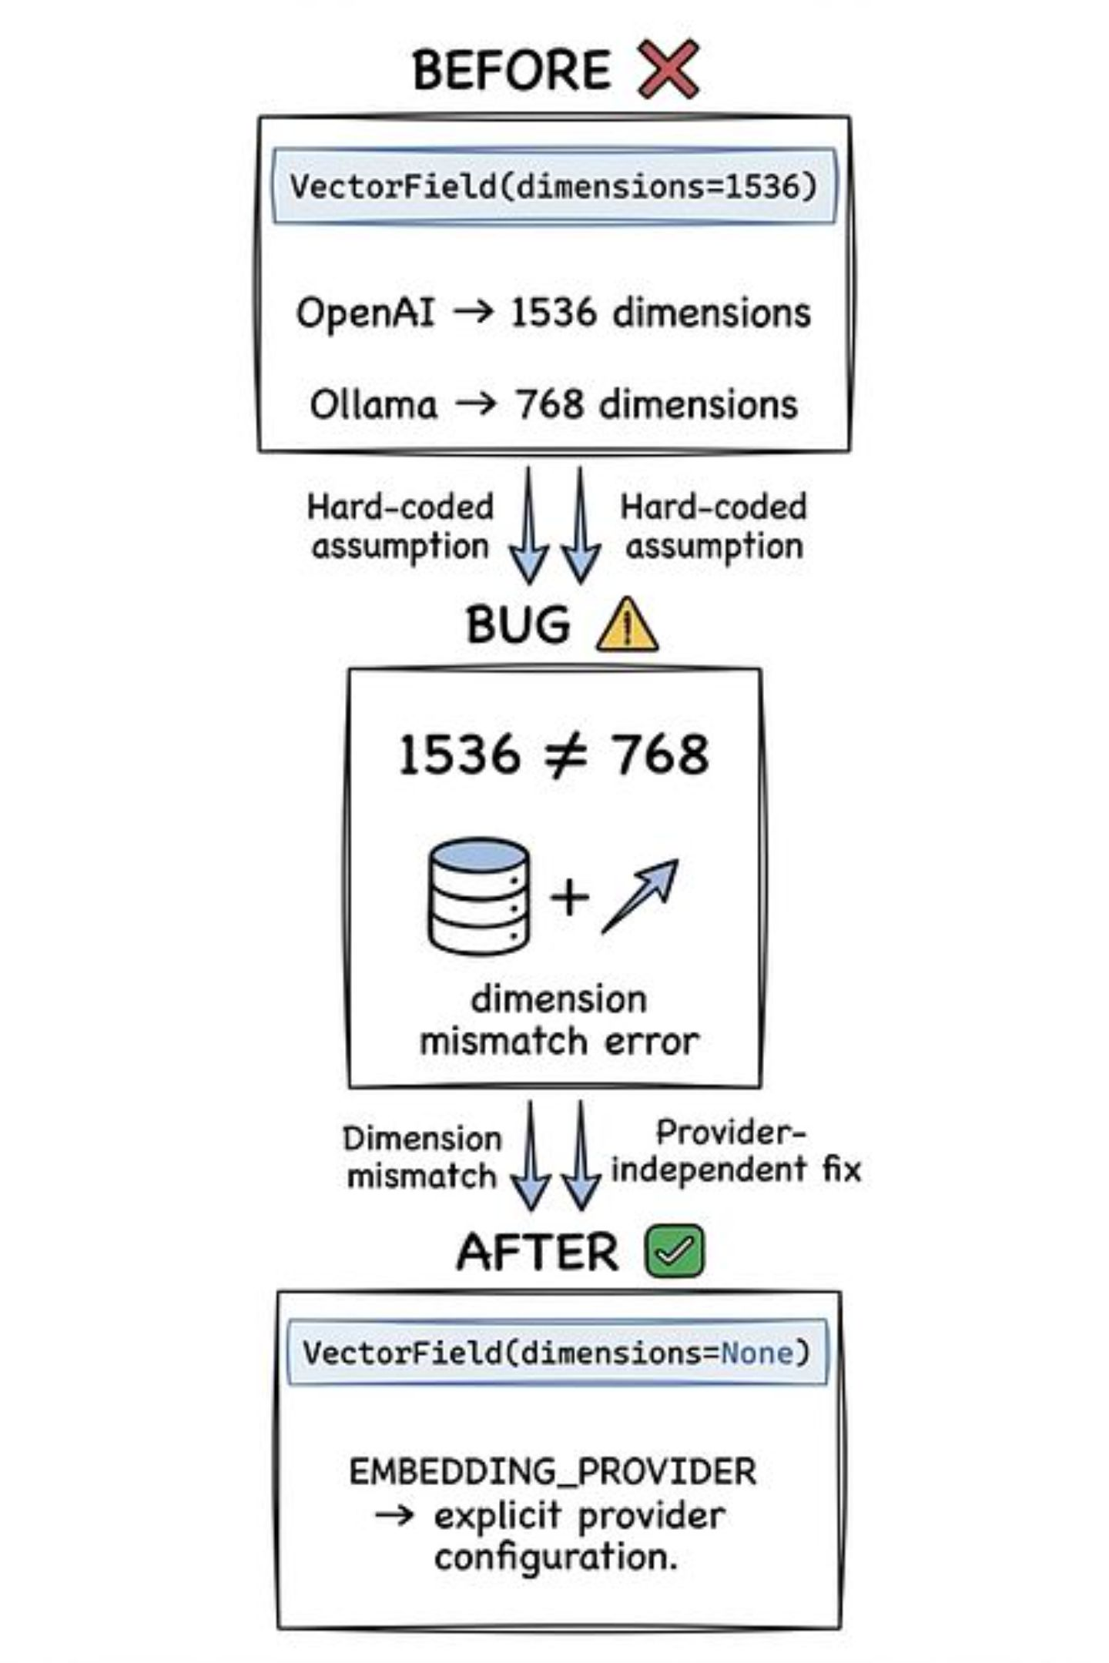
Real Bug: Embedding Dimension Mismatch
When DocumentChunk.embedding was defined as VectorField(dimensions=1536), ingesting with Ollama active caused immediate insert failures — the vector length did not match the schema.
1
Root cause
Hard-coded dimension assumed OpenAI; Ollama produces 768-dim vectors
2
The fix
Unconstrained pgvector column + EMBEDDING_PROVIDER as its own explicit setting, with no fallback chain
3
The principle
Provider assumptions must never be implicit — every model choice is an architectural contract

Slide 11
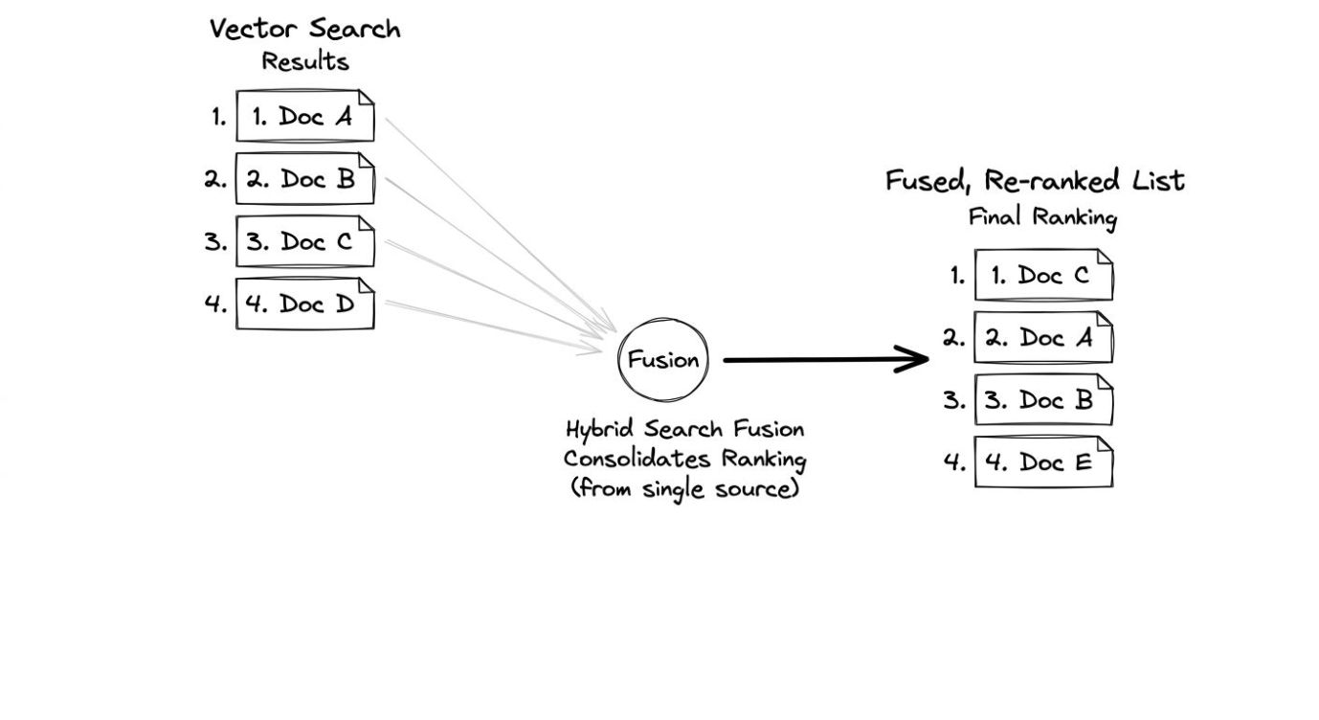
Hybrid Retrieval
Hybrid Retrieval
Dense Retrieval
Utilises DenseRetriever with pgvector for semantic search, measuring similarity via cosine distance.
Keyword Retrieval
Employs KeywordRetriever leveraging Postgres full-text search (SearchRank) for exact term matching.
These two retrieval methods are combined using Reciprocal Rank Fusion (RRF). Unlike a simple weighted average, RRF combines the strengths of both systems by assigning scores based on an item's rank in each list, resulting in a robust, fused list that prioritises highly ranked documents from either source.

Slide 12
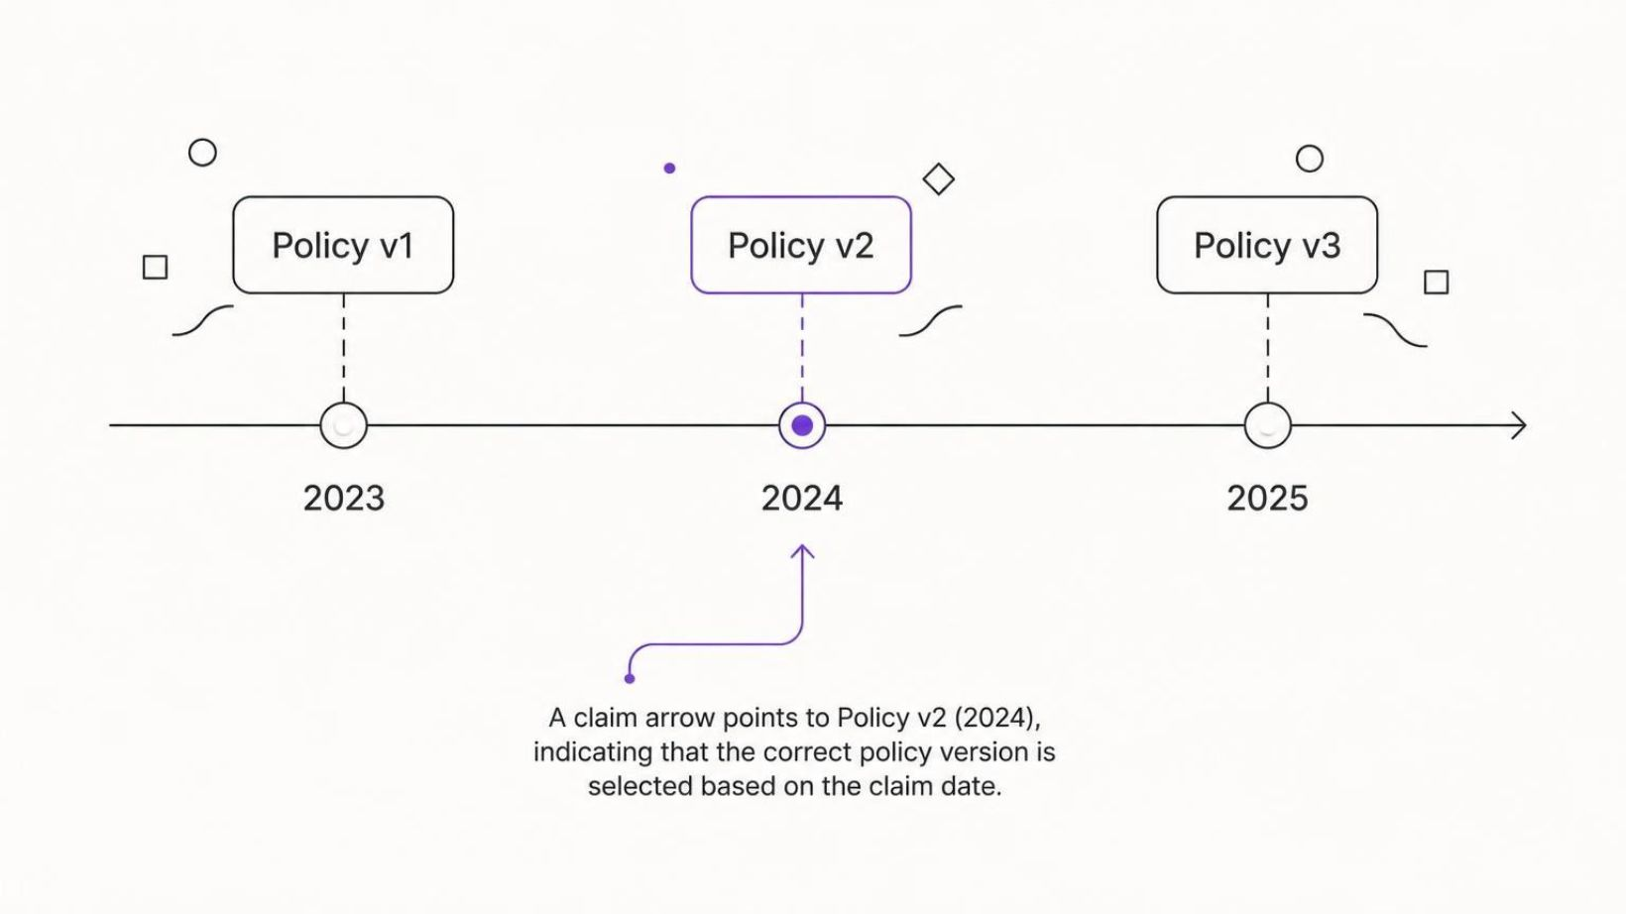
Metadata Filtering: The Policy-Version Problem
A critical named domain risk was retrieving the wrong policy version for a claim's specific date of loss, leading to inaccurate information.
To mitigate this:
A get_policy_version tool is invoked to resolve the correct PolicyVersion based on the claim_date before any retrieval occurs.
Subsequent retrieval operations are strictly filtered to only search within the documents associated with that specific policy_version_id

Slide 13
Boilerplate Ambiguity in Retrieval
Identical or near-identical text across different policy types can lead to incorrect retrieval if not properly contextualized.
Auto Policy - Exclusions
Cyber Policy - Exclusions
This policy excludes coverage for intentional acts, acts of war, nuclear risks, and damages caused by normal wear and tear.
This policy excludes coverage for intentional acts, acts of war, nuclear risks, and damages caused by normal wear and tear.
The Challenge
Multiple synthetic policy types shared near-identical "Exclusions" or "General Conditions" boilerplate.
The Symptom
A query about cyber liability limits incorrectly retrieved the auto policy's limits section.
The Fix
Contextualize each chunk's embedded text by prepending its policy name and section, e.g., "{policy_name} — {section}: {content}", while keeping the citation-facing content clean.

Slide 14
Structured Citations & Grounding
Every piece of retrieved information isn't just a block of text; it's a structured object. Each result includes a detailed citation containing its chunk_id, source document, specific policy_version, relevant section and clause, page number, and the excerpt itself.
A single, consistent format_citation() function ensures uniformity across the system, presenting these details clearly to the user.
Crucially, grounding means the LLM's response is constrained by this retrieved text, not merely provided with it. The model must derive its answer directly from the supplied excerpts, preventing hallucination.
Sample Citation JSON
{
"chunk_id": "pol-xyz-v2.1-sec3.2.1-p42",
"document": "Commercial_Liability_Policy_v2.1.pdf",
"policy_version": "v2.1",
"section": "3.2.1",
"clause": "Exclusions: Intentional Acts",
"page": "42",
"excerpt": "This policy expressly excludes coverage for any loss or damage arising directly or indirectly from intentional acts..."
}

Slide 15
Refusal: The Hardest Real Problem in This Project
A binding principle for our system was to refuse rather than guess on low-evidence questions, ensuring accuracy over speculative answers.
First Attempt
Why it Failed
We initially tried to gate refusal on the fused Reciprocal Rank Fusion (RRF) score of retrieved documents. This approach failed empirically during testing.
RRF reflects rank position only; an irrelevant query's nearest (still distant) match can rank #1 in both retrieval lists and score identically to a genuinely strong, relevant match, making it an unreliable signal for confidence.

Slide 16
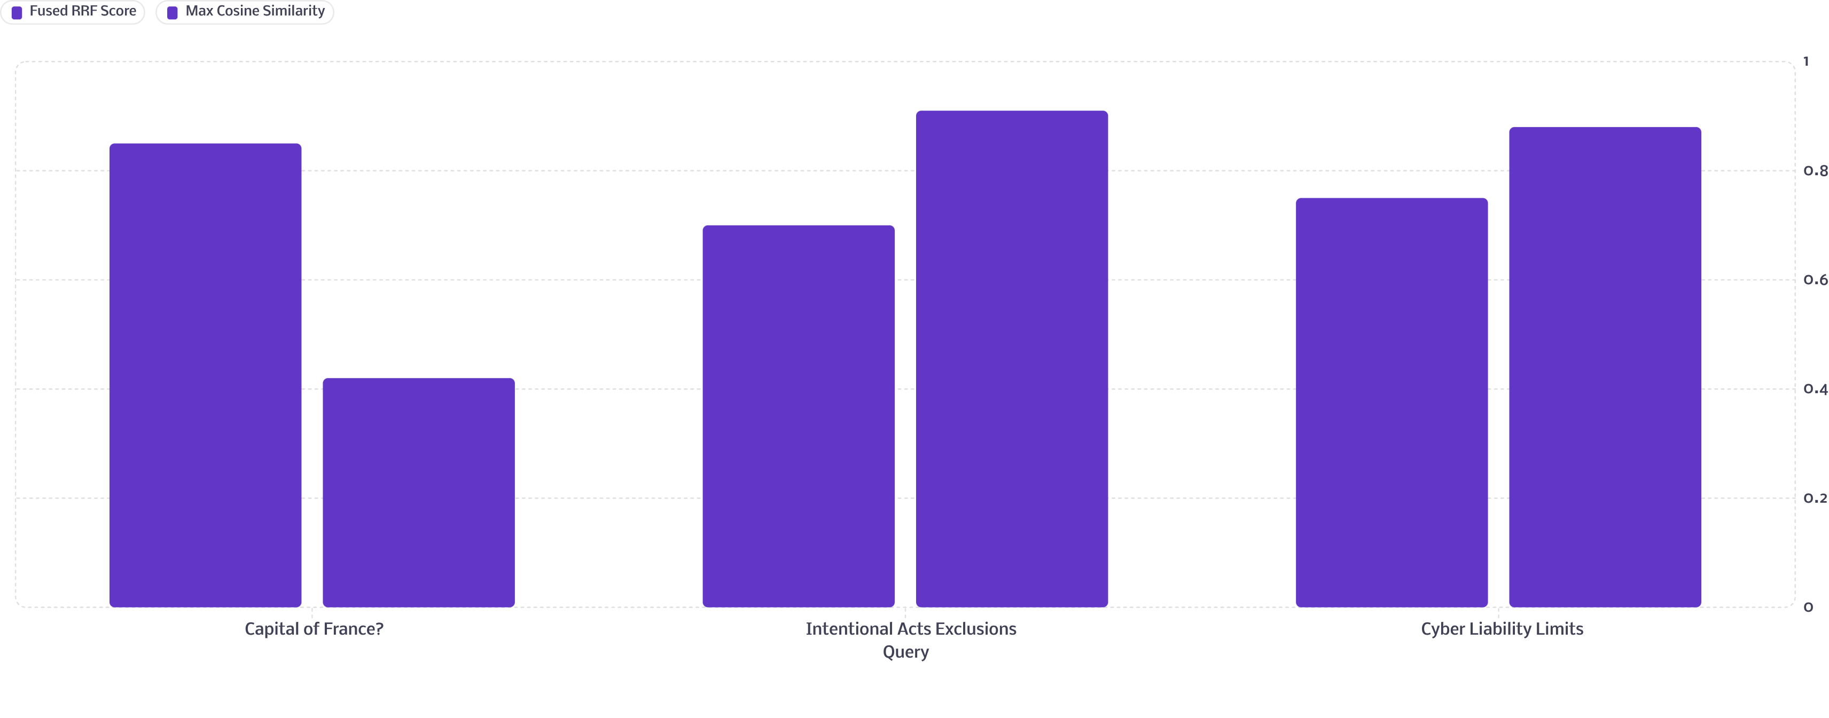
Real Data: Why RRF-Gated Refusal Failed
Our initial refusal mechanism, gated on the fused Reciprocal Rank Fusion (RRF) score, proved unreliable in distinguishing genuinely relevant answers from irrelevant but highly-ranked noise.
For example, the query "What is the capital of France?" often received a higher fused RRF score than several questions directly answerable by the policy documents.

Slide 17
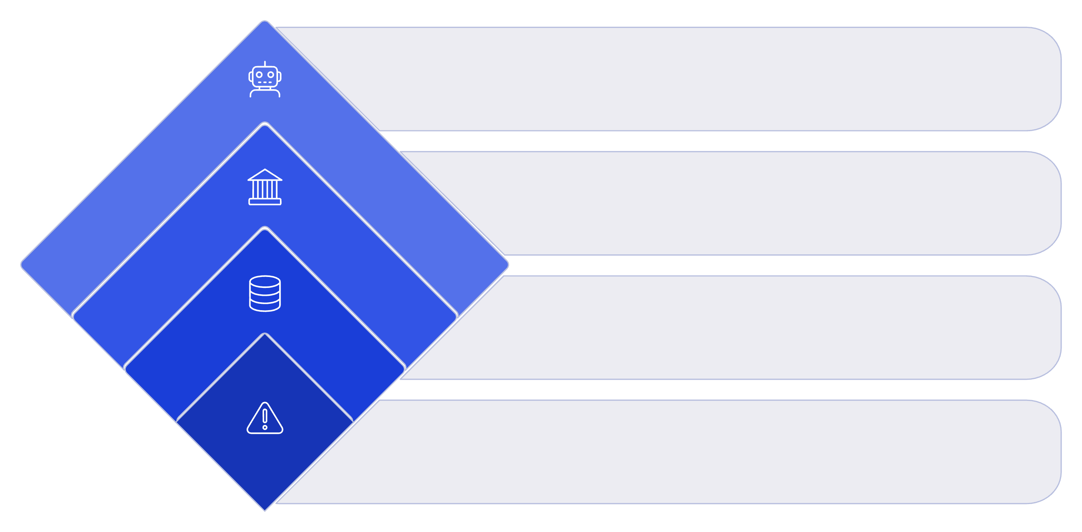
Failure Modes: A Taxonomy From Real Incidents
Use this decision tree to diagnose a wrong answer quickly: first verify retrieval, then decide whether the fix belongs in retrieval or generation.
Generation-fix
LLM ignored correct context
Retrieval-fix
No relevant doc, wrong doc
Check Retrieval
Inspect retrieved chunks
Wrong Answer
Identify incorrect output

Slide 18
Security: Retrieved Content Is Data, Never Instructions
A fundamental security principle in our RAG system is strict privilege separation. Retrieved content is always treated as inert data, never as executable instructions or system commands.
Privilege Separation
Adversarial Injection Cases
Indirect Injection
Retrieved chunk text is never interpreted as system instructions, ensuring that malicious content cannot hijack the LLM's behaviour or underlying system.
Evaluation includes a dedicated adversarial prompt injection test case, specifically designed to bypass guards and manipulate the LLM.
An indirect injection case, where malicious instructions are embedded within an actual ingested document, was tested and mitigated to prevent subversion through data.
Tool Gateway Enforcement
The ToolGateway implements strict per-agent tool allow-lists. Any attempt by an agent to call an out-of-scope tool immediately raises a ToolNotAllowedError, preventing unauthorised access or actions.
This multi-layered approach ensures the LLM's operational integrity and prevents any retrieved document from escalating its privileges.

Slide 19
Access Control on Retrieval
Robust access control is paramount to ensure sensitive policy information is only accessed by authorised personnel. Our system implements a fine-grained, role-based access policy at the retrieval layer.
Authentication LayerUser authentication is handled via JWT (JSON Web Token), leveraging Djoser and SimpleJWT, providing a secure and scalable method for user verification.
Defined Roles
Domain-Level Policy
Two distinct roles are established: ADJUSTER and MANAGER, each with specific retrieval privileges.
Access policies are implemented at the domain level (domain/policies/claim_access_policy.py), using a framework-free rule set with a thin DRF permission class on top for enforcement.
Role-Based Access
An ADJUSTER is strictly limited to retrieving information pertaining to their own assigned claims only. A MANAGER, conversely, has the privilege to retrieve information for any claim across the system.

Slide 20
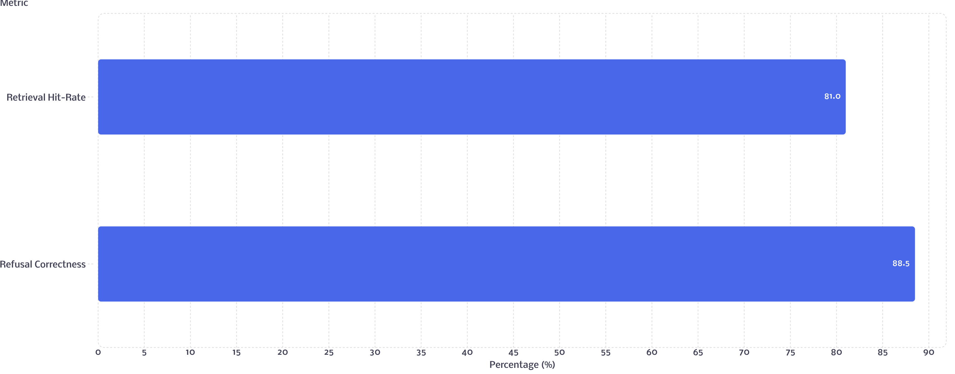
Evaluation: Does It Actually Work?
Our system undergoes rigorous evaluation against a comprehensive 26-case golden set, comprising 20 normal queries and 6 adversarial scenarios to test resilience.
Real-world recorded results demonstrate robust performance, with an 81.0% retrieval hit-rate and 88.5% refusal correctness. Crucially, every single miss is meticulously analyzed and documented, ensuring continuous improvement and transparency rather than being hidden.

Slide 21
Recap and Assessment
As we conclude the theoretical overview, let's consolidate the key takeaways from this deep dive into production-grade RAG.
Specific Failure Points
Empirical Problem Solving
Next Steps: Lab
RAG in production isn't plagued by one monolithic "hallucination" problem, but rather a chain of real, specific failure points that require precise diagnosis and mitigation.
Every successful fix and improvement in this project stemmed from meticulous analysis of real system output, not from theoretical assumptions.
Now, it's time to apply these insights. You will complete the lab tasks and tackle stretch challenges to build a deeper, practical understanding.

Slide 22
HANDS-ON LAB
INTRODUCTION
Hands-On Lab
Welcome to the practical lab session. Over the next few steps, you will interact directly with the system, performing key operations and confronting a real-world challenge.
All commands and tools you will use today are authentic and reflect our actual environment; no simulated interfaces or invented commands will be used.

Slide 23
Thank You
Questions? Let's connect and continue the conversation!

