Slide 1

SMART INDIA HACKATHON 2025
Problem Statement ID – 25033
Problem Statement Title – Al-Based Smart Allocation Engine for PM Internship Scheme
Theme- Smart Automation
PS Category- Software
Team Name - INFINITE LOOPS
Neranjana GM– ECE (Team Leader) Mentors:
NaveeyaSri S – ECE 1) Vidhiya S (AP/CSE)
Pradeepa R– EEE 2) Senthil Kumar C (AP/ECE)
Mohamed Nasthaeen S – ECE
Joshua Arnold Leo – CSE
Hamsavardhan S – CSE

Slide 2
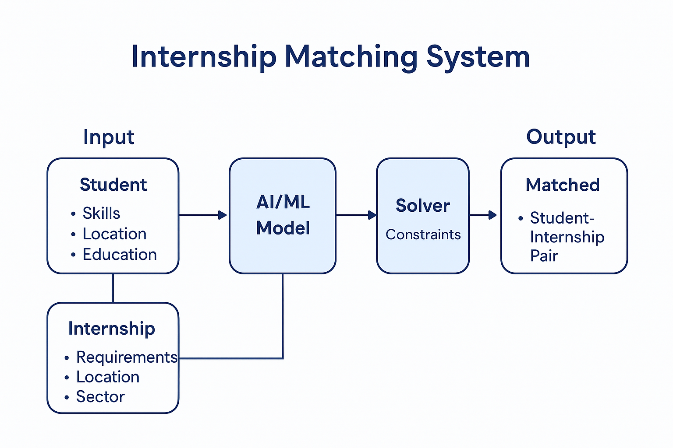
Al-Based Smart Allocation Engine for PM Internship Scheme
INFINITE LOOPS
Proposed Solution (Describe your Idea/Solution/Prototype)
Explanation :
AI/ML based solver engine and calculation featuring should be developed We plan to build an AI-based Smart Allocation Engine that will automatically match interns with the right projects and mentors.
1. It will check each intern’s skills, interests, and preferences.
2. It will compare them with project and mentor requirements.
3. The AI will then suggest the best match for both sides.
Address :
1. Ensures fair and transparent allocation of interns.
2. Reduces manual effort and saves time in the allocation process.
3. Prevents bias and ensures equal opportunities for all interns.
4. Balances workload to avoid overloading mentors.
Uniqueness :
1. Preference + Requirement balance – considers both intern interests and mentor/project needs.
2. Fairness and Transparency – avoids human bias and shows clear matching criteria.
3. Dynamic adaptability – adjusts allocations in real-time if projects or availability change

Slide 3
TECHNICAL APPROACH
INFINITE LOOPS
Programming Stack:
Frontend: React.js / Angular (user dashboards)
Styling: Tailwind CSS / Material UI (responsive UI)
Backend: Node.js + Express.js / Django / FastAPI
Database: MongoDB (NoSQL) or PostgreSQL (SQL)
AI/ML Layer: Python (Scikit-learn, TensorFlow, PyTorch) with Flask/FastAPImicroservices
Authentication: OAuth 2.0 / JWT
Cloud & DevOps: AWS / Azure / GCP, Docker, Kubernetes
Methodology:
Collect: Gather intern and project data.
Filter: Remove incompatible matches using rules.
Score: Rank matches using AI/ML models.
Evaluate: Monitor outcomes and improve the model

Slide 4
FEASIBILITY AND VIABILITY
INFINITE LOOPS
Technical Feasibility:
Can be implemented using existing AI/ML frameworks (Scikit-learn, TensorFlow, PyTorch).
Optimization tools (Google OR-Tools, PuLP) already exist for solving assignment problems.
Operational Feasibility:
Scalable for thousands of students and companies.
Can integrate with university/industry databases via APIs.
Economic Feasibility:
Initial cost is mainly in model development & training.
Can save time and resources in manual allocation.
Potential Risks:
Strategies to Overcome:
Data Quality
Bias in AIML
Scalablity
Acceptance
Pipeline Process
Fairness Bias Reduction
Cloud Based Storage
Pilot ,Fairness Expand

Slide 5
IMPACT AND BENEFITS
INFINITE LOOPS
Potential impact on the target audience
Students → Fair and faster access to the right internships, even for rural and underrepresented groups.
Companies/Industries → Get well-matched candidates, reducing recruitment effort and mismatch costs.
Universities/Government → Streamlined, transparent internship allocation process with data-driven fairness
.Skill Gap Identification: Highlights areas where interns or teams need training before starting.
Diversity & Inclusion: Ensures balanced allocation across departments, skill levels, and backgrounds.
Benefits of the solution (social, economic, environmental, etc.)
Social → Promotes inclusivity (rural, reserved category, diverse representation).
Economical → Saves time and cost of manual shortlisting and interviews.
Environmental → Reduces physical paperwork and manual processing less resource waste.
Insightful Analytics: Generates actionable reports on intern performance trends and project success rates.

Slide 6
RESEARCH AND REFERENCES
INFINITE LOOPS
https://www.sciencedirect.com/science/article/pii/S2772941925001206
https://dl.acm.org/doi/10.24963/ijcai.2023/309
https://arxiv.org/abs/2107.00221
https://en.wikipedia.org/wiki/Fairness_%28machine_learning%29

