Slide 1
EmployExcel Attrition analysis using Excel
Student name:Hamsa varthini.R
Register no:3112211714
Department: bcom general (commerce)
College: thiruthangal Nadar college

Slide 2
Agenda
1: problem statement
2: project overview
3: end users
4: our solution and proposition
5: dataset description
6: modelling approach
7: results and discussion
8: conclusion

Slide 3
Problem statement
Analyze employee Attrition data to identify key factors contributing to turnover. Enabling data- driven retention strategies

Slide 4
Project overview
Utilize Excel to examine employee Attrition data, uncover patterns, and provide actionable insights or hr and management

Slide 5
End users
Hr professional. Management, business leaders, and analysts seeking to understand and address employee Attrition

Slide 6
Our solution and proposition
Leverage Excel is analytical capabilities to transform complex attrition data into easily digestible insights. Enabling data- driven decision and improved retention strategies

Slide 7
Dataset description
Employee Attrition data, including:
Employee ID
Department
Job title
Tenure
Reason for leaving
Date of departure
Demographic data

Slide 8
Modelling approach
Calculate attrition rates by department, job title, and tenure
Identify top reasons for leaving
Analyze trends in attrition over time
Examine correlation between variables
Create pivot tables and charts for visualization

Slide 9
Results and discussion
Attrition rates and trends
Top reasons for leaving
Correlations between variables
Insights into High –risk groups or department
Recommendation for retention strategies

Slide 10
Table:
FirstName | LastName | StartDate | ExitDate | Title | Supervisor | Performance Score | Current Employee Rating
Uriah | Bridges | 20-Sep-19 |  | Production Technician I | Peter Oneill | Fully Meets | 4
Paula | Small | 11-Feb-23 |  | Production Technician I | Renee Mccormick | Fully Meets | 3
Edward | Buck | 10-Dec-18 |  | Area Sales Manager | Crystal Walker | Fully Meets | 4
Michael | Riordan | 21-Jun-21 |  | Area Sales Manager | Rebekah Wright | Fully Meets | 2
Jasmine | Onque | 29-Jun-19 |  | Area Sales Manager | Jason Kim | Fully Meets | 3
Maruk | Fraval | 17-Jan-20 |  | Area Sales Manager | Sheri Campos | Fully Meets | 3
Latia | Costa | 06-Apr-22 | 03-Jul-23 | Area Sales Manager | Jacob Braun | Exceeds | 4
Sharlene | Terry | 06-Nov-20 | 29-Jan-23 | Area Sales Manager | Tracy Marquez | Fully Meets | 2
Jac | McKinzie | 18-Aug-18 |  | Area Sales Manager | Sharon Becker | Exceeds | 3
Joseph | Martins | 21-Jan-22 | 29-Jun-23 | Area Sales Manager | George Jenkins | Fully Meets | 5

Slide 11
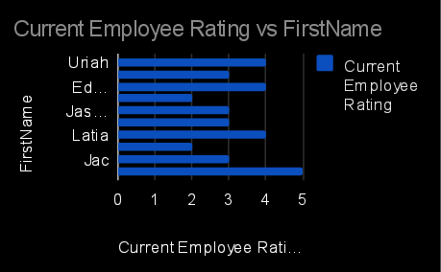
Par chart:

Slide 12
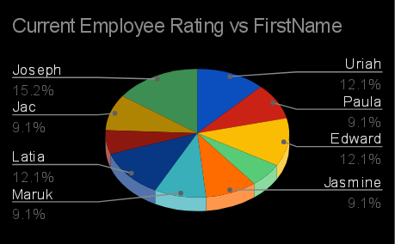
Pie chart:

Slide 13
Conclusion
Summarize the value of using Excel for employee attrition analysis, emphasizing actionable insights, data-driven decision making. And improved retention strategies

