Slide 1
Revenue And Customer Analysis
By Hamse Mohamed

Slide 2
Data insights and Recommendation
Revenue
At $ 427,497 October is highest Total selling month , while month of September was lowest with $ 355,629
October was 4.6% of our profit in that year
6 different brands total sales goes from $ 738,833 to 2.3 M
Transactions
At $ 3 M was highest total sales by people aged between 41-50, while lowest sales is $ 1 M by 60>
5 different age groups ranage between $ 1 M to 3 M

Slide 3
Data insights and Recommendation
For Customer job industry Financial service with highest total sales $ 2 M, while lowest is Telecommunication $ 167,312
Financial are 20.4 % of our Total sales
Customers
1533 Bronze customers had height customers than can not lose them which lowest of 755 Premium

Slide 4
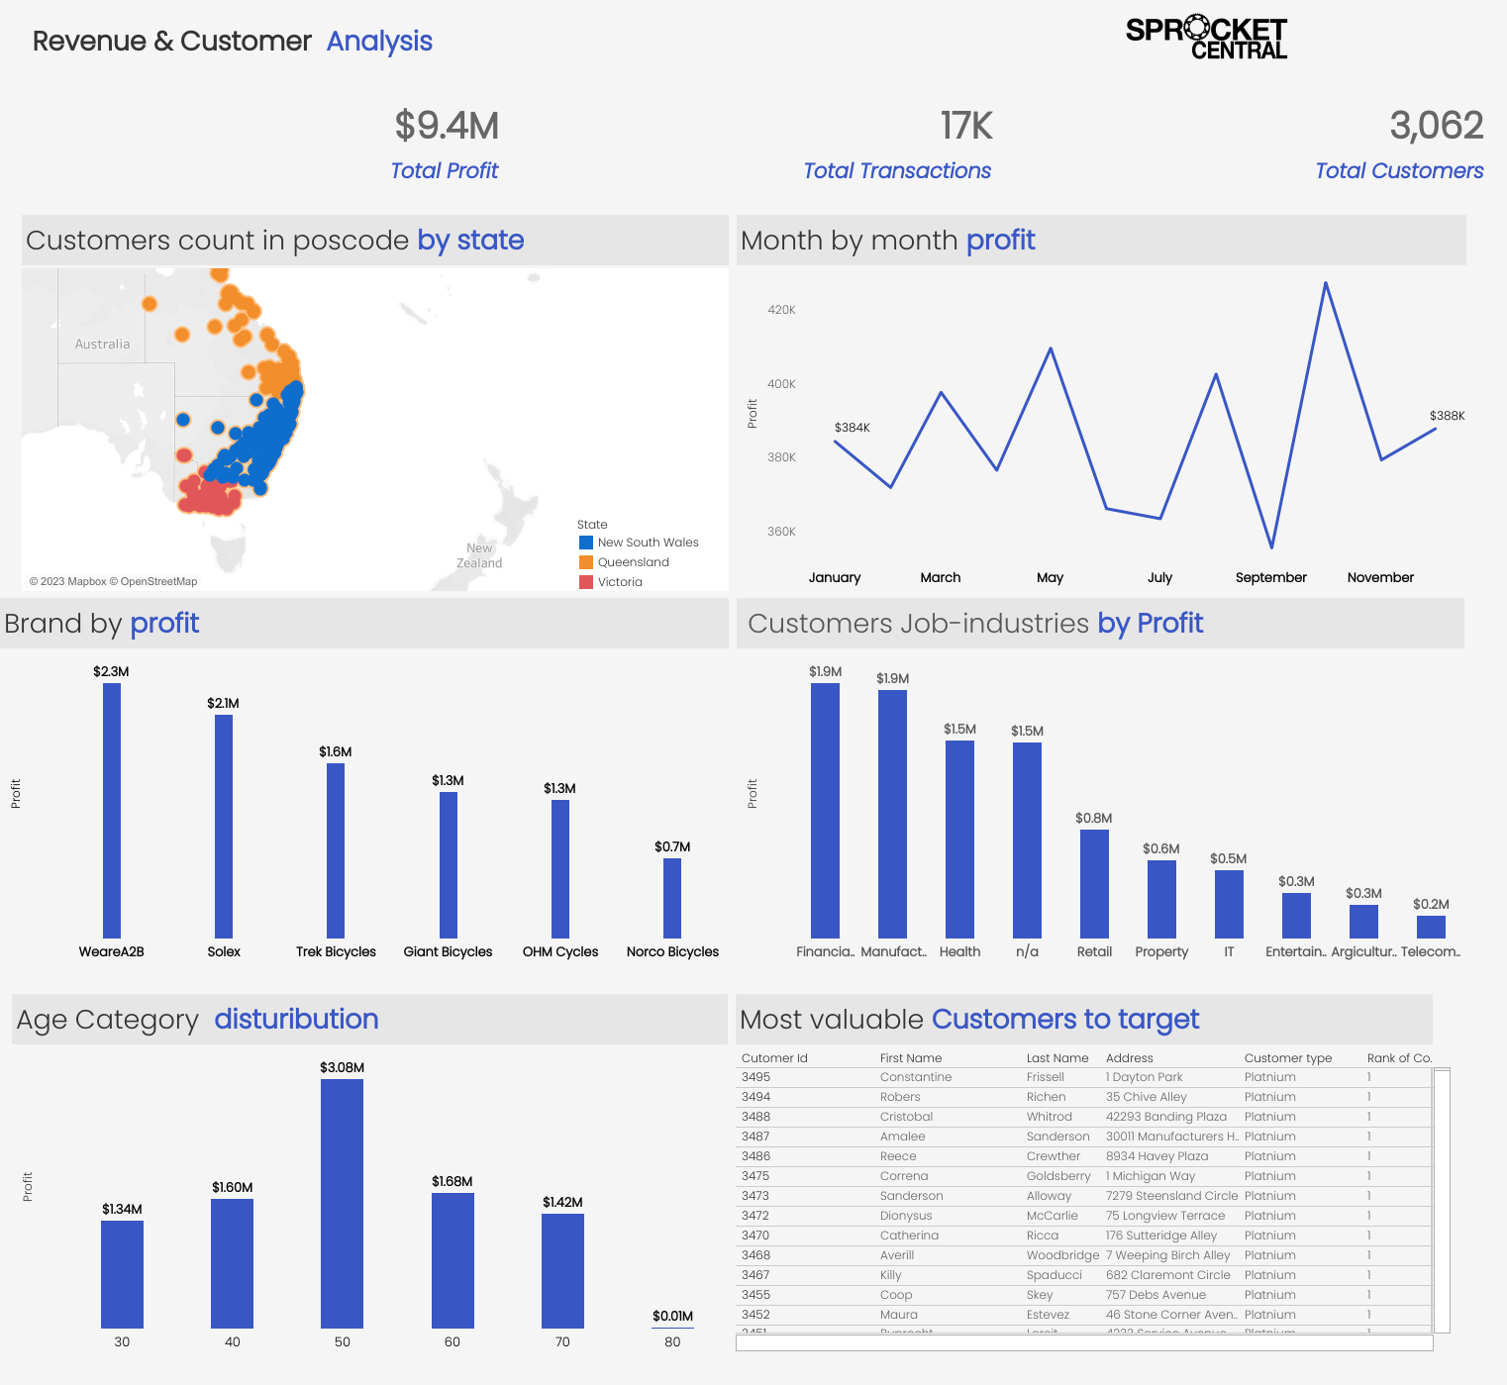

Slide 5
