Slide 1
MSc PRACTICUM — SCHOOL OF COMPUTING, DCU
Explainable AI in
Anomaly Detection
Explaining a Transformer-based host intrusion detector to the humans who have to trust it
Harrish Dhaithya Kutte Ajan Babu
Hamshavardhan Mohankumar
Supervisor: Dr. Irina Tal

Slide 2
MOTIVATION
Attacks are outrunning rule-based detection
— 79% malware-free. CrowdStrike's 2025 report: most 2024 intrusions were hands-on-keyboard, not signature-matchable malware.
— Rule-based IDS can't keep up. Static, pre-configured rules miss evolving, novel attack behaviour.
— ML/DL fixes detection, breaks trust. Deep models catch more, but analysts can't see why an alert fired — the classic “black box” problem.
— XAI is the bridge. This work builds a detector, then explains its decisions three different ways, and asks security practitioners which explanation they actually trust.
THE GAP
Accurate detector
+
No explanation
=
Analyst can't verify,
can't act, can't trust it.
Explainable AI in Anomaly Detection
2

Slide 3
SCOPE
Two research questions
RQ1
RQ2
Which Explainable AI method is best suited for anomaly detection, and which one is most transparent and understandable for security analysts?
How does adding explainability affect the model's performance, such as accuracy and response time?
Explainable AI in Anomaly Detection
3

Slide 4
RELATED WORK
Detection improves; explanation stays an afterthought
— Deep learning for IDS is mature. DeepLog (LSTM) [8], CNN-LSTM-attention [9], ensembles [10], federated ResNets [11], self-supervised online learning [12], Transformer encoders on ADFA-LD [13].
— XAI-for-IDS work exists, but mostly applies SHAP/LIME post-hoc to tree models or CNNs, on network-flow datasets, without asking the intended user anything [16][17][18][19].
— Nobody compares explanation methods head-to-head with a real security-practitioner survey, on host-level syscall data, while also measuring their cost.
POSITIONING
This work sits at the intersection:
Host-based, syscall-level detection
(like [13], but trace-level)
+
Multiple XAI methods compared
directly, with a user study
and a cost measurement
(gap left by [16][17][18][19])
Explainable AI in Anomaly Detection
4

Slide 5
METHODOLOGY — DATASET
NGIDS-DS: 90 million host events, 6 days
— Source. Haider (2018), UNSW thesis — real system-call traces from a 32-bit Linux host, labelled against real CVEs.
— Scale. 90,054,239 events → 1,262,427 attack (1.4%), across 99 CSV files, ~10GB raw → 300MB as parquet.
— Categories. Exploits, DoS, Generic, Backdoors, Shellcode, Worms, Reconnaissance.
Split | Date(s)
Training | 11–14 Mar 2016
Validation | 15 Mar 2016
Test | 16 Mar 2016
Temporal split — train on the past, test on an unseen future day.
Each row: date, time, process id, path, syscall, event id, attack_cat, attack_subcat, label.
Ground-truth file marks exactly which events are simulated attacks.
Explainable AI in Anomaly Detection
5

Slide 6
METHODOLOGY — PREPARATION
From raw logs to model input
1. CLEANING
2. FEATURE ENGINEERING
— Removed duplicate logged events.
— Dropped clock_gettime / gettimeofday — 52% of all events, equally common in attack and normal, zero separating power.
— 90,054,239 → 42,647,584 events after cleaning.
— Run-length encode. collapse repeated calls into (call, count) runs.
— Fix length to 256. pad short traces, evenly downsample long ones.
— Tokenise. vocabulary built from training days only.
— Drop the program name. victim programs appear almost only in attacks — keeping identity would let the model cheat instead of learning behaviour.
— Label the trace, attack if any of its events is an attack.
Why drop the program name?
Firefox has zero normal events in this dataset; soffice.bin is >99% attack. Keeping the name would let the model memorise the victim, not learn the behaviour.
Explainable AI in Anomaly Detection
6

Slide 7
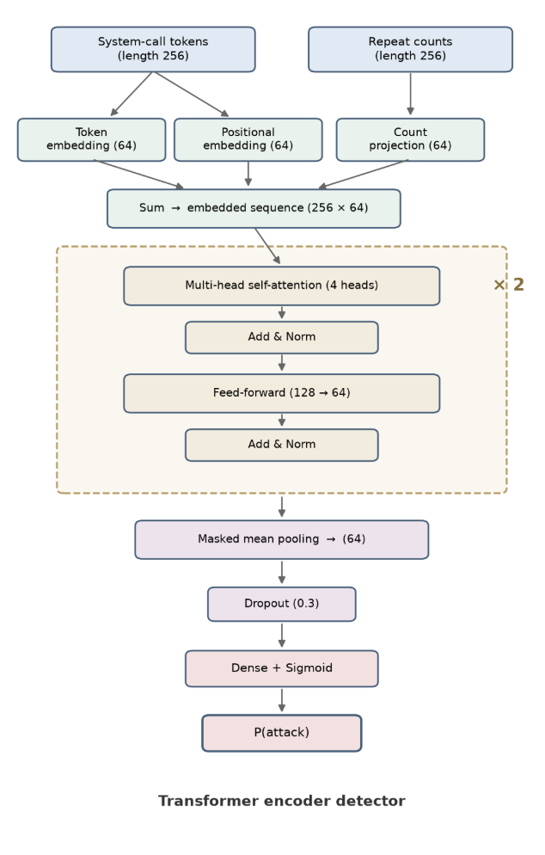
METHODOLOGY — MODEL
A Transformer encoder over syscall traces
— Input. 256 positions × (call token + repeat count) — token, positional and count embeddings summed to 64-d.
— 2 encoder blocks. 4-head self-attention (padding masked) + feed-forward (64→128→64), residual + layer norm.
— Pool & classify. masked mean over real positions → dropout(0.3) → sigmoid → P(attack).
TRAINING
Adam · batch 128 · up to 25 epochs · early stop on validation PR-AUC
Class-weighted loss (attacks are rare)
Threshold picked on validation to maximise F2 (recall > precision), frozen for test
Explainable AI in Anomaly Detection
7

Slide 8
EXPLAINABILITY
Three lenses on the same alert
Occlusion
Attention
LIME
Remove a call / group, re-score, measure the log-odds drop.
Read the weights the model already computed.
Fit a local linear surrogate on perturbed traces.
EXACT, MODEL-AGNOSTIC
FREE-ISH, MODEL-SPECIFIC
APPROXIMATE, MODEL-AGNOSTIC
All three applied to the same alert, shown in the same card format — the study measures content, not presentation.
Explainable AI in Anomaly Detection
8

Slide 9
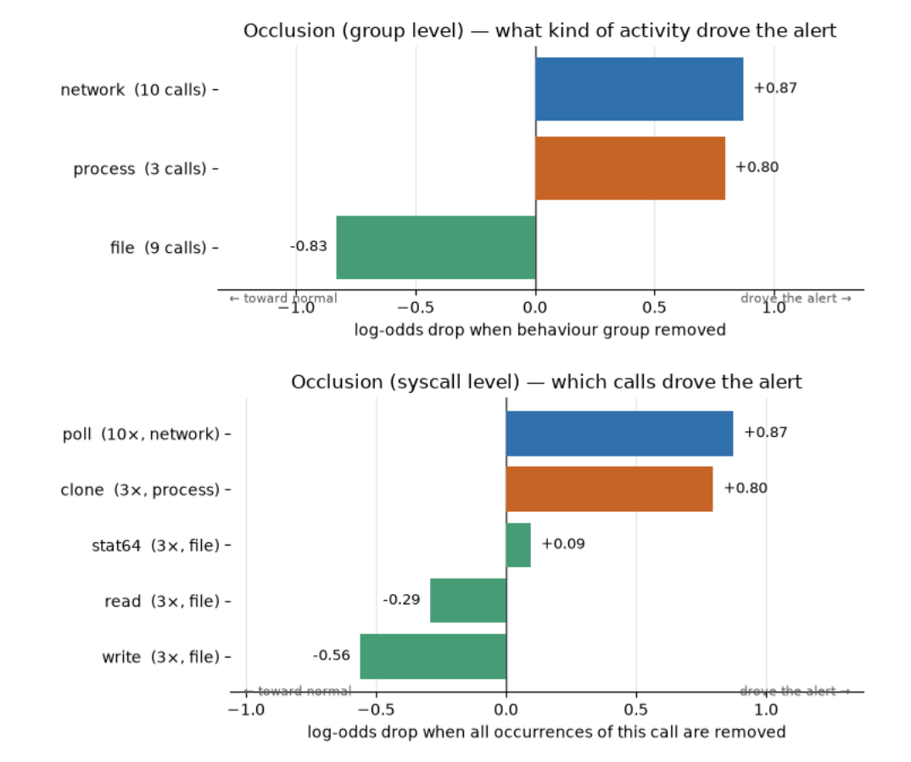
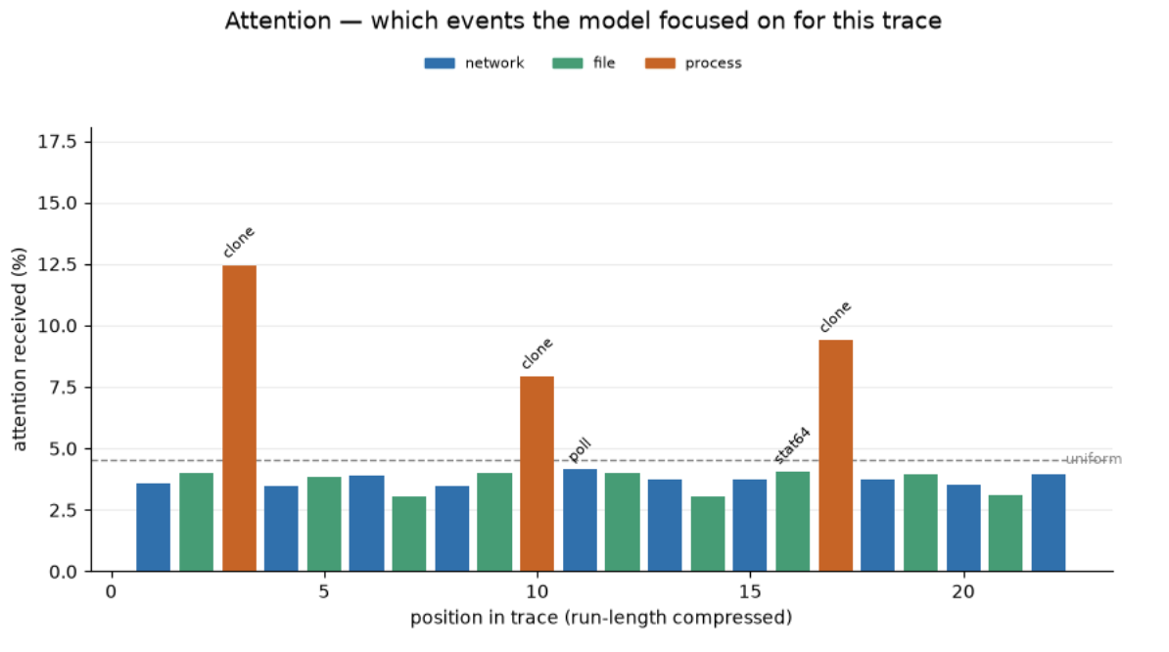
EXPLAINABILITY — OCCLUSION
Which behaviour drove this alert?
Explainable AI in Anomaly Detection
9

Slide 10
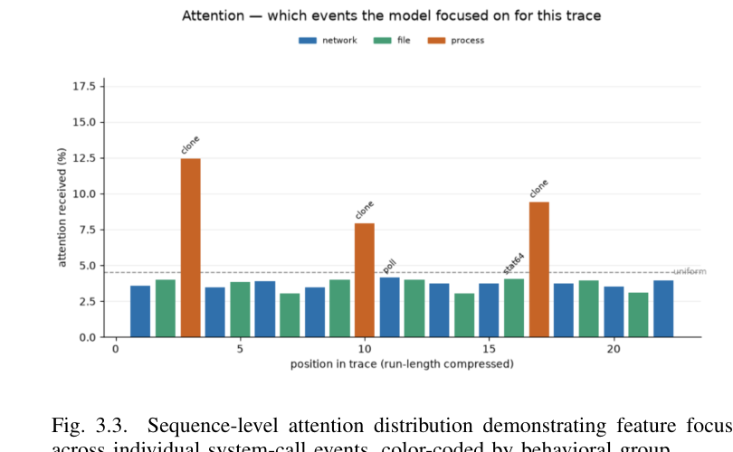
EXPLAINABILITY — ATTENTION
Where did the model look?
Three process-related spikes (clone) stand out clearly above the uniform baseline — read straight off the model's own forward pass.
Explainable AI in Anomaly Detection
10

Slide 11
EXPLAINABILITY — LIME
A local surrogate, one weight per call
— Perturb the trace by randomly dropping calls.
— Score every perturbation with the detector.
— Fit a linear model to the results.
— Surrogate weight = that call's contribution to the alert.
— Familiar, widely-used local-importance format — but approximates the model rather than measuring it exactly.
SAMPLE OUTPUT (excerpt)
Syscall | Behaviour | LIME weight | Impact
clone | Process | +0.0023 | raises score
poll | Network | +0.0004 | raises score
write | File | −0.0016 | lowers score
stat64 | File | +0.0001 | raises score
Full case: 22-run window from a real Firefox exploit trace on the test day, base score 0.92 vs threshold.
Explainable AI in Anomaly Detection
11

Slide 12
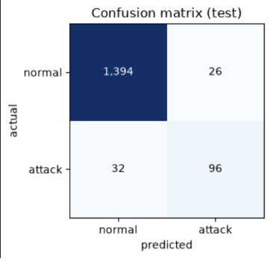
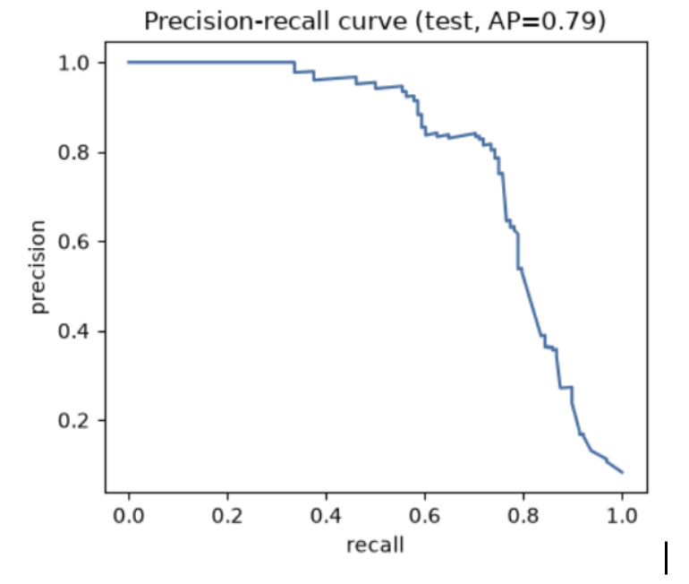
RESULTS — MODEL EVALUATION
Detector performance on the held-out test day
Recall
75.0%
Precision
78.7%
PR-AUC
0.79
FAR
1.8%
1,548 test traces (128 attack). 96 attacks caught, 32 missed; 26 false alarms out of 1,420 normal traces.
Accuracy
96.3%
Explainable AI in Anomaly Detection
12

Slide 13
RESULTS — RQ1: USER-CENTRIC EVALUATION
17 practitioners rate three explanations
Method | Usefulness | Ease | Trust
Occlusion | 6.24 | 6.59 | 6.94
Attention | 7.29 | 7.29 | 7.00
LIME | 7.06 | 6.82 | 6.88
“MOST EFFECTIVE OVERALL” (n=17)
Attention
53%
Occlusion
29%
LIME
18%
Open feedback themes
6 Software Devs · 4 IT Professionals · 3 Security Analysts · 4 Students
• More plain-language explanation alongside visuals
• A clearer baseline/threshold to compare numbers against
• A similarity score vs. previously seen attacks
Explainable AI in Anomaly Detection
13

Slide 14
RESULTS — RQ2: COST OF EXPLAINABILITY
Latency added per alert
GPU (ms)
CPU (ms)
Method | Explain | Total
Baseline | — | 86.9
Attention | 188.4 | 275.3
Occlusion | 171.1 | 258.0
LIME | 431.8 | 518.7
Method | Explain | Total
Baseline | — | 90.0
Attention | 196.9 | 286.9
Occlusion | 195.3 | 285.3
LIME | 11,583.3 | 11,673.3
Attention and Occlusion: ~170–200ms either way — a small, fixed number of extra forward passes.
LIME: 431.8ms on GPU, but 11.6 seconds on CPU — it scores many perturbed samples individually, so it lives and dies by parallel hardware.
Explainable AI in Anomaly Detection
14

Slide 15
DISCUSSION
What this does and doesn't show
— Lack of quantified impact. Most XAI-for-IDS work asserts an explanation is useful; this study is one of the few that actually measures usefulness, ease and trust against real practitioners — and finds Attention preferred, but not by a wide margin.
— Lack of standardisation. Occlusion, Attention and LIME were deliberately shown in one common card format so the comparison is about content, not presentation — but the field still has no agreed way to present or benchmark an explanation.
— Cost is rarely reported at all. RQ2 shows the cost question isn't academic: LIME's CPU cost (11.6s) would be a real deployment blocker at alert volume, while Attention and Occlusion are effectively free by comparison.
— Scope. Single-alert case studies, one dataset, one architecture — breadth across attack types and models is future work, not a claim made here.
Explainable AI in Anomaly Detection
15

Slide 16
CONCLUSION & FUTURE WORK
CONCLUSION
FUTURE WORK
— Behaviour-only Transformer detector: 75.0% recall, 78.7% precision, 0.79 PR-AUC, 1.8% FAR, 96.3% accuracy.
— Three explanation methods compared head-to-head; Attention preferred by 53% of 17 practitioners.
— Occlusion and Attention: near-free. LIME: GPU-bound, 11.6s on CPU.
— Plain-language explanation layer alongside the visuals.
— Similarity scoring against previously seen attacks.
— Broaden evaluation beyond the single flagged-trace case studies used here.
Explainable AI in Anomaly Detection
16

Slide 17
Thank you
Questions?
Harrish Dhaithya Kutte Ajan Babu · Hamshavardhan Mohankumar — School of Computing, Dublin City University

