Slide 1
Symphony Of Algorithms: Music Composition using Deep Learning Models
By:
HAMSHIKA R.(21BAI1003)
HARSHITA RAJINIKANTH(21BAI1226)
SNEHALATHA PRAKASH(21BAI1519)

Slide 2
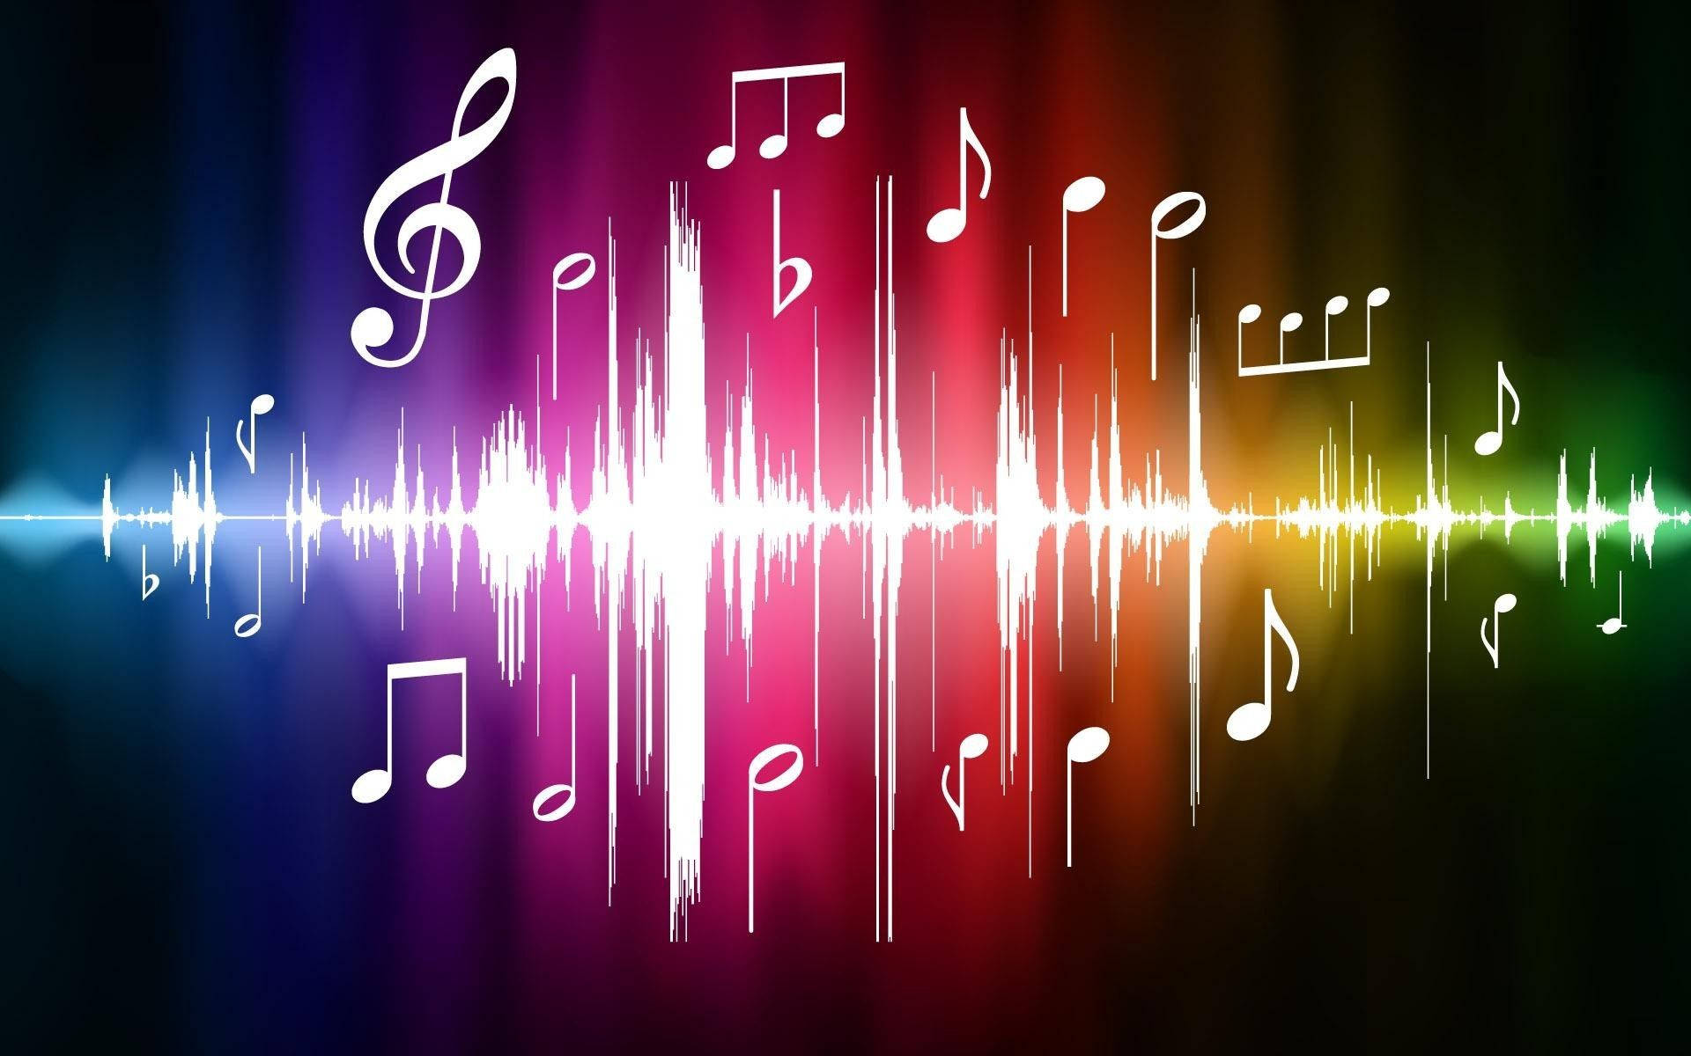
CONTENTS
l
Introduction
Problem Statement
Research Objective
About Proposed Systems
100% implementation with the results
Conclusion
References

Slide 3
INTRODUCTION
This project explores the effectiveness of various AI models—Generative Adversarial Networks (GANs), Gated Recurrent Units (GRUs), Variational Autoencoders (VAEs), OpenAI’s Jukebox, Transformers, and Diffusion Models—in generating original music compositions. Each model employs unique architectures: GANs refine outputs through adversarial training, GRUs capture temporal flow, VAEs enable diverse musical variations, and Jukebox leverages transformers for high-fidelity audio. Transformers enhance sequence modeling for coherent compositions, while diffusion models introduce gradual noise removal to synthesize intricate and realistic sounds, expanding possibilities for creative audio generation.
We will evaluate each model's output using metrics and this analysis aims to reveal the strengths and limitations of each model, guiding advancements in AI-driven music composition.

Slide 4
PROBLEM STATEMENT
AI music generation presents challenges in identifying the optimal model for producing coherent, high-quality compositions. Models like GANs, GRUs, VAEs, Jukebox, Transformers, and Diffusion models each employ unique methodologies, yet a direct comparative analysis of their impact on music quality and creativity remains underexplored.
This project aims to fill this gap by evaluating these models using metrics such as harmonicity, rhythmic consistency, novelty, and coherence. The goal is to identify the strengths and limitations of each model, offering insights to guide future advancements in AI-based music composition.

Slide 5
RESEARCH OBJECTIVE
The objective of this research is to conduct a comparative analysis of GANs, GRUs, VAEs, OpenAI’s Jukebox, Transformers and Diffusion models for music generation, assessing each model's effectiveness in creating high-quality, coherent, and diverse compositions. By using evaluation metrics such as harmonicity, rhythmic consistency, novelty, coherence, and subjective human assessment, this study seeks to:
1. Identify the unique strengths and limitations of each model in capturing musical structures.
2. Determine which model best balances creativity and coherence for practical music generation.
3. Provide insights into the potential of these models for applications across different music genres.

Slide 6
ARCHITECTURES
INTRODUCTION
The proposed system aims to evaluate and compare the performance of various deep learning models—GANs, GRUs, VAEs, OpenAI’s Jukebox, Transformers and Diffusion models —for generating music. By leveraging these diverse architectures, the system will create unique music compositions and evaluate them across multiple dimensions of musical quality.
Each model brings a unique approach to music generation. GANs create compositions through an adversarial process, enhancing realism by iteratively refining outputs. GRUs, with their capability to capture sequential dependencies, are effective for maintaining the flow and structure in musical sequences. VAEs, through their probabilistic framework, introduce variation and creativity into compositions. OpenAI’s Jukebox, using a transformer-based architecture, provides high-resolution audio and complex musical patterns. Transformers excel at long-sequence modeling, capturing intricate musical themes over time, while Diffusion models generate compositions by incrementally denoising, enabling fine-grained control over the synthesis of realistic and diverse sounds.

Slide 7
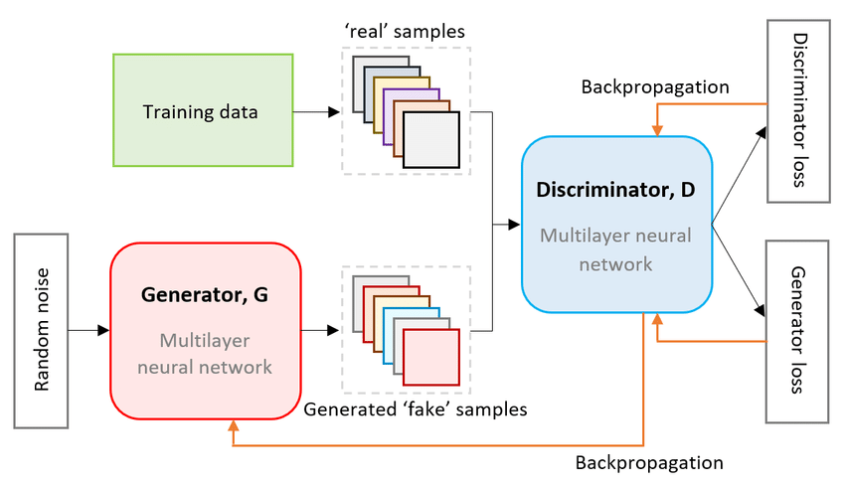
GAN ARCHITECTURE

Slide 8
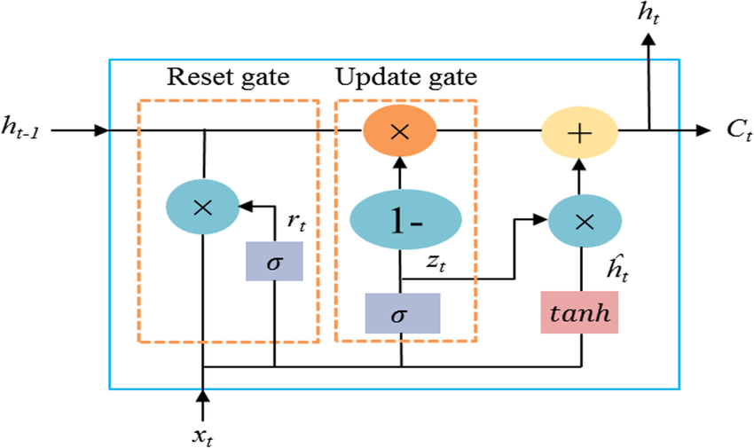
GRU ARCHITECTURE

Slide 9
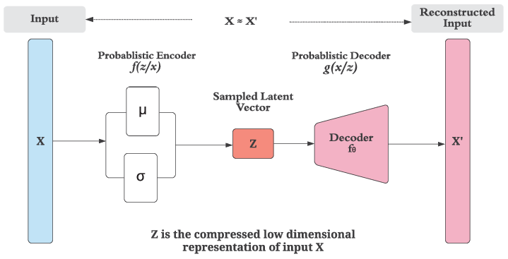
VAE ARCHITECTURE

Slide 10
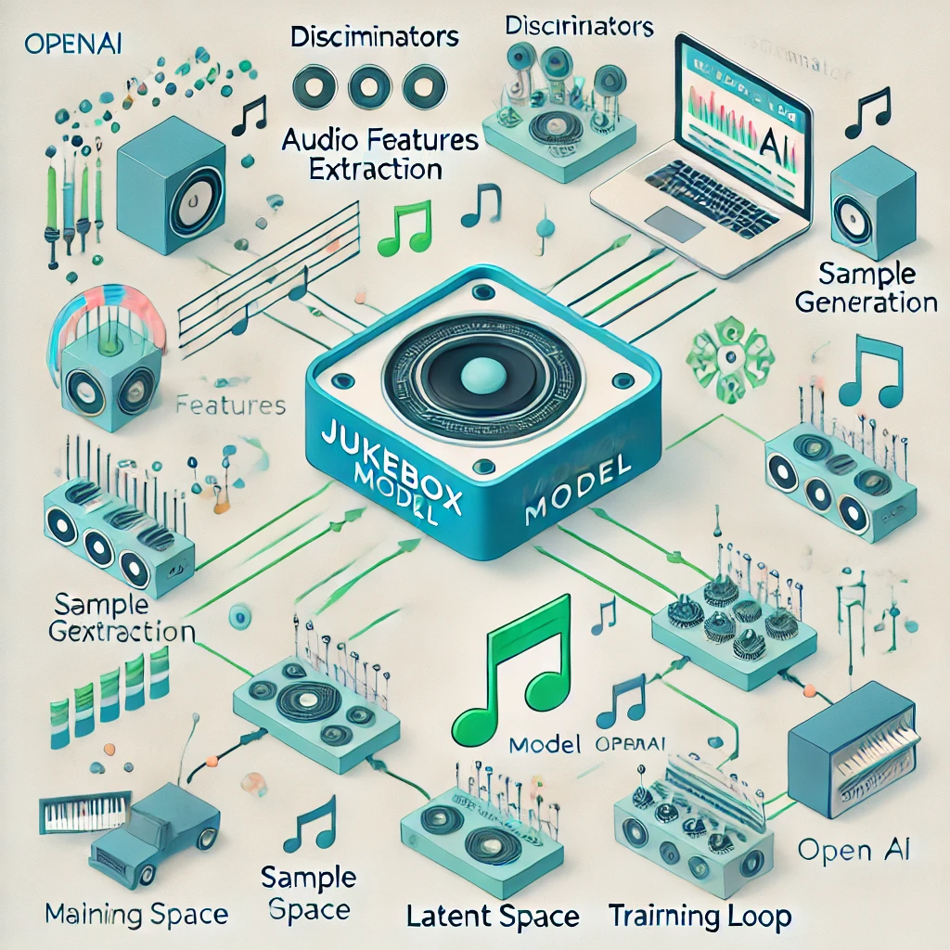
JUKEBOX ARCHITECTURE

Slide 11
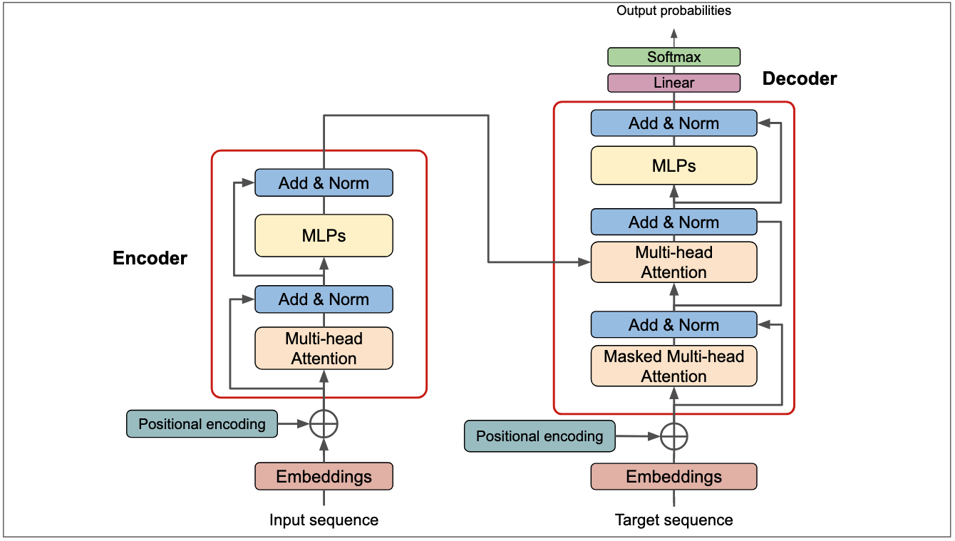
TRANSFORMERS ARCHITECTURE

Slide 12
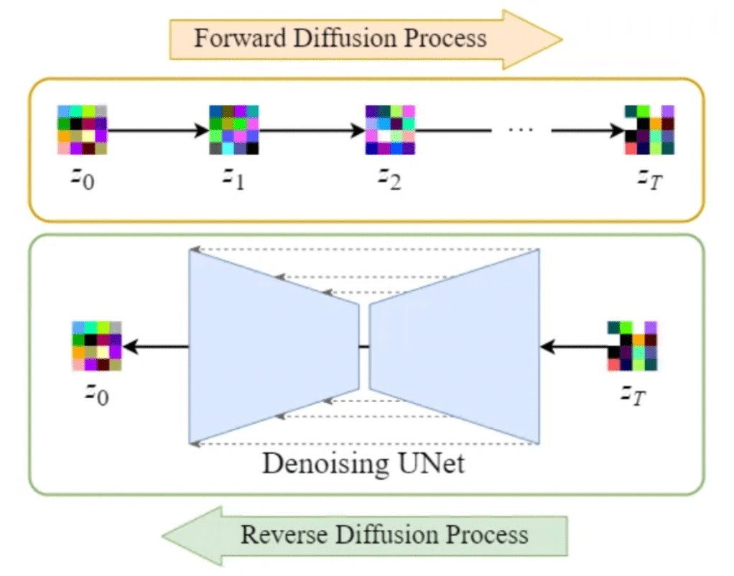
DIFFUSION MODEL ARCHITECTURE

Slide 13
PROPOSED SYSTEMS
LIST OF MODULES
1. Data Handling and Preprocessing
NumPy
Pandas
SciPy
2. Music Processing
Mido
3. Machine Learning and Deep Learning
TensorFlow
PyTorch
4. Visualization
Matplotlib
Seaborn
5. Evaluation and Metrics
Scikit-learn

Slide 14
PROPOSED SYSTEMS
1. Data Handling and Preprocessing
NumPy:
NumPy is a fundamental package for numerical computing in Python. It provides support for arrays, matrices, and a variety of mathematical functions
    Key Features:
    Multi-dimensional arrays: Efficiently store and manipulate large datasets.
    Mathematical functions: Perform element-wise operations, linear algebra, and statistical operations.
Pandas:
Pandas is a powerful data manipulation and analysis library that provides data structures like DataFrames for handling structured data.
    Key Features:
    DataFrame and Series: Easy-to-use data structures for handling tabular data.
    Aggregation and grouping: Perform operations like grouping data and applying statistical functions.
SciPy:
  Key Features:
  Signal Processing: Functions for filtering, Fourier transforms, and other signal processing tasks that can be useful for audio data manipulation.
  Statistical Functions: Provides statistical functions for data analysis, which can be useful for analyzing generated music characteristics.

Slide 15
PROPOSED SYSTEMS
2. Music Processing
Mido:
Mido is a library for working with MIDI files in Python, useful for handling musical data represented in the MIDI format.
    Key Features:
    MIDI file reading/writing: Read and write MIDI files with ease.
    Message handling: Create, modify, and send MIDI messages.
    MIDI file parsing: Parse MIDI files to extract note sequences and other relevant information for music generation.
3. Machine Learning and Deep Learning
TensorFlow:
    Developed by Google Brain, TensorFlow is an open-source library for numerical computation and machine learning. It provides a flexible ecosystem of tools and libraries for building and deploying machine learning models.
    Key Features:
    Static Computation Graphs: TensorFlow allows you to define and optimize computation graphs before running them, which can lead to performance improvements.
    TensorFlow Keras: An integrated high-level API for building and training models, making it user-friendly for beginners and experts alike.
PyTorch:
Developed by Facebook's AI Research lab, PyTorch is an open-source deep learning framework known for its dynamic computation graph and intuitive interface. Support for libraries like torchvision for computer vision tasks, torchtext for natural language processing, and torchaudio for audio processing.

Slide 16
PROPOSED SYSTEMS
4. Visualization
Matplotlib:
Matplotlib is a comprehensive library for creating static, animated, and interactive visualizations in Python. It is widely used for its flexibility and control over plot aesthetics.
Key Features:
    Wide Range of Plots: Supports various types of plots, including line plots, scatter plots, bar charts, histograms, pie charts, and more.
    Customizable: Provides extensive options to customize every aspect of a plot, including colors, labels, titles, and axes.
Seaborn:
Seaborn is a statistical data visualization library based on Matplotlib that provides a high-level interface for drawing attractive and informative statistical graphics.
Key Features:
    Simplified Syntax: Offers simpler functions for complex visualizations, making it easier to create aesthetically pleasing plots with less code.
    Statistical Functions: Includes functions to visualize distributions, relationships, and categorical data with a focus on statistical insight.

Slide 17
PROPOSED SYSTEMS
4. Evaluation and Metrics
Scikit-learn
Scikit-learn is a powerful and widely used library for machine learning in Python. It provides simple and efficient tools for data mining and data analysis, built on NumPy, SciPy, and Matplotlib.
Key Features:
    Model Evaluation Metrics: Scikit-learn includes a variety of metrics for evaluating model performance, including classification , regression and clustering metrics
Soundfile
  Soundfile is a Python library designed for reading and writing sound files, providing a simple interface to handle various audio formats. It is particularly useful for audio processing tasks, especially when working with generated music or sound samples.
  Key Features:
    File Format Support: Soundfile supports a variety of audio file formats, including WAV, FLAC, and OGG, allowing you to read and write audio files in these formats easily.
    Read/Write Operations: Provides straightforward methods to load audio data into NumPy arrays and save audio data back to files.

Slide 18
PROPOSED MODELS
GRU
GRU is a type of recurrent neural network (RNN) specialized for sequential data.
It addresses vanishing gradient problems in traditional RNNs using update and reset gates.
Efficient for learning long-term dependencies in music sequences.
Layers:
Embedding Layer: Converts notes to dense vectors.
GRU Layers: Processes sequential data and learns temporal patterns.
Fully Connected Layer: Maps GRU output to the note space.
Softmax Activation: Converts predictions into probabilities
Key Features of GRU in Music Generation
Memory Efficiency: Lightweight compared to LSTMs.
Temporal Context: Preserves long-term dependencies in music patterns.
Generative Potential: Produces coherent and diverse musical sequences.
GRU-based models are a powerful and efficient choice for generating music sequences due to their ability to capture temporal dependencies in sequential data. By leveraging the update and reset gates, GRUs overcome the vanishing gradient problem of traditional RNNs, making them suitable for handling complex, long-term relationships in musical patterns. The combination of embedding layers, GRU units, and fully connected layers enables the generation of coherent and diverse musical compositions. These models can learn from existing music datasets and produce new, creative pieces that maintain harmony and structure. GRUs are lightweight and computationally efficient, making them accessible for a variety of applications, from automated composition to real-time interactive music tools.

Slide 19
PROPOSED MODELS
.
GAN
GAN is a deep learning architecture with two networks: Generator and Discriminator.
Generator: Creates new, synthetic data resembling the training data.
Discriminator: Distinguishes between real and generated data.
Both networks train simultaneously in a zero-sum game.
Layers
1. Generator Layers:
Dense/Linear Layers: Transform latent noise vectors (e.g., random input) into higher-dimensional representations.
Transpose Convolution Layers: Upsample the data to create structured sequences like melodies.
Activation Functions: LeakyReLU or ReLU for non-linearity.
2. Discriminator Layers:
Convolutional Layers: Capture temporal and pitch-based features of input sequences.
Dense/Linear Layers: Flatten and classify inputs as real or fake.
Activation Functions: Sigmoid for binary classification (real/fake output).
GAN-based models offer a unique framework for music generation by creating an adversarial training loop that refines the generator and discriminator iteratively. This dynamic interplay produces highly realistic and creative music pieces. GANs excel at handling diverse musical styles and are particularly well-suited for tasks requiring innovation, such as composing novel melodies or remixing existing music patterns. With advancements in GAN architectures, music generation continues to reach new levels of quality and creativity.

Slide 20
PROPOSED MODELS
.
VAE
VAE is a generative model that learns to represent input data in a lower-dimensional latent space.
Combines encoder and decoder networks for efficient representation and reconstruction.
Introduces stochastic sampling for generating new, diverse music sequences.
Layers
1. Encoder Layers:
  Convolutional/Dense Layers: Extract meaningful features from the input music sequence.
  Latent Space Layer: Maps input to a latent space (mean and variance vectors).
  Reparameterization Trick: Ensures gradient backpropagation by sampling latent variables.
2. Decoder Layers:
  Dense Layers: Reconstruct latent representations back to the original sequence structure.
  Deconvolutional Layers: Upsample to match the input sequence size (e.g., notes or time steps).
  Activation Functions: LeakyReLU or ReLU for non-linearity
  VAE-based models offer a robust framework for music generation by combining probabilistic encoding and decoding. The use of latent space allows for both reconstruction of existing patterns and creation of novel music pieces. With its ability to interpolate between styles, a VAE is particularly suited for tasks like style transfer, theme blending, and interactive composition. These models empower creative and personalized music generation across various genres and applications.

Slide 21
PROPOSED MODELS
.
OpenAI Jukebox
OpenAI Jukebox is a neural network model for generating high-quality, raw audio music with lyrics.
Combines state-of-the-art autoregressive models with transformers to create multi-genre music.
Trained on an extensive dataset of audio tracks, enabling stylistic and thematic diversity.
Key Components in OpenAI Jukebox:
1. Audio VQ-VAE:
Compresses raw audio into a hierarchical latent representation at multiple levels.
Enables efficient generation of high-fidelity audio.
2. Transformer Layers:
Utilizes autoregressive transformers to model long-term dependencies in music.
Captures structure across melody, rhythm, lyrics, and instrumentation.
3. Hierarchical Architecture:
Models operate at three levels of resolution (coarse, middle, fine).
Coarse: Generates high-level structure (e.g., melody and harmony).
Middle & Fine: Adds detailed textures and nuances to the audio.
OpenAI Jukebox is a groundbreaking model for raw audio music generation, leveraging hierarchical VQ-VAE and autoregressive transformers. Its ability to generate music with lyrics in various styles and resolutions makes it a versatile tool for creative and professional applications. With OpenAI Jukebox, the boundary between human-composed and AI-generated music continues to blur, opening new possibilities in the music industry.

Slide 22
PROPOSED MODELS
.
Transformers:
Transformers are a deep learning architecture designed to process sequential data efficiently using self-attention mechanisms.
They model long-term dependencies and relationships in music sequences without the need for recurrent connections.
Suitable for generating coherent and stylistically diverse music compositions.
Key Components
Embedding Layers:
  Encodes musical data (e.g., notes, chords, timing) into dense vector representations.
  Positional encoding helps capture the sequential order of music elements.
Self-Attention Mechanism:
  Calculates the relevance of each token (note or event) to others in the sequence.
  Enables global context understanding across entire compositions.
Multi-Head Attention:
  Processes multiple attention heads in parallel, capturing different aspects of musical structure (e.g., harmony, rhythm).
Feedforward Layers:
  Applies non-linear transformations to attention outputs, enhancing expressiveness.
Decoder Layers:
  Predicts the next musical element in the sequence, enabling autoregressive generation.
  Transformers have revolutionized music generation by offering unparalleled performance in modeling long-term dependencies and capturing intricate patterns in music data. Their ability to handle diverse styles, generate extended compositions, and scale efficiently makes them an essential tool in modern music AI applications. With continued advancements, transformers are reshaping the boundaries of creative music production, enabling innovative and expressive compositions.

Slide 23
PROPOSED MODELS
.
Diffusion models:
Diffusion models are generative models that transform noise into structured musical sequences through a process of gradual denoising. They have shown great potential for creating diverse, high-quality music compositions.
Key Components:
Forward Process: Adds noise to music over time, simulating degradation into randomness.
Reverse Process: Learns to denoise the noisy sequence, recovering coherent music.
Noise Scheduling: Controls how noise is added and removed, affecting diversity and quality.
Score-Based Objective: Guides the model in denoising to preserve musical features like rhythm and melody.
Conditional Diffusion: Allows for music generation based on specific styles or themes.
Advantages:
High Creativity: Generates diverse and innovative music.
Long-Term Coherence: Captures long-term musical dependencies.
Expressiveness: Enhances details like dynamics and texture.
Diffusion models represent a breakthrough in music generation, offering a powerful and flexible approach to creating high-quality compositions. By gradually transforming noise into structured music, they excel at capturing intricate patterns, long-term dependencies, and creative diversity. Their ability to model complex musical features and generate coherent, expressive music makes them a promising tool for the future of AI-driven music production. As they continue to evolve, diffusion models will play a pivotal role in pushing the boundaries of music composition, enabling innovative and dynamic musical experiences.

Slide 24
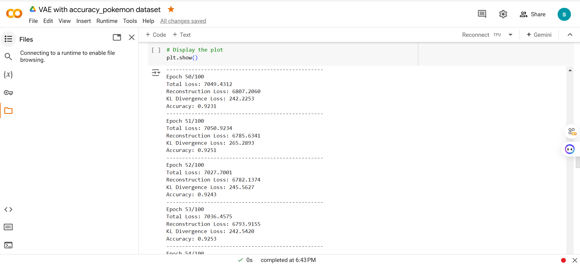
100% IMPLEMENTATION WITH RESULTS
VARIATIONAL AUTOENCODERS

Slide 25
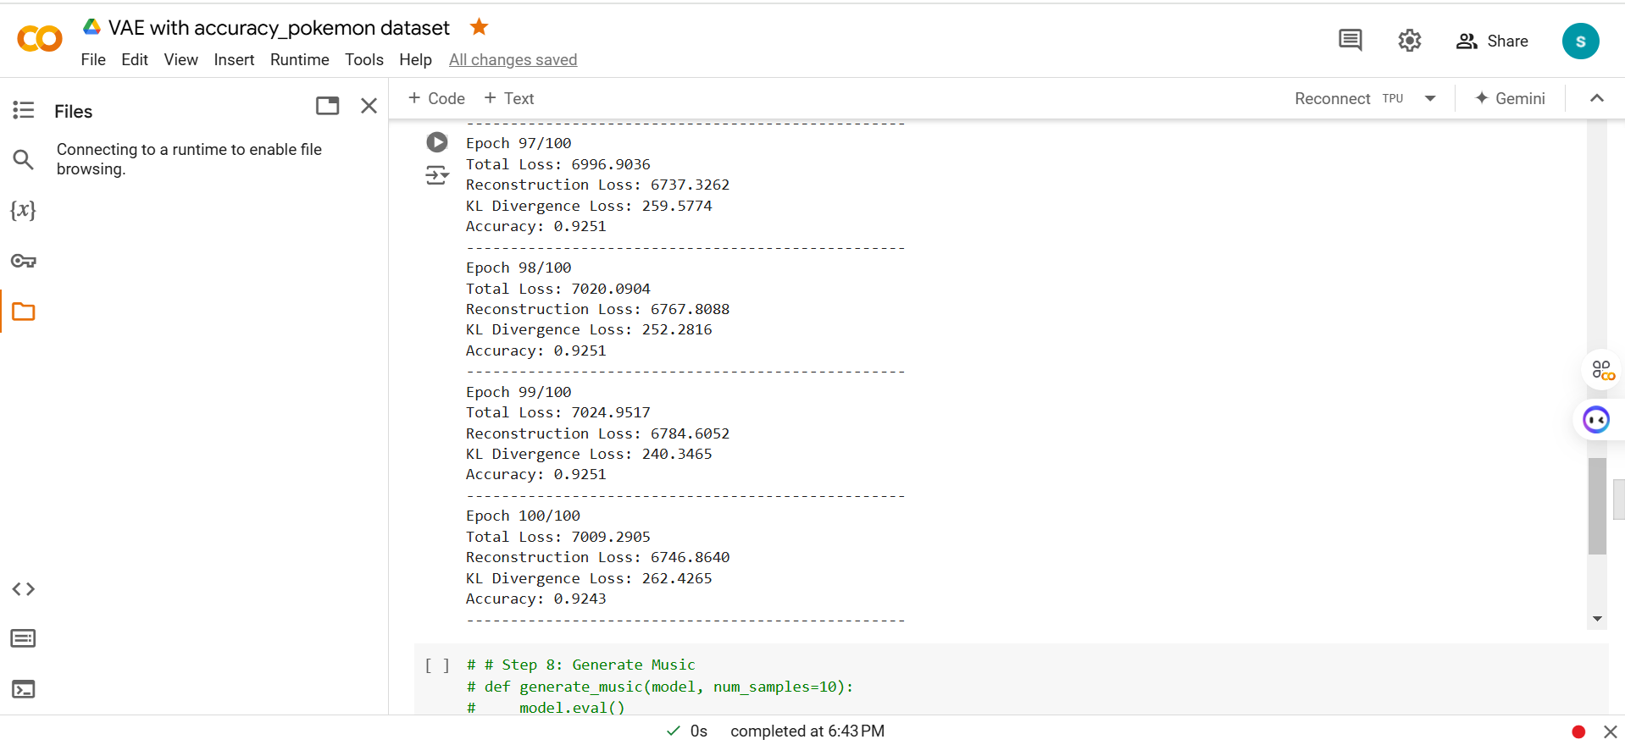
100% IMPLEMENTATION WITH RESULTS
VARIATIONAL AUTOENCODERS

Slide 26
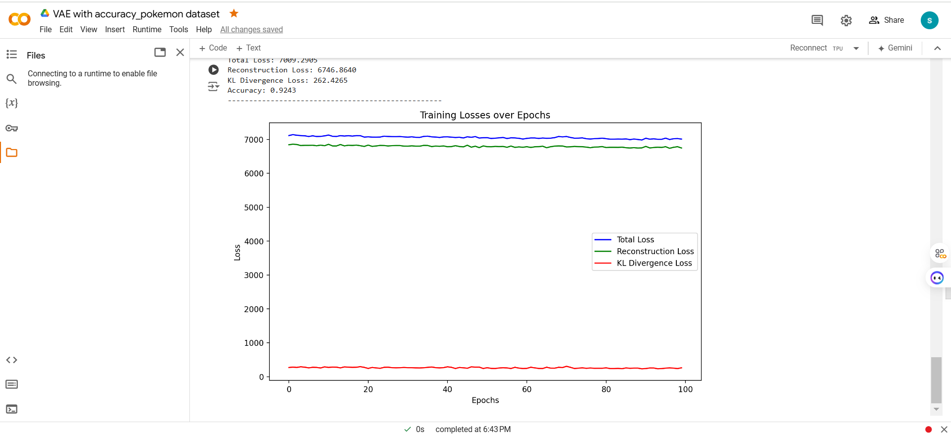
100% IMPLEMENTATION WITH RESULTS
VARIATIONAL AUTOENCODERS

Slide 27
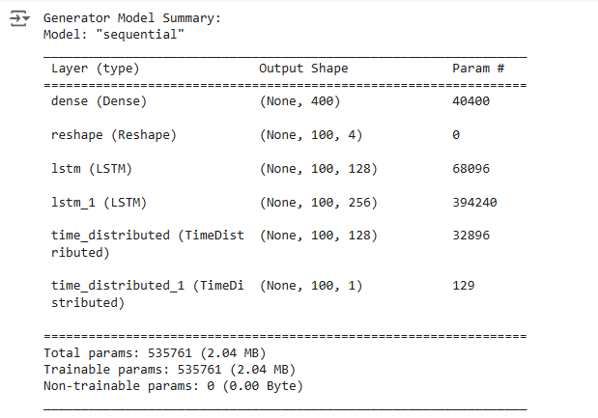
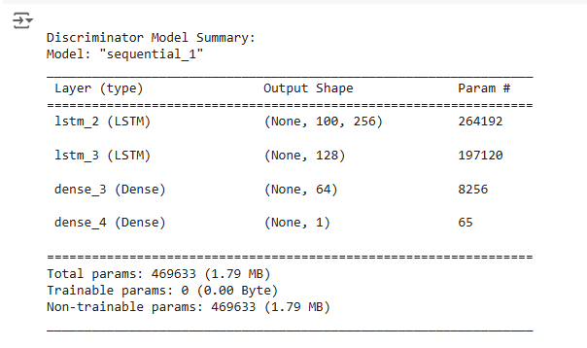
100% IMPLEMENTATION WITH RESULTS
GAN

Slide 28
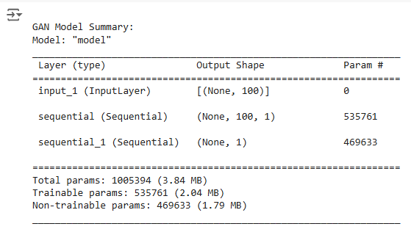
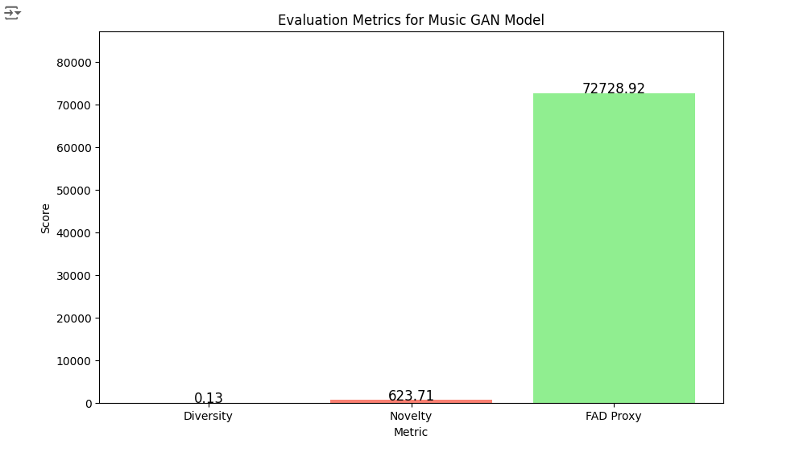
100% IMPLEMENTATION WITH RESULTS
GAN

Slide 29
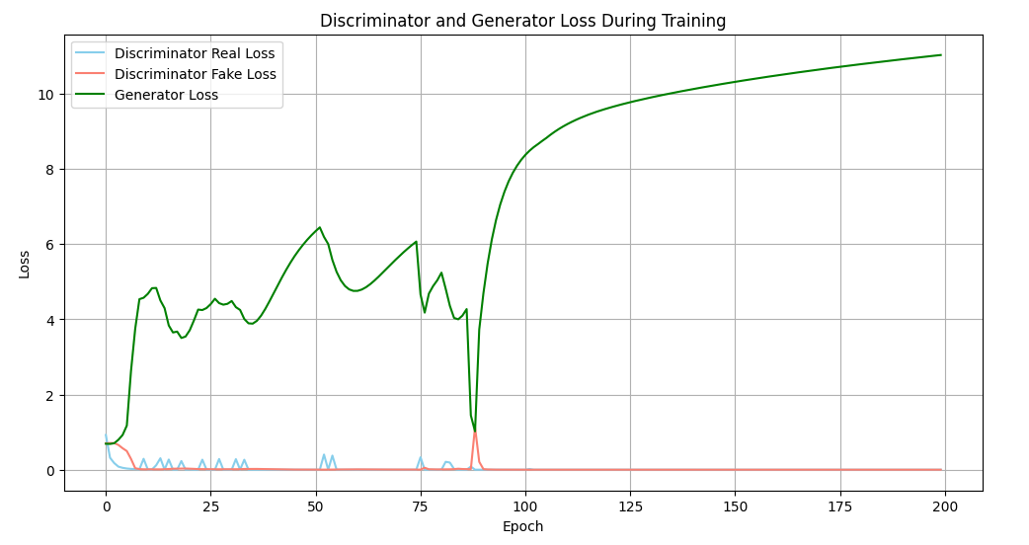
100% IMPLEMENTATION WITH RESULTS
GAN

Slide 30
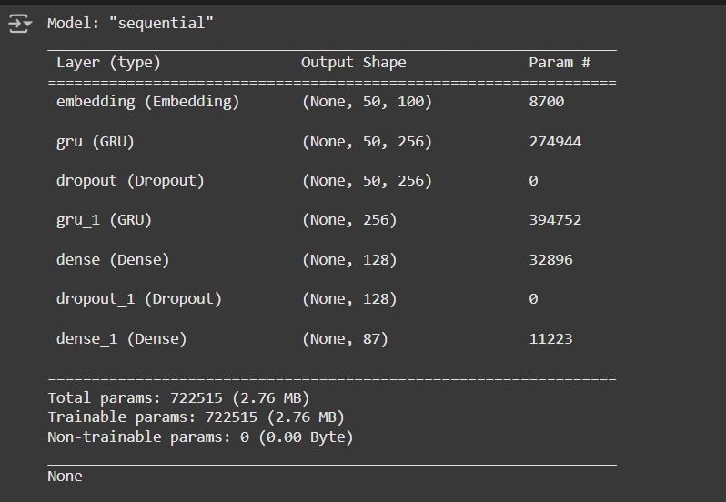
100% IMPLEMENTATION WITH RESULTS
GRU

Slide 31
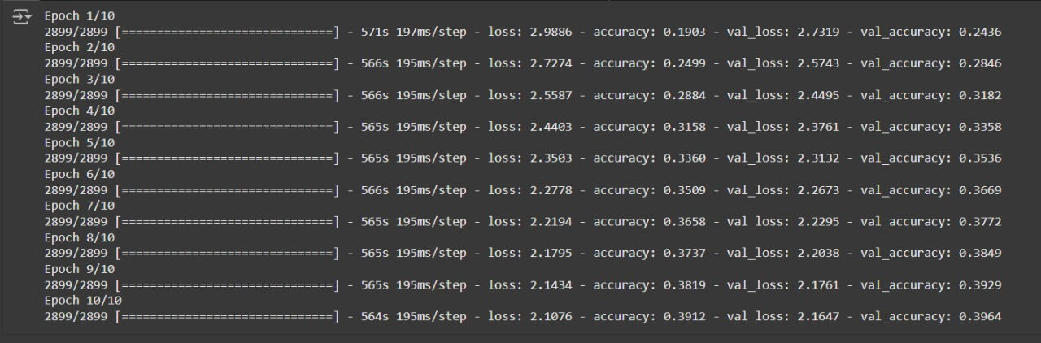
100% IMPLEMENTATION WITH RESULTS
GRU

Slide 32
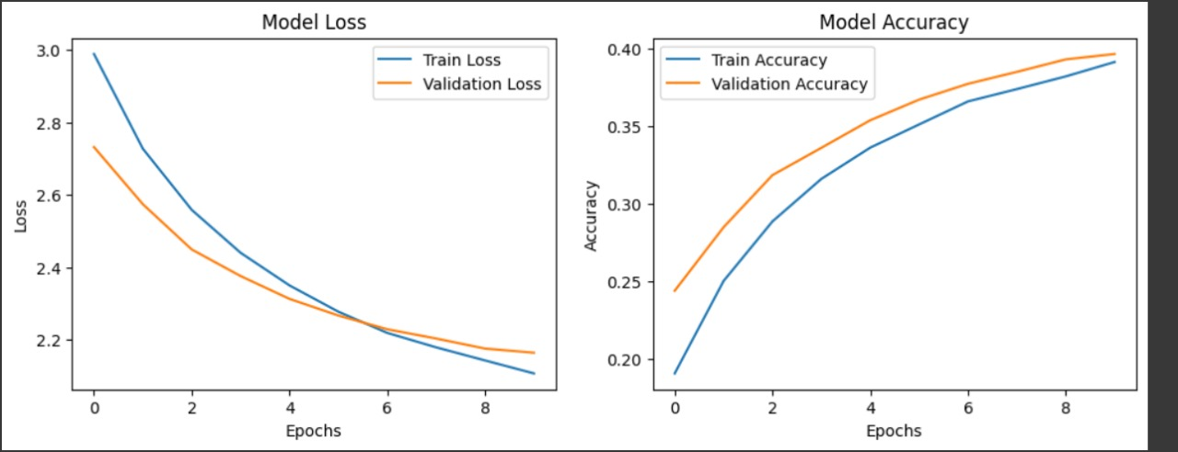
100% IMPLEMENTATION WITH RESULTS
GRU

Slide 33
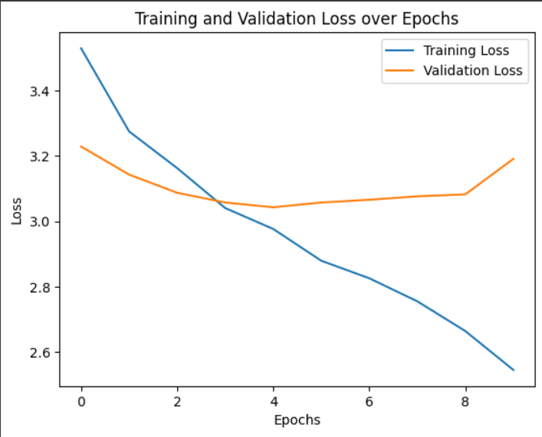
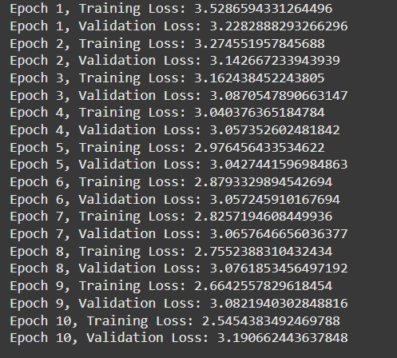
100% IMPLEMENTATION WITH RESULTS
TRANSFORMERS

Slide 34
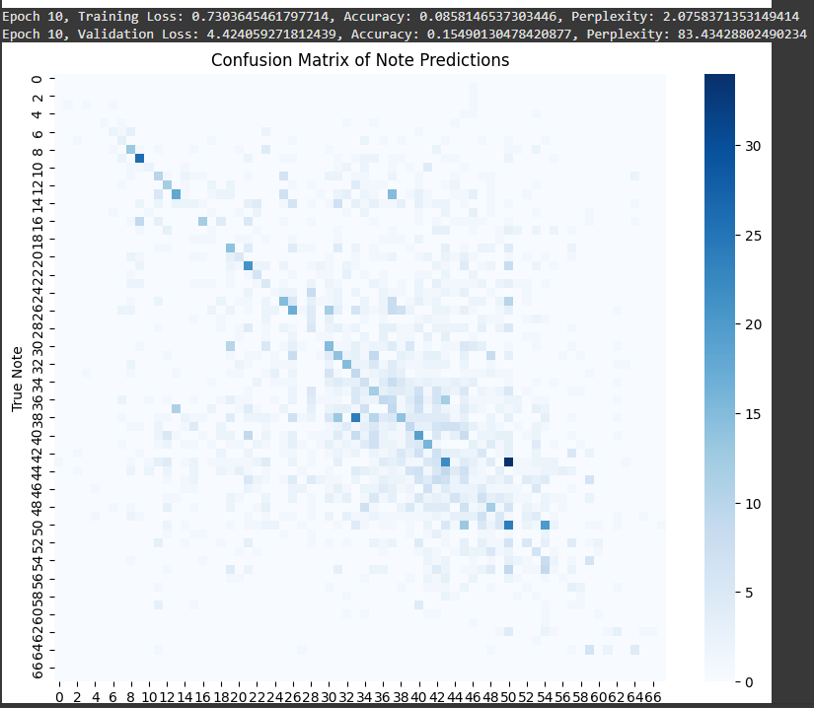
100% IMPLEMENTATION WITH RESULTS
TRANSFORMERS

Slide 35
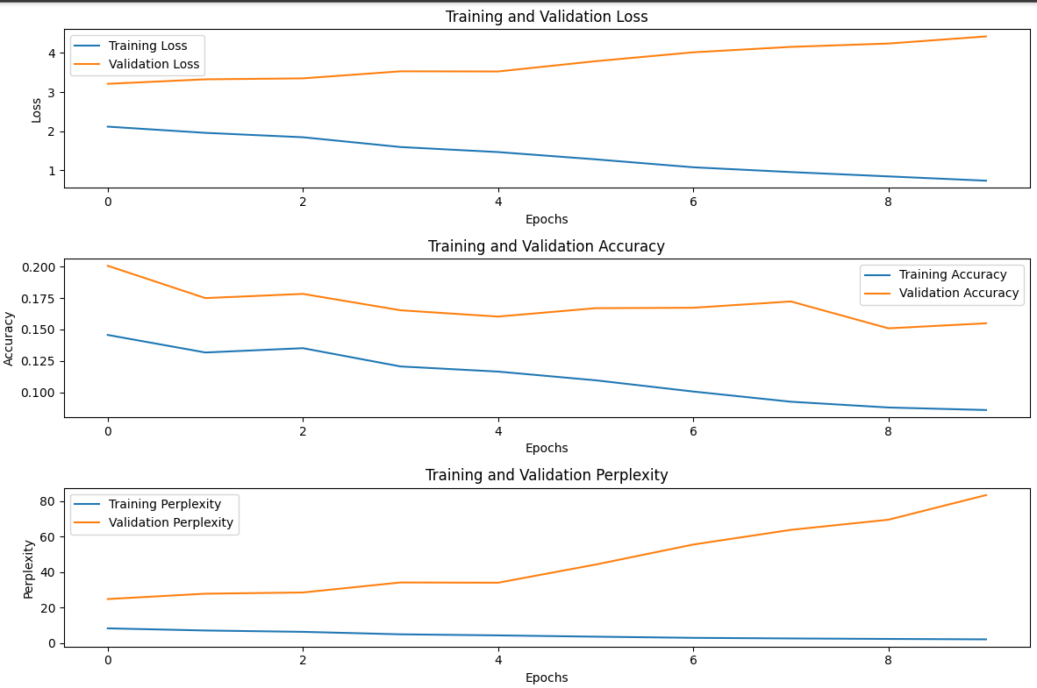
100% IMPLEMENTATION WITH RESULTS
TRANSFORMERS

Slide 36
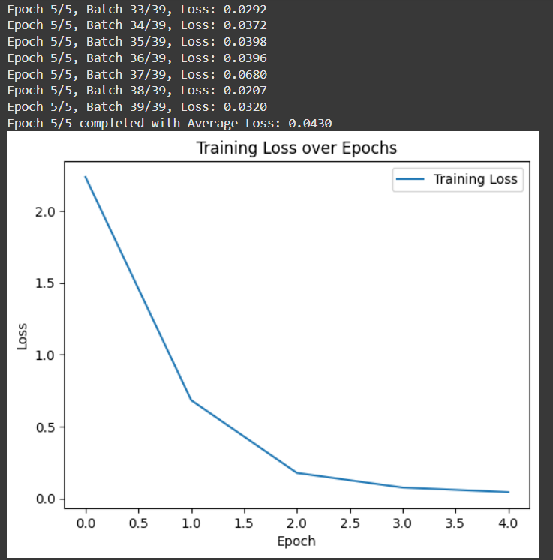


100% IMPLEMENTATION WITH RESULTS
DIFFUSION MODEL

Slide 37
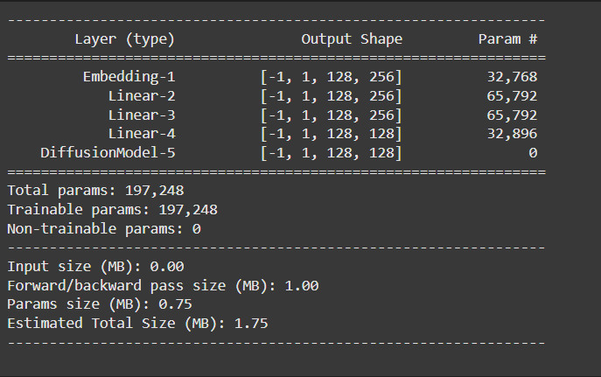
100% IMPLEMENTATION WITH RESULTS
DIFFUSION MODEL

Slide 38

OUTPUT GENERATED
GRU
GAN
VAE

Slide 39
OUTPUT GENERATED
OpenAI Jukebox
Transformers
Diffusion models

Slide 40
INTERPRETATION
Comparative Model Evaluation:
The project is comparing six AI models:
  Generative Adversarial Networks (GANs): These models use an adversarial process where a generator creates music and a discriminator evaluates it. This cycle improves the quality of generated music, but it might struggle with maintaining long-term coherence.
  Gated Recurrent Units (GRUs): These are a type of recurrent neural network (RNN) designed to model sequential data like music. GRUs are good at capturing temporal flow in music, but may face challenges in producing diverse variations or creative, novel outputs.
  Variational Autoencoders (VAEs): These models are used to generate diverse music by learning a continuous latent space. VAEs allow for creative variations but might lack long-term musical coherence or structure.
  OpenAI’s Jukebox: Jukebox uses transformers, a type of deep learning architecture that excels at handling long-range dependencies. It is capable of generating high-fidelity music, including vocals, across various genres, but might be computationally intensive.

Slide 41
INTERPRETATION
Transformers: These models are highly effective in handling long-range dependencies, making them well-suited for music generation. Transformers utilize a self-attention mechanism that enables them to capture intricate musical patterns and maintain coherence over long compositions. They excel in generating structured, coherent sequences but can require substantial computational resources, especially for lengthy compositions.
Diffusion Models: Diffusion models generate music by gradually refining a noisy signal into a coherent composition through iterative denoising steps. This process allows for precise control over the generated output, potentially producing unique and intricate sounds. Diffusion models are powerful for creating high-quality, realistic audio; however, they may be slower to train and generate music due to the iterative refinement process.

Slide 42
INTERPRETATION
Metrics for Evaluation: The models’ outputs will be evaluated based on both objective metrics and subjective assessments:
Harmonicity: How musically correct or pleasant the generated music is in terms of harmony (e.g., chord progressions).
Rhythmic Consistency: The timing and rhythm of the music, ensuring it flows smoothly and maintains consistent beats.
Novelty: The originality or creativity in the music generation—how well the model avoids repetitive or formulaic compositions.
Coherence: The ability of the model to generate compositions that make sense from a musical standpoint, without abrupt transitions or inconsistencies.
Subjective Human Assessment: User feedback, which will be critical in evaluating the perceived quality and enjoyment of the generated music.

Slide 43
INTERPRETATION
Attention Mechanism: The self-attention layers in Transformers allow the model to focus on different parts of a musical sequence, making it possible to retain a sense of structure and progression, essential for harmonicity and coherence.
Handling Long Sequences: Transformers can generate music over extended sequences while maintaining rhythmic consistency, which is crucial in producing coherent musical phrases.
Denoising Process: Diffusion models add noise to an input signal and learn to reverse this process. This iterative refinement can yield highly detailed and novel musical outputs, potentially enhancing the Novelty metric by creating unique, less formulaic compositions.
Audio Synthesis Potential: Diffusion models excel at producing high-quality audio directly, making them effective for generating realistic sound textures that adhere to harmonicity.
Control and Conditioning: Diffusion models can be conditioned on specific features, such as genre or emotion, enabling more targeted music generation that aligns with user preferences, thus improving subjective human assessment.

Slide 44
CONCLUSION
In conclusion, various AI models—GRUs, GANs, VAEs, OpenAI’s Jukebox, Transformers, and Diffusion models—each offer unique strengths and limitations for music generation. GRUs excel at capturing temporal sequences, making them effective for maintaining rhythm and flow but limited in generating diverse and novel outputs. GANs, through their adversarial process, produce high-quality music but can struggle with long-term coherence. VAEs allow for creativity and variation by exploring a continuous latent space, though they may lack structural consistency over extended sequences.
OpenAI's Jukebox, leveraging transformers, demonstrates an impressive ability to capture long-range dependencies and create genre-specific music, including vocals, though at a high computational cost. Transformers themselves, with their self-attention mechanism, are highly capable of modeling intricate patterns and maintaining coherence across long compositions, making them suitable for structured musical pieces. Finally, Diffusion models stand out for their ability to generate realistic and high-quality audio through iterative refinement, offering fine control over the output but requiring more time for training and generation.
Ultimately, each model brings unique capabilities to the field of AI music generation. The choice of model should be guided by the specific requirements of the project—whether it’s coherence, creativity, fidelity, or computational efficiency. Combining these approaches or applying them to different stages of the creative process could open up new avenues for innovative and high-quality AI-generated music.

Slide 45
REFERENCES
"A Survey on Generative Adversarial Networks for Music Generation" by Yang, J., et al. (2020) - arXiv:2001.05094
Website: Magenta by Google - Magenta is a popular open-source project by Google that explores machine learning techniques, including GANs, for music generation.
Paper: "Generating Music with Recurrent Neural Networks" by Graves, A. (2013) - arXiv:1303.2524
Website: OpenAI Jukebox: Music and Lyrics Generation using Deep Neural Networks - While focused on Jukebox, OpenAI's approach also references recurrent network architectures, which can help contextualize GRU-based models in music generation.
"A Hierarchical Variational Autoencoder for Generating Musical Scores" by Roberts, A., et al. (2018) - Link: arXiv:1803.05220
[3] J. Dhariwal, H. Jun, C. Payne, P. Kim, A. Radford, and I. Sutskever, "Jukebox: A Generative Model for Music," OpenAI Blog, Apr. 2020. Available: https://www.openai.com/blog/jukebox.
Website: Magenta: MusicVAE - MusicVAE is a VAE-based model by Google’s Magenta that generates music by learning from sequences. It provides tools for music composition and transformation.

Slide 46
REFERENCES
J. Ho, A. Jain, and P. Abbeel, "Denoising Diffusion Probabilistic Models," in Advances in Neural Information Processing Systems, vol. 33, pp. 6840–6851, 2020.
Score-Based Models for Audio Generation - Overview and applications of diffusion models for audio in a general sense
Diffusion Models for Audio - A guide to understanding how diffusion models are applied to audio.
Hugging Face Transformers - Extensive tutorials and tools for using transformer models, including BERT, GPT, and other transformer-based architectures for creative tasks: Hugging Face Transformers

