Slide 1
BootStrap4
Bootstrap is the most popular HTML, CSS, and JavaScript framework for developing responsive, mobile-first websites. Bootstrap 4 is the newest version of Bootstrap; with new components, faster stylesheet and more responsiveness.. Bootstrap 3 is the most stable version of Bootstrap,

Slide 2
BootStrap
Bootstrap is a free front-end framework for faster and easier web development
Bootstrap includes HTML and CSS based design templates for typography, forms, buttons, tables, navigation, modals, image carousels and many other, as well as optional JavaScript plugins
Bootstrap also gives you the ability to easily create responsive designs which automatically adjust themselves to look good on all devices, from small phones to large desktops.

Slide 3
How to get BootStrap
There are two ways to start using Bootstrap 4 on your own web site
Include Bootstrap 4 from a CDN
<!-- Latest compiled and minified CSS --> <link rel="stylesheet" href="https://maxcdn.bootstrapcdn.com/bootstrap/4.3.1/css/bootstrap.min.css">
<!-- jQuery library --> <script src="https://ajax.googleapis.com/ajax/libs/jquery/3.4.1/jquery.min.js"></script>
Download Bootstrap 4 from getbootstrap.com
go to https://getbootstrap.com/, and follow the instructions and download

Slide 4
Containers
Bootstrap 4 requires a containing element to wrap site contents.
There are two container classes to choose from:
The .container class provides a responsive fixed width container
The .container-fluid class provides a full width container, spanning the entire width of the viewport

Slide 5
Bootstrap 4 Grid System
Bootstrap's grid system allows up to 12 columns across the page
If you do not want to use all 12 columns individually, you can group the columns together to create wider columns. Make sure that the sum adds up to 12 or fewer columns.
The Bootstrap grid system has four classes:
xs (for phones - screens less than 768px wide)
sm (for tablets - screens equal to or greater than 768px wide)
md (for small laptops - screens equal to or greater than 992px wide)
lg (for laptops and desktops - screens equal to or greater than 1200px wide)

Slide 6
Bootstrap 4 Text/Typography
Bootstrap 4 Default Settings
font-size of 16px
line-height is 1.5.
font-family is "Helvetica Neue“
<p>:margin-top: 0 , margin-bottom: 1rem
Bootstrap 4 styles HTML headings (<h1> to <h6>)
Display Headings:larger font-size and lighter font-weight,4 classes(display-1, display-2, display-3, display-4)
<small> element is used to create a lighter, secondary text in any heading
<mark> element for highlight
<blockquote> when quoting blocks of content from another source

Slide 7
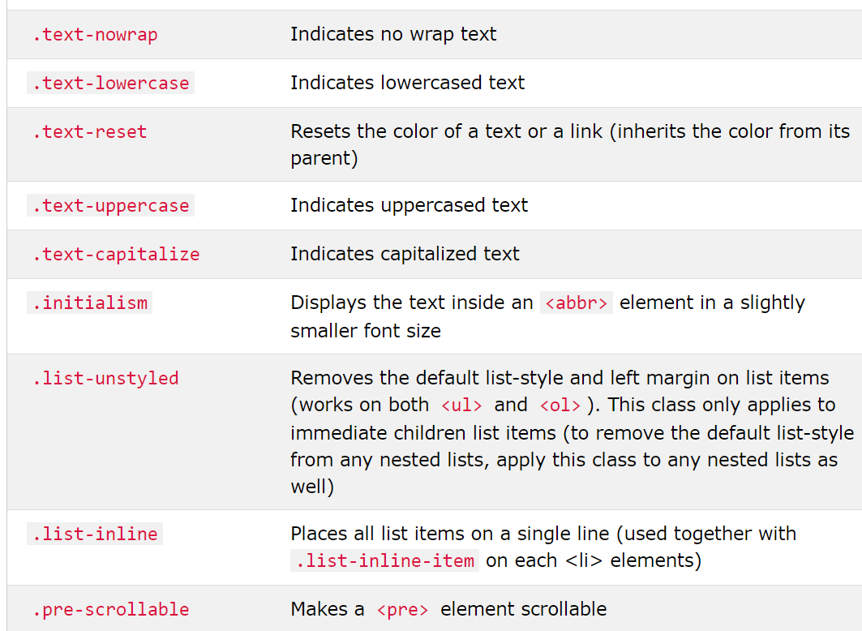
Text prperties

Slide 8
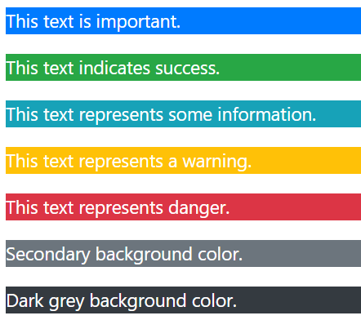
Bootstrap 4 Colors
Bootstrap 4 provides "meaning through colors“
.text-muted, .text-primary, .text-success, .text-info, .text-warning, .text-danger, .text-secondary, .text-white, .text-dark, .text-body (default body color/often black) and .text-light
Background Colors as .bg-primary, .bg-success, .bg-info, .bg-warning, .bg-danger, .bg-secondary, .bg-dark and .bg-light.

Slide 9
Bootstrap 4 Basic Table
The .table class adds basic styling to a table
.table-striped, table-bordered, .table-hover, .table-dark , .table-dark, .table-hover, .table-borderless
Contextual classes can be used to color the whole table (<table>), the table rows (<tr>) or table cells (<td>).
.table-primary,.table-success, .table-danger, .table-info, .table-warning, .table-active, .table-secondary, .table-light, .table-dark

Slide 10
Bootstrap 4 Images
Bootstrap supports:Rounded Corners, Circle, Thumbnail
The .img-rounded class adds rounded corners to an image
The .img-circle class shapes the image to a circle
The .img-thumbnail class shapes the image to a thumbnail
Responsive images automatically adjust to fit the size of the screen. img-responsive class applies display: block; and max-width: 100%; and height: auto; to the image

Slide 11
Bootstrap Jumbotron and Page Header
A jumbotron indicates a big box for calling extra attention to some special content or information.
A jumbotron is displayed as a grey box with rounded corners. It also enlarges the font sizes of the text inside it.
Place the jumbotron inside the <div class="container"> if you want the jumbotron to NOT extend to the edge of the screen
Bootstrap Use a <div> element with class .page-header to create a page header
The .well class adds a rounded border around an element with a gray background color and some padding. .well-sm, .well-lg for small and large

Slide 12
Button Styles
Bootstrap provides different styles of buttons
.btn, btn-default, btn-primary, btn-success, btn-info, btn-warning, btn-danger, .btn-link
The button classes can be used on an <a>, <button>, or <input> element
Bootstrap provides four button sizes:btn-lg,.btn-md,.btn-sm,.btn-xs
class .btn-block to create a block level button
class .active makes a button appear pressed, and the class .disabled makes a button unclickable

