Slide 1
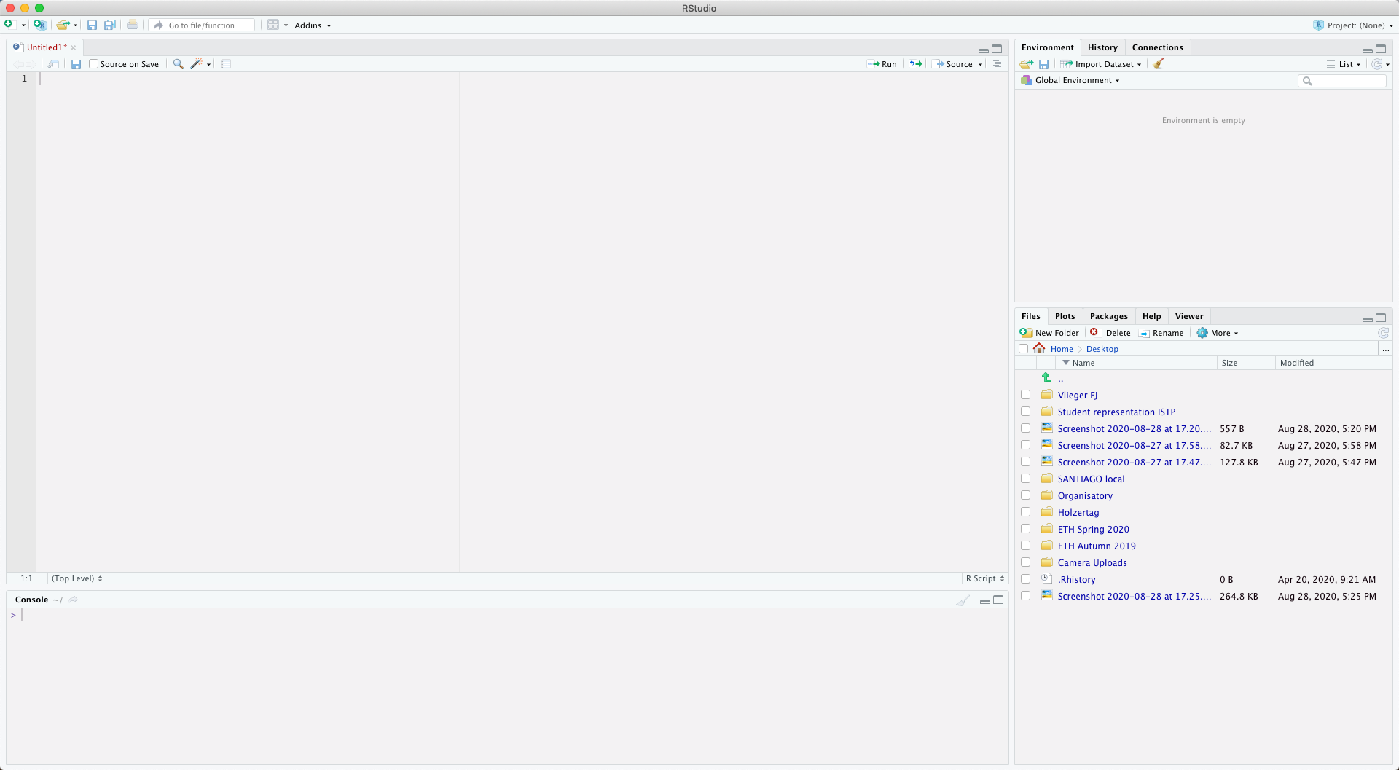
Run your code
Open a new:
script
Rmarkdown
Rpresentation
…
previous assignments/
commands
workspace
assigned variables,
loaded data-sets,
…
This is where you write your script
working directory,
and all files contained in that
installed packages
This is where you can perform quick calculations, call variables, see output

