Slide 1
I am a size template for project pictures on the segal webpage (assuming a ratio of 580x385).
Add content to me and change my background to white.

Slide 2
I am a size template for project pictures on the segal webpage (assuming a ratio of 640x500).
Add content to me and change my background to white.

Slide 3
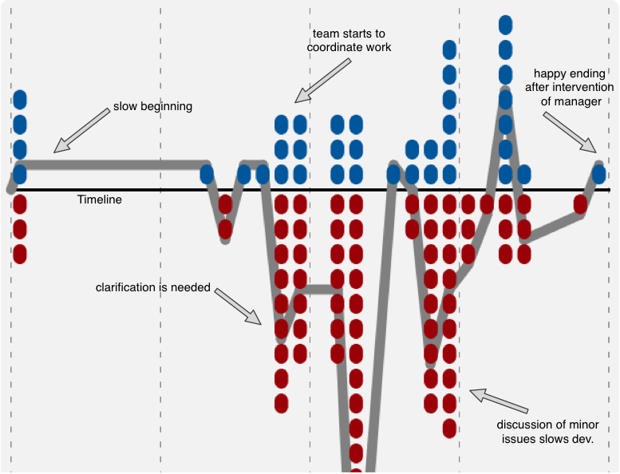
I am a size template for project pictures on the segal webpage (assuming a ratio of 640x500).
Add content to me and change my background to white.

Slide 4
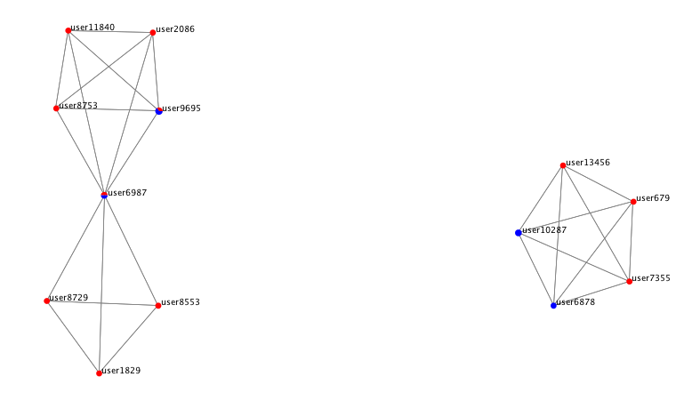
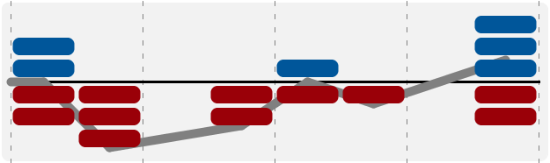
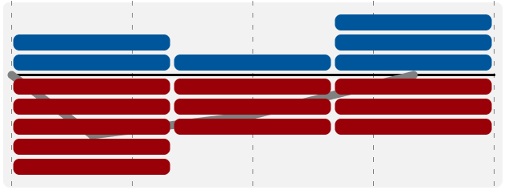
I am a size template for project pictures on the segal webpage (assuming a ratio of 640x500).
Add content to me and change my background to white.
I am a size template for project pictures on the segal webpage.
Add content to me and change my background to white.

Slide 5
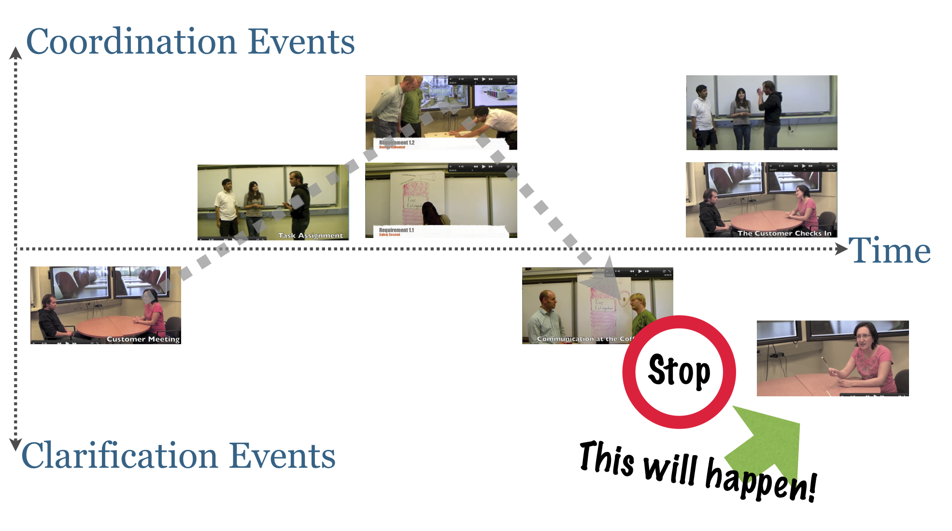
I am a size template for project pictures on the segal webpage (assuming a ratio of 640x500).
Add content to me and change my background to white.
I am a size template for project pictures on the segal webpage.
Add content to me and change my background to white.

Slide 6
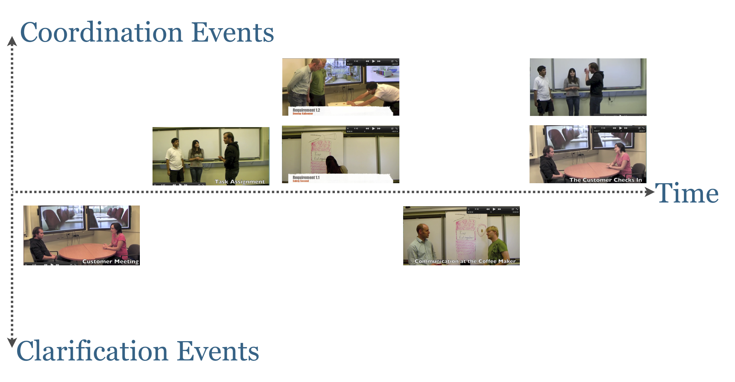
I am a size template for project pictures on the segal webpage (assuming a ratio of 640x500).
Add content to me and change my background to white.
I am a size template for project pictures on the segal webpage.
Add content to me and change my background to white.

Slide 7
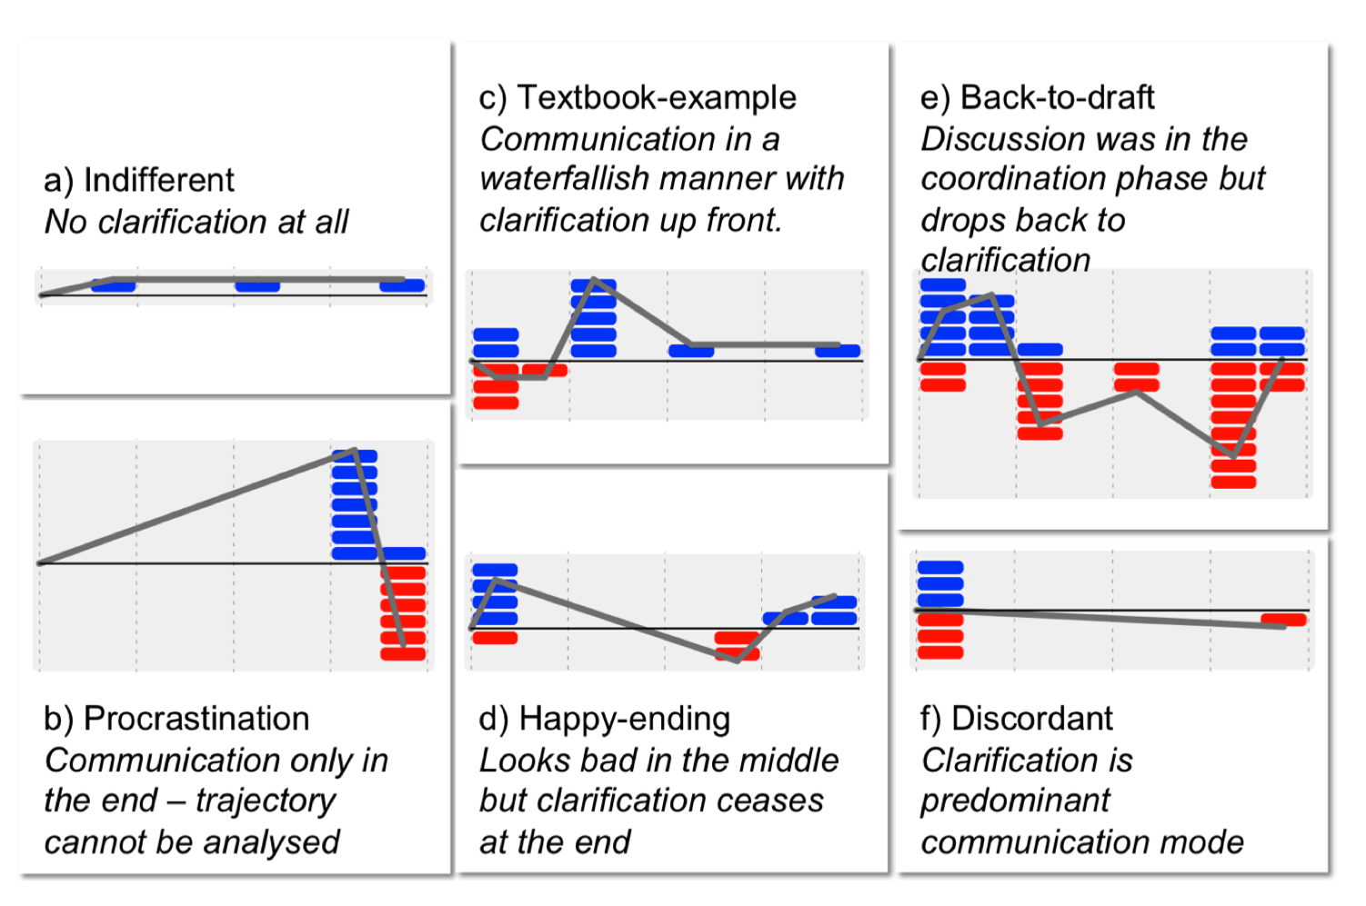
I am a size template for project pictures on the segal webpage (assuming a ratio of 640x500).
Add content to me and change my background to white.

