Slide 1



BOTALYZE
AI-Based Voice Agents for Hotels, Restaurants
Your AI Assistant for Smarter Planning.
University of Engineering and Technology, Lahore

Slide 2



Group Members
Noman Haider ( 2025-GA-06 )
Ghania Majid ( 2025-GA-07 )
Zainab Aftab ( 2025-GA-09 )
Fakiha Ruhma ( 2025-GA-12)
Muhammad Hamza ( 2025-GA-54 )

Slide 3
Course Instructor
Ms. Ramsha Khalid
Lecturer, Department of Computer Science

Slide 4



Overview
  Introduction
  Objectives
  Demo Screenshots
  Charts
  Design and Decision
  Resource Links
  Reflection and Learning
  Conclusion
  Q/A

Slide 5



Introduction
The Bottlenecks

Slide 6

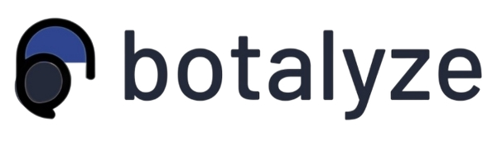

What is Botalyze ?
  Botalyze is an AI-powered voice agent designed specifically for the hotel industry.
  It automatically handles incoming calls, guest inquiries, and booking requests 24/7.
  The system reduces missed calls and eases staff workload during busy hours.

Slide 7
Objectives
  Automate Booking: Seamlessly handle reservations and inquiries using advanced AI voice agents.
  24/7 Customer Support: Provide uninterrupted service and instant responses around the clock.
  Integrate Platforms: Connect effortlessly with existing hospitality booking systems for unified operations.
  Reduce Staff Workload: Free up valuable human resources by delegating routine tasks to AI.

Slide 8




Addressing Key Industry Challenges
Redefining with AI

Slide 9

Common Pain Points
  Missed booking opportunities due to unanswered calls.
  Manual handling of inquiries during peak operational hours.
  Human errors in data entry and reservation management.
  Lack of scalable automation for small to medium-sized businesses.

Slide 10

Botalyze’s Solutions
  Botalyze directly tackles these issues by providing an intelligent,
always-on voice agent that ensures no customer interaction is missed.
  Operational efficiency is maximized, and service quality is consistently high.
  By automating routine tasks, businesses can focus on delivering exceptional
in-person experiences..

Slide 11
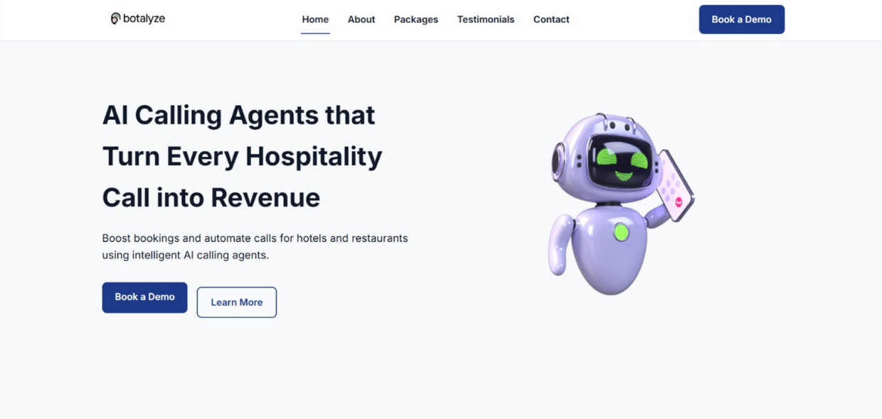
Website Home Page
  The Botalyze homepage serves as the gateway to our solution, offering a clear overview of our AI voice agent capabilities and their benefits. Visitors can quickly understand how Botalyze transforms customer interactions in the hospitality sector, with intuitive navigation to explore features and pricing.

Slide 12
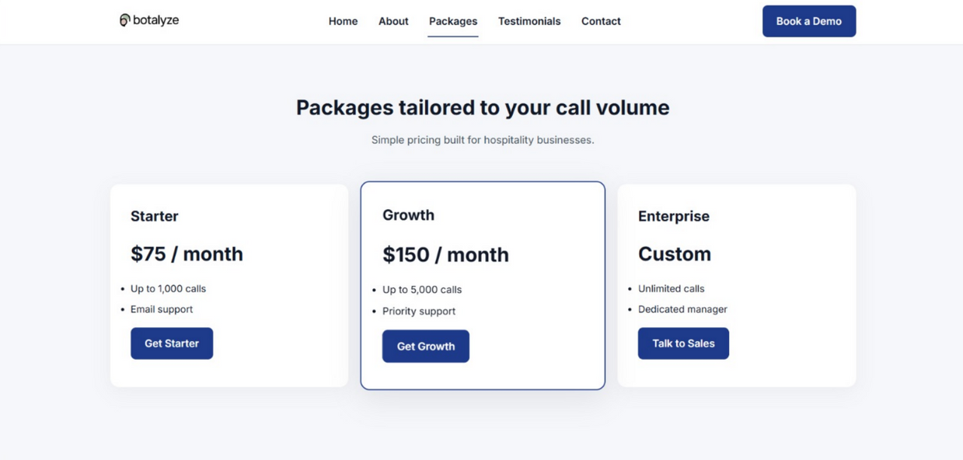
Website Product & Services
  AI Voice Agents : Intelligent conversational agents available 24/7.
  Automated Booking : Seamless Reservation and inquiry handling.
  Platform Integration : Connects with popular booking systems.

Slide 13
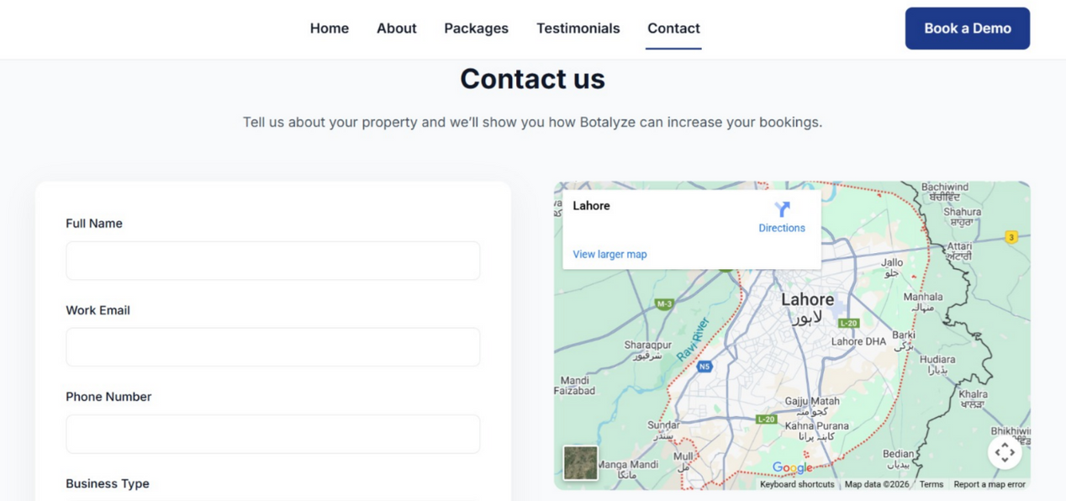
Website Contact Page
  The Contact page is designed for ease of access, allowing prospective clients to reach out for demonstrations, custom quotes, or partnership inquiries. It facilitates direct communication for businesses ready to integrate Botalyze into their operations.

Slide 14
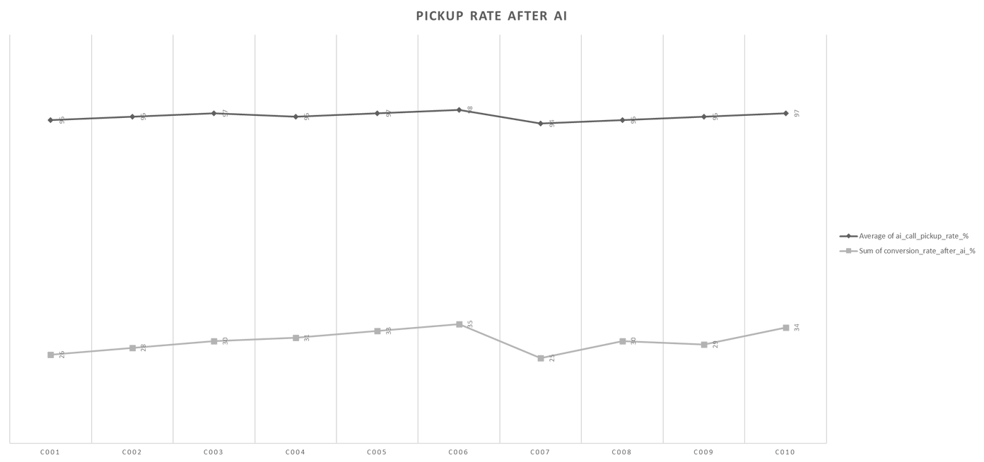
Market Growth
  AI implementation significantly improved call pickup rates, with hotels experiencing up to 96% increase in answered calls within the first month.
  Reduction in missed calls, especially during peak hours and off-peak shifts, leading to better guest engagement.
  Consistent 24/7 availability ensured every guest inquiry was answered, driving higher customer satisfaction and repeat bookings.

Slide 15

Key Insights from Data
  Improved Efficiency: Significant reduction in time spent on routine booking tasks.
  Faster Response Times: Instant customer interaction leads to higher satisfaction.
  Increased Booking Handling: Ai agents process more bookings concurrently without errors.
  Reduced Operational Loads: Staff can now focus on high-value guest experiences.

Slide 16
Design & Decision
  UI/UX Simplicity: Intuitive interfaces for effortless user and administrator experience.
  Voice-First AI: Prioritizing natural language processing for seamless voice interactions.
  GitHub Pages: Efficient and reliable deployment for project accessibility.

Slide 17


Resource Links
Experience Botalyze firsthand and explore our code
Live Website : https://hamz16-30.github.io/Botalyze/
GitHub Repository : https://github.com/Hamz16-30/Botalyze

Slide 18

Reflection & Learning
  Understanding a specific business problem.
  We had to narrow the idea down to hotels only and think about actual hotel operations, call volumes, and the pain of missed calls.
  Balancing technical terms with simple language
  It was tempting to use a lot of AI buzzwords, but hotel managers mainly care
about fewer missed calls and more bookings. Translating technical ideas into
everyday benefits was a key lesson.

Slide 19


Conclusion:
Why Botalyze?

Slide 20
Final Summary
  Botalyze effectively addresses missed calls and staff workload by providing a reliable AI-powered voice agent for hotels.
  The solution improves call pickup rates, guest communication, and booking efficiency, leading to increased revenue potential.
  This project demonstrates the future role of AI automation in hospitality, showing how smart technology can support service quality and business growth.

Slide 21
ANY QUESTIONS?

Slide 22
THANK YOU
For your attention

