Slide 1


Self—Interference Cancellation Low Noise Amplifier (Pakistan 6) (Design Review) Team Members: Engr. Mudassir Ali Engr. Hafiz Saleem Ullah Engr. Usama Liaqat Engr. Hamza Saleem
National University of Computer and Emerging Sciences (FAST-NU),
A.K. Brohi Road, H-11/4,
Islamabad-44000, Pakistan

Slide 2
Outline
Detailed Design
Simulations Results

Slide 3
Outline of Presentation
Detailed Design
Simulations Results

Slide 4
Detailed Design
Complete Schematic:

Slide 5
Operation of Stage 1

Slide 6
Operation of Stage 2

Slide 7
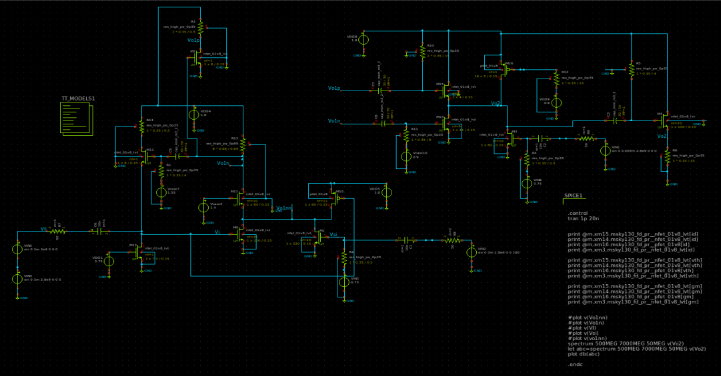
Detailed Design (xschem schematic)

Slide 8
Outline of Presentation
Detailed Design
Simulations Results

Slide 9
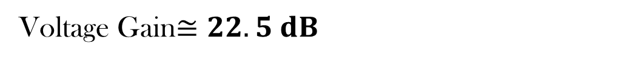
Gain
Voltage Gain$≅22.5 dB$

Slide 10
$S_{11}$
Input Reflection Coefficient$< −10 dB$

Slide 11
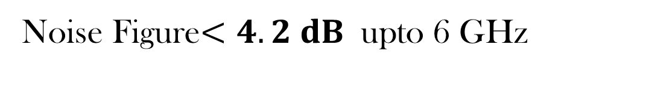
Noise Figure
Noise Figure$<4.2 dB$ upto 6 GHz

Slide 12

SIC w.r.t Frequency

Slide 13

Gain and Cancellation at 0.9GHz
Frequency of Desired Received Signal=0.92 GHz=> Amplification (21 dB)
Frequency of Interference Signal=0.9 GHz=> Cancellation (31 dB)

Slide 14
Gain and Cancellation at 1.8GHz
Frequency of Desired Received Signal=1.82 GHz=> Amplification (21 dB)
Frequency of Interference Signal=1.8 GHz=> Cancellation ( 25 dB)

Slide 15
Gain and Cancellation at 2.4GHz
Frequency of Desired Received Signal=2.42 GHz=> Amplification (20.5 dB)
Frequency of Interference Signal=2.4 GHz=> Cancellation ( 24 dB)

Slide 16
Gain and Cancellation at 5.4GHz
Frequency of Desired Received Signal=5.42 GHz=> Amplification (19 dB)
Frequency of Interference Signal=5.4 GHz=> Cancellation ( 17 dB)

Slide 17
Thank You

