Slide 1


Final Year Project
DeepTruth – Detecting DeepFakes using Deep Learning algorithms
Supervised By: Dr. Jawaid Iqbal (In-charge Program Cyber Security)

Slide 2
Project Team
Hamza (27671)
Omer Fayyaz Khan (28559)
Muhammad Labib Amir (26217)

Slide 3
Table of Content
Background and Introduction
Market Survey
Problem Statement
Endeavour
Project Scope
Proposed Solution
Requirements Summary
Design Summary
Methodology
Implementation Summary
Experiments and Results Summary
Testing Summary
Conclusion and Outlook

Slide 4
“Humanity is acquiring all the right technology for all the wrong reasons.”

Slide 5
BACKGROUND AND INTRODUCTION

Slide 6
Introduction
Derived from Deep Learning and Fake
Synthetic media – generated by computers
Replaces looks of one with another person
For entertainment, revenge, misinformation

Slide 7
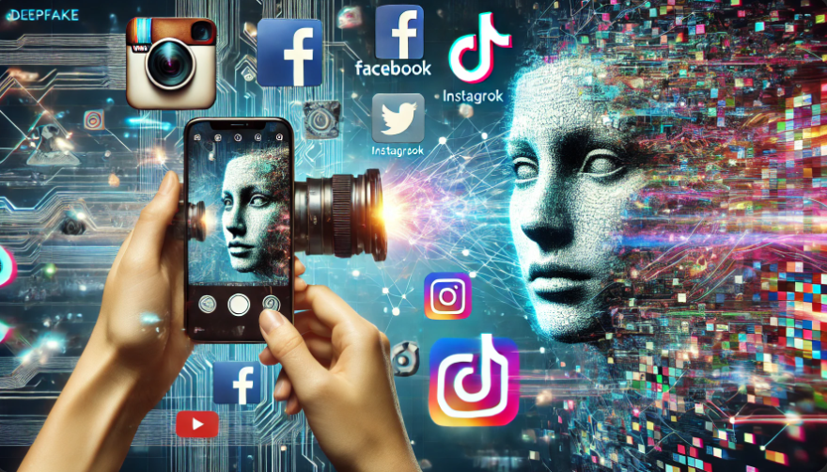

Background
Social Media + Mobile Camera Technology + Deep Learning = DeepFakes

Slide 8
Stakeholders
Politicians
Celebrities
General public
Corporate entities
Government agencies

Slide 9
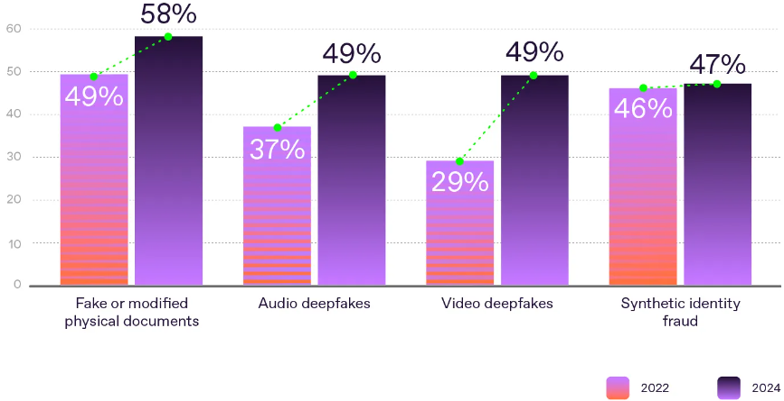
Surge over the past two years

Slide 10
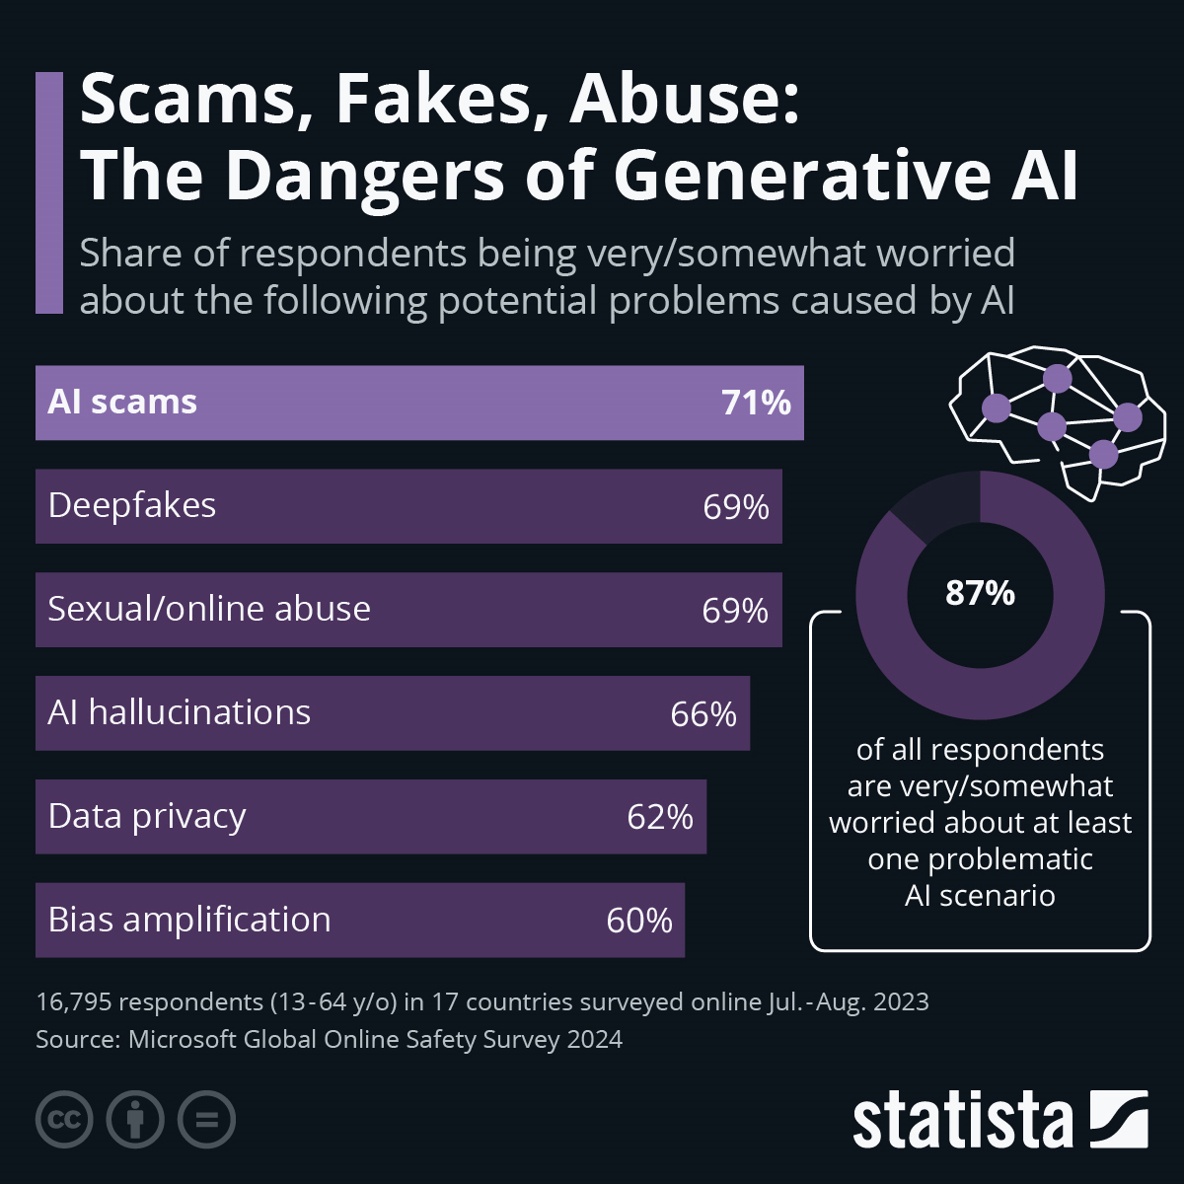
Public concerns about AI problems

Slide 11
MARKET SURVEY

Slide 12




Market Survey
Criteria | Sensity.ai | DeepFake Detector | Deepware Scanner | Microsoft Video Authenticator
Detection Accuracy | More than 95% accuracy in identifying face swaps, and lip-sync, using deep learning and pixel analysis​ | Reliable for simple manipulations, may struggle with complex DeepFakes | More than 90% accuracy, though results vary based on DeepFake complexity​ | Very high accuracy with real-time analysis, especially in media with subtle inconsistencies
Deployment Flexibility | Cloud-based, on-premise, and API integration for enterprise use | Primarily cloud-based, lacks on-premise or API options | Available as standalone and API, supports batch processing | Primarily cloud-based, with API access for select partners, designed for enterprise integration
Target Audience | Enterprise-focused, suitable for media, law enforcement, and financial institutions​ | Consumer-focused, ideal for individual users, journalists, and small businesses | Focused at both individual and enterprise users needing batch media verification | Enterprise-focused, such as news agencies and social media platforms needing real-time verification
Real-time Capabilities | Near-real-time detection, beneficial for live monitoring in high-risk sectors | Lacks real-time capability, best suited for post-upload verification | Supports near-real-time detection for some plans​ | Excels in real-time analysis, suited for live media verification​
Usability | User-friendly interface, with API integration for easy deployment in enterprise setups | Simple, accessible platform, suitable for non-technical users | Straightforward interface with batch processing and API option | Easy to use, though enterprise setup may require some technical support
Cost | Custom pricing for enterprise | Cost-effective for individuals and small businesses | Tiered pricing, with basic and advanced plans | Pricing not publicly disclosed, customized based on enterprise needs

Slide 13
PROBLEM STATEMENT

Slide 14
Problem Statement
Access mostly available to paid users
Accuracy jeopardized by disproportionate false positives and false negatives
Inability to cater for larger amount of media
Extensive computational power required

Slide 15
ENDEAVOUR

Slide 16
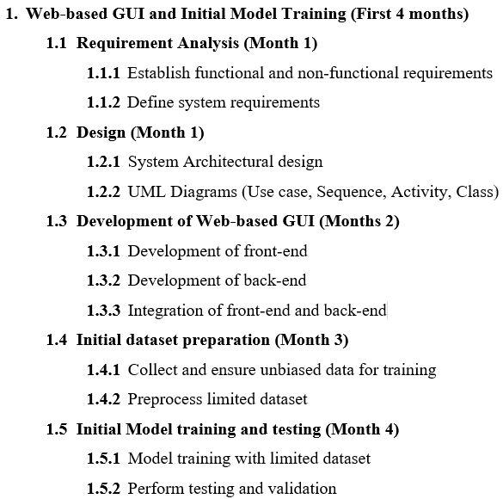
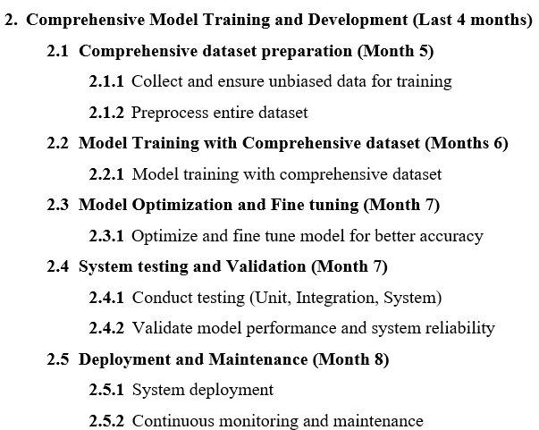
Work Breakdown Structure

Slide 17
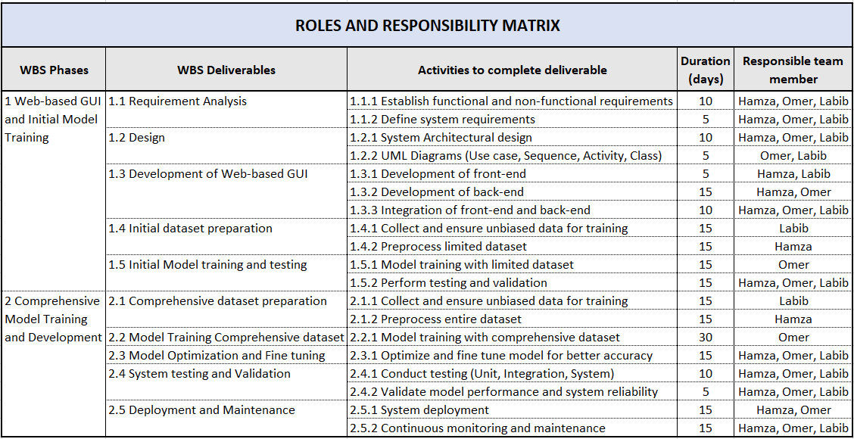
Responsibility Assignment Matrix

Slide 18
PROJECT SCOPE

Slide 19
Project Scope
Free for all web based DeepFake detection
Improved accuracy comparing with others
Solution that caters for larger amount of data
Use of lesser power intensive technologies
Intuitive user interface to improve usability

Slide 20
PROPOSED SOLUTION

Slide 21
Proposed Solution
ResNeXt, a Residual Convolutional Neural Network for essential feature extraction at the frame level
LSTM, a Recurrent Neural Network which processes frames sequentially, enabling temporal analysis of the content
Datasets include DFDC, Celeb-DF, and Face Forensics++

Slide 22
Requirements Summary
User’s ability to upload videos of a prescribed size and format
System’s ability to extract features from video using ResNeXt CNN
System’s ability to capture dependencies and inconsistencies using LSTM RNN
System’s ability to classify video as authentic or forged
System’s ability to return classification, confidence level and accuracy to user

Slide 23
Software Requirements
Hardware Requirements
Operating System:
Windows 10
Programming Language:
Python 3.11
Framework:
PyTorch 2.3.0, Django 5.0.6
Libraries:
OpenCV, Face-recognition
Client-side browser:
Chrome, Firefox, or Edge
CPU:
A modern multi-core CPU GPU:
CUDA enabled GPU
RAM:
16GB or above
Storage:
128GB SSD

Slide 24
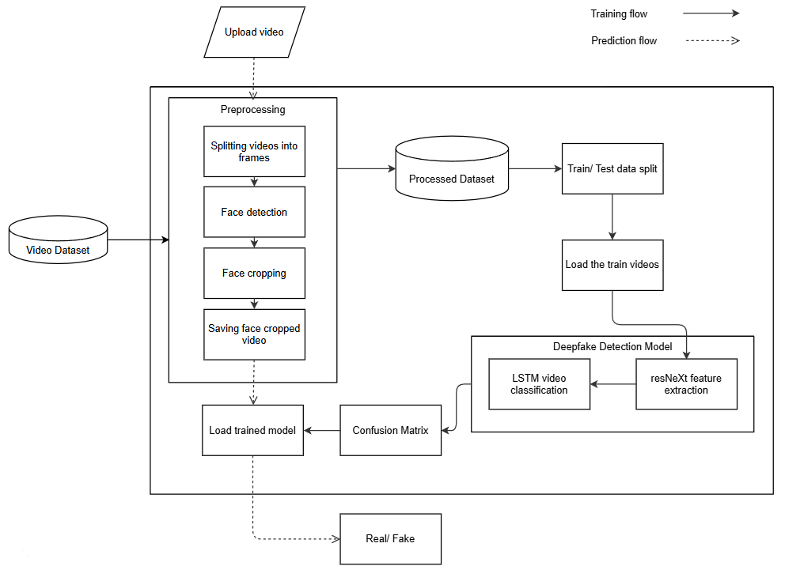
Design Summary

Slide 25
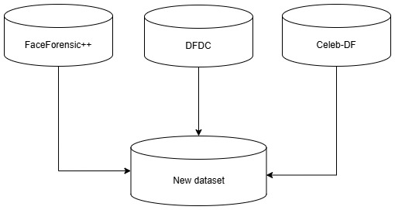
Methodology – Data Collection

Slide 26
Methodology – Data Pre-Processing
Split video into frames
Face cropping
1
2
3
4
Face detection
Saving the face cropped images

Slide 27
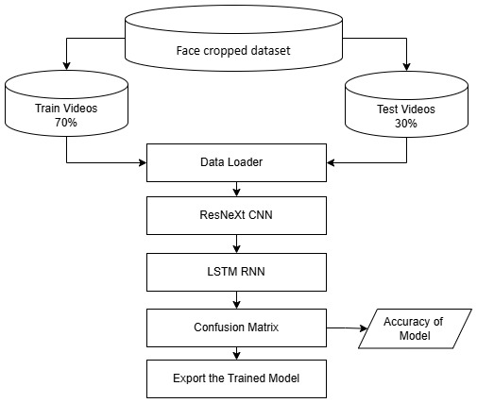
Methodology – Training Workflow

Slide 28
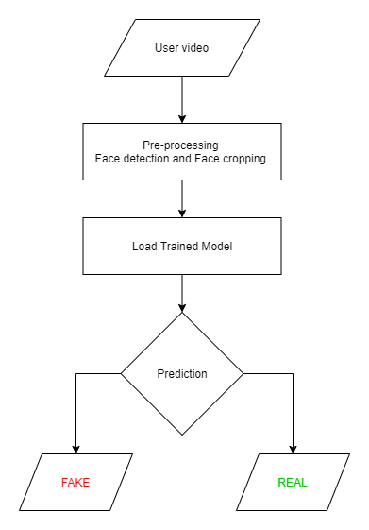
Methodology – Prediction Workflow

Slide 29
Implementation Summary
Requirement Analysis
System Design
Development front and back-end
Integration front and back-end
Preparation of initial dataset
Pre-processing of dataset
Model training
Testing

Slide 30
Experiments and Results Summary
Models | Dataset | Accuracy | Precision | Recall | F1 Score | Specificity
40 Frames | New dataset | 89.35% | 0.88 | 0.90 | 0.89 | 0.88
60 Frames | FaceForensics++ | 97.49% | 0.97 | 0.95 | 0.96 | 0.99
100 Frames | New dataset | 93.91% | 0.96 | 0.89 | 0.93 | 0.97

Slide 31
Testing Summary
Sr. no. | Case Description | Expected outcome | Actual outcome | Status
1 | Upload video of enlisted formats | Real/Fake | Real/Fake | Pass
2 | Upload corrupt or invalid video files | Only video files allowed | Only video files allowed | Pass
3 | Upload video size above 100 MB | Maximum file size 100 MB | Maximum file size 100 MB | Pass
4 | Upload video with no faces | No faces detected. | No faces detected. | Pass
5 | Press upload without video selection | Please select a file | Please select a file | Pass
6 | Upload video with insufficient frames | Video has less than required frames | Video has less than required frames | Pass

Slide 32
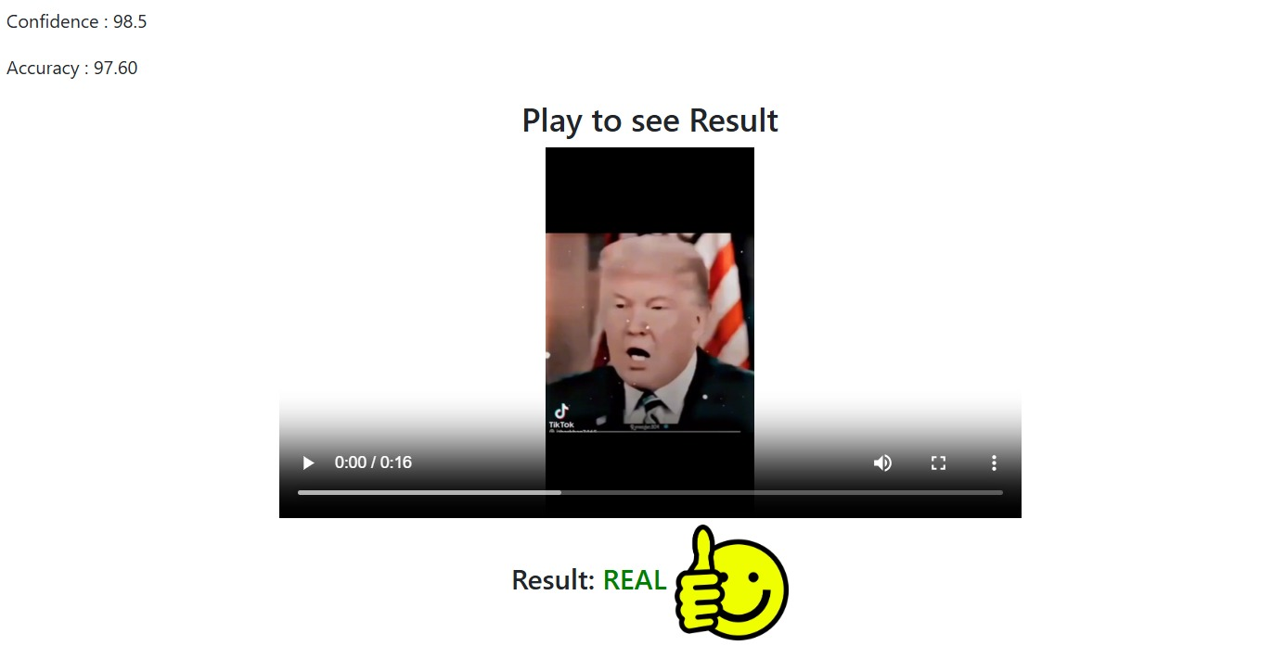
Test Case 1

Slide 33
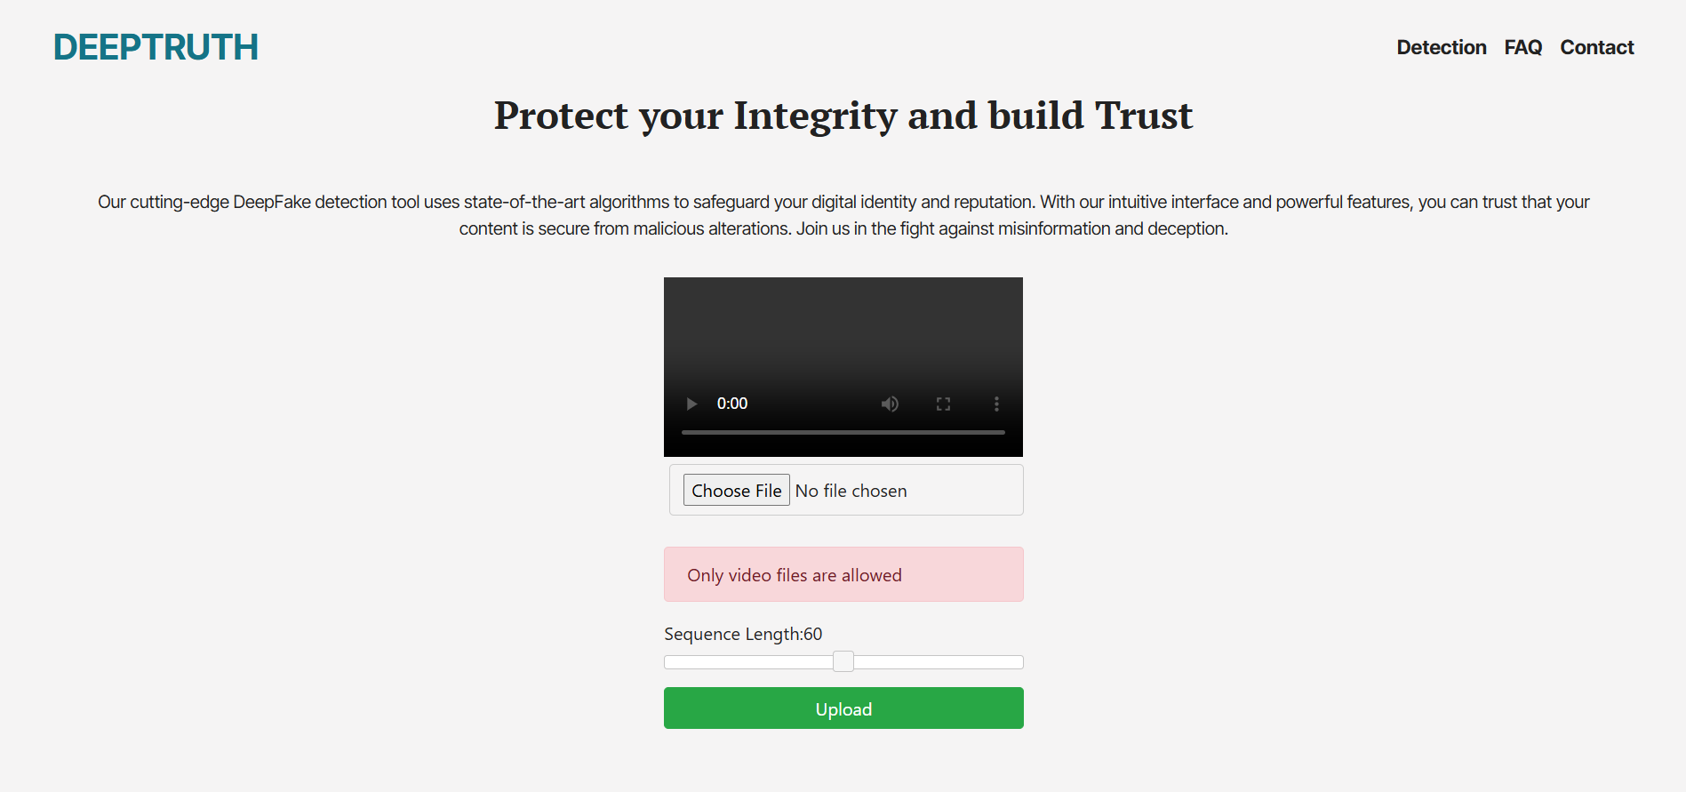
Test Case 2

Slide 34
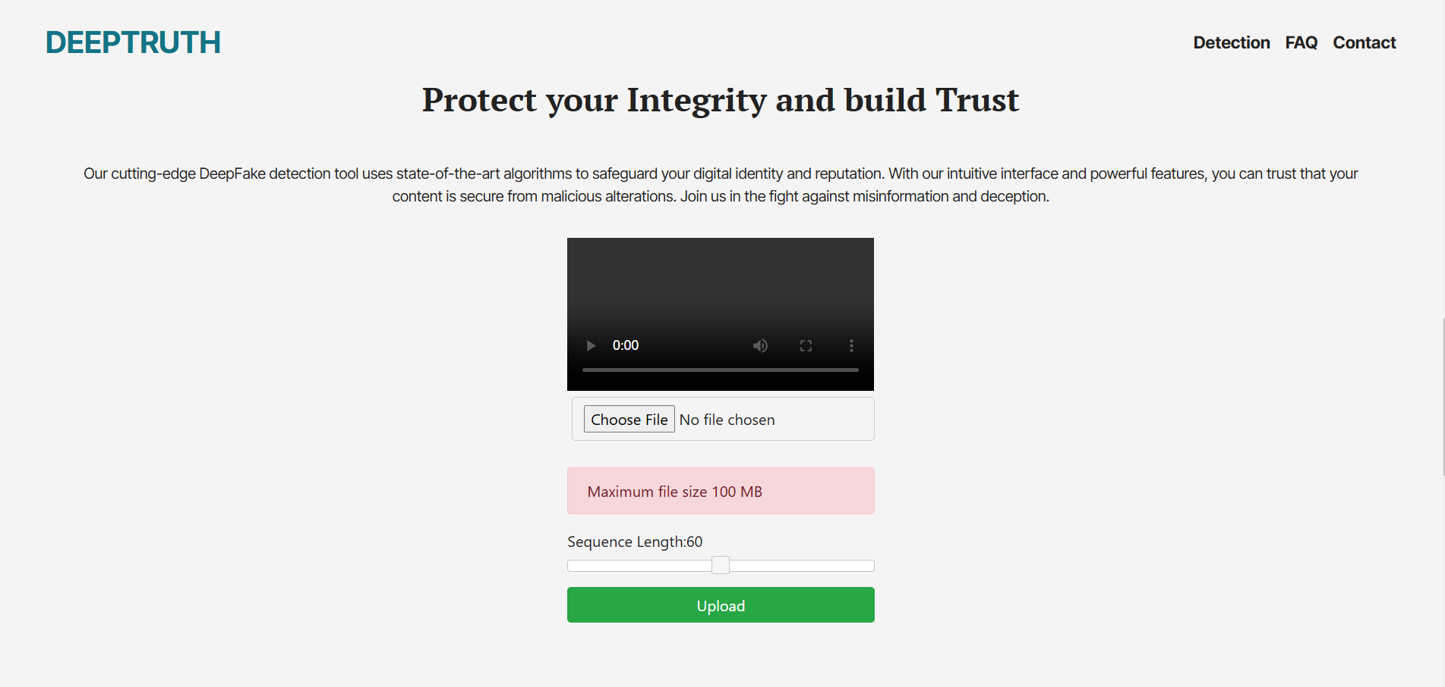
Test Case 3

Slide 35
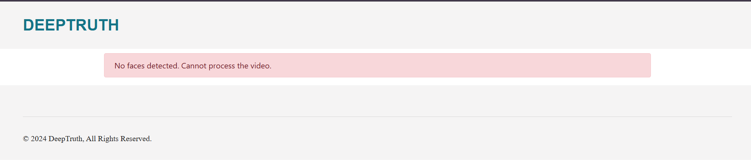
Test Case 4

Slide 36
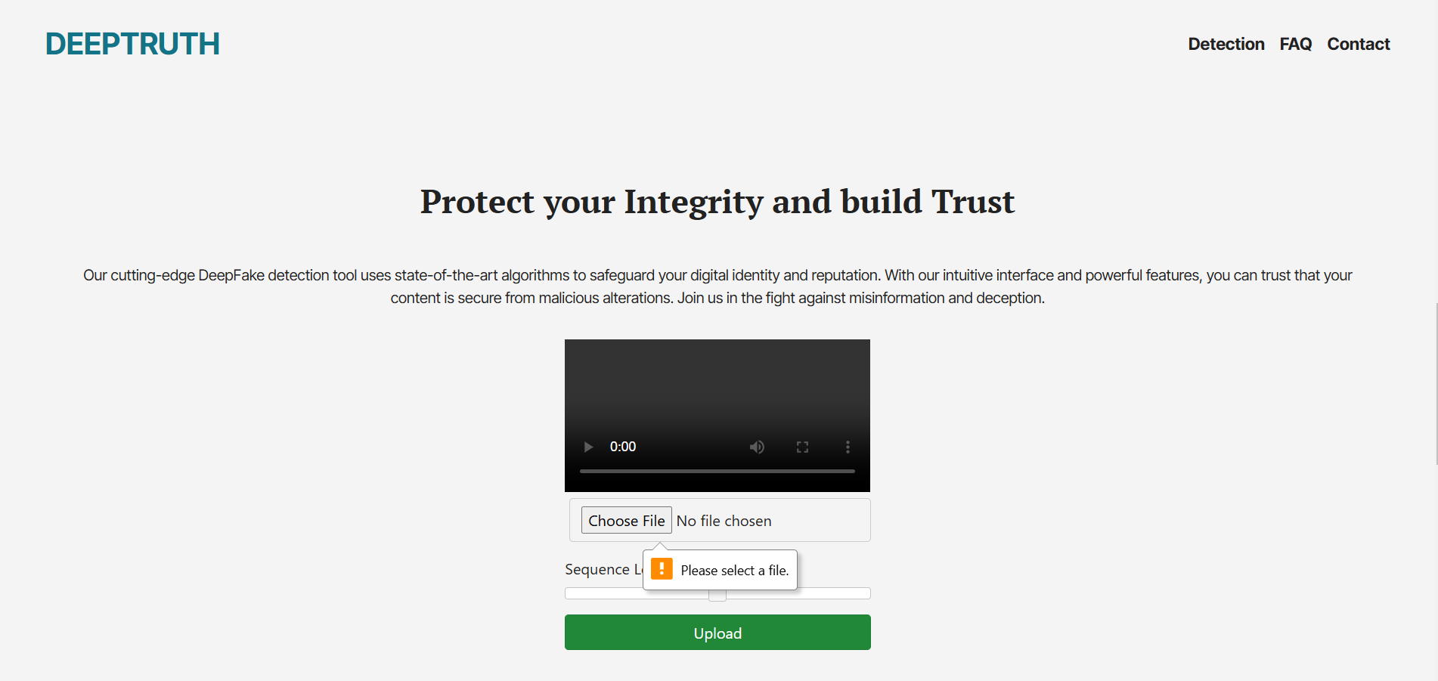
Test Case 5

Slide 37
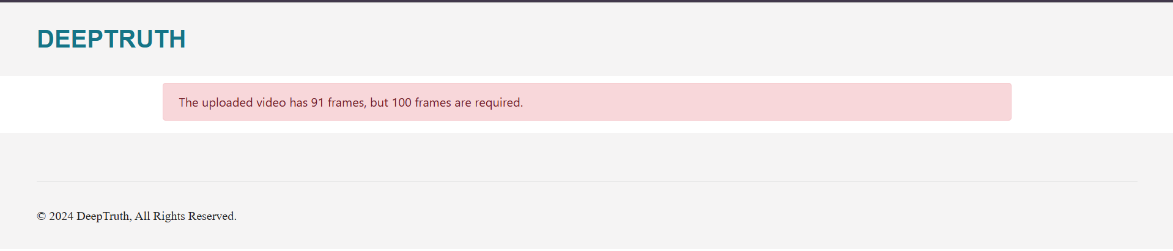
Test Case 6

Slide 38
CONCLUSION AND OUTLOOK

Slide 39
Conclusion
Developed an effective DeepFake detection model combining ResNeXt CNN and LSTM RNN
Demonstrated strong accuracy and reliability across multiple datasets
Contributed to advancements in DeepFake detection, enhancing digital security

Slide 40
Outlook
Improve model scalability for enhanced real-time performance
Improve the accuracy of the model by making use of large and diverse datasets
Explore integration with security systems for live protection against synthetic media

Slide 41
“One machine can do the work of fifty ordinary men. No machine can do the work of one extraordinary man.”

Slide 42
THANK YOU

