Slide 1
Study of Terrorist Activity Around The World
Nabila Bibi [MSCS22038]
Hamza Ahmed [MSCS22034]
Muhammad Azhar [MSCS22035]
Shahid Zikria [MSCS22013]

Slide 2
Problem Statement and Challenges
Enhancing global counterterrorism efforts by identifying and analyzing recurrent behavioral patterns among terrorists across the globe.
Certain types of terrorist activities could be overrepresented or underrepresented due to political, cultural, or geographic factors. The sheer volume and complexity of data within to be analyzed can be overwhelming.

Slide 3
Dataset
Global Terrorism Dataset (GTD)
An open-source database with information on international terrorist events around the world from 1970 – 2021.
Contains information on over 200,000 terrorist attacks.
GTD defines a terrorist attack as the threatened or actual use of illegal force and violence by a nonstate actor to attain a political, economic, religious, or social goal through fear, coercion, or intimidation.

Slide 4
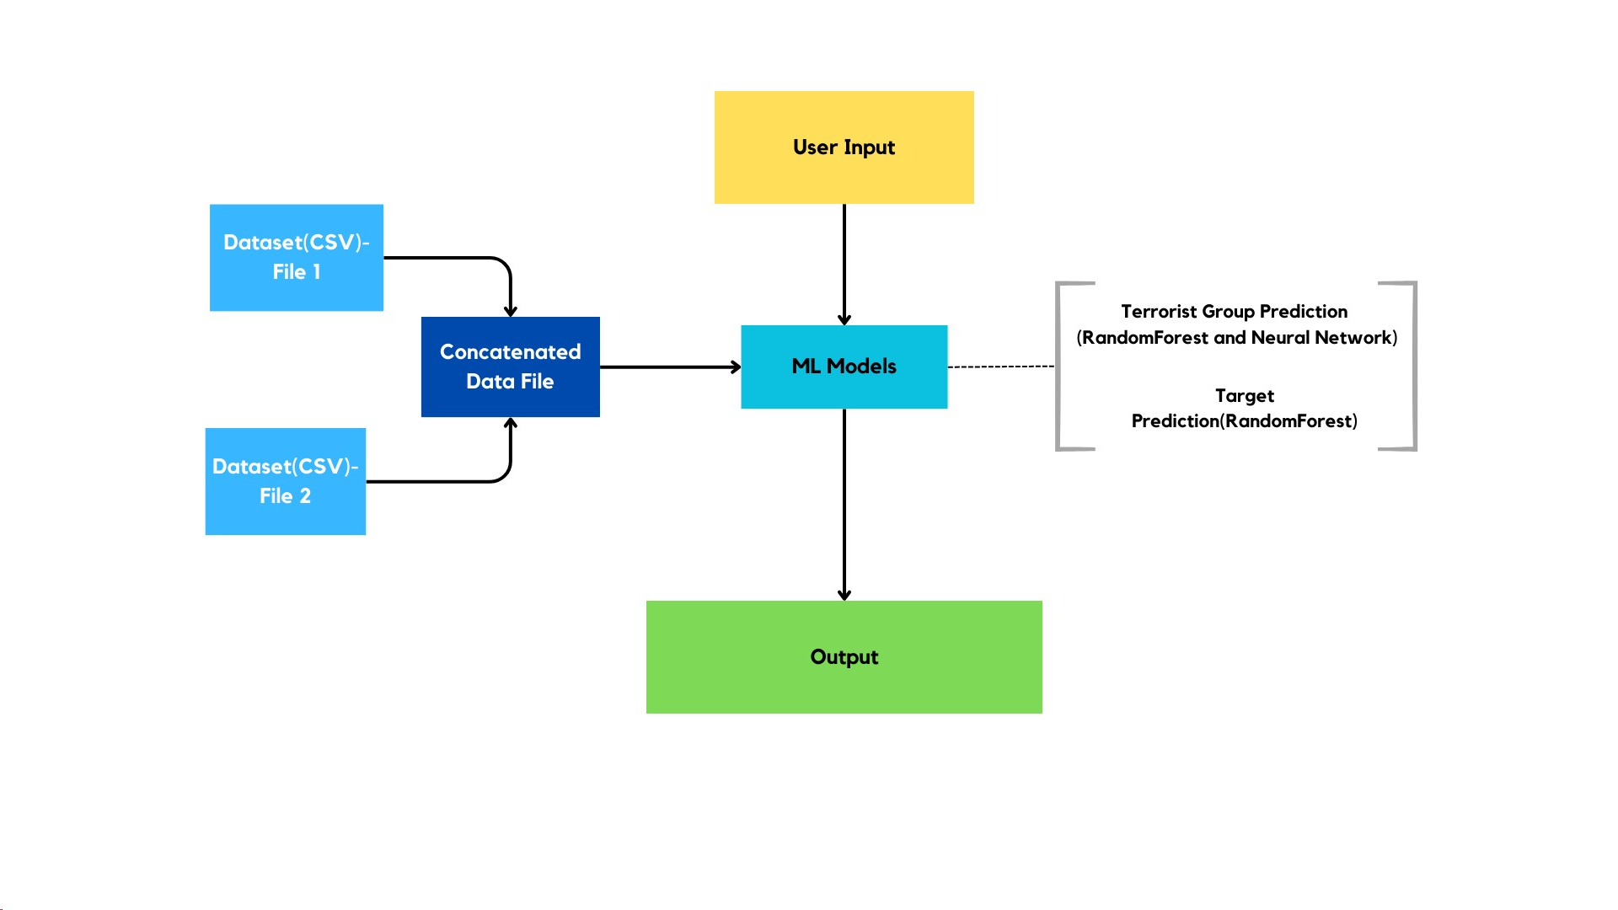
Architecture

Slide 5
Exploratory Data Analysis(Contd.)
The incident must be intentional – the result of a conscious calculation on the part of a perpetrator.
The incident must entail some level of violence or immediate threat of violence – including property violence, as well as violence against people.
The perpetrators of the incidents must be sub-national actors. The database does not include acts of state terrorism.

Slide 6
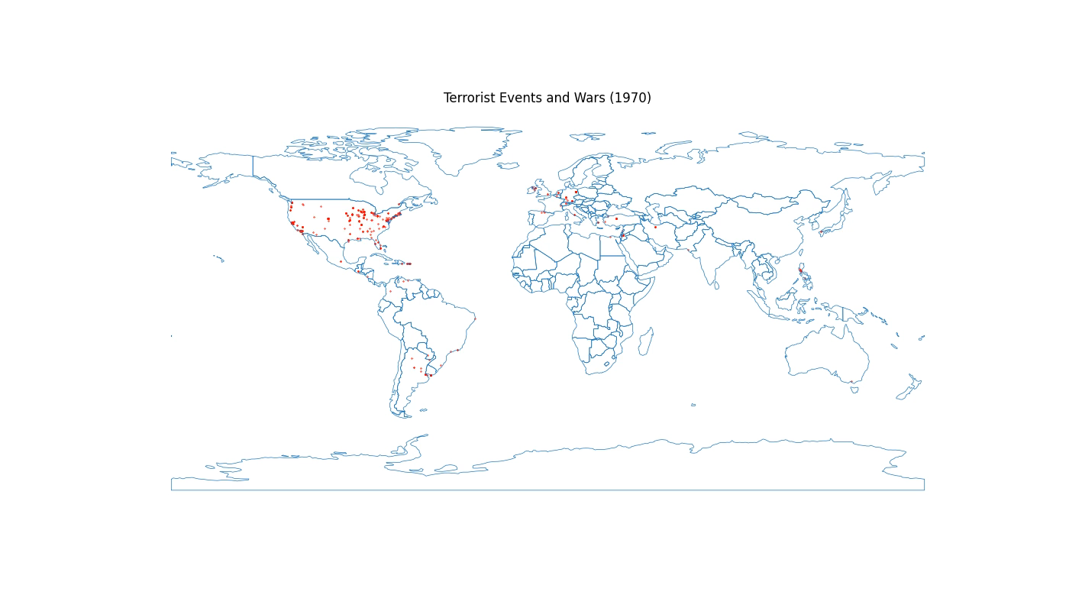
Results

Slide 7
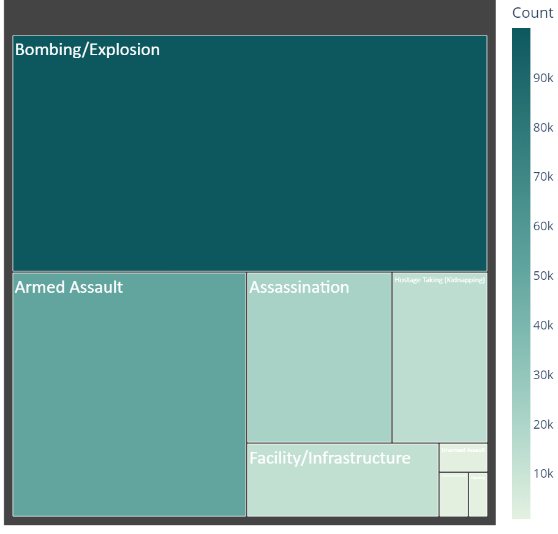
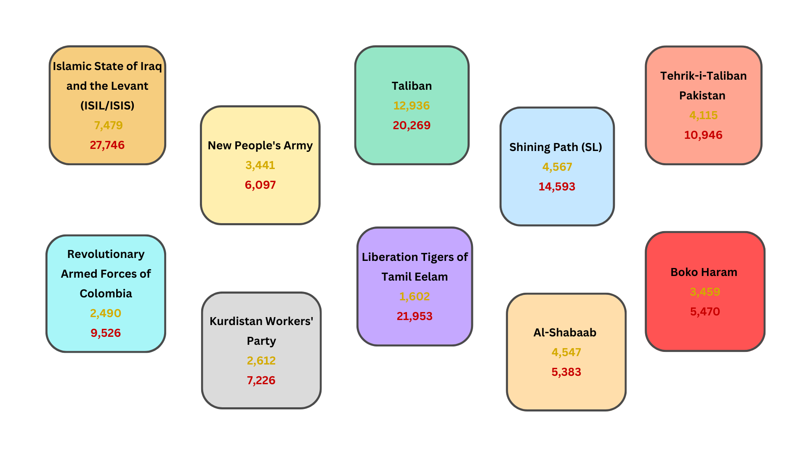
Results(Contd.)

Slide 8
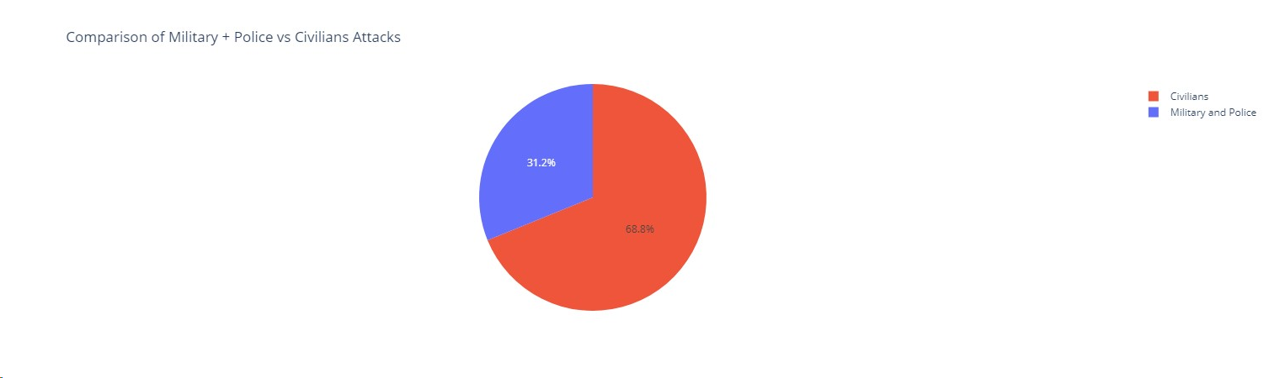
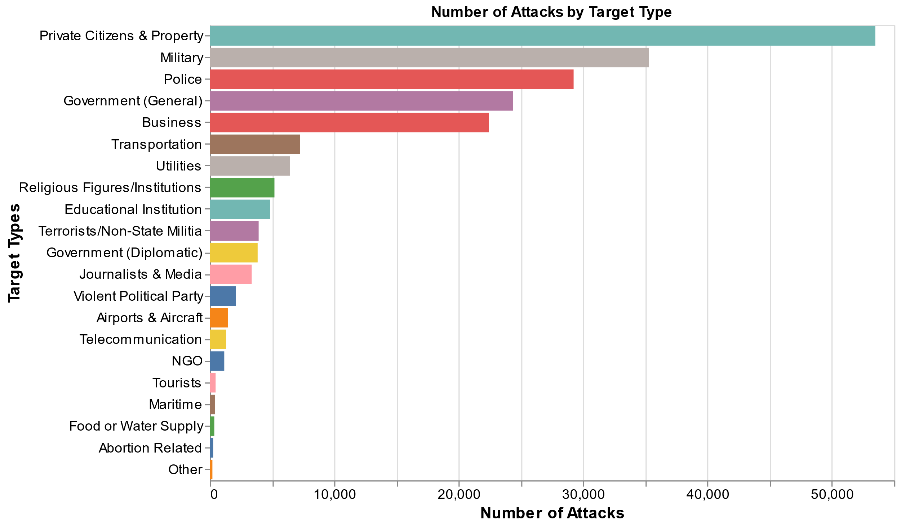
Results(Contd.)
Additional insights from Exploratory Data Analysis(EDA) and Model Deployment are available at: https://8157-2400-adc5-108-6100-c955-2855-ca6f-d787.ngrok-free.app/

