Slide 1

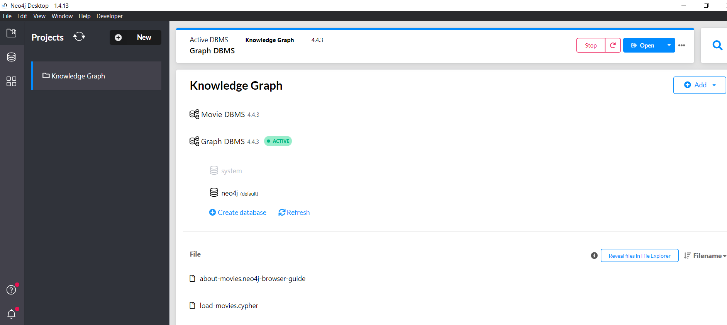

Slide 2
Application used to create and query a KG

