Slide 1




DATA ANALYTICS PORTFOLIO PROJECT
Hotel Booking
Data Analysis
From raw booking records to a governed Power BI dashboard — data cleaning, exploratory analysis, feature engineering and business recommendations.
Clean
Analyze
Engineer
Visualize
Hamza Ahmed Bayoumi
Instructor : ENG Rawan Mahmoud
Instant xODC

Slide 2




AGENDA
What This Presentation Covers
01
Project Overview & Objective
02
Dataset Overview
03
Data Cleaning & Preparation
04
Exploratory Data Analysis
05
Feature Engineering
06
Power BI Dashboard
07
Key Insights & Recommendations
08
Conclusion
Hotel Booking Data Analysis | Hamza Ahmed Bayoumi
2

Slide 3
01 PROJECT OVERVIEW
Business Objective
Online travel agencies now generate the majority of hotel bookings, but a growing share of those bookings never arrive. This project analyzes 119K+ hotel reservation records across a City Hotel and a Resort Hotel to understand booking behavior, quantify the revenue impact of cancellations, and turn the findings into an interactive Power BI dashboard for ongoing monitoring.
Headline scale (Power BI)
87K
27.5%
Total bookings analyzed
Overall cancellation rate
Core business questions
€34.46M
106.34
1
Which guests and channels cancel the most — and why?
Total booked revenue
Average daily rate (ADR)
2
How much booked revenue is genuinely at risk from cancellations?
3
Which bookings should be flagged and managed proactively?
Deliverable
A 4-page Power BI dashboard (Executive, Customer, Cancellation, Revenue & Room views) backed by a documented Python cleaning and feature-engineering pipeline.
4
How can findings be delivered as a self-serve BI dashboard?
Hotel Booking Data Analysis | Hamza Ahmed Bayoumi
3

Slide 4
02 DATASET OVERVIEW
What's In the Data
Public hotel-bookings dataset covering two properties in Portugal: a City Hotel and a Resort Hotel, with arrivals from July 2015 to August 2017 (only 2016 is a complete calendar year).
Dataset size, end to end
119,390
Booking details
Hotel, lead time, arrival date, market segment, distribution channel, deposit type
Raw rows loaded
87,396
Stay details
Nights (week/weekend), room type reserved vs. assigned, meal plan
After removing 31,994 exact duplicates
Guest profile
86,638
Adults, children, babies, country, repeat-guest flag, customer type
After business-driven outlier treatment
Commercial
67 cols
ADR, special requests, booking changes, agent / company, reservation status
After feature engineering (+35 new features)
Hotel Booking Data Analysis | Hamza Ahmed Bayoumi
4

Slide 5
03 DATA CLEANING & PREPARATION
Duplicates & Missing Values
Missing values — treated by business rule, not blind imputation
31,994 duplicate rows removed
Column
Missing
Treatment
26.8% of the raw file. Left in place, duplicates inflated the cancellation rate to 37.0% instead of the true 27.5% — the single biggest correction in the project.
company
82,137
Corporate + missing → "Unknown Company"; else → "No Company"
agent
12,193
Direct channel + missing → "Direct Booking"; else → "Unknown Agent"
country
452
Filled as "Unknown" (no reliable inference available)
Why business rules, not the mode?
children
4
Filled with 0 (count-type field)
Cross-tabulating company against market_segment showed nulls cluster in Direct, Online TA and Groups — bookings that structurally never carry a company ID. Filling with the mode would have invented a false corporate signal; encoding the absence instead preserves the real business meaning.
Hotel Booking Data Analysis | Hamza Ahmed Bayoumi
5

Slide 6
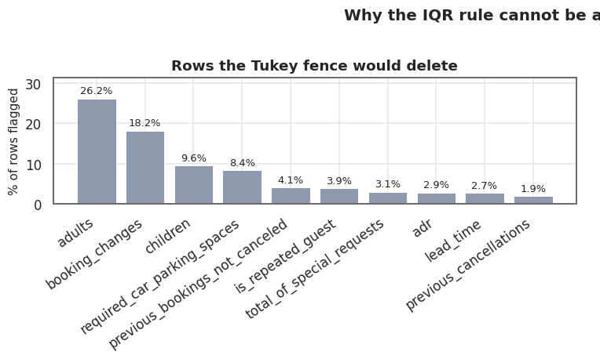
03 DATA CLEANING & PREPARATION
Outlier Treatment: Screen Statistically, Decide Commercially
Decision register (sample)
ADR = 5,400 (1 record)
REMOVE
10x the next-highest rate — a keying error
ADR = 0 (1,778 records)
KEEP
91% of Complementary segment — real comp stays
A blind Tukey-fence rule would have flagged ~26% of bookings as "outliers" — mostly ordinary solo travellers and 2-guest parties. Each flagged column was checked against booking context before any row was touched.
Adults 10–55, Group type (13)
KEEP + FLAG
Genuine tour-operator allocation blocks
Zero guests / zero nights (817)
REMOVE
No occupancy, no revenue — administrative artifacts
Stays 30–69 nights (23)
KEEP
Real extended-stay contracts at discounted ADR
Result: only 758 rows removed (0.87% of the dataset) — every one a provable non-stay. ADR skewness fell from 10.92 to 0.93 without applying any transformation, because a single erroneous record was removed rather than masked.
Hotel Booking Data Analysis | Hamza Ahmed Bayoumi
6

Slide 7
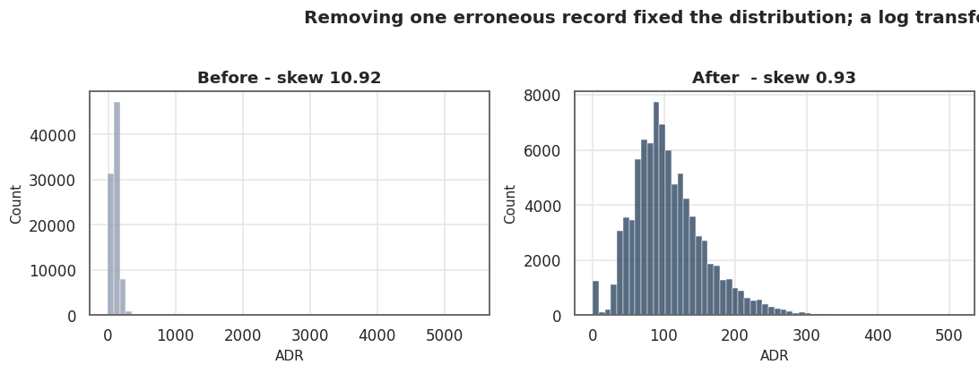
04 EXPLORATORY DATA ANALYSIS
Distribution & Composition Insights
Lead time — Mean 80 days vs. median 50 — a long tail of early planners on top of a large same-day mass (mode 0).
Channel concentration — Online TA is 59.2% of all bookings; travel agents/operators account for 79.2% of distribution overall.
Removing the single erroneous €5,400 booking (not a transform) fixed ADR's shape — skew fell from 10.92 to 0.93.
Deposit policy — 98.7% of bookings carry No Deposit — hotels take almost no financial guarantee on the average booking.
Customer mix — 82.4% Transient (independent) guests; Contract and Group business is only 4.2% combined.
87,396 → 86,638. After cleaning: zero duplicates, zero missing cells, class balance 27.7% cancelled — imbalanced but workable for descriptive analysis without resampling.
Hotel Booking Data Analysis | Hamza Ahmed Bayoumi
7

Slide 8
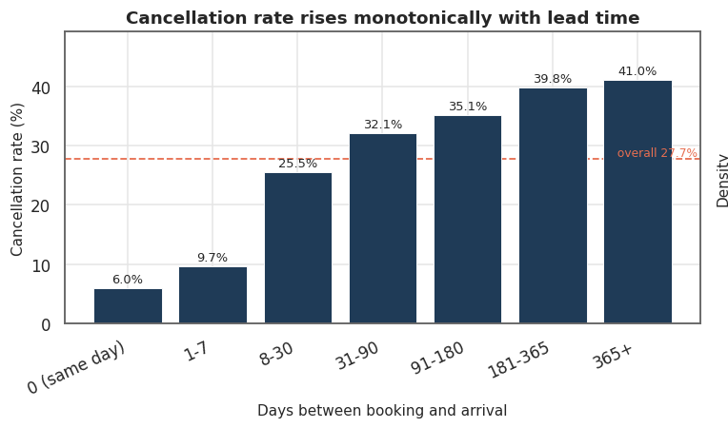
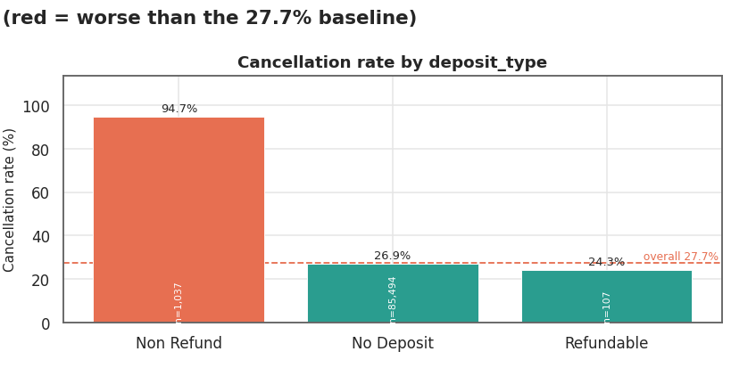
04 EXPLORATORY DATA ANALYSIS
What Drives a Cancellation
Lead time: the strongest continuous driver
Deposit type: the most surprising number
Cancellation rises monotonically from 6.0% (same-day) to 41.0% (over a year out) — a 6.8x spread. Risk nearly triples between the 1–7 day and 8–30 day windows.
Non Refund bookings cancel at 94.7% vs. 26.9% for No Deposit. This isn't causal — deposits are applied to bookings already judged risky (long lead time, domestic guests), not a deterrent.
Protective signal: special requests are the cleanest predictor in the data — cancellation falls monotonically from 33.5% (0 requests) to 5.6% (5 requests), independent of lead time.
Hotel Booking Data Analysis | Hamza Ahmed Bayoumi
8

Slide 9
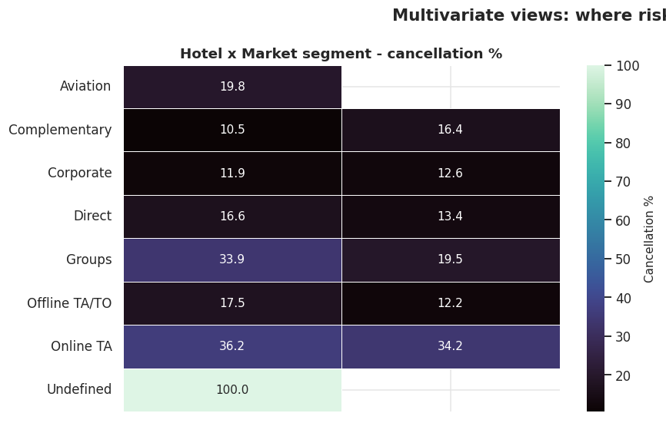
04 EXPLORATORY DATA ANALYSIS
The Hidden Interaction: Guest Origin x Channel
Averaging hides the real risk
Portugal is 31% of bookings and cancels at 36.4% vs. 23.8% internationally — but the channel interaction is far sharper than that average suggests:
Segment
Int'l
Portugal
Gap
Groups
1.6%
58.8%
37x
Offline TA/TO
0.5%
44.4%
89x
Corporate
2.7%
15.1%
5.6x
Online TA
33.2%
44.4%
1.3x
Most actionable finding: roughly 6,700 domestic Group and Offline TA/TO bookings drive this gap — a targetable book of business that leaves the reliable international base untouched.
Hotel Booking Data Analysis | Hamza Ahmed Bayoumi
9

Slide 10




05 FEATURE ENGINEERING
35 New Features, Each Justified by an EDA Finding
Stay & value
Temporal
total_nights, total_guests, adr_per_guest, total_revenue
guest_composition (Solo / Couple / Family)
arrival_date, arrival_quarter, booking_season
is_high_season, is_weekend_arrival
Behavioral & source
Data-integrity flags
previous_cancel_ratio, is_repeat_customer
booking_source_group (6 managed channels)
is_group_block, is_child_only_record, is_zero_rated
cancellation_risk_score (composite, see next slide)
Leakage guardrail: reservation_status, required_car_parking_spaces and room_changed were excluded from any predictive use — each is only known after check-in and would leak the outcome (e.g. parking spaces = 0 cancellations in 7,290 bookings, because parking is assigned on arrival).
Hotel Booking Data Analysis | Hamza Ahmed Bayoumi
10

Slide 11
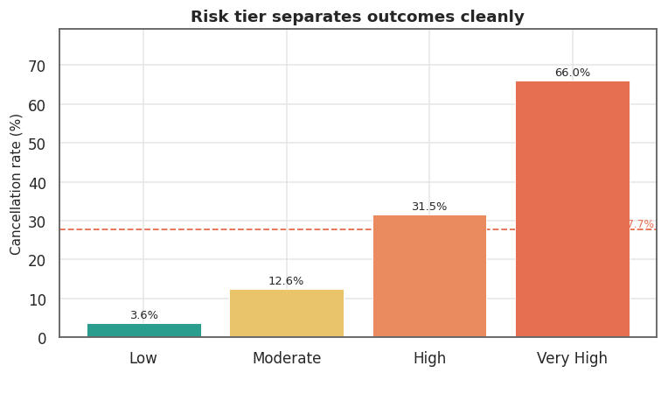
05 FEATURE ENGINEERING
Composite Cancellation Risk Score
An additive, leakage-free score built only from information known at booking time — lead time, deposit type, prior cancellations, channel and guest origin — weighted by each signal's observed effect size.
Tier
Bookings
Share
Cancel rate
Low
7,043
8.1%
3.6%
Moderate
31,265
36.1%
12.6%
High
35,052
40.5%
31.5%
Very High
13,278
15.3%
66.0%
18.2x lift from Low to Very High — a smooth, monotone curve with no inversions.
Operational value: the Very High tier is 15.3% of bookings but carries €6.8m of booked revenue at a 66% failure rate — small enough to manage by hand with reconfirmation calls or deposit terms.
Hotel Booking Data Analysis | Hamza Ahmed Bayoumi
11

Slide 12
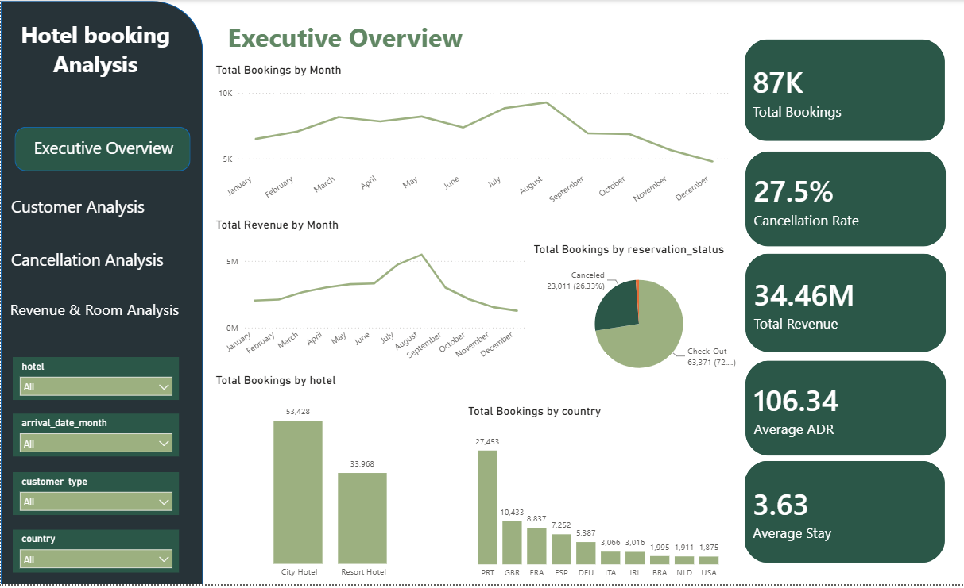
06 POWER BI DASHBOARD
Executive Overview
A 4-page interactive report — Executive, Customer, Cancellation and Revenue & Room views — filterable by hotel, month, customer type and country.
87K
Total bookings
27.5%
Cancellation rate
€34.46M
Total revenue
106.34
Average ADR
3.63
Average stay (nights)
Hotel Booking Data Analysis | Hamza Ahmed Bayoumi
12

Slide 13
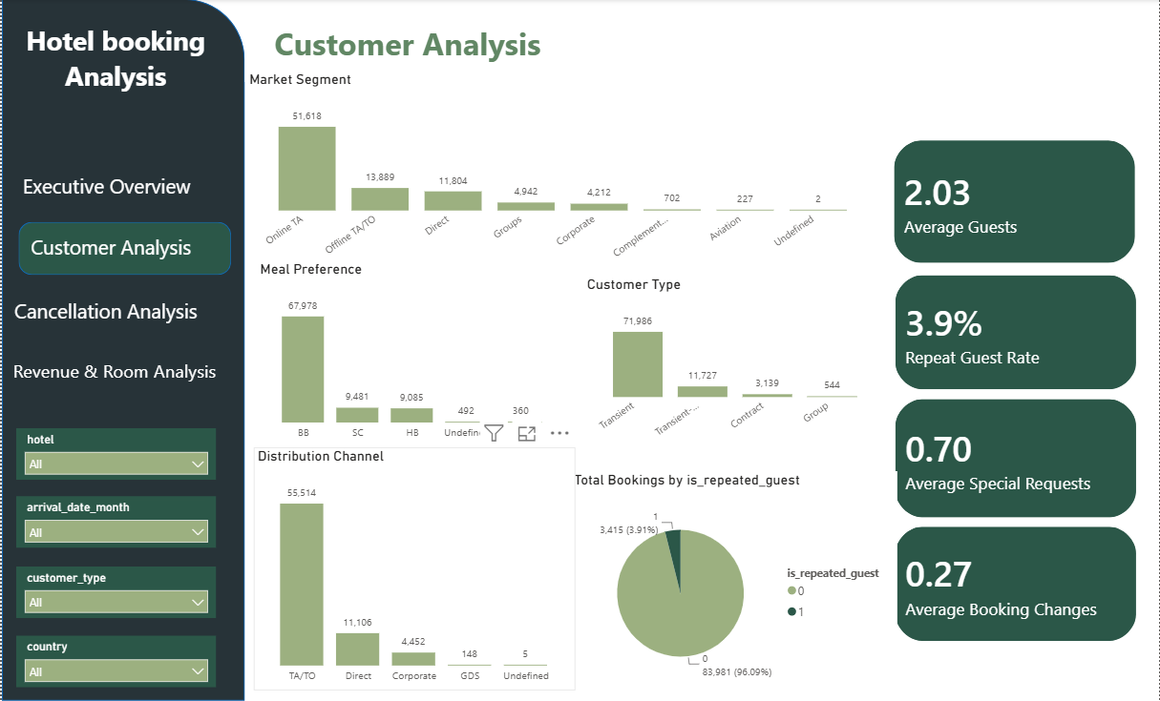
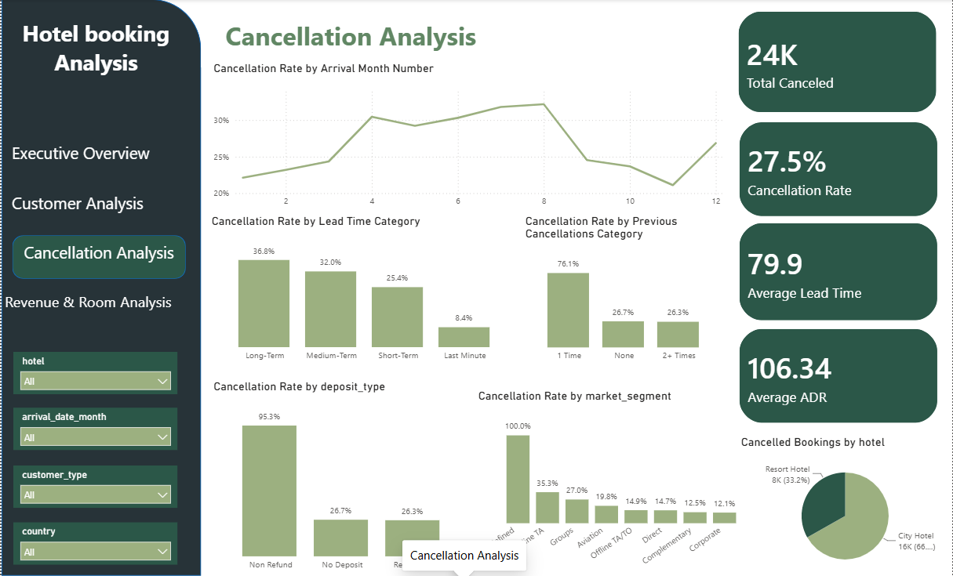
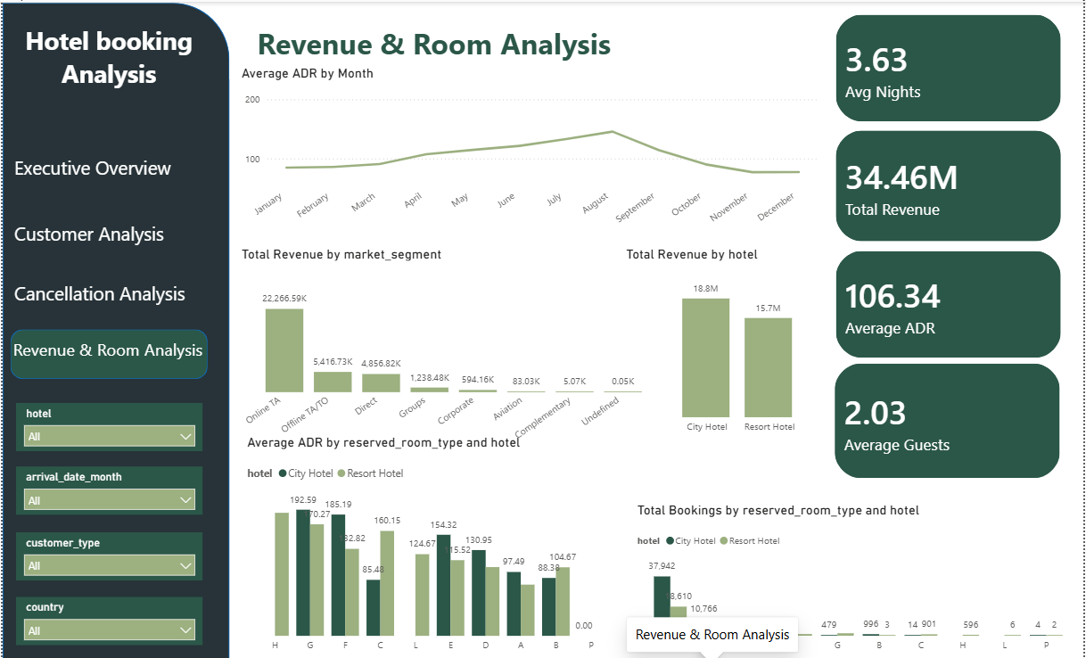
06 POWER BI DASHBOARD
Customer, Cancellation & Revenue Views
Customer Analysis
Cancellation Analysis
Revenue & Room Analysis
Market segment, meal preference, distribution channel and repeat-guest rate (3.9%).
Cancellation rate by lead time, deposit type and market segment, month by month.
ADR trends, revenue by market segment and room-type performance by hotel.
Design choice: consistent card KPIs and a single sage/forest palette across all four pages so filters (hotel, month, customer type, country) read the same way on every view.
Hotel Booking Data Analysis | Hamza Ahmed Bayoumi
13

Slide 14
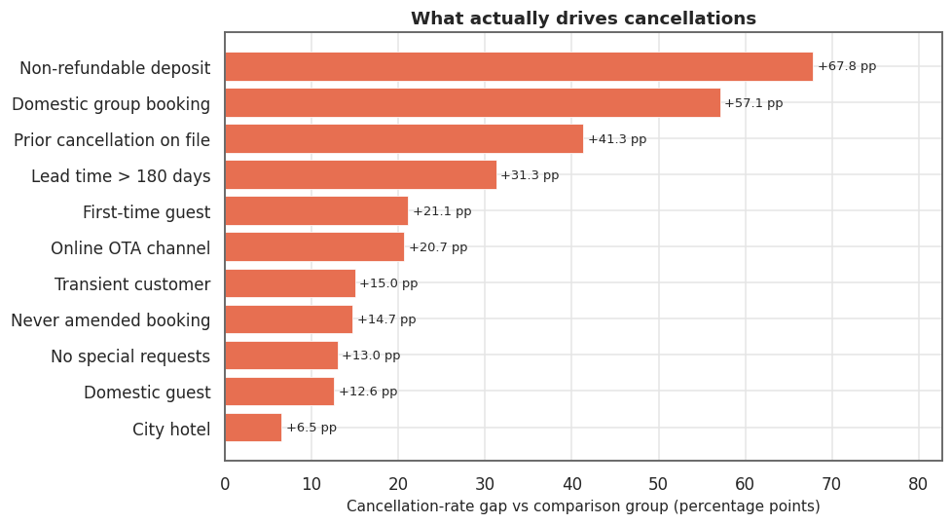
07 KEY BUSINESS INSIGHTS & RECOMMENDATIONS
Ranked Drivers & Recommended Actions
Recommendations
1
Require a partial deposit or 72-hr reconfirmation for domestic Group / Offline TA/TO bookings (~6,700 bookings, the single most targetable segment).
2
Manage the Very High risk tier (13,278 bookings, 66% cancel, €6.8m) as an active book with reconfirmation contact.
3
Shift OTA volume toward Direct — OTA loses 42% of booked revenue vs. 19% for Direct at a comparable rate.
4
Solicit guest preferences on long-lead bookings; special requests cut cancellation nearly in half.
Effect size of each driver vs. baseline (percentage-point gap). Non-refundable deposit and prior cancellations are reactive markers; domestic-Groups is the most directly actionable.
5
Move deposit policy from flat to seasonal — summer carries both peak cancellation risk and peak revenue.
Hotel Booking Data Analysis | Hamza Ahmed Bayoumi
14

Slide 15
CONCLUSION
From 119K Raw Rows to a Governed BI Asset
86,638 x 67
Clean, feature-rich analysis-ready dataset
€11.24M
Net revenue exposure quantified and traced
18.2x
Risk-tier lift from the composite cancellation score
4-page
Power BI dashboard for ongoing monitoring
This project shows the full analyst workflow end to end: business-driven data cleaning, structured EDA, justified feature engineering, and translating findings into both quantified recommendations and a self-serve dashboard non-technical stakeholders can use.
Hamza Ahmed Bayoumi
Thank you

