Slide 1
Google News Economy Dataset
Hamza Al-Habash
ID:19110034
HTU: School of Computing and Informatics
Date: 2021/12/17

Slide 2
Count-Vectorizer
It transforms a given text into a vector, based on the frequency/count of each word that occurs in the entire text corpus.
The Count-Vectorizer model can be used to convert each word in each text into vectors in case we have multiple texts corpus.

Slide 3
Term frequency–Inverse Document Frequency (TF-IDF)
It’s a Vector Space Model(VSM) which represents text units as vectors of numbers.
The TF-IDF approach quantifies words in a set of documents. and it's used to signify each word's importance in the document and corpus.

Slide 4
Word Embedding [Word2Vec]
Word Embedding is a representation of document vocabulary which can capture the context of a word in a document, semantic similarity, relation with other words.
The Word2vec model groups the words with similar meanings together, and words with different meanings far from each other, by representing the meaning of the words as real-valued vectors in a vector space.

Slide 5
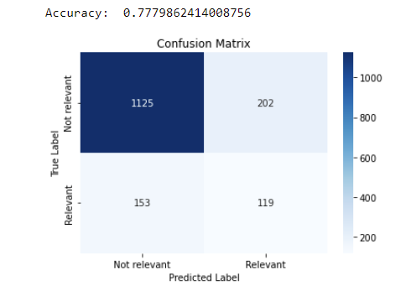
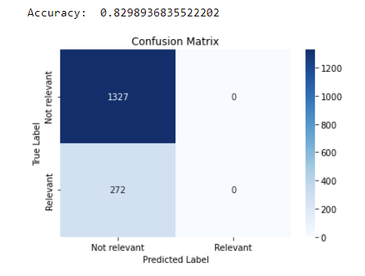
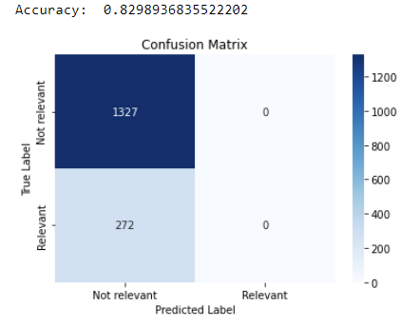
Main Performance Conclusions
I’ve used the Naive bayes classifier in classifying the economy news articles with all the models.
I found that the Count-Vectorizer model accuracy performance was [0.7779862414008756] with a confusion matrix as represented below.
On the other hand, I found that the TF-IDF & Word Embedding W2V models surprisingly have the same accuracy performance which was [0.8298936835522202] and the same confusion matrix for each is represented below.
As a result, I can conclude that the TF-IDF and Word2Vec models both were better than the count-vectorizer model with a higher accuracy and with a better matrix, since both had a more true and less false overall result. Thus, they would be the best models to use to analyze our data.
Count-Vectorizer TF-IDF Word2Vec

