Slide 1
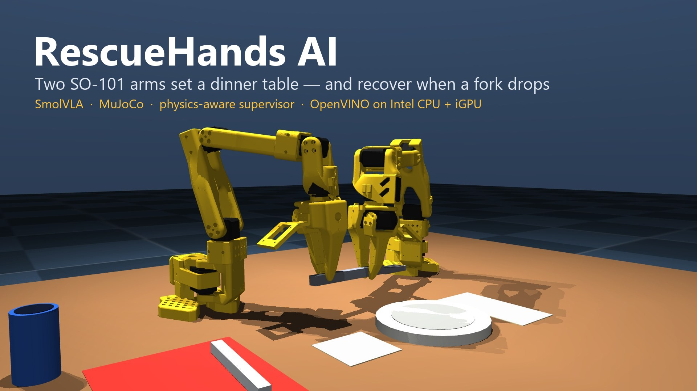
Intel Bimanual VLA Manipulation track · AI Infra Summit Hackathon 2026

Slide 2
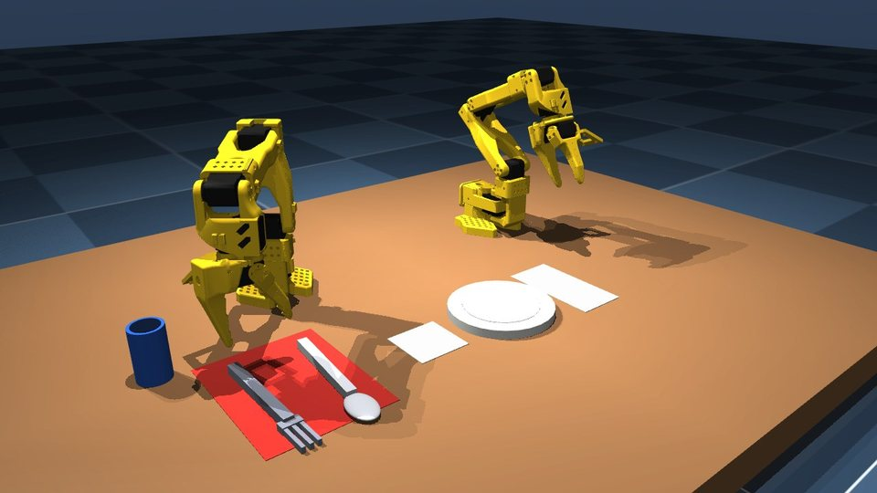
THE PROBLEM
A policy acts even after reality went wrong
• Vision-language-action models predict the next move; they do not check the last one.
• With two arms, one slip by one hand ruins the other hand's work.
• Learned policies drift into states their demonstrations never showed.
• So: never trust an action because a model produced it — check the physics, then recover.
A real drop: the gripper is forced open, the fork falls, both arms back off and retry.

Slide 3
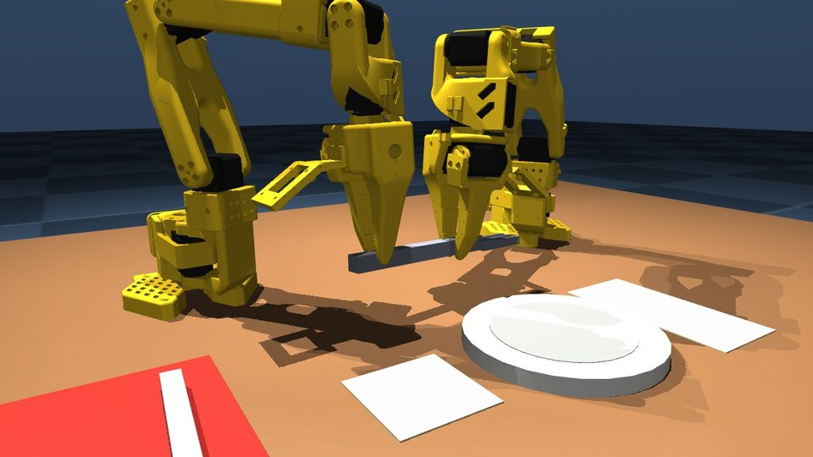
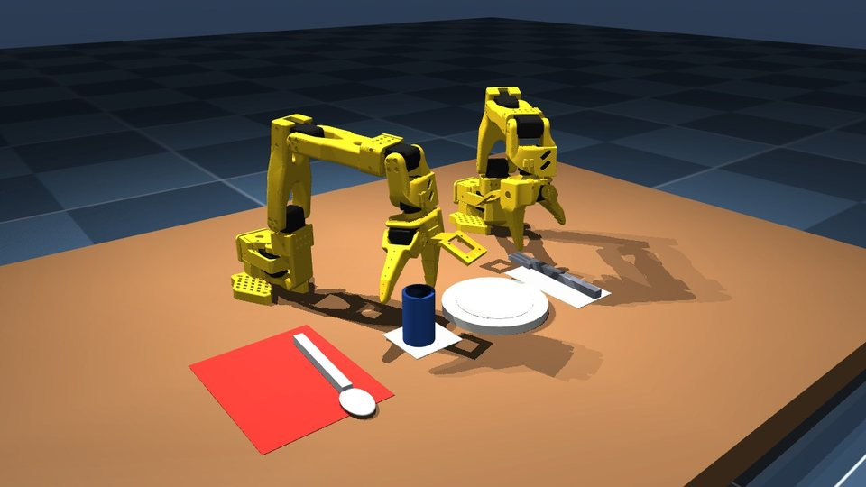
THE TASK
Set a dinner place with two SO-101 arms
• “Hand the spoon over to the left arm, then place the cup next to the plate.” — the words pick fork or spoon
• Right arm picks → in-air hand-off → left arm places the utensil → right arm places the cup
• Every seed changes positions, sizes, mass, friction, lighting and table colour; contact grasps only, no welding

Slide 4
ARCHITECTURE
The VLA proposes; physics decides
Instruction
3 cameras
12 joints
SmolVLA
OpenVINO on Intel iGPU
Action guard
limits + step size
MuJoCo physics
2× SO-101
Physics auditor
held? dropped? placed?
Policy sees
Supervisor sees
IK only in the teacher
Camera images, joint positions and the instruction. Nothing else — no object poses, no contacts.
Simulator ground truth: which jaws hold what, support, zones, arm-to-arm contact. Used only to judge and recover.
A scripted IK teacher makes demonstrations and the baseline. The deployed loop has no IK: SmolVLA outputs the 12 joint targets.

Slide 5
LEARNED POLICY
SmolVLA, taught to get back on track
 | v1 | v2
Episodes | 101 | 569
Frames (20 fps) | 57,173 | 336,729
Clean demonstrations | 101 | 293
Messy starts (arms nudged, items moved) | — | 194
Real drop → recovery → finish | — | 82
Training | 12,000 steps from SmolVLA base | 6,000 steps from v1, lr 5e-5
• Why v2: v1 copied the teacher closely (open-loop error ≈ 0.01 rad) but only 1 of 9 completed live episodes succeeded — live runs reach states the clean demos never showed.
• Trained on free Kaggle T4 GPUs; camera images rendered on the GPU (229 s → 14 s per episode after an EGL fix).

Slide 6
SAFETY & RECOVERY
Physics decides success — not the policy
Supervisor
Task success (10 steps stable)
Checked, not assumed
Drop or stalled grasp → open both hands, return to a safe pose, let the policy re-plan. At most 2 retries. The retreat itself is watched: an item leaving the table ends the episode.
Cup and utensil in their zones, released, supported, cup upright (≤15°), settled, spare utensil untouched, and an ordered IN-AIR hand-off: right alone → both → left alone, with at most 5 steps of contact flicker.
Model contracts pin joint order, cameras, rate and file hashes. Every run writes a manifest (code revision, arguments, versions). An independent audit's findings were reproduced, fixed and re-measured.

Slide 7
RESULTS
Results on 10 randomized seeds
Policy | Supervisor | Gripper fault | Success
Scripted teacher (baseline) | on | none | 8/10
Scripted teacher (baseline) | off | yes | 2/10
Scripted teacher (baseline) | on | yes | 7/10
SmolVLA v2 · OpenVINO iGPU | off | none | ⟨y⟩/10
SmolVLA v2 · OpenVINO iGPU | on | none | ⟨x⟩/10
SmolVLA v2 · OpenVINO iGPU | on | yes | ⟨z⟩/10
The supervisor turns 2/10 into 7/10 for the teacher under a real gripper fault. Every number comes from committed result files with run manifests.

Slide 8
INTEL OPTIMIZATION
Running the policy on an Intel laptop
Backend (Intel Core i5-6300U + HD Graphics 520) | Time per 50-action chunk | Max action diff vs FP32
PyTorch, CPU (baseline) | ⟨b⟩ s | ⟨d⟩ rad
OpenVINO FP32, CPU | ⟨e⟩ s | 0 (reference)
OpenVINO FP16, iGPU | ⟨a⟩ s | ⟨d⟩ rad
OpenVINO INT8 weights (NNCF) | ⟨f⟩ s | ⟨g⟩ rad
• iGPU speed-up over PyTorch CPU: ⟨c⟩×, with its accuracy cost reported next to it
• Exported with Intel Physical AI Studio; organizers allowed non-Core-Ultra Intel hardware
• Load time and memory are measured inside the same timer for every backend

Slide 9
HONEST LIMITS
What we claim, and what we do not
Limits
Reproduce it
• Collision checks cover arm-to-arm contact only.
• Randomized item friction does not reach the jaw contacts (measured), so slippery grasps are not tested.
• Simulation pauses during inference: not real-time 20 Hz control.
• Evaluation seeds guided teacher debugging, so they are not a pristine unseen set.
• Pinned MuJoCo scene and SO-101 asset revision
• Data generation, training, export, evaluation, benchmark scripts
• Public dataset ABDHAM/rescuehands_table_v2 and model ABDHAM/smolvla_rescuehands_v2
• 99 unit and physics tests · per-run manifests · dataset provenance logs

Slide 10
THANK YOU
RescueHands AI
A VLA should not be trusted just because it produced an action. Check what physically happened — and recover.
github.com/Hamza-Atiq/rescuehandsAI
huggingface.co/ABDHAM/smolvla_rescuehands_v2
huggingface.co/datasets/ABDHAM/rescuehands_table_v2

