Slide 1
Data Driven reachability analysis toolbox using Python
Hamza Bouhelal
Notes:
The goal of this study is to implement a robust Data Driven Reachability analysis toolbox that relies on simulations of a system with unknown dynamics to over-approximate the reachable set of multiple types of systems when starting from a defined set of initial states.

Slide 2
Contents
Introduction
Motivation
Set Representation
Zonotope
Matrix Zonotope
Problem statement
Notation
Approach / Application
LTI systems
Lipschitz nonlinear systems
Polynomial systems
Conclusion
References

Slide 3
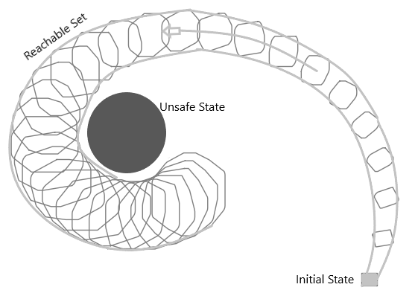
Introduction
Reachability analysis is a formal verification technique for determining whether a system can or cannot reach a certain state. It is often used to verify the safety of systems, such as checking that a system will never reach an unsafe state.

Slide 4

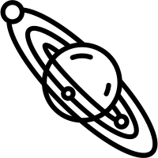
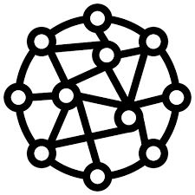
Introduction
There are many examples of where reachability analysis could be applied.
Robotics
Astrophysics
Nanotechnology
And so on …
Notes:
robotics. When designing a robotic system, engineers need to consider the reachability of the robot's arm in order to ensure that the robot can perform the tasks it is designed to do.
. In astrophysics, to study the dynamics of celestial bodies such as stars and planets,
In nanotechnology, to design and control the behavior of nanoscale devices

Slide 5
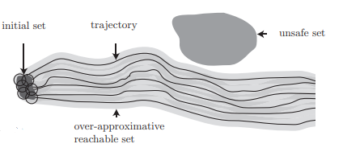
Motivation
How to Compute the reachable sets from simulated trajectories with noise having no prior information about the system dynamics?
Notes:
The most common approaches used in reachability analysis rely on the knowledge of the system dynamics. The advantage of these approaches is the high accuracy of the results, however, it can be difficult to obtain the necessary information about the system. In many cases, the system dynamics are not known, or are too complex to be analysed.

Slide 6
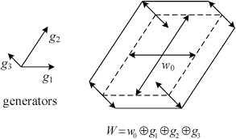
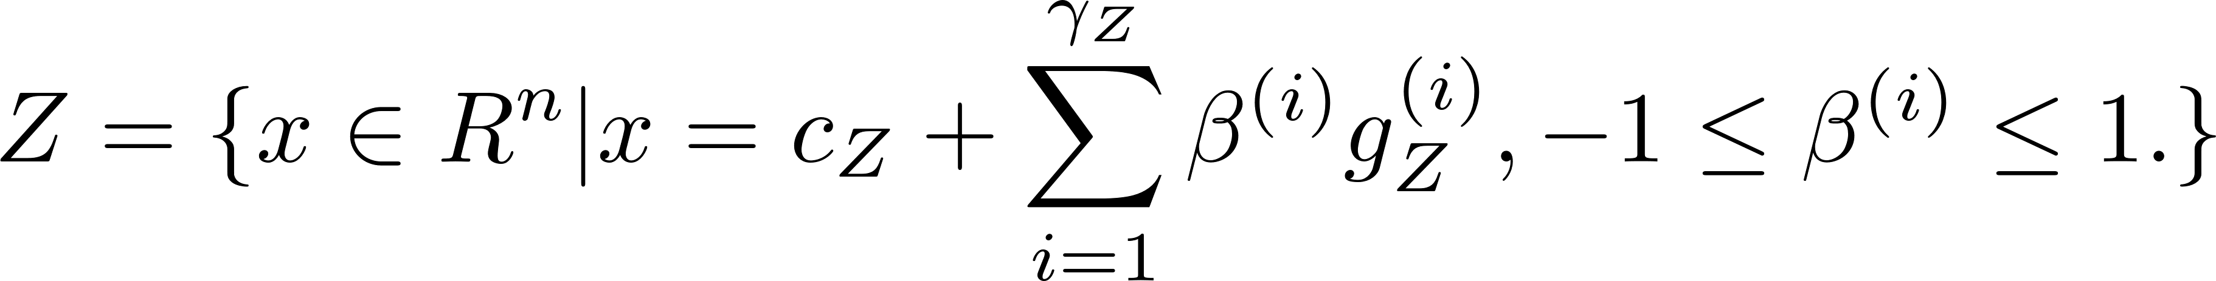
Set Representation
Zonotope[1] are used to represent sets in this toolbox
Given a center cᶻ ∈ ℝⁿ and a generator matrix G=[g⁽¹⁾₎, …, g⁽γᶻ⁾ ] with g⁽ᵏ⁾ a generator vector, we define a zonotope by Z = <c, G> and further define:
Notes:
a geometric object that is the Minkowski sum of a finite number of line segments in n-dimensional space.

Slide 7
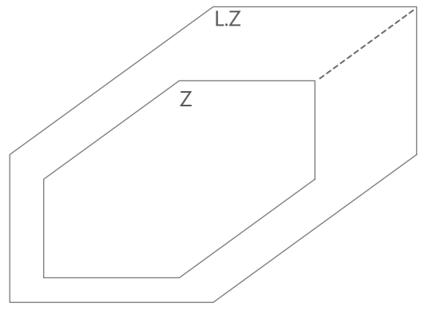
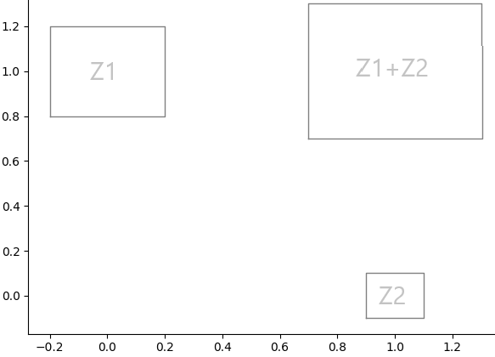
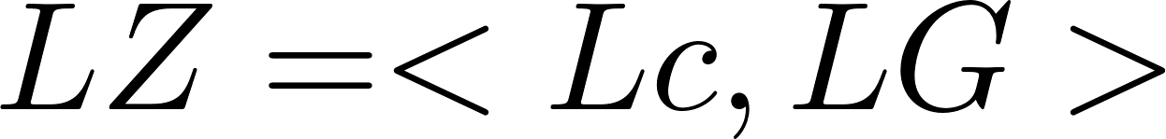
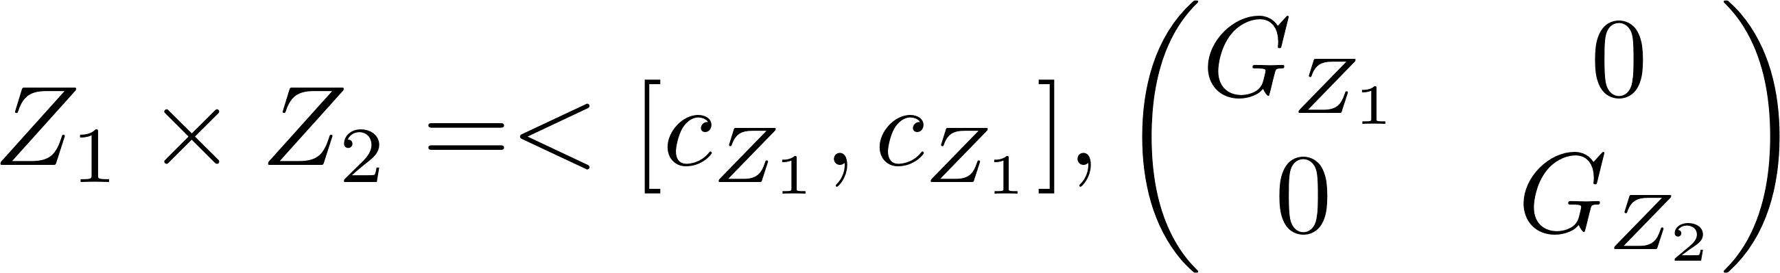
Set Representation
Zonotope Properties:
Linear map:
Minkowski sum:
Cartesian product:

Slide 8
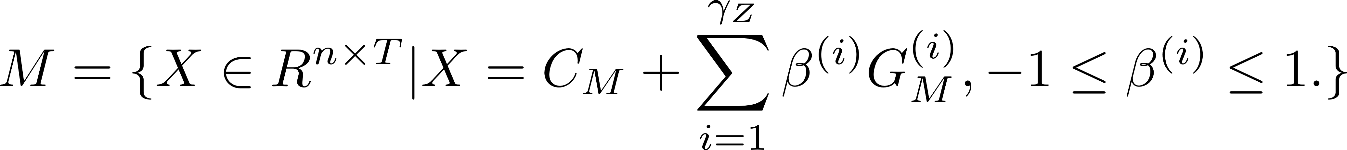
Set Representation
Matrix Zonotope:
Given a center matrix Cᴹ ∈ ℝⁿ and Ğ =[G⁽¹⁾₎, …, G⁽γᶻ⁾ ] with G⁽ᵏ⁾ a generator matrix , we define a matrix Zonotope as:

Slide 9
Problem statement
Recall [2] a discrete-time system is defined by:
The Exact Reachable Set [3] Rₙ of the system for N time steps is:
How to compute an over-approximation of the exact reachable set Rₙ ?
Linear time invariant systems:
Lipschitz nonlinear systems:
Polynomial systems:
Notes:
Where u(t) ∈ Uₖ the input bounded by the input Zonotope Uₖ, w(t) ∈ Zw the noise bounded by the noise Zonotope Zw, x(t) the state of the system at time t.
| X0 the initial state
This study aims to compute using data from the simulated system a set Ř that verifies the exact reachable set Rₙ ⊆ Ř, we would therefore conclude that since Ř never reaches an unsafe state so won’t Rₙ

Slide 10
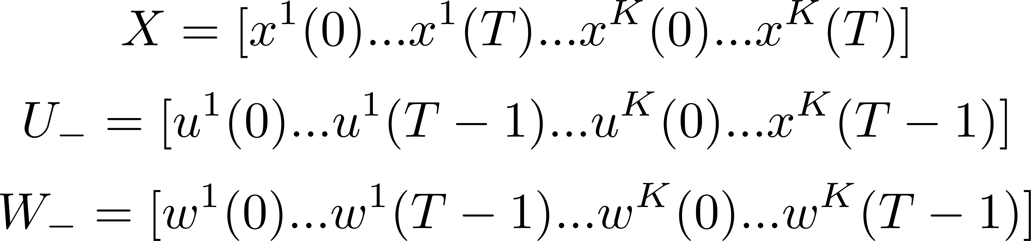
Notation
Let K input-state trajectories of length T simulated from a system. we denote D = {U₋, X} the collection of all the data from the simulated trajectories with bounded noise W₋.
Finally, we define all matrices [A B] that are consistent with the data D by:

Slide 11
Approach / Application
For this analysis, we consider the Ideas from [4] Verifying dissipativity properties from noise-corrupted input-state data that were applied in [3] Data-Driven Reachability Analysis Using Matrix Zonotopes and [5] Data-Driven Reachability Analysis from Noisy Data to perform the reachability analysis.

Slide 12
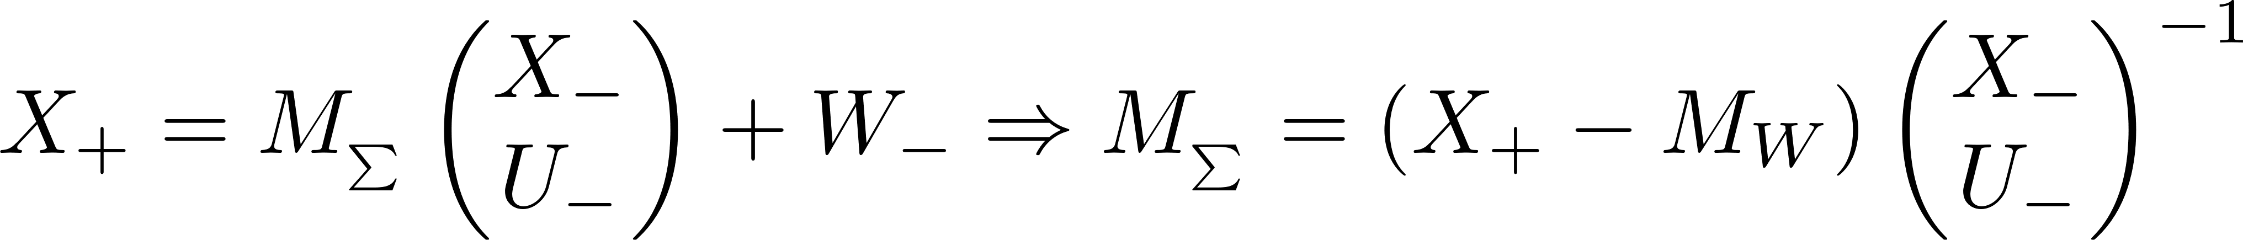
Approach / Application
Linear time-Invariant system:
Given that the true system is within the set of models NΣ, we have [A B] ∈ NΣ.
We have by definition that: NΣ ⊆ MΣ.
Solve MΣ = ?
Notes:
We can then say that since the set MA,B over-approximates the set NΣ, then a reachable set computed using MA,B would over-approximate the exact reachable set Rₙ.

Slide 13
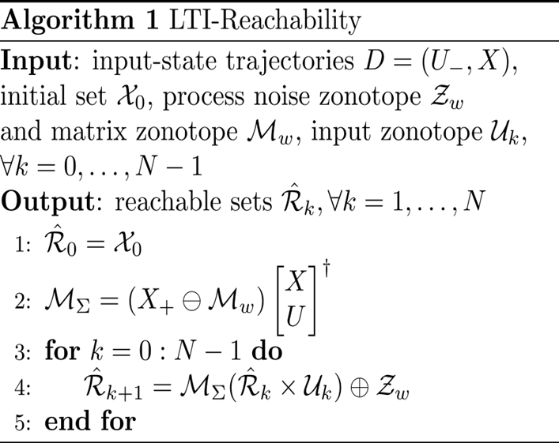
Approach / Application
Linear time-Invariant system:

Slide 14


Approach / Application
Linear time-Invariant system:
We consider the data driven reachability of the discrete version (sampling time 0.05sec) of the system from [6] Zanasi Roberto “System Theory”:
After discretization of the system, we get:

Slide 15
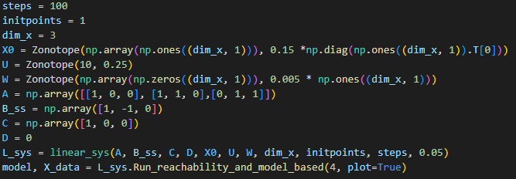
Approach / Application
Linear time-Invariant system:

Slide 16
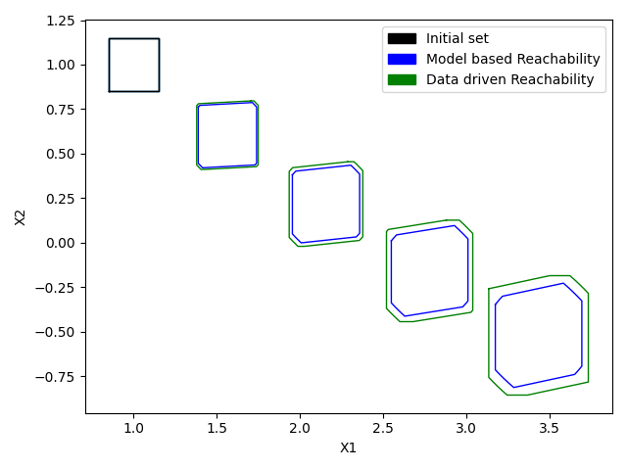
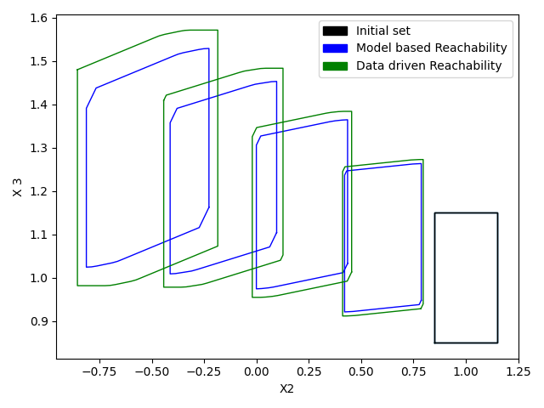
Approach / Application
Linear time-Invariant system:

Slide 17
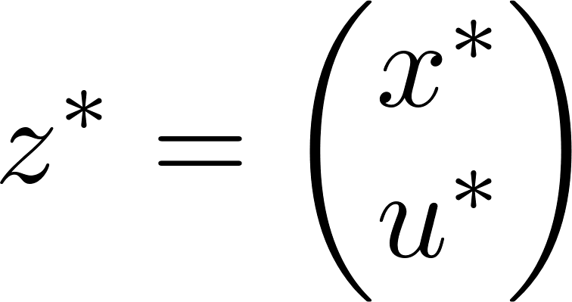

Approach / Application
Lipschitz nonlinear systems:
Taylor series expansion at the linearization point ,
The result of the expansion is an infinite Taylor series that can be over-approximated by a first-order Taylor series and a remained L(z):
Notes:
A linearization of the system can performed

Slide 18
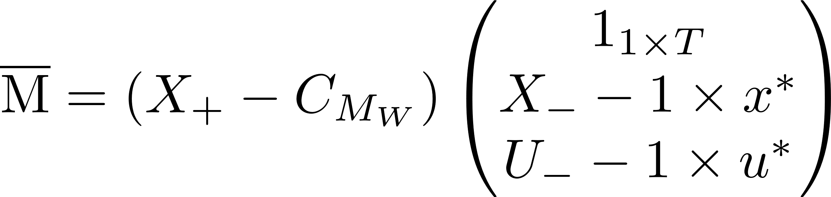
Approach / Application
Lipschitz nonlinear systems:
Obtain an approximate linearized model from the noisy data.
Obtain a zonotope that over-approximates the modeling mismatch together with the Lagrange remainder L(z) for the chosen system
We assume f Lipschitz continuous ( [7] and [8] ), We can use the approximation:
Notes:
1- Least-square approach:

Slide 19
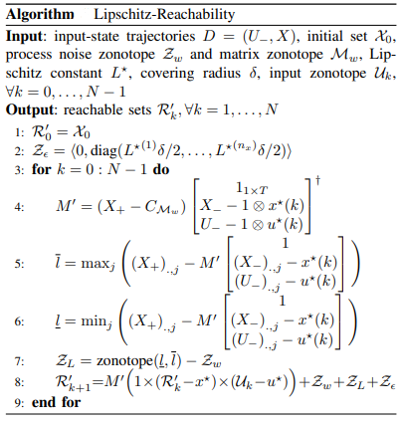
Approach / Application
Lipschitz nonlinear systems:

Slide 20
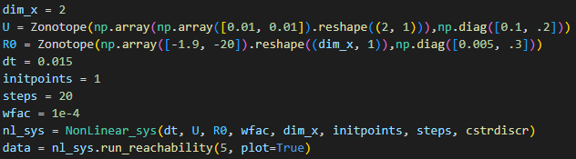
Approach / Application
Lipschitz nonlinear systems:
We consider the discrete-time version of the stirred-tank reactor system in [9].

Slide 21
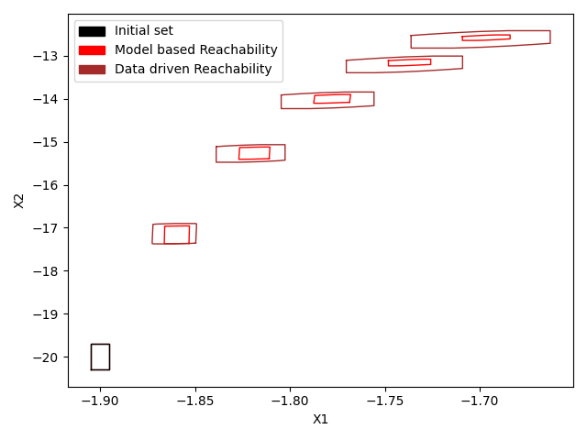
Approach / Application
Lipschitz nonlinear systems:

Slide 22
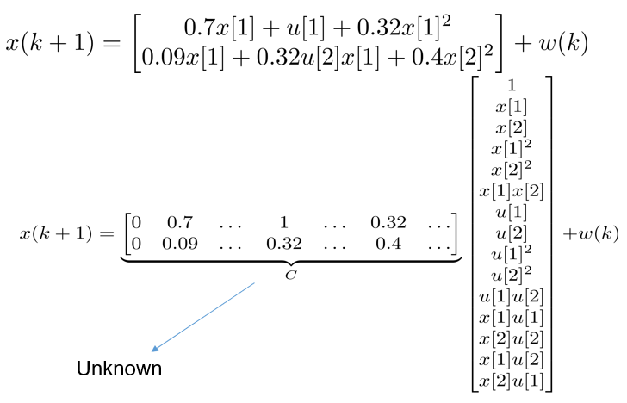
Approach / Application
Polynomial systems:
Notes:
Let z(k) = [x(k)ᵀ u(k)ᵀ]ᵀ, we can say that fₚ(z(k)) = C h(z(k)) + w(k) with h containing at least all the monomials present in fₚ and C contains the unknown coefficients of the monomials in h.

Slide 23
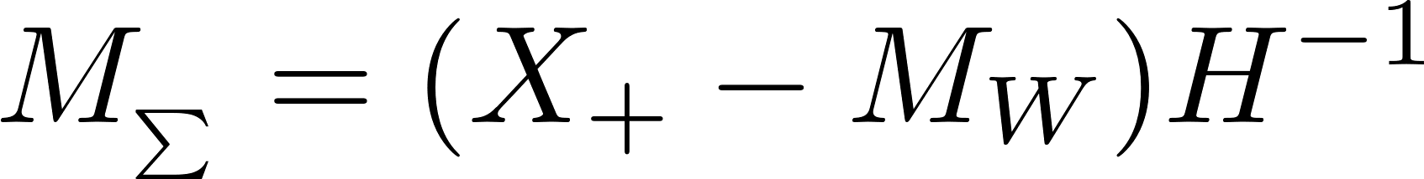
Approach / Application
Polynomial systems:
Construct
Compute matrix Zonotope MΣ that contains all matrices C that are consistent with the data:
Propagate ahead using MΣ

Slide 24
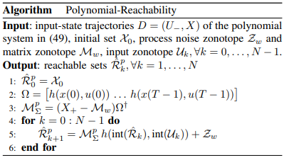
Approach / Application
Polynomial systems:

Slide 25
Approach / Application
Polynomial systems:
NOTE:
The data driven reachability analysis of polynomial systems isn’t functional yet.

Slide 26
Conclusion
In this study, I implemented algorithms to over-estimate a system's reachable set by over-estimating the reachable set of all systems consistent with the data and noise.
The data-driven reachability results, as displayed in the application, appropriately over-estimate the exact reachable sets. Thus, theoretical guarantees are provided.
However, the method used produces conservative results.

Slide 27
References
[1] Matthias Althoff and Bruce H. Krogh "Zonotope Bundles for the Efficient Computation of Reachable Sets"
[2] State-Space Linear Systems
[3] Amr Alanwar , Anne Koch, Frank Allgöwer, and Karl Henrik Johansson “Data-Driven Reachability Analysis Using Matrix Zonotopes”
[4] Anne Koch, Julian Berberich, and Frank Allgöwer “Verifying dissipativity properties from noise-corrupted input-state data”
[5] Amr Alanwar , Anne Koch, Frank Allgöwer, and Karl Henrik Johansson “Data-Driven Reachability Analysis from Noisy Data”
[6] Zanasi Roberto “System Theory”
[7] Jan M Montenbruck and Frank Allgower “ Some problems arising in controller design from big data ¨ via input-output methods.”
[8] Carlo Novara, Lorenzo Fagiano, and Mario Milanese “ Direct feedback control design for nonlinear systems”
[9] Jose Manuel Bravo, Teodoro Alamo, and Eduardo F Camacho “Robust MPC of constrained discrete- ´ time nonlinear systems based on approximated reachable sets”

