Slide 1
Data Collection and Cleaning
Pavement Performance - Rutting

Slide 2
Initial Variables Selection
 | LTPP Tables Used:
Traffic Load Related:
AADT, AADTT, ANNUAL_ESAL_TREND | TRF_TREND
Climate Related:
TEMP_MEAN_AVG, PRECIPITATION, FREEZE_INDEX | MERRA_TEMP_ANNUAL, MERRA_PRECIP_ANNUAL
Pavement Performance:
RUTTING | MON_T_PROF_INDEX_SECTION
Material & Structural Properties:
SUBBASE THICKNESS, SUBGRADE MATERIAL TYPE, AIR VOIDS & ASPHALT CONTENT IN THE MIX | TST_L05B, INV_PMA_ORIG_MIX
The variables were chosen based on background literature review and existing studies. This selection was later changed to create a more unique model.

Slide 3
Final Variables Selection
Variables | Description | Source Table
CONSTRUCTION_NO | Cumulative number of construction event | TST_L05B
MAX_MEAN_DEPTH_1_8 | Maximum rut depth | MON_T_PROF_INDEX_SECTION
MR_MATL_TYPE | Material type of subgrade | TST_UG07_SS07_A
REPR_THICKNESS | Subgrade thickness | TST_L05B
RES_MOD_AVG | Characterization of subgrade material stiffness | TST_UG07_SS07_WKSHT_SUM
TOTAL_ANN_PRECIP | Annual Precipitation (mm) | CLM_VWS_PRECIP_ANNUAL
FREEZE_INDEX_YR | Freeze index | CLM_VWS_TEMP_ANNUAL
MAX_ANN_TEMP_AVG | Maximum annual temperature average | CLM_VWS_TEMP_ANNUAL
MAX_ANN_TEMP_DAYS | Maximum annual temperature days | CLM_VWS_TEMP_ANNUAL
DAYS_ABOVE_32_C_YEAR | Average number of days above 32 ° C | CLM_VWS_TEMP_ANNUAL
ANL_KESAL_LTPP_LN_YR | Traffic Load - Annual ESAL (equivalent single axle loads) estimates | TRF_HIST_EST_ESAL & TRF_MON_EST_ESAL

Slide 4
Data Cleaning & Preprocessing
Data Acquisition from LTPP website.
Conduct analysis to identify missing data / anomalies.
Convert data into arrays
Fit the RF model and obtain variable importance
Join tables and retain necessary and required variables.
Split data into training and testing sets
Separate data into features and labels
Preprocess categorical variables - One hot encoding
Remodel with using features with significant impact on the target label
Using Python and MySQL

Slide 5
Data cleaning highlights
No records found for some features
For observed traffic loads, data dates from 1990
Table joining caused significantly less data points – not enough to create model
Solutions:
Background research and looking through LTPP database for features that better suited the purpose
Use of estimated values for years before 1989

Slide 6
Training, Testing, Optimization
Dataset has 10 input variables and 7875 data points
80-20 train-test split was used for the final prepared dataset
5 fold cross-validation and 10 fold cross-validation at hyperparameter optimization stage
Initial Random Forest model had default parameters:
Number of trees = 100
Minimum number of samples on each leaf = 1
Minimum number of samples on each split = 2
Maximum depth of each tree = ~30-40

Slide 7
Hyperparameter optimization results
Maximum depth of each tree = 22
Maximum number of features to consider for each split = 8
Minimum number of samples on each leaf = 4
Number of trees = 5
Repeated 10 fold Cross-validation R^2 = 96.501%

Slide 8
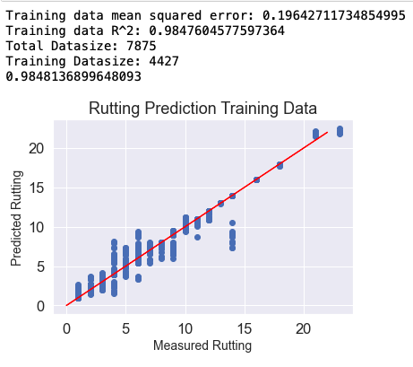
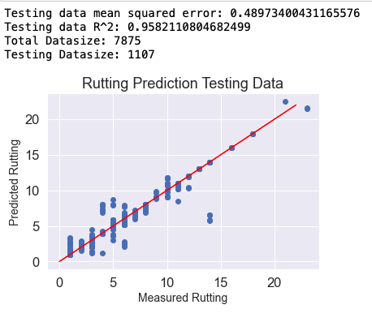
Training R^2 = 98.476%
MSE = 0.196
Repeated 10 fold
Cross-validation R^2 = 96.501%
Testing R^2 = 95.821
MSE = 0.489

Slide 9
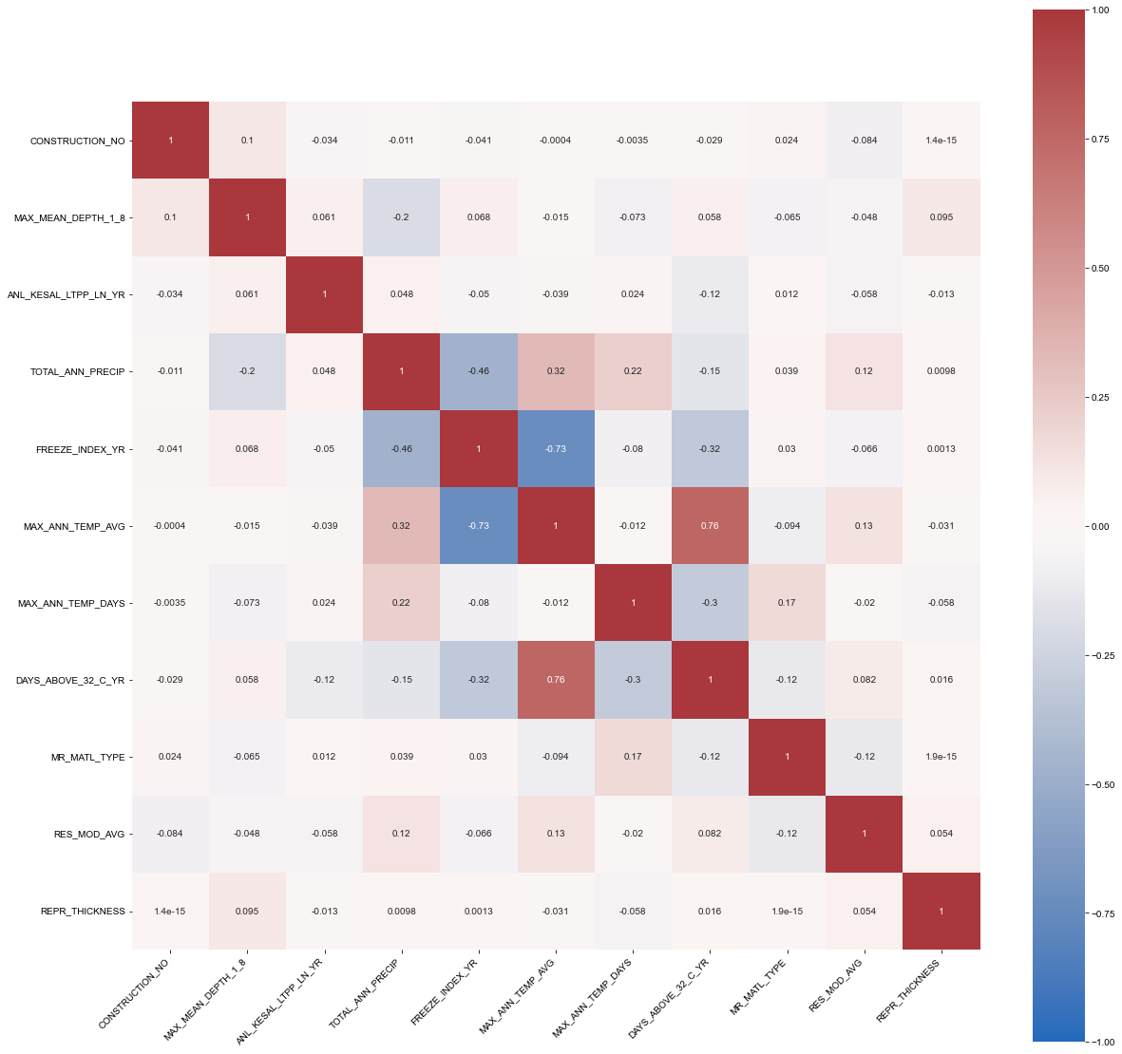
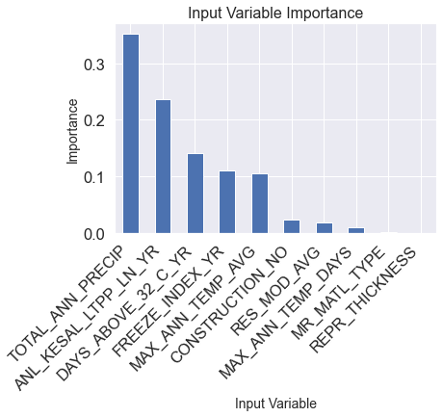
Input Variable Importance
Correlation Matrix

Slide 10
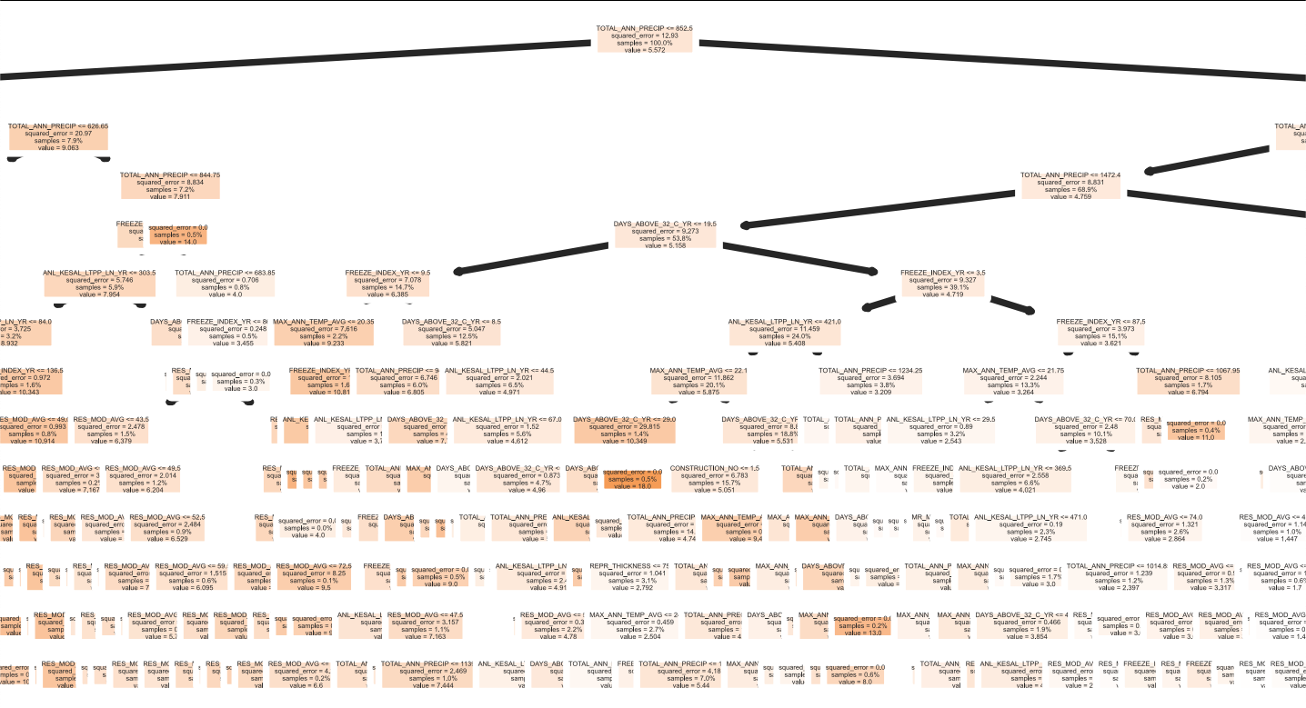
Decision Tree Visualization

Slide 11
References:
Scikit-learn: Machine Learning in Python, Pedregosa et al., JMLR 12, pp. 2825-2830, 2011.
Federal Highway Administration. 2019. Long-Term Pavement Performance Information Management System User Guide. Federal Highway Administration, FHWA-RD-03-088.

