Slide 1

Introduction to PageRank
PageRank is a revolutionary algorithm developed by the founders of Google, Larry Page and Sergey "Brin", that revolutionized the way search engines rank and display web pages. This groundbreaking technique analyzes the relationships between websites to determine their relative importance and relevance, ultimately providing users with the most valuable and authoritative information for their queries. By understanding the core principles behind PageRank, we can gain valuable insights into the inner workings of the modern internet and how search engines continuously strive to deliver the best possible user experience.

Slide 2

What is PageRank ?
PageRank is a fundamental algorithm that forms the core of Google's search engine technology. Developed by Google's founders, Larry Page and Sergey Brin, PageRank revolutionized the way web pages are ranked and displayed in search results. At its heart, PageRank analyzes the complex network of interconnections between websites, assigning each page a numerical value that reflects its relative importance and authority on the web. This unique approach goes beyond simply matching keywords, instead prioritizing pages that are widely cited and linked to by other reputable and trusted sources. By understanding a page's PageRank, search engines can more effectively identify the most relevant and valuable content to present to users, providing them with the most helpful and informative results for their queries.

Slide 3
How PageRank Works
Random Surfer Model
Concept: Imagine a user (the random surfer) who randomly clicks on links across the web.
  Example: A user starts on a random web page, such as "1.html".
Transition Probabilities
Link Following: With a probability 𝑑d (the damping factor), the surfer follows a link from the current page.
  Example: If the damping factor is 0.85, there's an 85% chance the surfer will follow a link from the current page.

Slide 4
Random Jump: With a probability 1−𝑑1−d, the surfer jumps to any page in the corpus at random, including the current page.
  Example: If the damping factor is 0.85, there's a 15% chance the surfer will jump to any random page in the corpus.
Transition Model
Input Parameters:
  Corpus: A dictionary mapping each page to a set of pages it links to.
  Current Page: The page the surfer is currently on.
  Damping Factor (d): Typically set to 0.85.
  Example: The corpus is {"1.html": {"2.html", "3.html"}, "2.html": {"3.html"}, "3.html": {"2.html"}} and the current page is "1.html".

Slide 5

How PageRank Works
Example:
Example:
  For a corpus with 3 pages, each starts with PR≈0.333 .
  Pages linked from "1.html": "2.html" and "3.html"
Update Rule:
  if 𝑑 = 0.85 and numlinks(p) = 20, then the probability for each linked page is d / numlinks(p) = 0.85 / 20 = 0.0425.
  Formula:
  if 𝑑 = 0.85 and there are 30 pages in the corpus, then the probability for each page is (1 - 𝑑) / total pages = (1 - 0.85) / 30 ≈ 0.05.
Where:
PR(p): PageRank of page
M(p): Set of pages that link to page
PR(i): PageRank of page
L(i): Number of outbound links from page
  Result: {"1.html": 0.05, "2.html": 0.475, "3.html": 0.475}

Slide 6
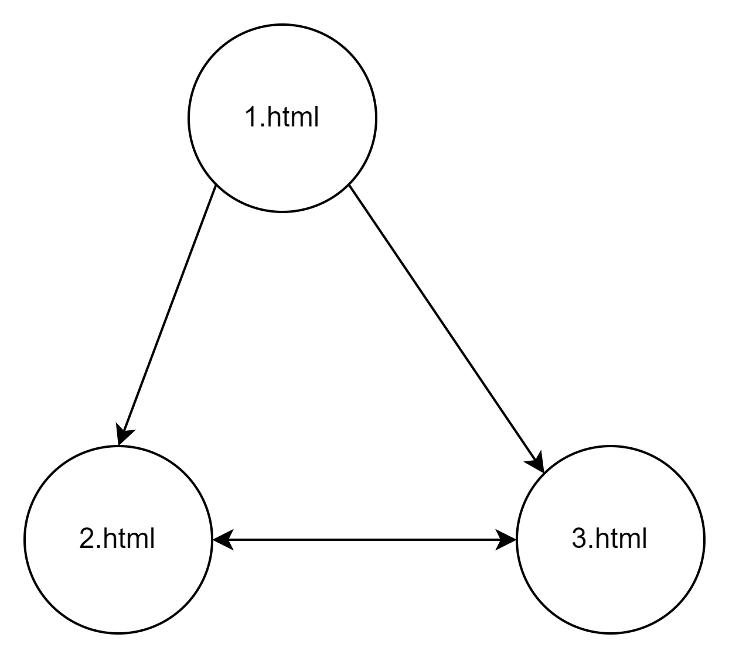
Example
Corpus: {"1.html": {"2.html", "3.html"}, "2.html": {"3.html"}, "3.html": {"2.html"}}
Damping Factor: 0.85
Initial PageRank: {"1.html": 0.333, "2.html": 0.333, "3.html": 0.333}
Iteration 1:
  1.html: (1-0.85)/3 + 0.85*(0) = 0.05 + 0 = 0.05
  2.html: (1-0.85)/3 + 0.85*(0.333/2 + 0.333/1) = 0.05 + 0.425 = 0.475
  3.html: (1-0.85)/3 + 0.85*(0.333/2 + 0.333/1) = 0.05 + 0.425 = 0.475

Slide 7
Methods
The code features various functions for computing PageRank scores. The main function initiates the program, prompting users for a directory path with HTML pages. It employs the crawl function to extract links, constructing a corpus of interconnected web pages.
Sample
The sample PageRank function employs random sampling to calculate PageRank scores. It selects pages randomly from the corpus and iterates through a specified number of iterations. During each iteration, it updates a dictionary to track page visits. Transition probabilities between pages are determined by the transition model function.
Iterative
The iterate PageRank function adopts an iterative method to compute PageRank scores. It initializes a ranks dictionary and updates scores based on linked page influence until the difference between new and old scores meets a defined threshold. The main function concludes by printing PageRank results for both sampling and iterative methods, offering insights into page importance within the corpus based on their scores.

Slide 8
Importance of PageRank
Influence on Advertising and Marketing Strategies
Building a Robust Online Presence
A high PageRank enables businesses to reduce reliance on paid advertising, allocate marketing budgets efficiently, and enhance both organic and paid campaign effectiveness.
PageRank continues to be a cornerstone of SEO and digital marketing, prioritizing relevance, credibility, and quality for mutual benefit of users and website owners.
The accuracy and efficiency of the implemented algorithms
The implemented algorithms effectively approximate PageRank values with accuracy, utilizing sampling and iterative methods, though the iterative approach may suffer from efficiency concerns due to repeated calculations until convergence.

Slide 9

Limitations of PageRank
Despite revolutionizing search engine ranking, PageRank faces challenges due to susceptibility to manipulation, prompting the development of sophisticated techniques like machine learning to preserve result integrity.
PageRank's reliance on link analysis may inadequately assess a webpage's value, especially with rapidly evolving content or niche topics, and it may struggle to incorporate the nuances of social media and user engagement, impacting modern SEO efforts.

Slide 10
PageRank, created by Larry Page and Sergey Brin, revolutionized web search by prioritizing relevance and trust. However, it faces challenges like susceptibility to manipulation and struggles to keep pace with internet evolution. Solutions include sampling and iteration, albeit time-consuming. Despite SEO advancements, PageRank remains vital, shaping online marketing strategies and emphasizing the need for trustworthy content.
Conclusion

