Slide 1
Frontdoor
Ask about any RealPage product.
Get an answer with sources, or get sent to the right team.
Built in one day from RealPage's public website.
Hamza Saraswat
AI Engineer · hamza-saraswat.com · github.com/Hamza-Saraswat/RP_Demo
Hamza Saraswat · Frontdoor · 1
Notes:
Hi, I'm Hamza. You asked for something built with AI that helps RealPage scale. I built this in one day, from your public website. I'll show you what it is, how it works, and why I made each choice.

Slide 2
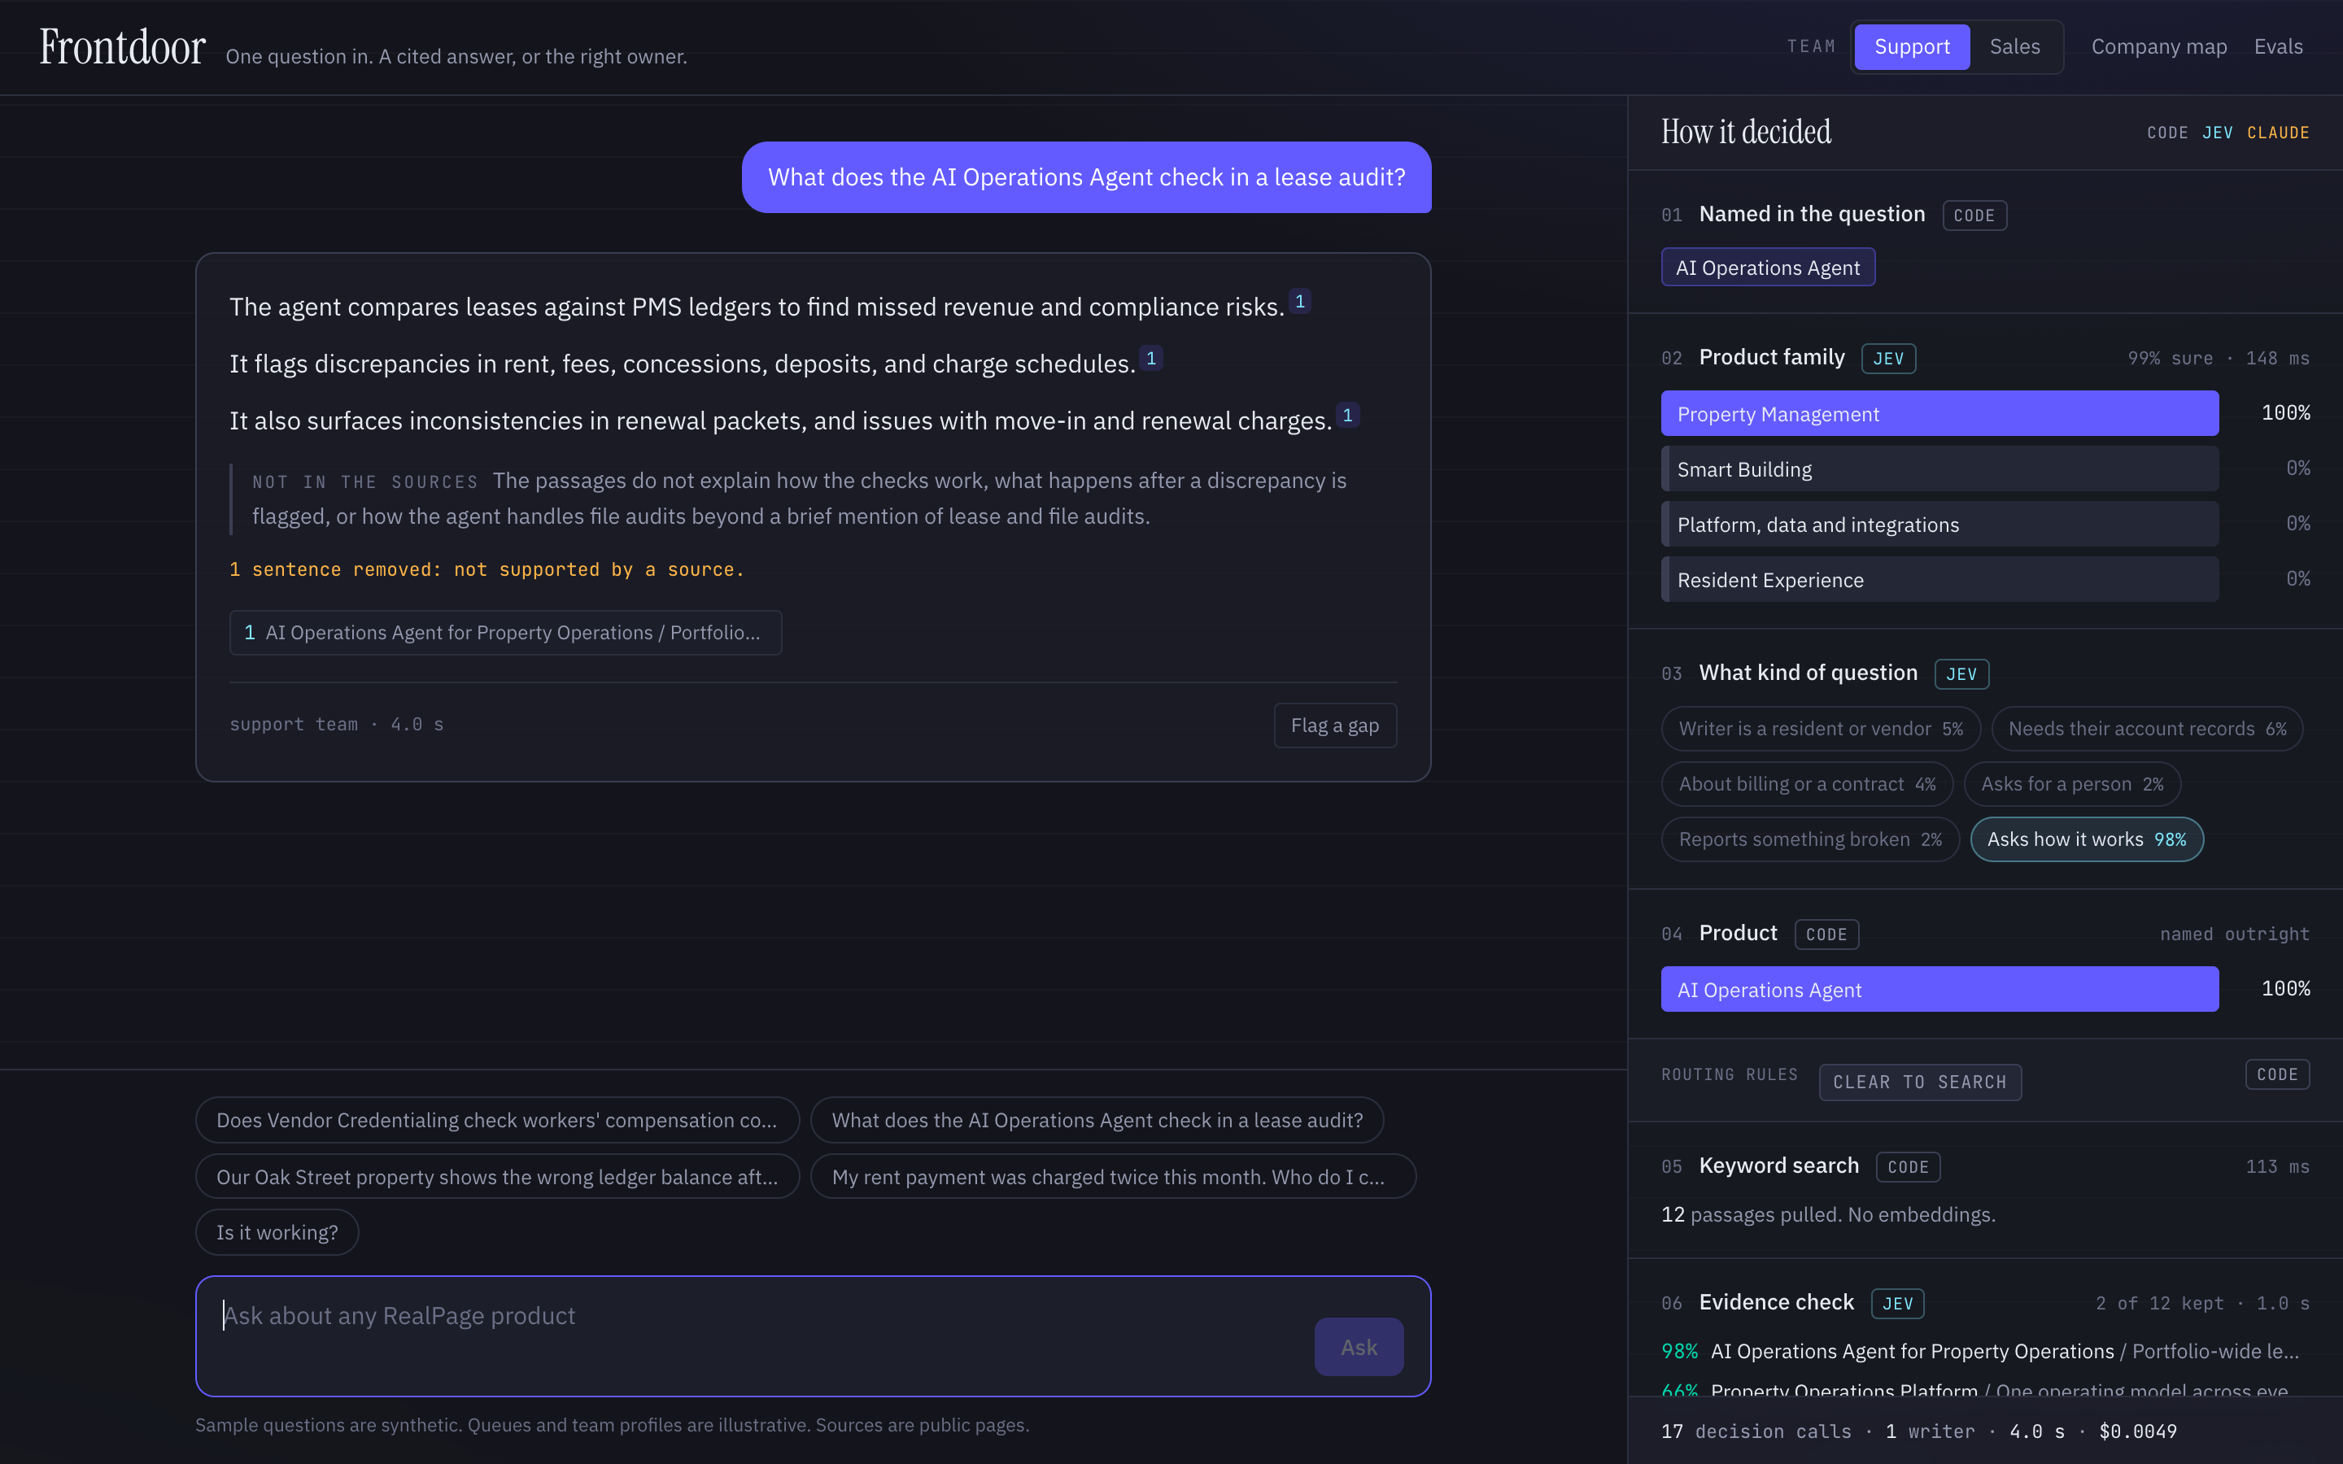
WHAT I BUILT
One place to ask about any RealPage product.
You ask a question. About any product, in your own words.
It answers, and shows its sources. Only from RealPage's own public pages.
Or it sends it to the right team. When the question needs a person, it says who, and passes along what it found.
Why this: RealPage has 63 products and has acquired more than 50 companies. Knowing who owns a question is hard.
Hamza Saraswat · Frontdoor · 2
Notes:
Here is what I built. It is one place to ask about any RealPage product. You type a question. It answers from RealPage's own public pages, and it shows you which pages it used. And if it's a question it shouldn't answer, like something about one customer's account, it sends that question to the right team instead. I picked this because RealPage has 63 products and has acquired more than fifty companies. With that many products, knowing who owns a question is hard.

Slide 3
HOW IT WORKS
What happens before you ask, and when you do.
BEFORE ANY QUESTION
1. I read the public website.
2. I organized it two ways.
221 pages: product pages, customer case studies, press releases, and leadership bios.
A company map. One short file for each product, family, acquired company, customer, and executive: 157 files. It is how it knows what exists and who owns it.
Searchable text. Every page, split at its headings into 1,323 sections.
WHEN YOU ASK
1. Understand
→
2. Find
→
3. Write
→
4. Check
Which product is this about? Does it need a person?
Search the 1,323 sections for the ones that answer it.
Write the answer using only those sections.
Compare each sentence to its source before showing it.
If it needs a person, or nothing answers it, the question goes to the owning team instead.
Hamza Saraswat · Frontdoor · 3
Notes:
Here is how it works. Two things happen before anyone asks a question. First, I read the public website: 221 pages. Product pages, customer case studies, press releases, and leadership bios. Second, I organized what I read in two ways. One is a company map: a short file for each product, product family, acquired company, customer, and executive. That is how it knows what exists and who owns it. The other is the page text itself, split at its headings into 1,323 sections, so it can be searched. Then, when you ask, four things happen. It works out which product you mean and whether this needs a person. It finds the sections that answer it. It writes the answer using only those sections. And it checks each sentence against its source before you see it. If it needs a person, or nothing answers it, the question goes to the owning team. Let me show you. [Switch to the app.]

Slide 4
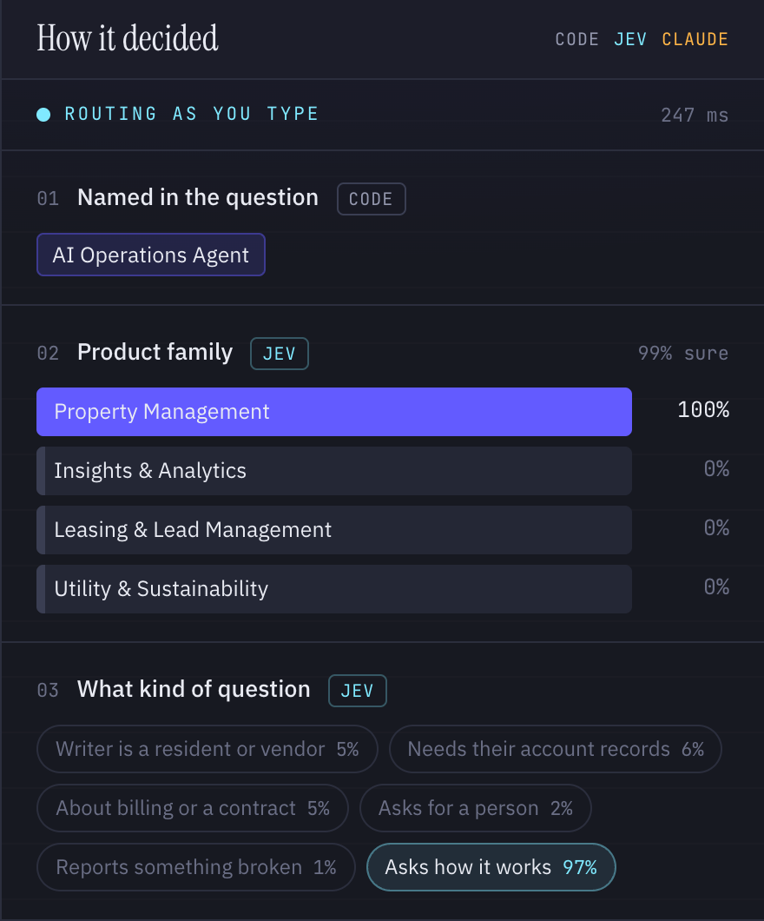
WHY I MADE EACH CHOICE · 1 OF 3
Jev makes the decisions. Claude does the writing.
Jev is a decision model. It does not write text. You give it a question with fixed answers, and it tells you how likely each one is.
1
It returns a number, not a paragraph.
"Property Management: 100%." My code sets the cutoff: under 60% sure, a person decides.
2
It is fast.
About a quarter of a second per decision. That is why the routing updates while you are still typing.
3
It is cheap.
One answer uses about 17 decisions. Together they cost about a tenth of the one writing call.
4
It turns one fuzzy question into small clear ones.
"Should we answer this?" becomes: Is the writer a resident? Does it need account records? Is it about billing?
Where I used it: which product · what kind of question · does this page answer it · does this sentence match its source
Hamza Saraswat · Frontdoor · 4
Notes:
I used two models, and they do different jobs. Claude writes. Jev decides. Jev is a decision model. It does not write text. I give it a question with fixed answers, like 'which product family is this about', and it tells me how likely each answer is. I chose it for four reasons. One: it gives me a number, not a paragraph. So my code can set a rule: under sixty percent sure, a person decides. Two: it is fast, about a quarter of a second. That is why you saw the routing change while I was still typing. Three: it is cheap. The seventeen decisions behind one answer cost about a tenth of what the one writing call costs. Four: it lets me break one fuzzy question, 'should we answer this', into small clear ones. Is the writer a resident? Does this need account records? Is it about billing? My rule of thumb: if a person could decide it in under ten seconds, it is a Jev question. If it needs writing or reasoning, it goes to Claude.

Slide 5
WHY I MADE EACH CHOICE · 2 OF 3
The simplest search that worked. And what I would use next.
It is small.
People name the product.
I checked.
221 pages. A keyword search over them takes 7 milliseconds and costs nothing.
"Does Vendor Credentialing check workers' comp?" The words asked are the words on the page.
It found the right page for all 18 test questions that had an answer.
OPTION | WHAT IT IS | USE IT WHEN | EXAMPLE
Keyword search (chosen) | Match the words in the question to words on the page | People use the same words the pages use | A product help site. This project
Query rewriting | A model rewrites the question into better search words first | People use shorthand the pages do not | Staff type "COI". The page says "certificate of insurance"
Keyword plus embeddings | Also match by meaning, not only by words | People describe a problem in their own words | "My tenant can't pay online" has to find "resident payment portal errors"
Embed at question time | Work out meaning on the spot. Nothing is stored | Content changes every hour | A live ticket queue, or a news feed
Pre-embed popular pages | Store meaning for the busiest pages only | A few pages get most of the traffic | A large wiki where 20% of pages get 80% of visits
Full vector database | Store meaning for everything | Very high volume, and content rarely changes | Millions of past support chats, searched thousands of times a day
When I would move up: when people start asking in words the pages do not use. The next step is query rewriting, not a vector database.
Hamza Saraswat · Frontdoor · 5
Notes:
For search, I picked the simplest option that worked: keyword search. It matches the words in the question to the words on the page. Three reasons. It is small: 221 pages, searched in seven milliseconds, for free. People name the product when they ask, so the words in the question are the words on the page. And I checked: it found the right page for all 18 test questions that had an answer. That does not make it the right choice everywhere. If staff type 'COI' and the page says 'certificate of insurance', I would add query rewriting. If people describe a problem in their own words, I would add embeddings, so it matches by meaning. If content changes every hour, I would work that out at question time. And at millions of documents and thousands of searches a day, a full vector database earns its cost. I would move up when people start asking in words the pages do not use. And the next step up is query rewriting, not a vector database.

Slide 6
WHY I MADE EACH CHOICE · 3 OF 3
The company map is how a question finds its owner.
Compliance Depot
→
Vendor Credentialing
→
Spend & Vendor Management
→
Owning team
the company it came from
the product
its family
who to send it to
What it is. The "company knowledge graph" from your brief: every product, its family, where it came from, and who owns it.
Why I built it. Without it, the assistant can answer a question but cannot say whose question it is.
Where the structure comes from. RealPage's own website menu. I did not invent the families.
HOW TO STORE IT | USE IT WHEN | EXAMPLE
Linked markdown files (chosen) | A few hundred to a few thousand entries that people need to read and fix | This project: 157 entries. Anyone can open a file and correct it
Auto-generated graph | You have a pile of documents and do not know what is in it yet | Drop in 500 mixed files and ask "what are the main topics here?"
Graph database | You need to follow long chains across millions of records | "Which customers are affected if we retire this product?"
Managed knowledge platform | Many live sources that must stay in sync, with permissions | Chat history, a wiki, and a ticket system, searched together
Hamza Saraswat · Frontdoor · 6
Notes:
Your brief asked for a company knowledge graph. This is mine. I call it the company map. It is a list of every product, the family it belongs to, the company it came from, the customers who published results with it, and who owns it. So Vendor Credentialing came from Compliance Depot, sits in Spend and Vendor Management, and goes to that team. I built it because without it, the assistant can answer a question but cannot say whose question it is. And I did not invent the structure. The families come from RealPage's own website menu. I stored it as plain linked files, one per entry, 157 of them, because at this size a person can open one and fix it. If I had a pile of documents and did not know what was in it, I would generate a graph automatically. If I needed to follow long chains across millions of records, I would use a graph database. And with many live sources that need permissions, I would use a managed platform.

Slide 7
WHERE THIS PATTERN COMES FROM
This is the pattern I run in production.
Teams it serves
IT support
Customer support
Customer success
Sales (next)
Company-wide agent harness
One agent core
Per-team tools
Versioned prompts
Tests on real transcripts
Universal knowledge layer
One place to search
Every answer cited
Verified answers saved
Connectors into company systems
Data warehouse (Metabase API)
Slack history, backfilled
Jira and Linear tickets
Wiki and help center
Hamza Saraswat · Frontdoor · 7
Notes:
This was not a one-off. It is a small version of what I built at FieldPulse over the past year. At the bottom are connectors into the company's systems: the data warehouse through the Metabase API, Slack history that I backfilled so years of tribal knowledge is searchable, Jira and Linear tickets, the wiki, and the help center. On top of that is one knowledge layer: one place to search, and every answer cited. On top of that is one agent harness: a single core, where each team gets its own tools, its own prompt, and its own tests. And then the teams it serves.

Slide 8
WHAT THAT HAS PRODUCED
One foundation. Fourteen tools.
14
2,200+
200+
183
AI tools in production
Questions answered
Support emails a week
Customer accounts set up
Across eight departments. Up from one Slack bot in January.
In Slack, for 110+ employees. 94% without pulling in product or engineering.
Triaged by the email support agent.
Through the onboarding app since June. Median nine minutes.
Each new team reuses the same knowledge and the same rules.
HOW I WORK
Ship a small version
→
The team tests it
→
They tell me what broke
→
I fix that
Hamza Saraswat · Frontdoor · 8
Notes:
Here is what that foundation has produced. One Slack bot became fourteen tools across eight departments since January. The Slack assistant has answered over twenty-two hundred product questions. The email agent triages two hundred support emails a week. The onboarding app has set up a hundred and eighty-three customers. Each new team reuses the same knowledge and the same rules. And this is how I work: ship a small version, let the team test it, and fix what they hit.

Slide 9
DAY ONE INSIDE REALPAGE
Swap the sources. Pick one team. Measure.
Swap the sources. Replace public pages with internal ones. Everything else stays as it is.
HAMZA SARASWAT
AI Engineer
Pick one team. Ship them a first version that week, and let them break it.
hamza-saraswat.com
github.com/Hamza-Saraswat/RP_Demo
hamza.saraswat@gmail.com
Measure with their questions. A test set written by the people who field them.
The code and every test are in the repo.
Then document workflows. Read, check against requirements, explain every gap at once, send unclear ones to a person.
Hamza Saraswat · Frontdoor · 9
Notes:
So here is day one inside RealPage. Swap the public pages for internal sources. Everything else stays as it is. Pick one team, and ship them a first version that week. Let them break it, and fix what they hit. Measure with their questions, not mine. After that, the same foundation takes on document workflows: read the document, check it against the requirements, explain every gap at once, and send the unclear ones to a person. That is what I would bring. Thank you.

