Slide 1
Histogram Equalization
& Matching
Digital Image Processing
Practical Implementation with MATLAB

Slide 2
Agenda
01
Introduction & Background
06
Histogram Matching
What is a histogram? Why enhance contrast?
Part 3 code & results
02
Theory: Histogram Equalization
07
Comparison & Analysis
CDF-based pixel remapping
Built-in vs Manual
03
Theory: Histogram Matching
08
Applications
Matching to a target distribution
Real-world use cases
04
MATLAB Built-in: histeq()
09
Conclusion & References
Part 1 code & results
Summary & sources
05
Manual Implementation
Part 2 code & results

Slide 3
Introduction & Background
What is a Histogram?
Problem with Low Contrast
Solution: Enhancement
A histogram shows the frequency distribution of pixel intensity values (0–255) in a grayscale image. It reveals whether an image is dark, bright, or well-contrasted.
Pixel values are clustered in a narrow range → dull, washed-out appearance. Medical scans, satellite imagery, and old photos often suffer from this.
Redistribute pixel intensities across the full 0–255 range to improve visual quality and reveal hidden details.
Pixel Intensity Range: 0 (Black) → 255 (White)

Slide 4
Theory: Histogram Equalization
1
Compute Histogram
Count occurrences of each intensity level h(k) for k = 0, 1, ..., 255
2
Compute CDF
Cumulative Distribution Function: CDF(k) = Σ h(i) for i = 0 to k
3
Normalize CDF
T(k) = round( (CDF(k) − CDF_min) / (N − CDF_min) × 255 )
4
Apply Mapping
Replace each pixel value k with its mapped value T(k)
Goal: Spread pixel distribution across full 0–255 range for maximum contrast

Slide 5
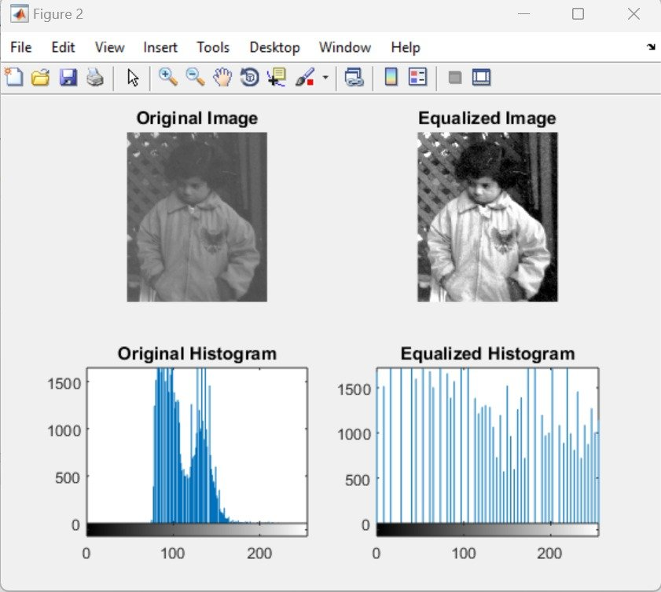
Part 1 — Built-in histeq() Function
% Read and equalize img = imread('pout.tif'); img_eq = histeq(img); % Display subplot(2,2,1); imshow(img); subplot(2,2,2); imshow(img_eq); subplot(2,2,3); imhist(img); subplot(2,2,4); imhist(img_eq);
Key Observations:
• Original histogram: concentrated around 80–150 (narrow mid-range) • Equalized histogram: spread across full 0–255 range → enhanced contrast

Slide 6
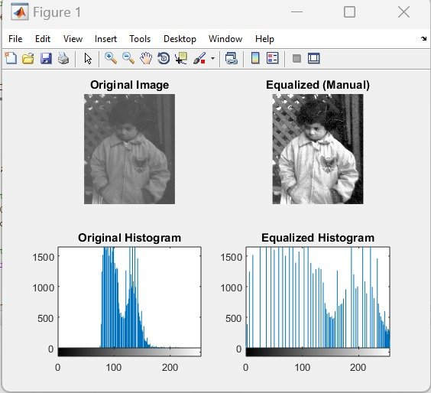
Part 2 — Manual Histogram Equalization
% Count histogram hist_count = zeros(1,256); for i=1:r
for j=1:c val = img_int(i,j)+1; hist_count(val)++; end end % CDF & normalize cdf = cumsum(hist_count); cdf_min = min(cdf(cdf>0)); mapping = round(((cdf-cdf_min)/ (total_pixels-cdf_min))*255); % Apply mapping img_out(i,j) = mapping(pixel+1);
Manual result matches histeq() output — validates correctness of the CDF-based algorithm implementation.

Slide 7
Theory: Histogram Matching
Histogram Matching (Specification) maps pixel values of a source image so its histogram resembles a target reference histogram.
1
Compute CDF of source image
2
Compute CDF of reference image
3
For each intensity in source, find matching intensity in reference where CDFs are closest
4
Apply the resulting mapping to the source image
Difference from Equalization: Instead of a uniform target, we match a SPECIFIC reference distribution (e.g., cameraman.tif)

Slide 8
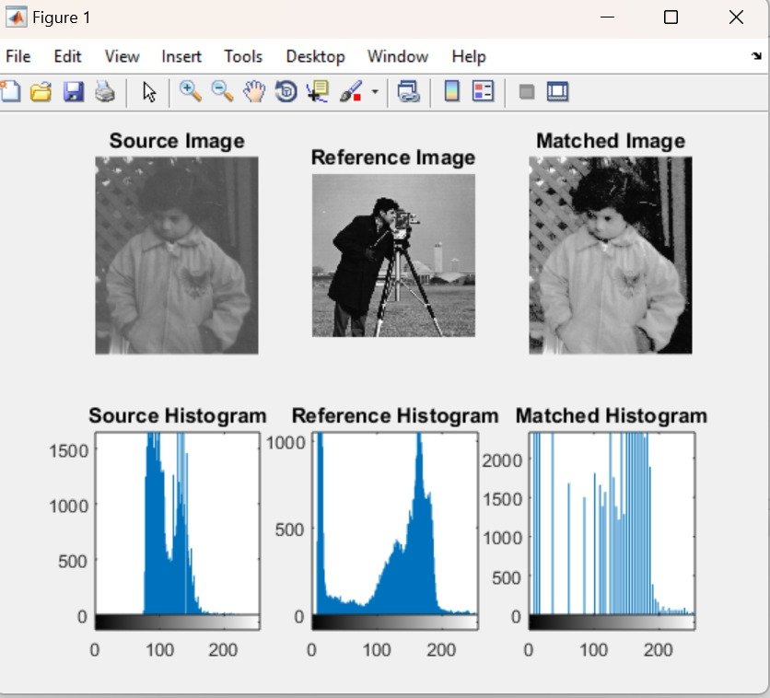
Part 3 — Histogram Matching (imhistmatch)
src = imread('pout.tif'); ref = imread('cameraman.tif'); matched = imhistmatch(src, ref); % 2x3 subplot display follows...

Slide 9
Comparison & Analysis
Criterion
Built-in histeq()
Manual Method
Histogram Match
Target Histogram
Uniform (flat)
Uniform (flat)
Any reference
Input Required
Image only
Image only
Image + reference
MATLAB Function
histeq(img)
Custom loops
imhistmatch()
Use Case
Quick enhancement
Learning/research
Style transfer
Flexibility
Low
High
Very High

Slide 10
Real-World Applications
🩺 Medical Imaging
🛰️ Satellite Imagery
📷 Photography
Enhance visibility of tissues in X-rays, CT scans, and MRIs. Detect tumors in low-contrast images.
Improve ground feature visibility. Enhance terrain, vegetation and water boundaries.
Auto-enhance old or poorly exposed photos. Dynamic range correction in digital cameras.
🔬 Microscopy
🎬 Video Processing
🤖 Machine Learning
Reveal cellular structures in biological samples that are nearly invisible in raw images.
Night-vision enhancement, surveillance video clarity, cinematic color grading.
Pre-processing step for image classification — normalizes input distributions.

Slide 11
Conclusion
Histogram Equalization
Enhances image contrast by spreading pixel intensity values uniformly using the CDF-based transform.
Manual vs Built-in
Our manual MATLAB implementation validates that results match MATLAB's built-in histeq(), confirming algorithm correctness.
Histogram Matching
More powerful than equalization — matches any target distribution using imhistmatch(), enabling style transfer and specific enhancement.
Practical Value
These techniques are foundational in medical imaging, satellite analysis, photography, and computer vision preprocessing.
References: Gonzalez & Woods, Digital Image Processing (4th ed.) | MathWorks MATLAB Image Processing Toolbox | pout.tif, cameraman.tif (built-in MATLAB)

