Slide 1

GUI Application for Minimum Spanning Tree (MST)
Course: Design and Analysis of Algorithm (CT-363)
Presented by:
Muhamad Hamza Khan (DT-48)

Slide 2
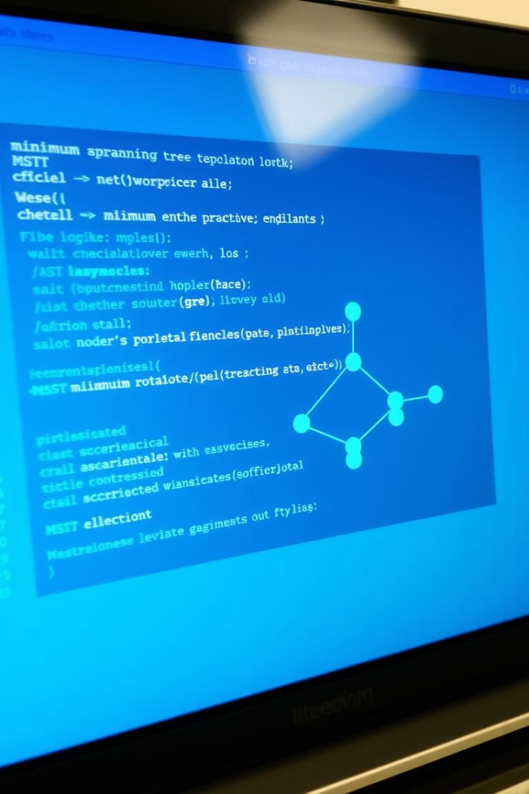
Project Abstract
Python GUI app leveraging Prim’s and Kruskal’s algorithms.
Input graphs and compute MSTs with visual output via Matplotlib.
CSV import/export for easy graph data management.
Designed as an interactive educational tool for algorithm learning.

Slide 3

Core Objectives
Intuitive GUI Design
Enable graph input and editing with ease.
Dual Algorithm Implementation
Integrate Prim’s and Kruskal’s for MST computation.
Side-by-Side Visualization
Compare MST outputs visually.
CSV Import/Export
Import graph data and save results efficiently.

Slide 4
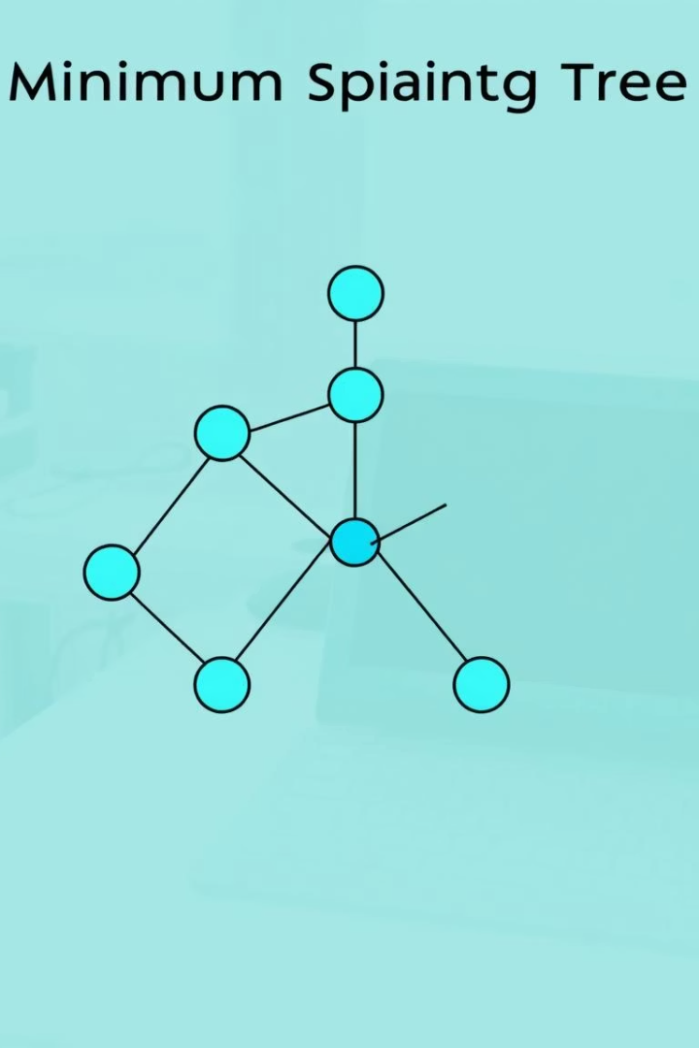
Applied Methodology
1
Graph Input
Manually add vertices and edges or import CSV files.
2
MST Computation
Run Prim’s and Kruskal’s algorithms to compute MSTs.
3
Visualization
Use Matplotlib for clear, comparative MST display.
4
Result Export
Export MST images and reset applications as required.

Slide 5
Key Features Overview
Dynamic graph creation and edge list display
Visual comparison of MSTs with weight display
Dual MST computations: Prim’s and Kruskal’s
CSV import/export and MST image saving
Error handling and reset functionality

Slide 6

Prim's vs Kruskal's Algorithms
Kruskal’s Algorithm
Prim’s Algorithm
Ideal for sparse graphs
Best for dense graphs
Sorts edges globally
No sorting required
Works with disconnected graphs
Needs connected graph
Uses Union-Find structure
Uses Min-Heap with adjacency list
Time complexity: O(E log E)
Time complexity: O(E log V)

Slide 7
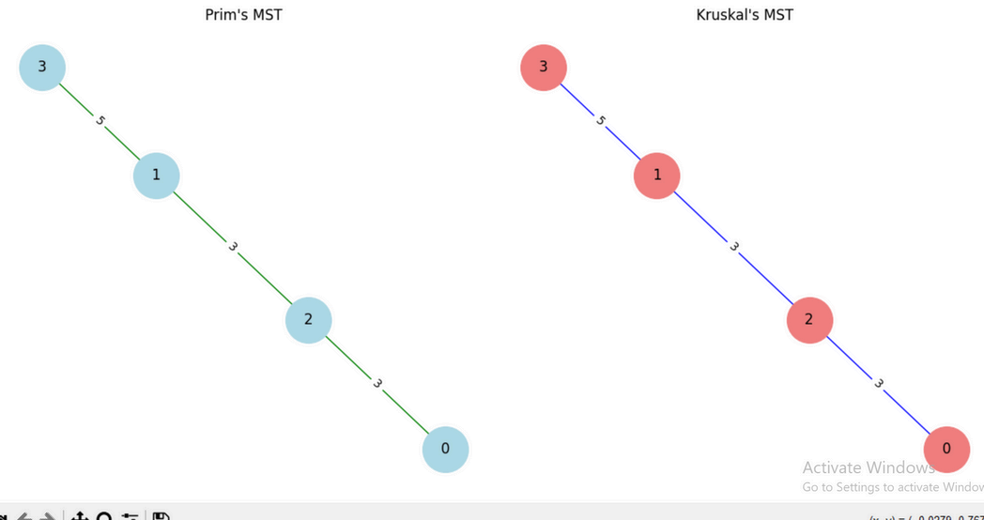
Results & Observations
Correct MSTs computed by both algorithms consistently.
Visualization aids clear structural comparison.
Exporting MST images facilitates documentation and study.
GUI boosts conceptual clarity for students and instructors.

Slide 8





Real-World Applications
Computer Networking
Transportation Planning
Image Segmentation
Machine Learning Clustering
Circuit Layout Optimization

Slide 9
THANK YOU !

