Slide 1
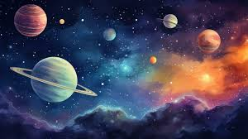
GalaxyMorph: Galaxy Classification
Group Members:
- Hasnat Noor Hassan (22I-2049)
- Hamza Zahid (22I-1974)
- Awais Arshad (22I-1989)
- Mahad Saeed (22I-1887)
Date: May 11, 2025

Slide 2
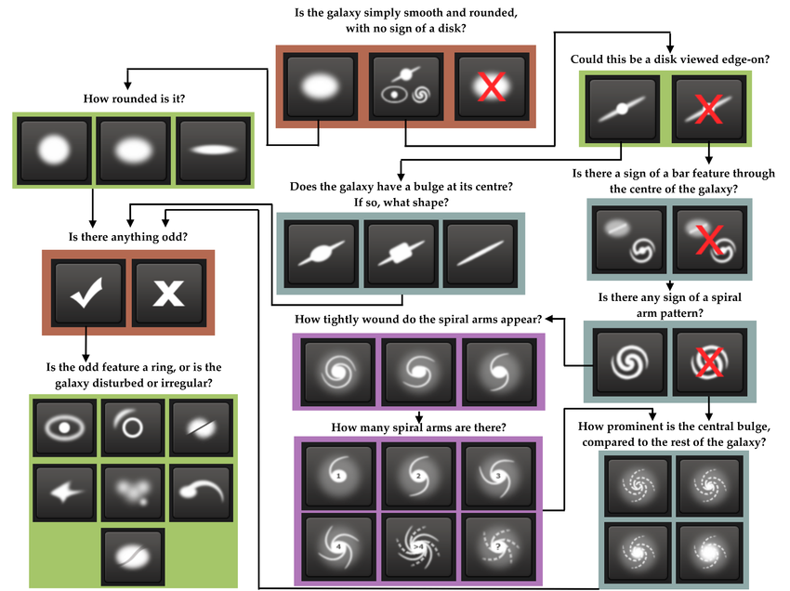
Introduction
• Classify galaxies using Galaxy Zoo 2 dataset
• Key components:
- Dataset structuring
- Image preprocessing & augmentation
- CNN model training
- Flask-based visualization (planned)

Slide 3
Dataset Description
• Source: Galaxy Zoo 2 (SDSS)
• Contents:
- JPEG galaxy images
- CSV with morphological class labels
• Final dataset: 9,998 images split into train/val/test sets

Slide 4
Dataset Creation
• Merged features via decision tree to form merged_final.csv
• Sampled up to 1,000 images/class
• Created image_class_mapping.csv
• Organized images into class-specific folders

Slide 5
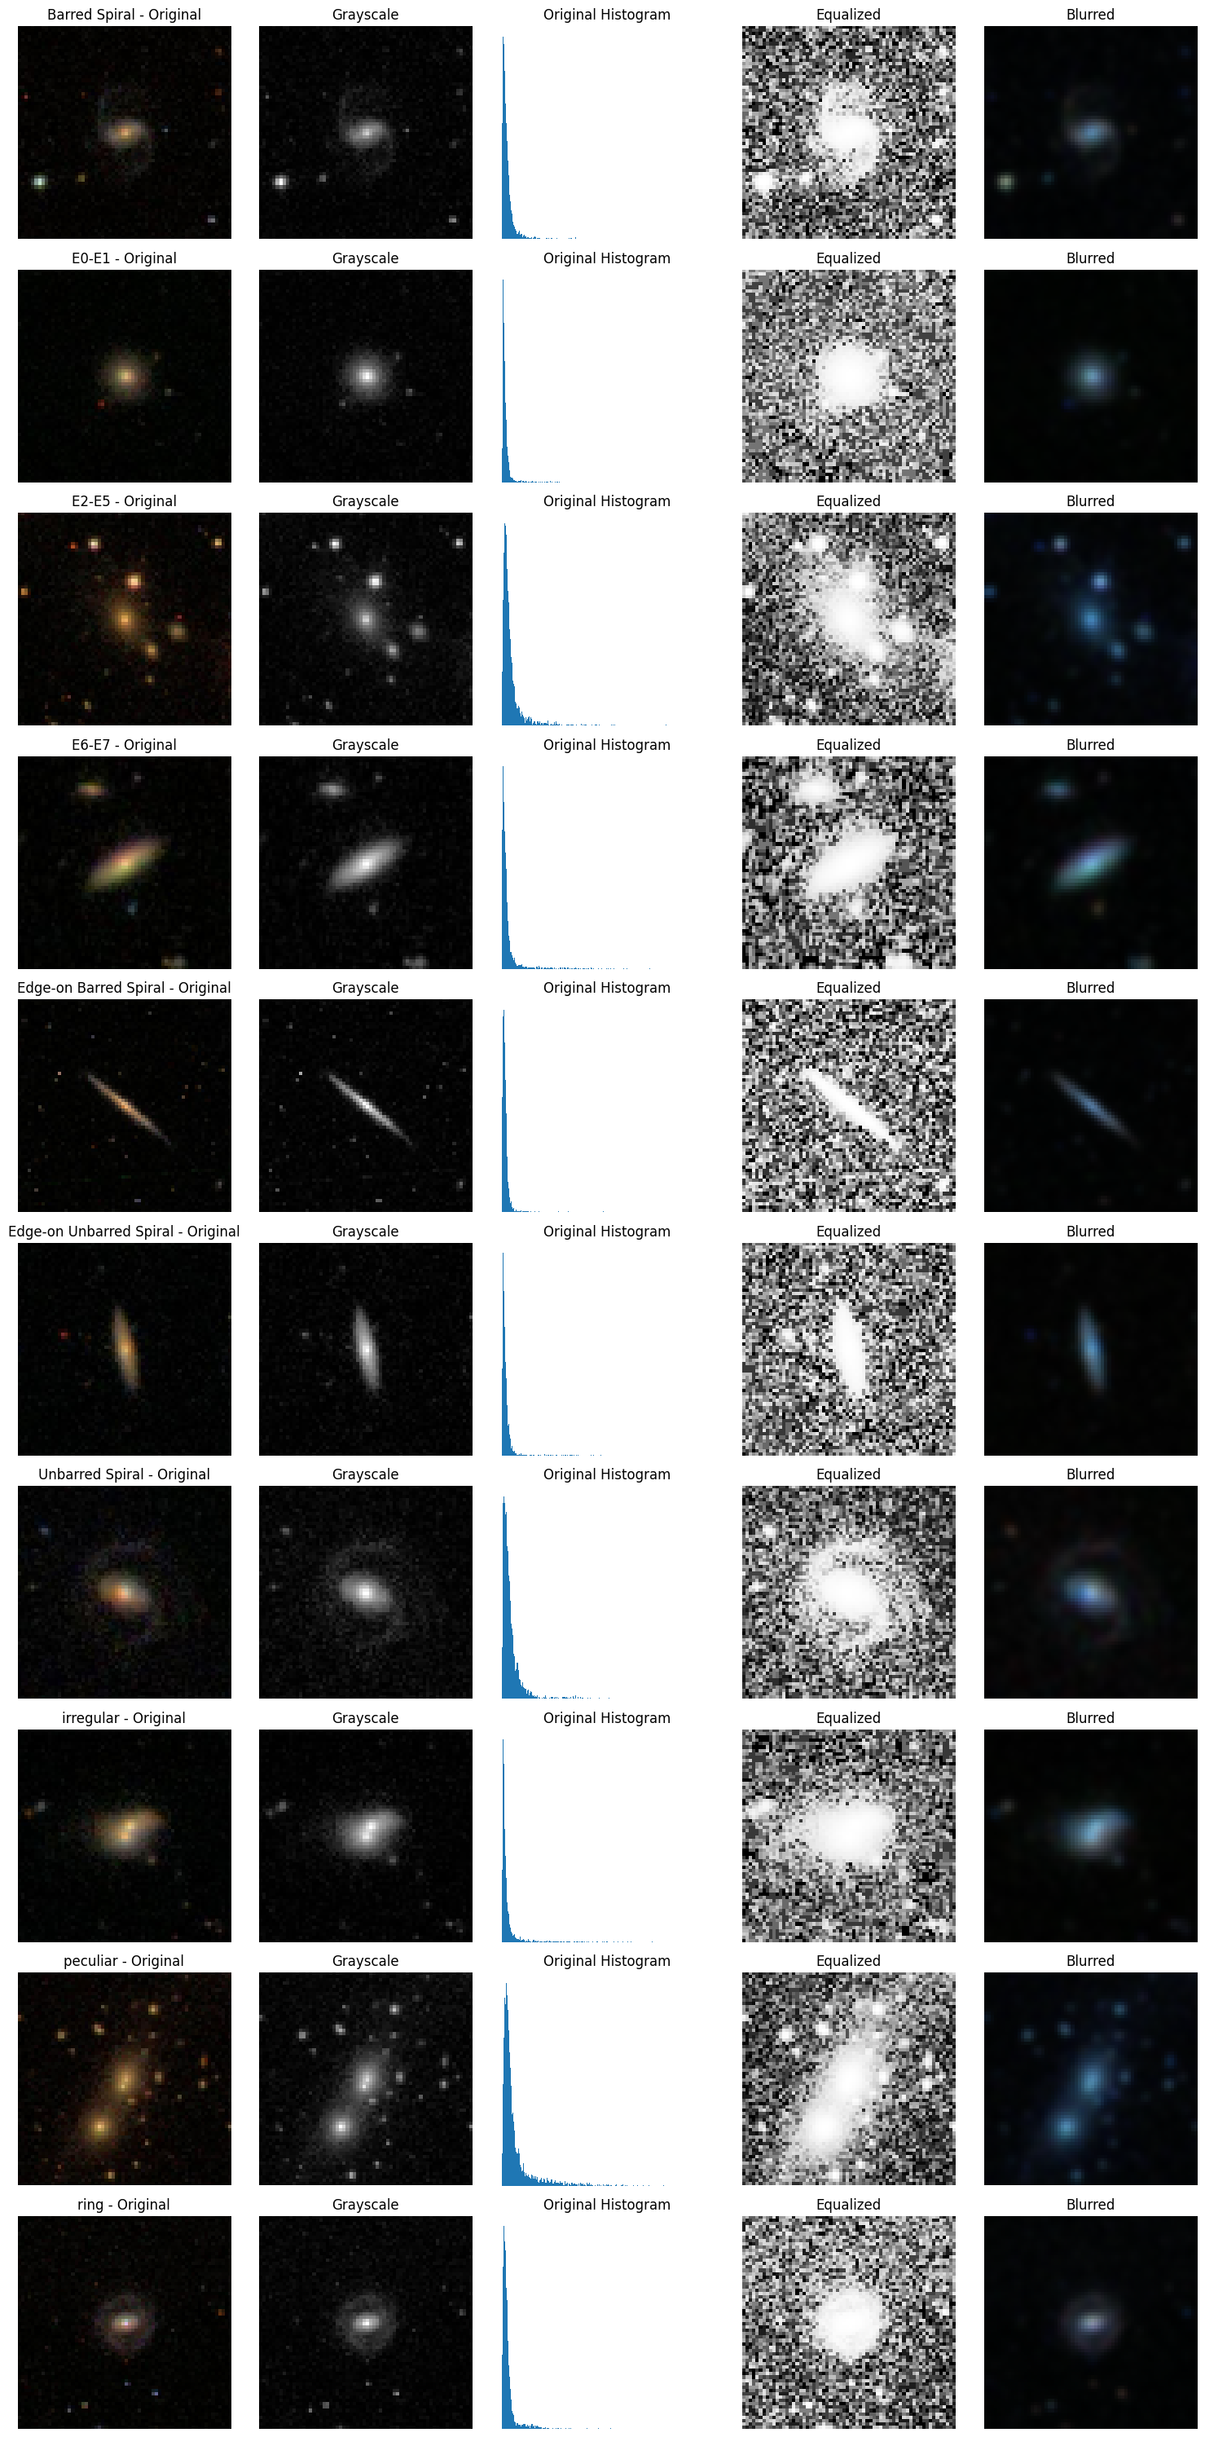
Image Preprocessing
• Techniques:
- Grayscale conversion
- Resize (64x64)
- Histogram equalization
- Gaussian blurring
- Thresholding to remove dark backgrounds

Slide 6
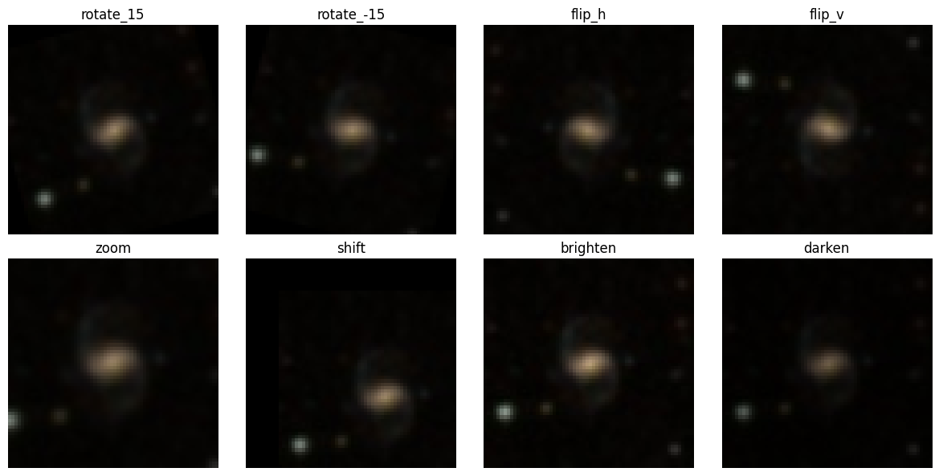
Data Augmentation
• Methods:
- Rotation
- Flipping
- Zoom & shift
- Brightness adjustment
• Advanced:
- Canny edge detection
- Binary thresholding
- Dilated mask (saved)

Slide 7
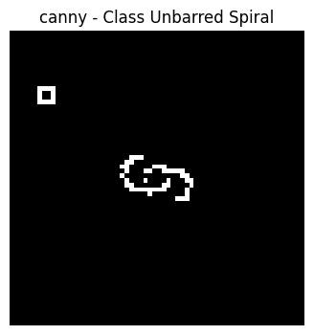
Image Processing Pipeline
• Preprocessing: Standardize image inputs
• Processing: Apply augmentation & enhancements
• Post-Processing: Save to transformed_dataset.csv

Slide 8
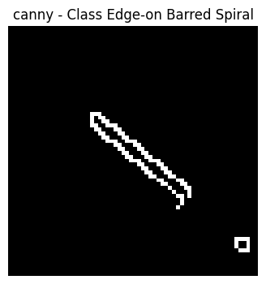
Convolutional Neural Network (CNN)
• CNN model to classify galaxy morphology
• Still in development
• Evaluation planned using accuracy & confusion matrix

Slide 9
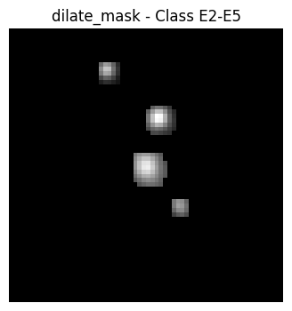
Flask Dashboard (Planned)
• Purpose: Visualize classification results via web UI
• Features:
- Upload galaxy image
- Show prediction & processed output

Slide 10
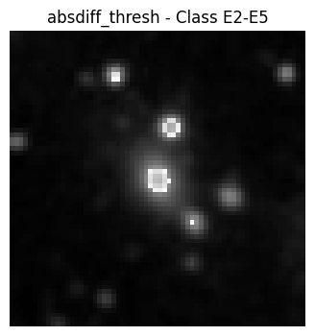
Conclusion & Future Work
• Achievements:
- Complete image processing pipeline
- Augmented & labeled dataset
• Pending:
- CNN training
- Flask dashboard
• Future: Extend to 3D data, improve accuracy

