Slide 1
Python AI
Here is where your presentation begins
←
→

Slide 2
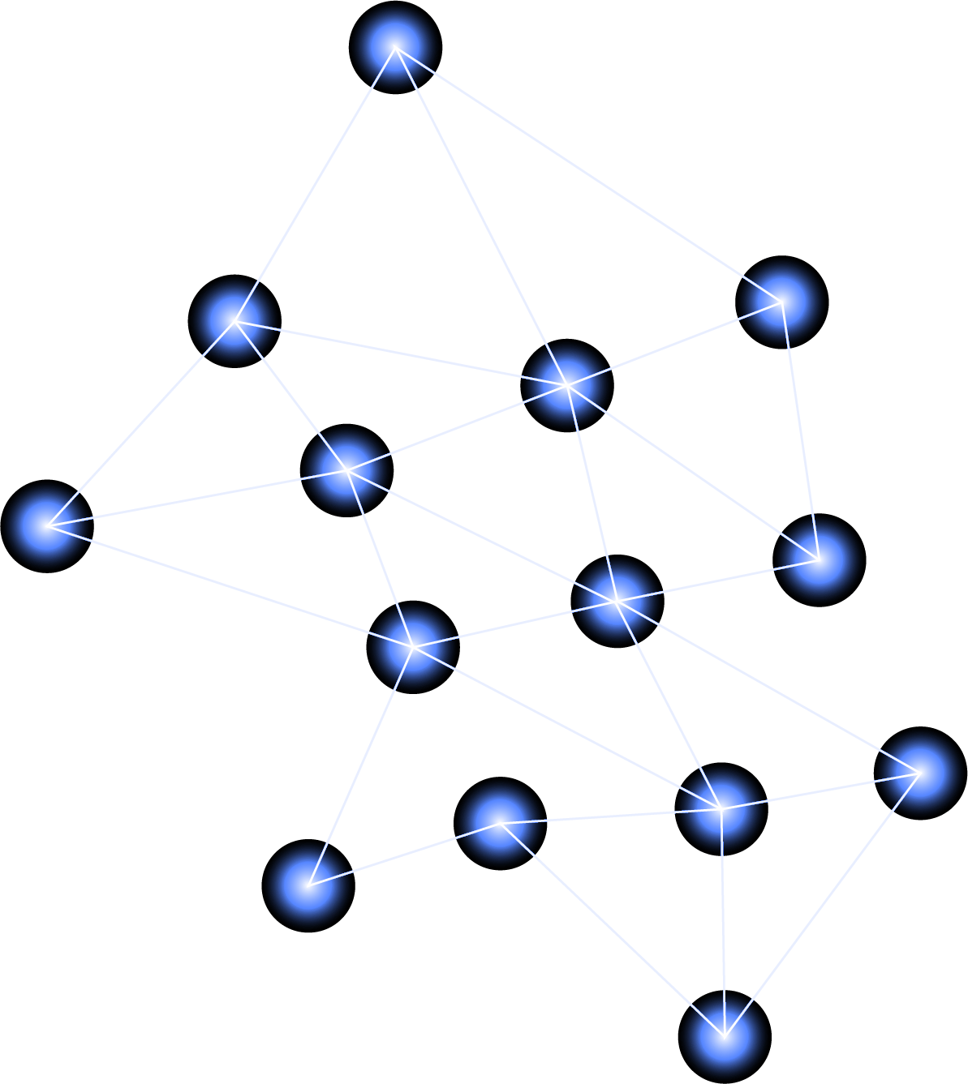

Table of contents
01
02
03
DataTypes in Python
Operators in Python
Loops in Python

Slide 3
01
Data Types in Python
5G
←
→

Slide 4

Data Types
Data types define the kind of value a variable can store. Each type serves a different purpose.

Slide 5
Integer and Flot
1
2
Flot
Integer
Float (float) - Stores decimal numbers.
Integer (int) - Stores whole numbers, positive or negative, without decimals.

Slide 6
String, Boolean and List
3
4
5
String
Boolean
Saturn
String (str) - Stores a sequence of characters (text values).
Boolean (bool) - Stores True or False values.
List (list) - Ordered, changeable collection that allows duplicate values.

Slide 7
Tuple, Dictionary and Set
6
7
8
Tuple
Dictionary
Set
Tuple (tuple) - Ordered, unchangeable collection.
Dictionary (dict) - Stores key-value pairs for fast lookups.
Set (set) - Unordered collection of unique values.

Slide 8
Examples of some key data tyeps.
# Integer
# String
x = 10 # Stores a whole number
name = “Random-Person" # Stores text
# List
# Boolean
fruits = ["Apple", "Banana", "Cherry"] # List of items, can be modified
is_active = True # Can be True or False

Slide 9
Operator
Operators are symbols that perform operations on variables and values.
Types of Operators and Examples.

Slide 10
Operators is Python
01
02
03
05
Membership Operators
(Check if a value exists in a sequence)
. Membership Operators (Check if a value exists in a sequence)
Arithmetic Operators (For calculations)
Comparison Operators
(For comparisons, returns True or False)
Logical Operators
(Used for conditional expressions)

Slide 11
Examples of some key Operators
Arithmetic Operators (For calculations)
Comparison Operators
(For comparisons, returns True or False)
a, b = 10, 3
print(a + b) # Addition (13)
print(a > b) # Greater than (True)
print(a == b) # Equal to (False)
Logical Operators
Membership Operators
x, y = True, False
print(x and y) # AND (False)
print(x or y) # OR (True)
list1 = [1, 2, 3, 4]
print(3 in list1) # True
print(5 not in list1) # True

Slide 12
Loops
Loops allow code to run multiple times based on conditions.

Slide 13
Loops is Python
01
04
02
03
For Loop - Used when the number of iterations is known.
Loop Control Statements - break, continue, pass to control flow.
While Loop - Used when the number of iterations is unknown but based on a condition.
Nested Loops - A loop inside another loop.

Slide 14
Examples of some key Loops
For Loop - Iterates through a range of numbers
While Loop - Runs while a condition is true
for i in range(5): # Runs from 0 to 4
print(i)
x = 0
while x < 5:
print(x)
x += 1
# Nested Loop - Loop inside another loop
Break Statement - Stops the loop prematurely
for i in range(2):
for j in range(2):
print(f"i={i}, j={j}")
for i in range(5):
if i == 3:
break # Loop stops at 3
print(i)

Slide 15
Difference between TS and Python Syntax
let x: number = 10; | x = 10
let name: string = "John"; | name = "John"

