Slide 1
Introduction
Hey, I am Hamza, and I am a full-stack web application developer skilled in Angular, .NET Core, Next.js, Tailwind, and TypeScript. My expertise spans both front-end and back-end development, allowing me to deliver seamless and efficient web applications tailored to modern user needs.

Slide 2
Getting Started
Prerequisites
Before starting, ensure you have the following installed:
Node.js
Next.js
Tailwind CSS
TypeScript

Slide 3
Installation
Step 1: Create a Next.js Application
npx create-next-app@latest my-app
Step 2: Install ShipEngine
npm install shipengine

Slide 4
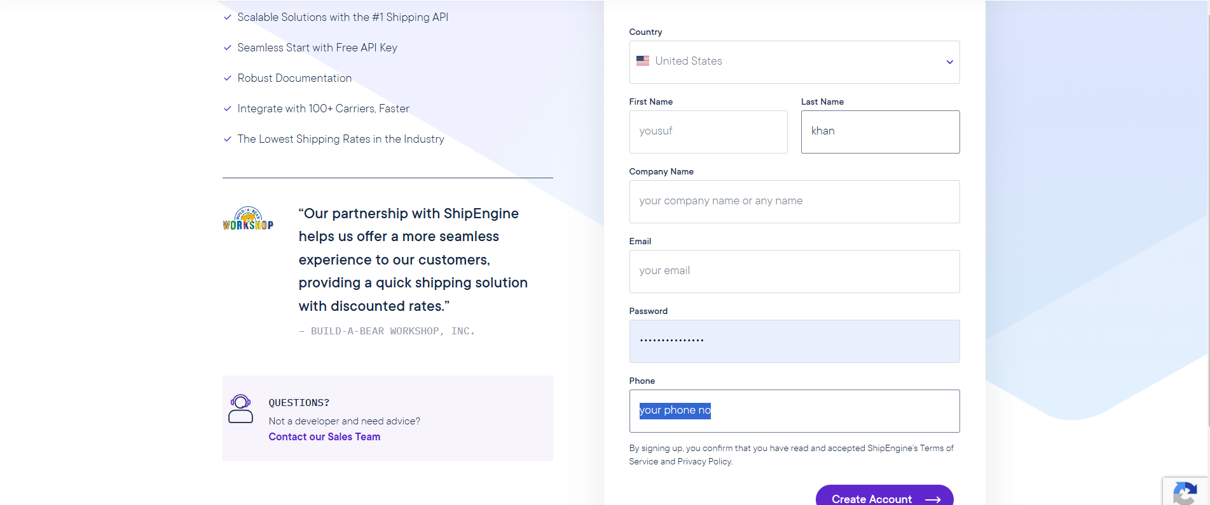
Setting Up ShipEngine
Getting Your Test API Key
Follow these steps to obtain your ShipEngine test API key:
Create an account at ShipEngine.

Slide 5
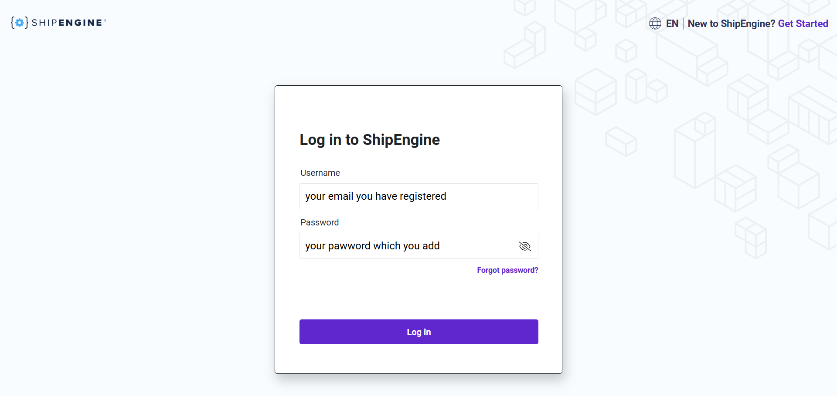
Verify your email through the link sent by ShipEngine. Log in to your account.

Slide 6
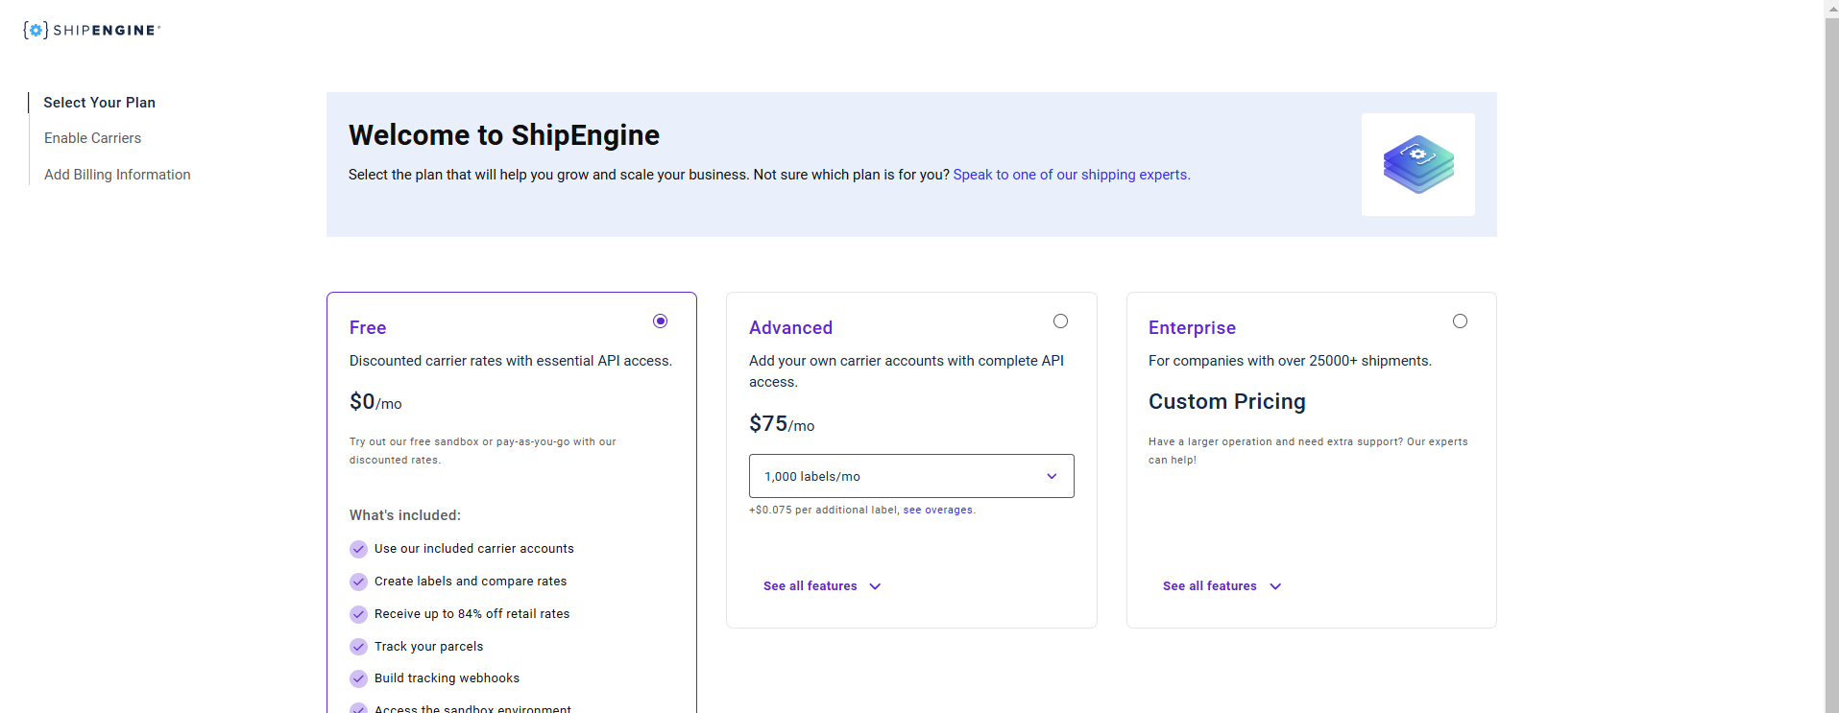
Select the free plan.

Slide 7
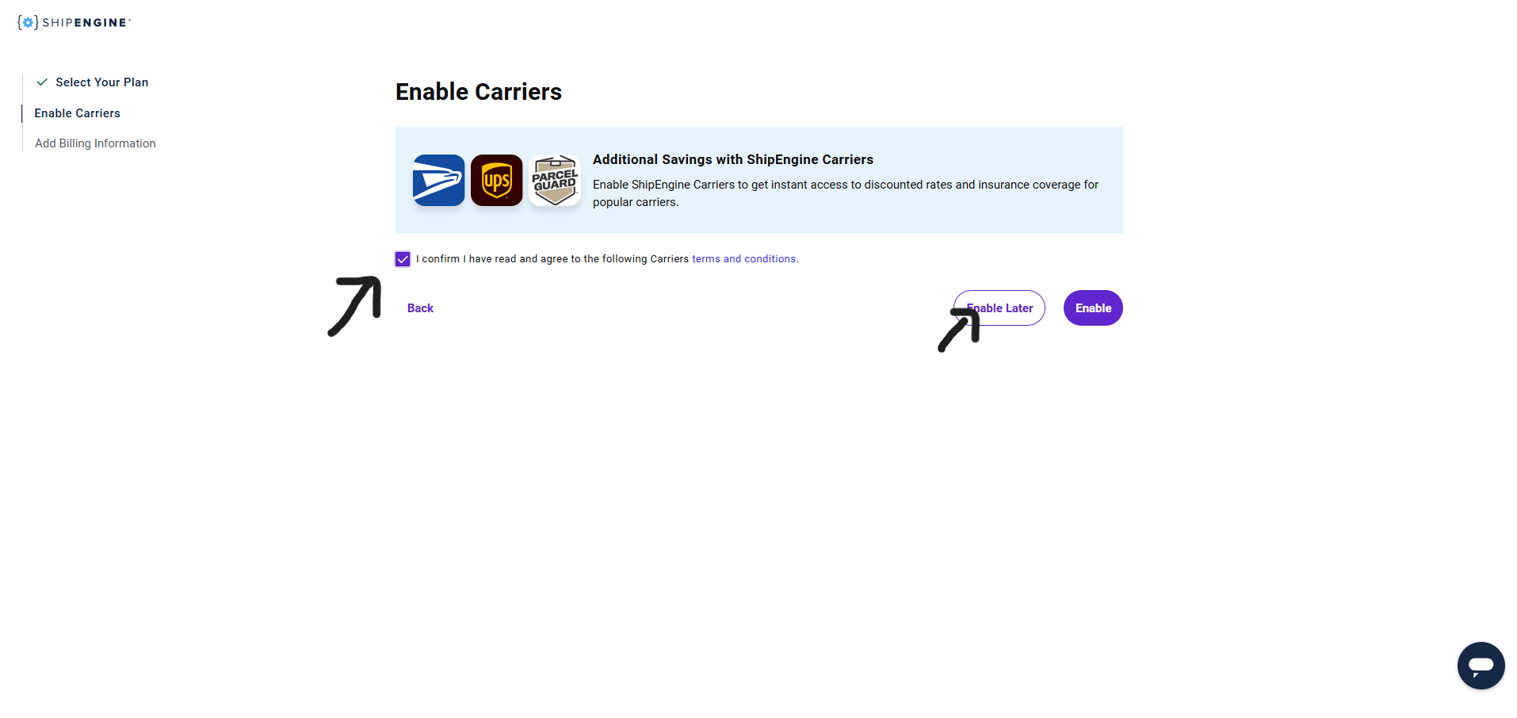
On the dashboard, click on "Enable Later" if prompted.

Slide 8
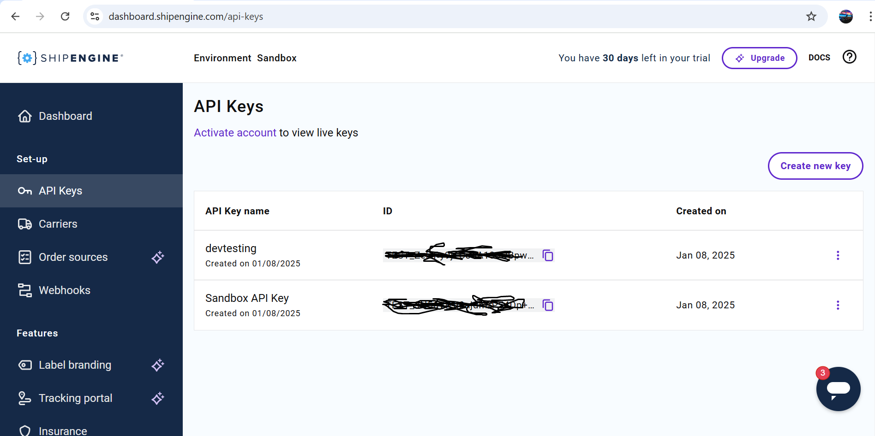
Copy your API key from the dashboard or generate new API key.

Slide 9
Setting Environment Variables
Create an .env file in your project and add the variables. SHIPENGINE_API_KEY="YOUR_API_KEY"
SHIPENGINE_FIRST_COURIER="your_first_carrier_code"
SHIPENGINE_SECOND_COURIER="your_second_carrier_code"
SHIPENGINE_THIRD_COURIER="your_third_carrier_code"
SHIPENGINE_FOURTH_COURIER="your_fourth_carrier_code"

Slide 10
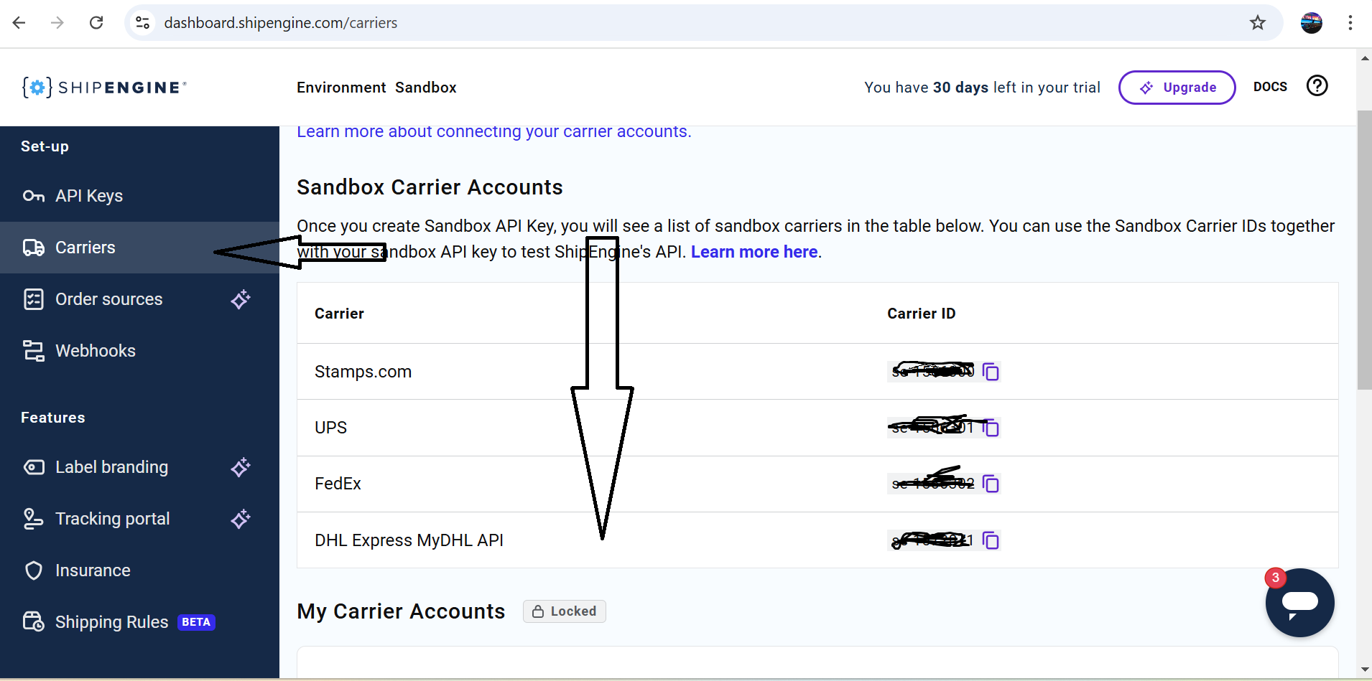
To get carrier codes, refer to this page:

Slide 11
Usage
Usage
Creating Shipment Rates
Step 1: Create a Reusable ShipEngine Object
Create a helper file named helpr/shipEngine.ts
import ShipEngine from "shipengine";
const shipEngine = new ShipEngine({
apiKey: process.env.SHIPENGINE_API_KEY,
});
export { shipEngine };

Slide 12
Step 2: Create the API Endpoint
Create a file name api/shipengine/get-rates/route.ts You can get the code from my github account with the same name folder and file Here is my github repo link: https://github.com/Hamza123545/Shipengine-api.git

Slide 13
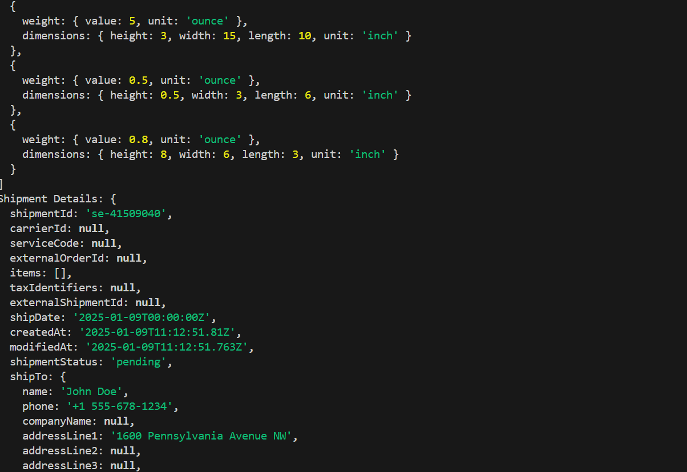
Step 3: Call the API Endpoint from the Frontend
Run npm run dev in our terminal and call the api in your frontend and you will get the such response like this.

Slide 14
Generating Label
Step 1: Create the API Endpoint
Create a file api/shipengine/create-label/route.ts
You can get the code my from github repo for this.

Slide 15
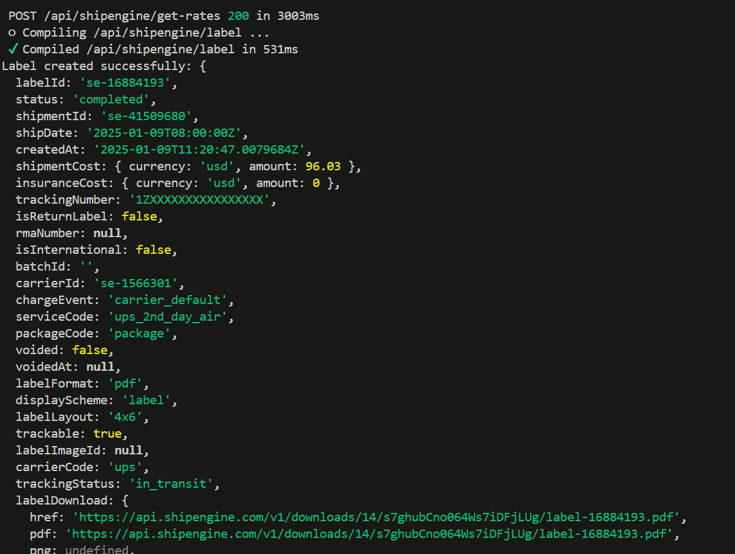
Step 2: Call the API Endpoint from the Frontend
You will see the code like this in your terminal or console.log

Slide 16
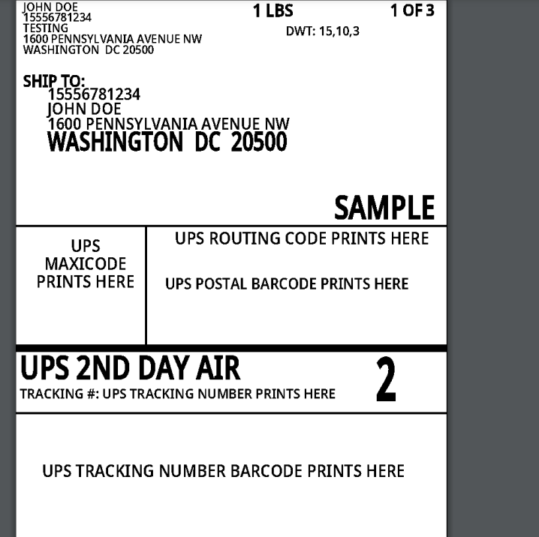
Label Image Example

Slide 17
Tracking Shipments
Step 1: Create the API Endpoint
In test mode, shipengine will not track shipment
Create a file name api/shipengine/track-shipment/route.ts
you can track order in two ways:
using label id
You can get the code for this from my Github Repo

Slide 18
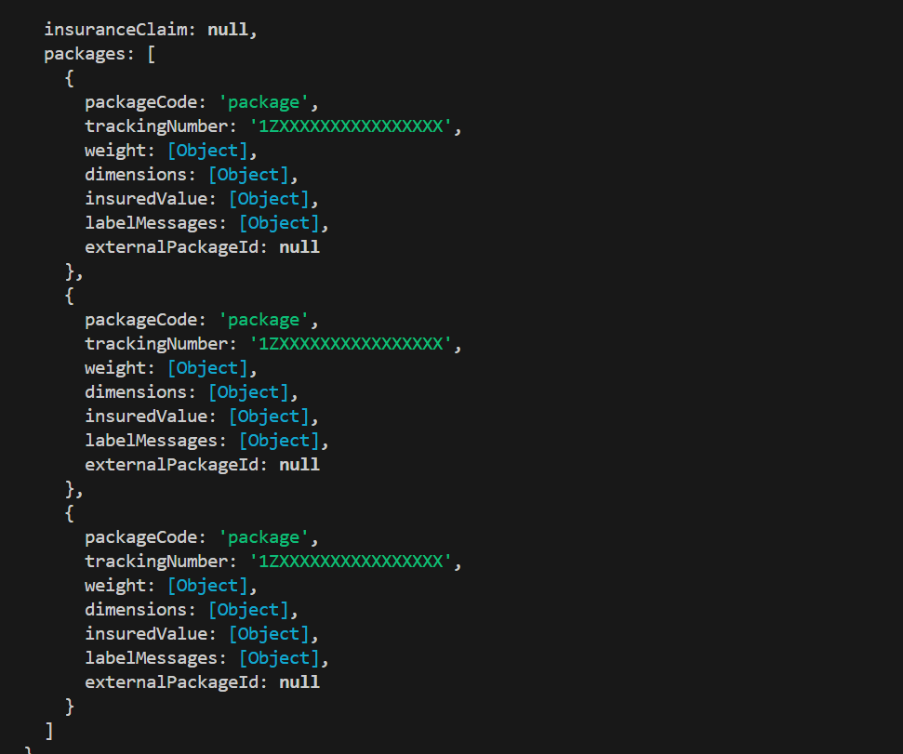
Step 2: Call the API Endpoint from the Frontend
In test mode, shipengine will not track shipment, this just for the testing prepose, for live tracking we have to go for subscribtion.

Slide 19
Conclusion
This guide helps you set up ShipEngine with your Next.js app, from getting API keys to creating shipments, printing labels, and tracking orders. By following these steps, you can make your shipping process simple and efficient. If you have any questions, check out the ShipEngine Documentation or contact their support team.

