Slide 1
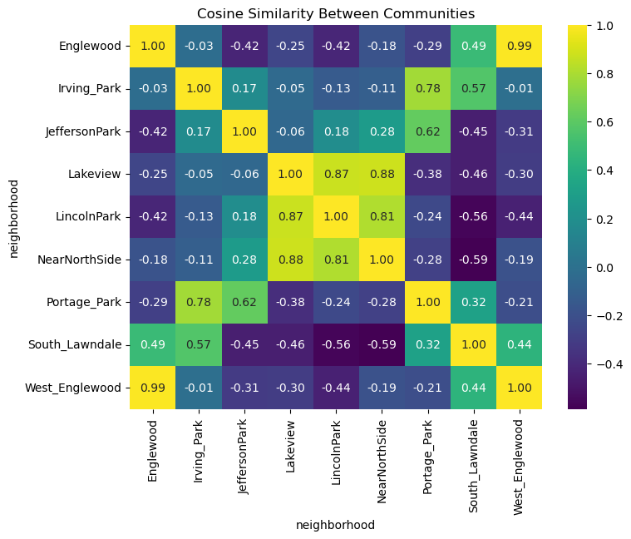
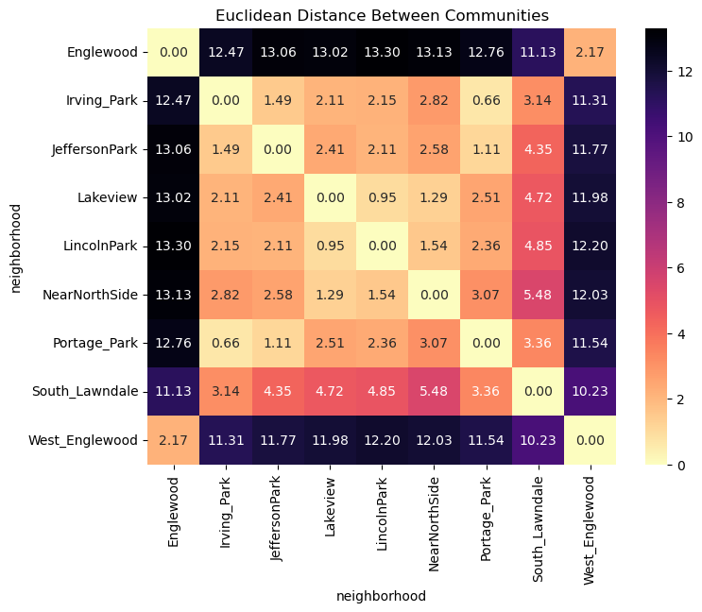
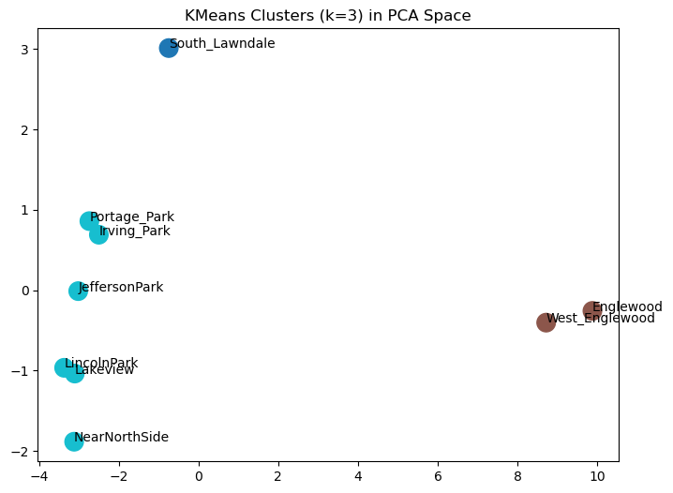
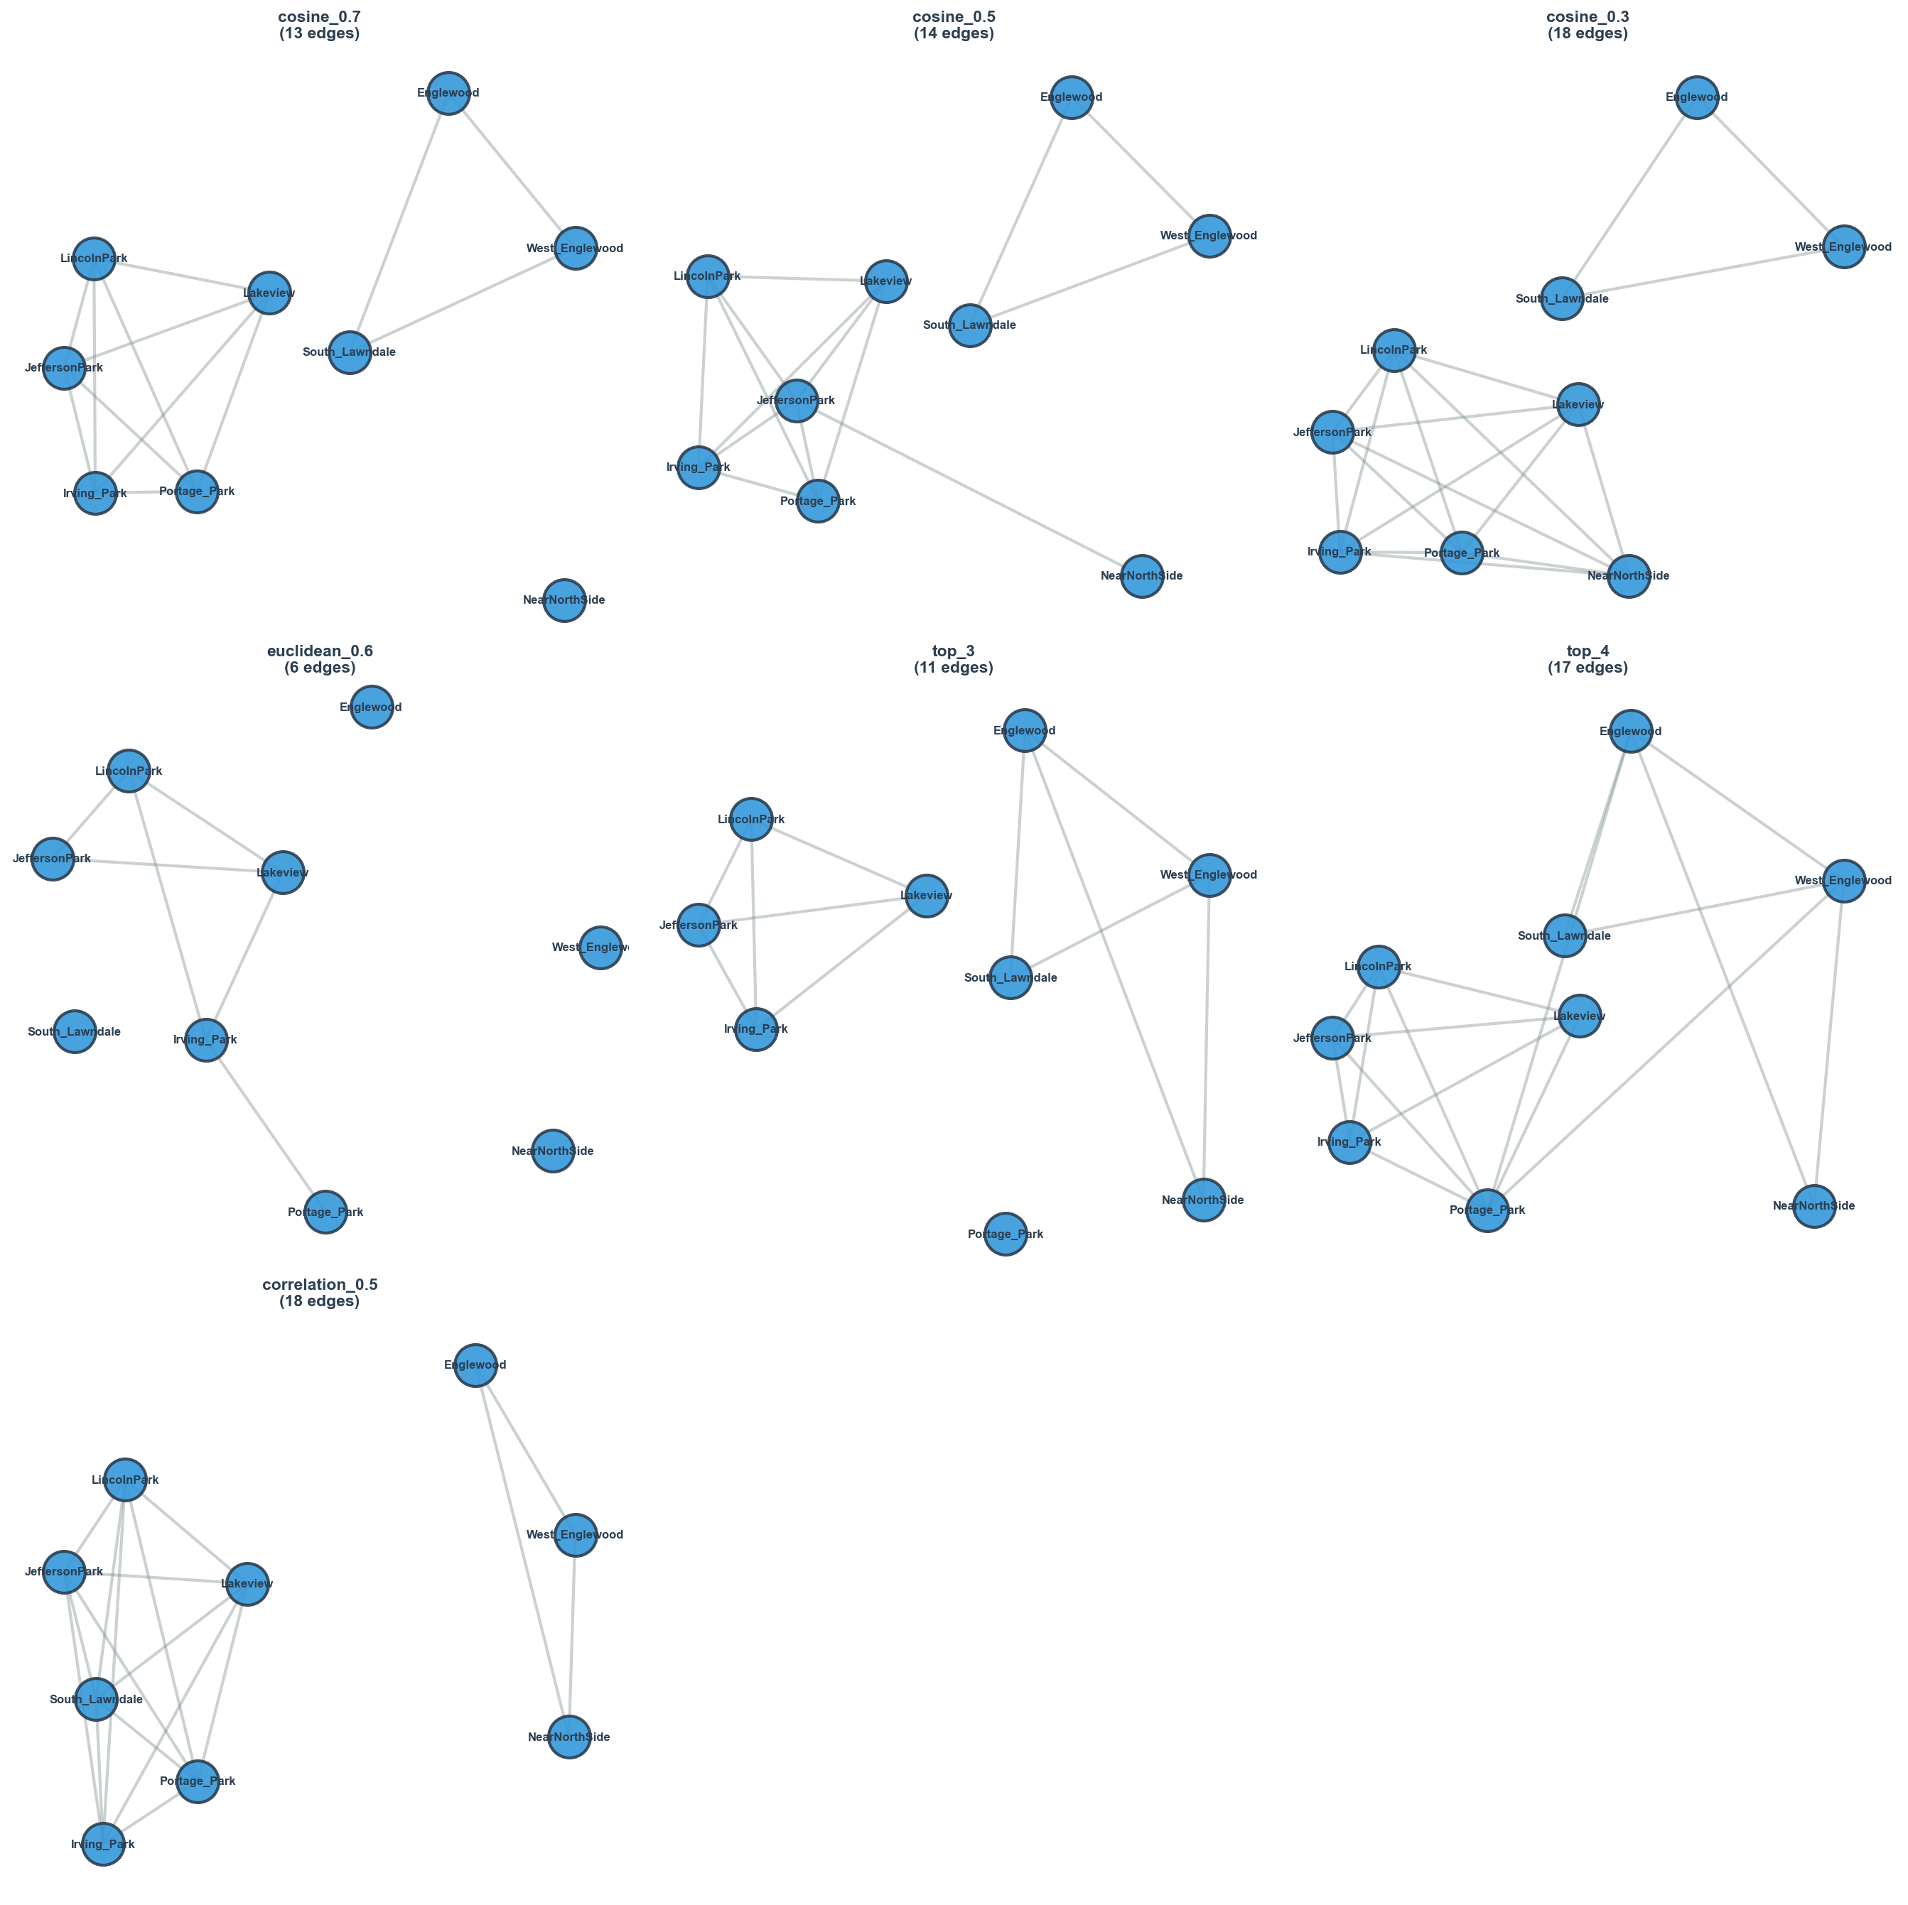
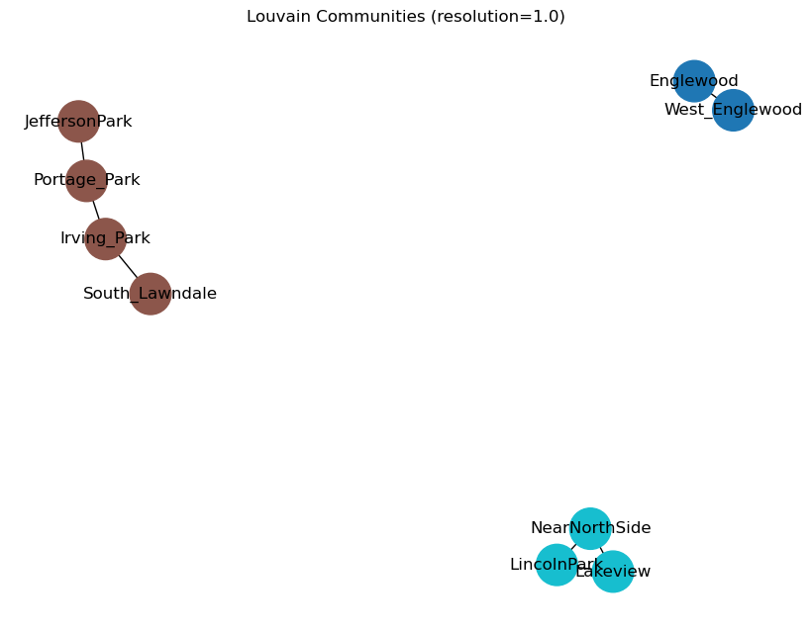
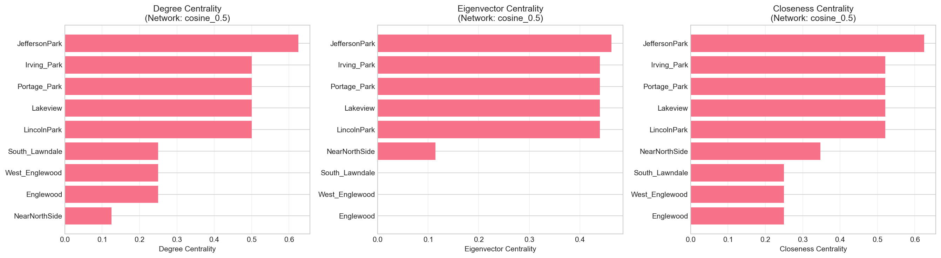
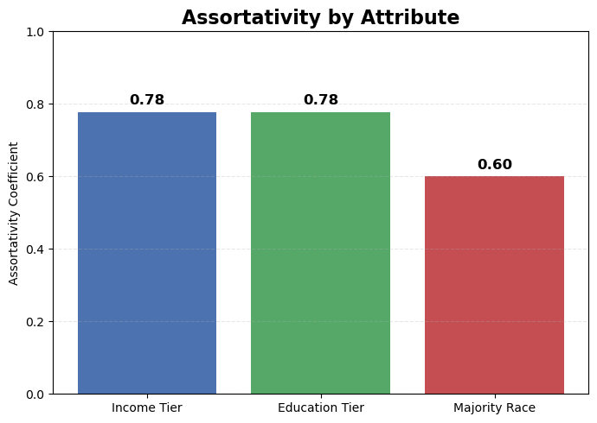
Network Modeling of Socioeconomic Segregation Across Chicago’s Community Areas
Understanding Similarities and Network Structure Across Chicago Communities.
This study analyzes how Chicago neighborhoods relate to one another based on demographic and socioeconomic indicators. By combining clustering, similarity measures, and network analysis, we identify which communities share common characteristics and how strongly they are connected.
Methodology
A feature dataset was standardized and reduced using Principal Component Analysis (PCA).
Community relationships were computed using cosine similarity, correlation, and Euclidean distance.
A network graph was constructed using a cosine ≥ 0.5 threshold, capturing the strongest structural connections.
Louvain community detection identified modular clusters in the network.
Centrality metrics (degree, eigenvector, closeness) were calculated to determine the most influential communities.
KMeans clustering (k = 3) was used to confirm groups in PCA space.
Key Findings
Two major clusters emerged:
North Side Cluster: Lincoln Park, Lakeview, Near North Side — highly similar with strong internal connections.
Northwest Side Cluster: Irving Park, Portage Park, Jefferson Park — well-connected and structurally similar.
Englewood and West Englewood form a distinct, isolated cluster, showing very low similarity to the rest of the city.
Louvain modularity (0.329) confirms meaningful community structure in the cosine-based network.
Centrality Insights
Jefferson Park and Irving Park consistently show high degree and eigenvector centrality, indicating strong influence within the similarity network.
Lakeview and Lincoln Park also score highly, confirming their central role in Chicago’s interconnected community structure.
South Lawndale shows moderate connectivity but bridges across clusters.
Clustering & Similarity Observations
KMeans and PCA visualization clearly separate Englewood/West Englewood as independent from all other neighborhoods.
Cosine similarity heatmap highlights strong pairings such as
Lakeview ↔ Lincoln Park
Lincoln Park ↔ Near North Side
Irving Park ↔ Portage Park
Euclidean distance matrix confirms these relationships, with very small distances inside clusters and large distances to Englewood.
Figure 1. Cosine similarity matrix revealing two highly similar clusters.
Figure 2. Euclidean distance matrix confirming similarity structure
Overall Conclusion : Chicago’s neighborhoods form three clear socioeconomic groups shaped by income, education, and racial composition. Affluent North Side areas are highly interconnected, while Englewood and West Englewood remain isolated from the rest of the city.
Assortativity results show a strong link between income and education (both 0.78), meaning neighborhoods with similar income levels also share similar educational attainment. These patterns reveal that socioeconomic advantages cluster together, creating distinct structural divisions across Chicago.
By combining similarity measures, clustering, and network analysis, this study highlights how socioeconomic characteristics form predictable and unequal networks across the city’s communities.
Figure 3. KMeans PCA plot showing three distinct socioeconomic clusters.
Result
Figure 4. Network graph under multiple thresholds demonstrating connectivity differences.
Figure 5. Louvain communities with modularity score.
Figure 7. Assortativity by Attribute
Figure 6. Centrality metrics identifying structural importance.

