Slide 1
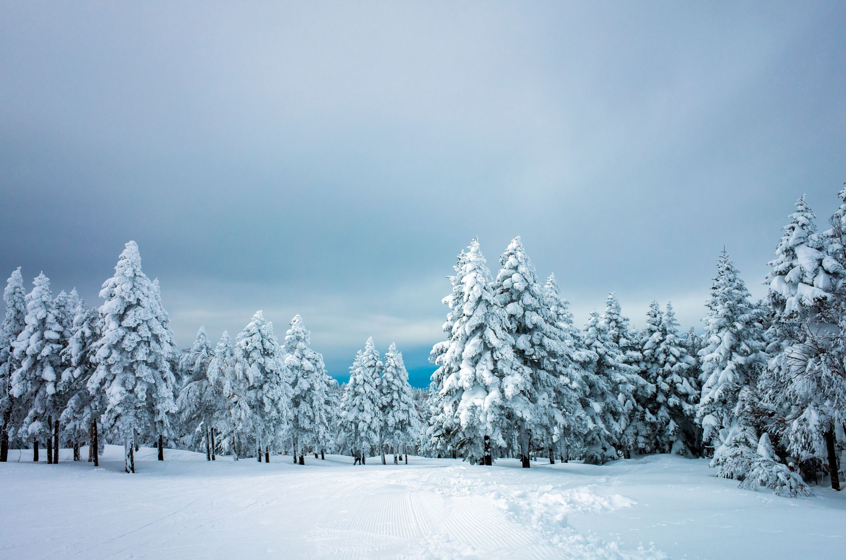
Title
Snow Covered Trees

Slide 2
Chapter 1: How Snow is made

Slide 3
Snow-capped trees, particularly coniferous trees with their conical shapes and needle-like leaves, are a common sight in snowy landscapes and offer both aesthetic beauty and practical benefits. Snow accumulation can act as insulation, protecting tree roots from extreme temperature fluctuations and drying winds, while also replenishing soil moisture. However, heavy snow loads can also pose a risk, potentially damaging branches or even toppling trees.

Slide 4
It’s Significance
insulation: Snow acts as a blanket, insulating the soil around tree roots and protecting them from harsh winter temperatures.
Moisture Retention: Snowmelt provides a source of moisture for trees, replenishing soil water and supporting root health.
Reduced Evaporation:
Snow cover can help to reduce evaporation from the soil surface, further conserving moisture.
Wind Protection:
Trees can act as windbreaks, causing snow to accumulate on their downwind side and providing shelter for other plants.
Aesthetic Value:
Snow-covered trees create a picturesque winter landscape, often admired for their beauty and tranquility.

Slide 5
Benefits
Snow-capped trees offer several benefits, acting as natural insulators to protect plants from harsh winter conditions, providing a slow and steady source of moisture as it melts, and even enriching the soil with nutrients. Additionally, the aesthetic beauty of snow-covered trees can be a positive influence on mood and mental well-being.

