Slide 1


A Project
Presentation
MOVIE RECOMMENDATION SYSTEM USING MACHINE LEARNING WITH PYTHON
SUBMITTED BY SUPERVISED BY
Hamza Dr. I Dr.Ihtiram Raza Khan
Associate Professor
B. Tech CSE-AI Computer Science & Engineering
SUBMITTED TO
dexob.com
Noida sector 62

Slide 2
OBJECTIVE
Aim of this project is to make is system which can take user input and suggest movie based on input given by the user in the form of movie name.
To learn machine learning algorithm for recommendation.

Slide 3
PROBLEM STATEMENT
Provide personalized movie recommendations to users.
Enhance the user experience and improve engagement on movie streaming platforms.

Slide 4
HIGHLIGHTS
The main factor by which we are recommending movie is Cosine similarity algorithm in which we are taking input from the user and comparing that movie title with 4800 movies which are present in our data set.
But with textual data finding similarity is not easy that’s why we convert into numerical.
There were 4000 plus row but I done feature selection to make it handleable.
To find closest match we had used library called difflib.

Slide 5
HIGHLIGHTS
Then will get 3 closest match and index value by which will find title of a movie name to recommend to the user.
The high similarity score shows that movie we should recommend to user
enumerate () to run loop in a particular list and it will give you the count.
For loop used to get index value to find the title of movie.

Slide 6
TYPE OF RECOMMENDATION SYSTEM USED
There are 3 main types of recommendation system :
content
popularity
collaborative based recommendation system.
So I will be making content and popularity based recommendation system.

Slide 7
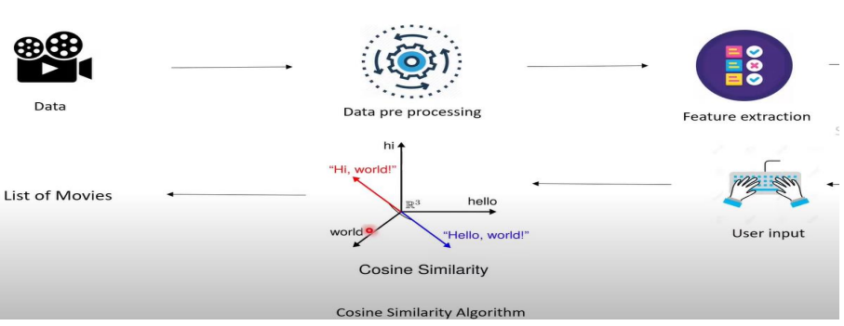
WORKFLOW

Slide 8
METHODOLOGY
Importing the Dependencies :
numpy for creating numpy arrays.
Pandas for creating data frames(structured table)
difflib can handle wrong spelling entered by user and for matching which movie & to get close match.
from sklearn.feature_extraction.text import TfidfVectorizer it used to convert textual data to numerical(feature vector) once we have them so it is easier to find Cosine similarity value
from sklearn.metrics.pairwise import cosine_similarity it gives similarity scores by which we can recommend movies
IDEA is Cosine similarity algorithm which is used to find similarity value if the similarity value of 2 movies is I then both movies is similar to each other and there is I probability that user will like it

Slide 9
Data pre-processing :
Feature selection taking 5 attributes out of 24 because all of them we don’t want.
Replacing the null values with null string.
Converting the text data to feature vectors reason is with textual data we not easy to find Cosine similarity but with numerical easily we can find. Fitting and transforming to get a feature vector.

Slide 10
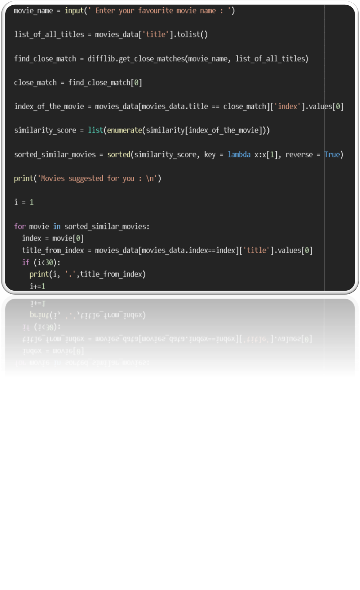
Movie Recommendation System

Slide 11
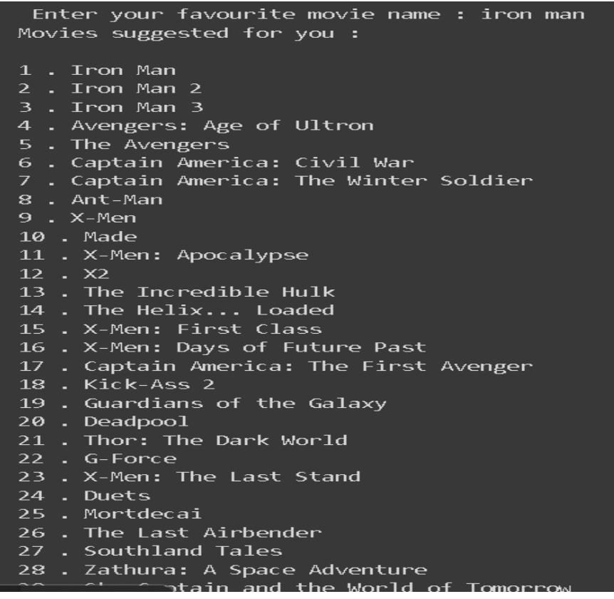
RESULT
If we enter movie name Iron Man which is superhero movie.

Slide 12
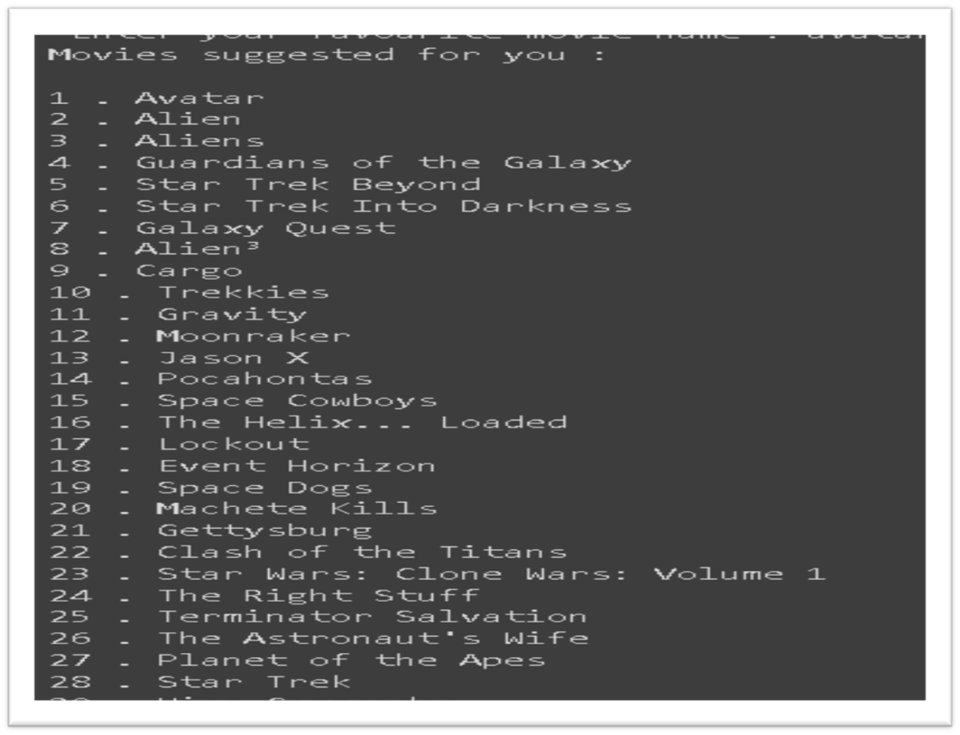
➔ let give input Avatar movie which is space and fantasy related.

Slide 13
CONCLUSION
The Cosine Similarity algorithm has been used to recommend the best movies that are related to the movie entered by the user based on different factors such as the genre of the movie, overview, the cast as well as the ratings given to the movie.
It could be used to provide personalized recommendations to users based on their movie preferences and viewing history
Gives idea to the producer to know what’s in demand.

Slide 14
REFERENCES
Periodically advise by Dr.Ihtiram Raza Khan sir
• some of my classmate for debugging in errors.
• Machine Learning Paperback by Anuradha Srinivasa Raghavan
• idea of Hollywood movie by Shahi Raza Khan
• one of my senior Arpit Mittal
Software – Jupyter Notebook , Pycharm.
Sites
https://stackoverflow.com/
www.google.com
www.youtube.com
www.kaggle.com

