Slide 1
METRO PROPERTY SHOP
Bilingual AI Voice Agent
An end-to-end voice AI product — built, deployed, and debugged on real phone calls
Hindi + English · Twilio · faster-whisper · Claude Haiku · edge-tts · Deployed on Railway

Slide 2
THE PROBLEM
Property shops lose leads to missed calls
▸ Missed calls are lost customers. When the office is busy or closed, the caller just tries a competitor instead.
▸ Generic chatbots don't fit. Most AI portfolio pieces are English-only text chat — the real customers here call in Hindi, English, or both.
▸ No client, no spec. Built unsolicited for a real local business — the scope, call flow, and features were mine to design.

Slide 3
THE SOLUTION
What the agent actually does
• Answers inbound calls AND places outbound advertisement calls — same agent, direction-aware
• Understands Hindi, English, or mixed Hinglish — and replies in kind
• Gathers requirement (buy/rent, budget, locality) and matches real listings
• Verifies budget fit with actual arithmetic before claiming a match
• Captures name + phone + requirement as a lead, saved the moment it's known
• Recognizes when a caller is busy and wraps up gracefully instead of interrogating them
• Every call is fully recorded as a durable artifact

Slide 4
ARCHITECTURE
How a call actually flows through the system
Caller
Twilio (telephony)
FastAPI backend
→
→
STT — faster-whisper
self-hosted, GPU-accelerated
LLM — Claude Haiku 4.5
conversation + tool use
TTS — edge-tts
free, Indian-accented voices
+ SQLite for durable lead storage · background task + poll loop to fit Twilio's sync webhook window
Why this stack: every component is free or self-hosted — proves the product before committing to recurring cost. That's a deliberate tradeoff (see the latency slide), not an oversight.

Slide 5
THE HARDEST ENGINEERING PROBLEM
Twilio's synchronous webhook vs. an 8–14 second pipeline
Twilio's voice webhook must respond fast or it gives up with a generic error. This pipeline's full STT → LLM → TTS chain realistically takes 8–14 seconds — too slow to fit in one response.
# Respond to Twilio INSTANTLY, process the turn in the background
@router.post("/handle-recording")
def handle_recording(background_tasks, CallSid, RecordingUrl):
call_results[CallSid] = {"status": "processing"}
background_tasks.add_task(_process_turn_in_background, CallSid, RecordingUrl)
vr.play(filler_audio_in_callers_own_language) # "Hmm... just a second..."
return redirect_to_poll(attempt=1) # returns in <100ms
# A separate poll loop holds the caller with short pauses + filler
# phrases until the background task finishes - never blocking Twilio.

Slide 6
DEBUGGED FROM REAL USAGE
Bugs that only showed up on real, live phone calls
▸ Token truncation corrupted conversation state. A tight token limit cut off a tool call mid-generation, silently breaking every later turn in that call.
▸ Agent claimed a listing was “within budget” — it was almost double. The model was pattern-matching on vibes, not doing arithmetic. Fixed by requiring an explicit numeric check.
▸ A latency optimization dropped an entire caller turn. Trimming the silence-timeout for snappier replies caused a real recording to cut off mid-sentence. Reverted — a lost turn is worse than 1 extra second.
▸ The “thinking” filler played in the wrong language. Hardcoded to Hindi regardless of the caller's actual language. Fixed to be bilingual and per-call.

Slide 7
CORRECTNESS OVER CONFIDENCE
Forcing the model to actually do the arithmetic
BUDGET ACCURACY IS NON-NEGOTIABLE: before describing a listing, actually
do the arithmetic comparing its price to the caller's stated budget.
Never say a price is "within budget", "right around your budget", or
similar UNLESS it genuinely is close (within ~10%). If every listing in
the requested area is meaningfully above or below budget, say so
plainly ... never paper over a real mismatch with vague reassuring
language. Getting this wrong isn't a rounding error, it actively
misleads the caller about what they can afford.
# -- system prompt excerpt, app/llm/prompts.py --

Slide 8
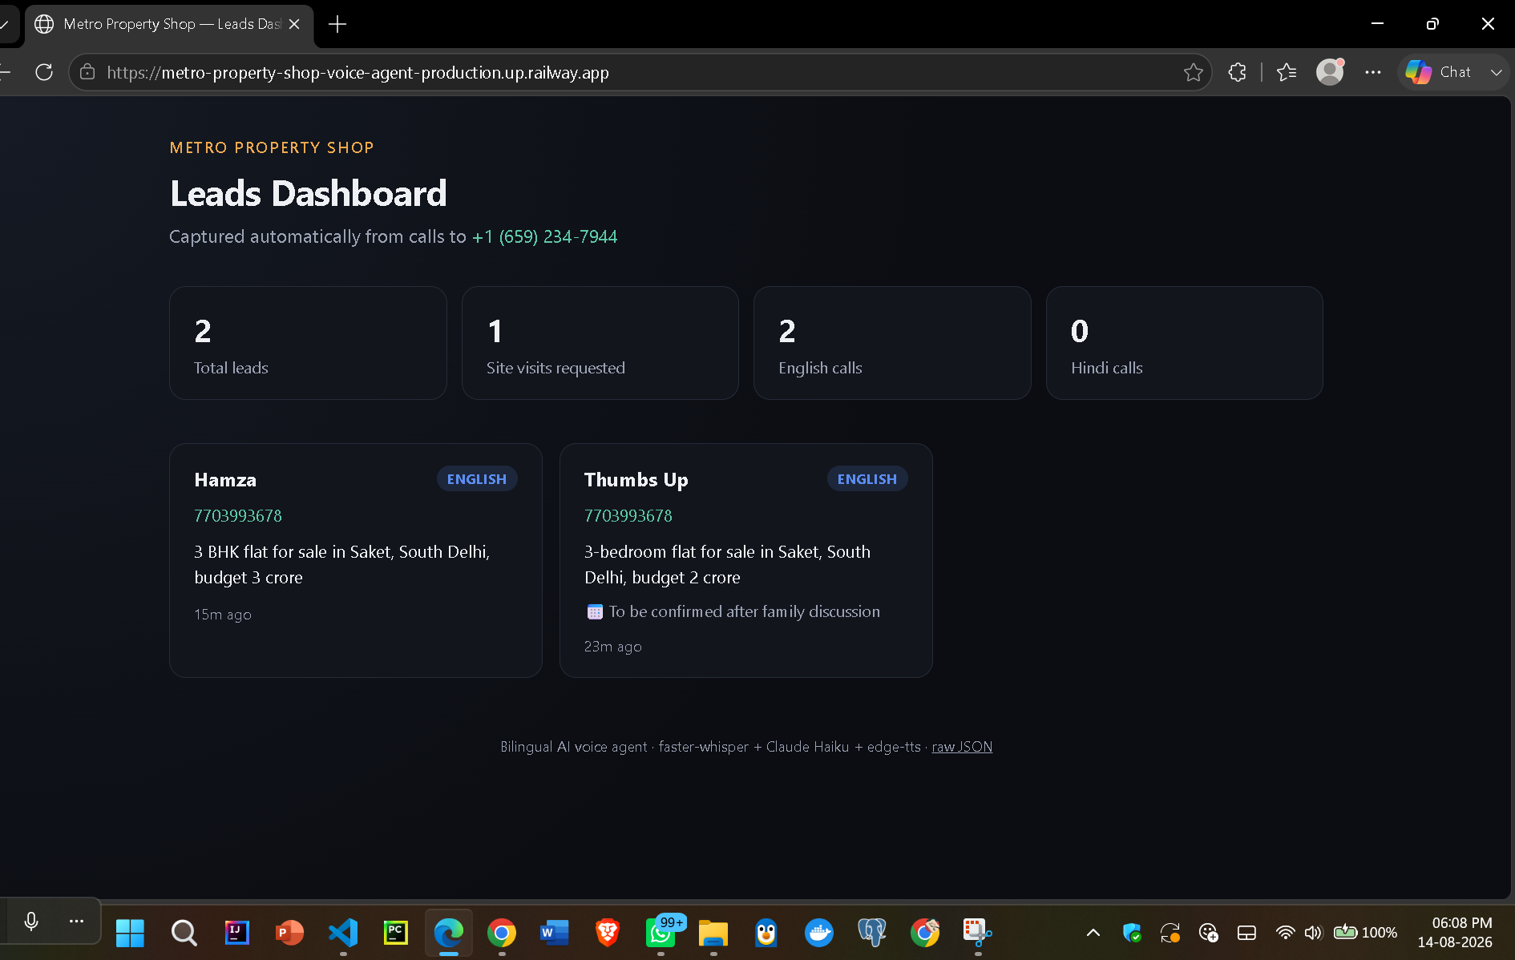
LIVE PRODUCT
A real dashboard, not just an API response

Slide 9
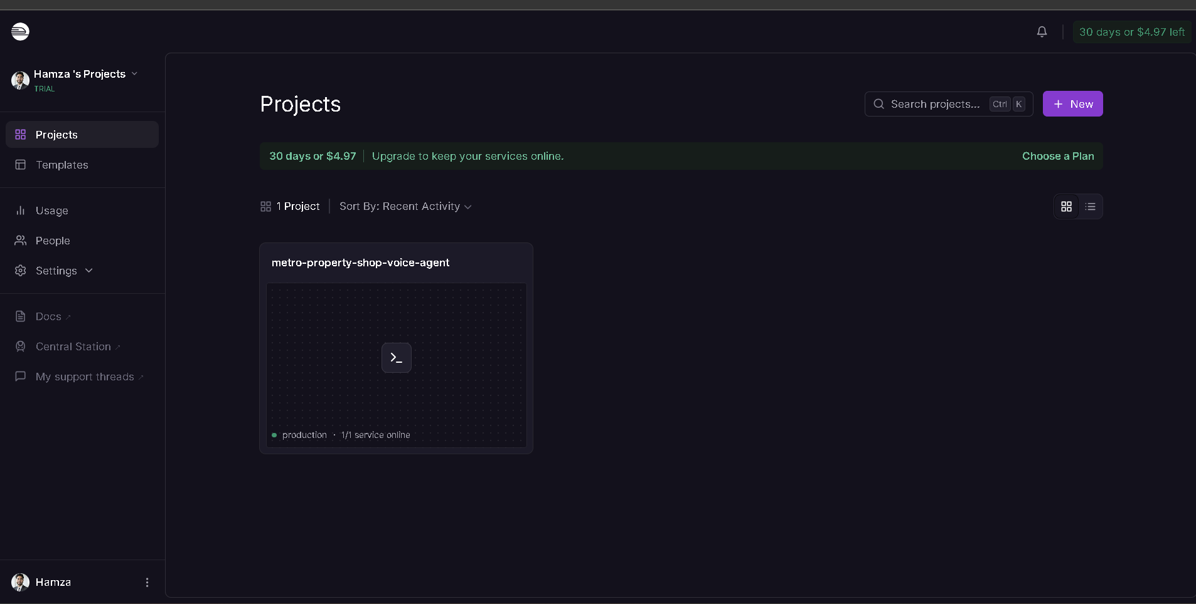
REAL INFRASTRUCTURE
Deployed and running, not just running on a laptop

Slide 10
SKILLS DEMONSTRATED
What this project actually proves
• Real-time multimodal pipeline engineering (STT + LLM + TTS under latency constraints)
• Working around hard platform constraints (async background task + poll pattern)
• Multilingual conversational AI with correct grammatical agreement
• Honest latency engineering — measured, root-caused, designed around, not hidden
• Debugging from production signal, not just unit tests
• Cost-conscious architecture on free/low-cost infrastructure
• Independent product scoping with no client spec
• Full deployment ownership: GitHub, Railway, DNS/ports, secrets, telephony config

Slide 11
See it live
Phone:
+1 (659) 234-7944
Dashboard:
metro-property-shop-voice-agent-production.up.railway.app
GitHub:
github.com/HamzaAITech/metro-property-shop-voice-agent
Built, deployed, and debugged end-to-end — not just a demo.

