Slide 1

Business Intelligence
Created by: Hamza AL-Risheq

Slide 2


What is business intelligence?
Business Intelligence (BI) is the use of technologies and strategies to analyze business data, transforming it into meaningful insights that inform and support strategic and tactical business decisions, and presenting business information. BI tools collect and analyze data to provide reports, dashboards, and visualizations that provide organizations with clear insights into their business operations and performance.

Slide 3
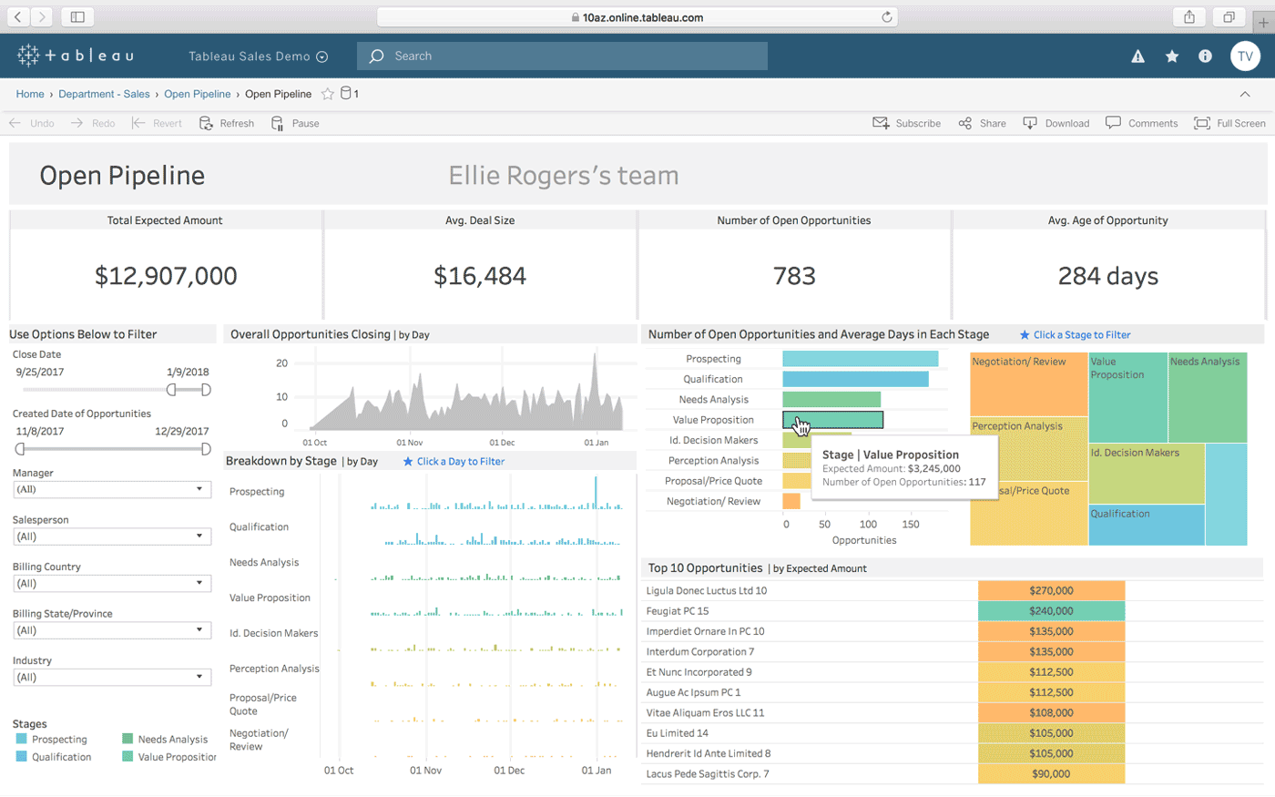
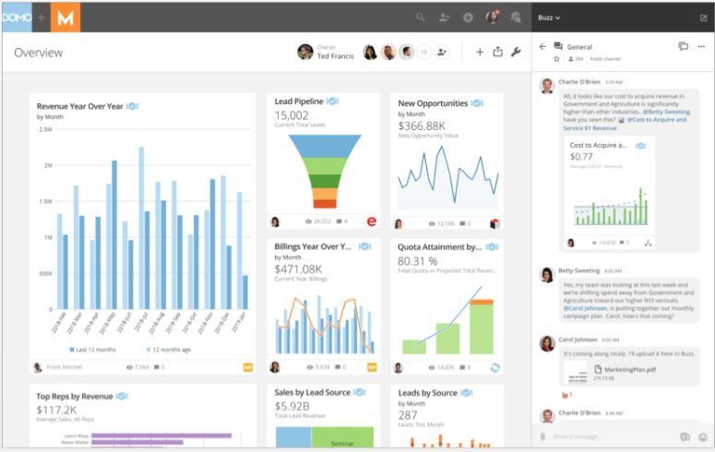
Tools Are Associated In Bi
Domo
Microsoft Power BI
Dundas BI
Tableau

Slide 4
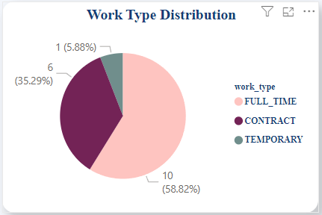
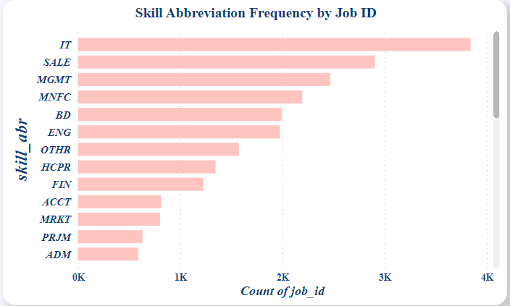
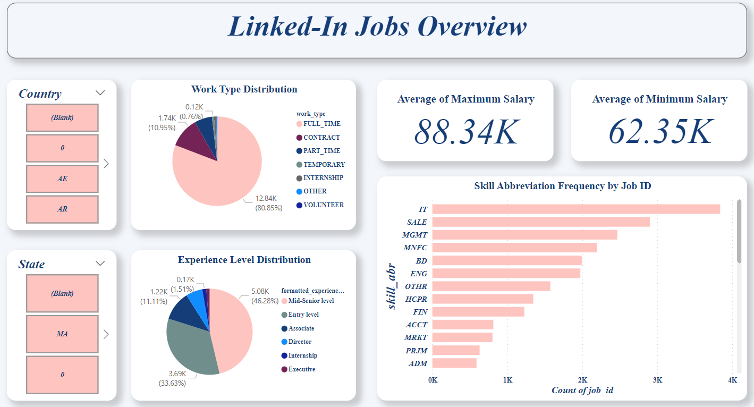
Techniques Are Associated In Bi
  Dashboards
  Visualizations
  Data Integration

Slide 5
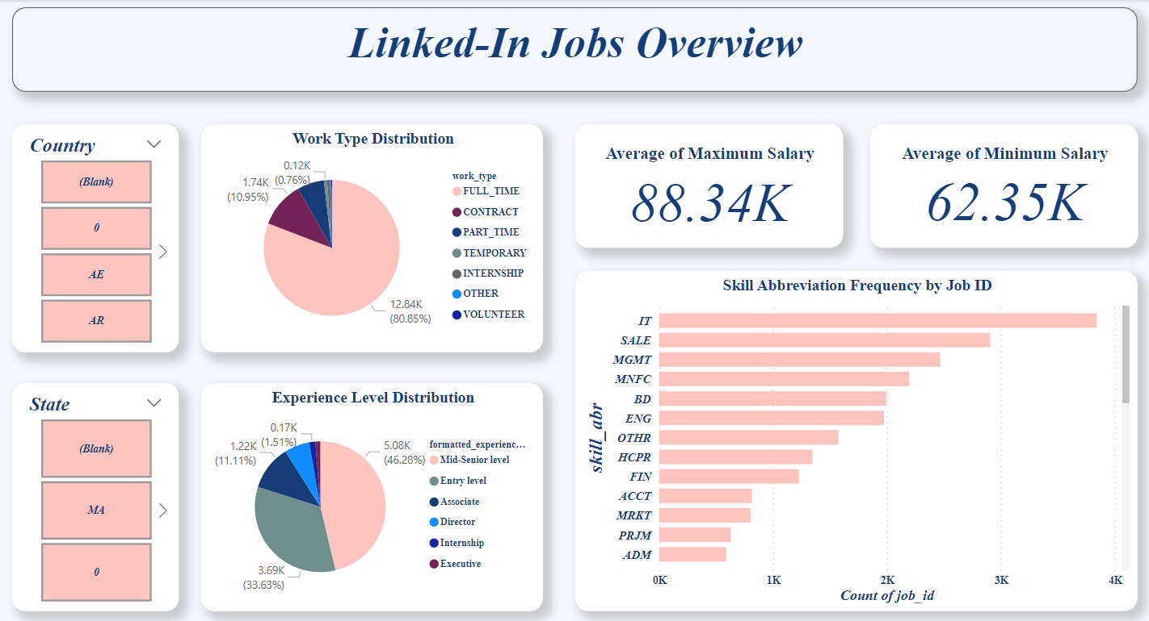
My Bi System

Slide 6
Critical Review of My BI System
What customization has been integrated into the design
  A pie chart that displays the average distribution of job types.
  A pie chart that shows the distribution of experience levels.
  A bar chart that presents the most requested skills by companies on LinkedIn, categorized by company ID.
  Card displaying the average minimum salaries.
  Card illustrating the average maximum salaries.
  Two filters: one filters countries based on a unique code, and the other filters states to refine the data displayed on the dashboard more precisely.

Slide 7
Critical Review of My BI System
How it meets a specific user or business requirement
  Real-Time Decision-Making: The developed BI provides vital information and insights about the average minimum and maximum salaries of job offers on LinkedIn, filtered by country and state. This allows for better and real-time insights and information for decision-making.
  Helps users easily identify the countries and states that offer the highest salaries.
  User-Friendly Interface: The developed BI dashboard is user-friendly for all users, easy to read, and everything is accessible. The colors are chosen in a way that is easy on the eyes.

Slide 8
Critical Review of My BI System (continued)
  Strengths
  Real-Time Decision-Making
    The BI tool offers up-to-date information on average minimum and maximum salaries for job offers on LinkedIn, essential for quick, informed decision-making.
    Features to filter data by country and state, the tool provides detailed, localized salary trends, aiding businesses and job seekers in targeting high-paying regions.
  Helps Users Identify High-Salary Regions
    Clear Identification: The tool effectively highlights countries and states with the highest salaries, simplifying the search for lucrative job opportunities.
    Strategic Planning: Valuable for businesses planning expansions or relocations and for professionals seeking higher-paying jobs.
  User-Friendly Interface
    Accessibility: The dashboard’s design ensures all users, regardless of technical expertise, can navigate and understand the data.
    Visual Appeal: The choice of colors and layout is easy on the eyes, reducing strain and enhancing the user experience.

Slide 9
Critical Review of BI System (continued)
  Weaknesses
  Removing Null Values: Enhancing the data quality is crucial for deriving accurate insights. By removing null values, the data set becomes more reliable, allowing users to make more informed decisions. This improvement also makes the filters more effective and user-friendly, as users can interact with complete data sets without encountering gaps or inaccuracies.
  Adding More Charts: To facilitate better decision-making, incorporating additional charts is essential. These charts can present data in various formats, providing a comprehensive view of the information.
  Creating Mobile-Friendly Dashboards: Accessibility is key in today’s fast-paced environment. Developing a mobile-responsive version of the dashboard ensures that users can access critical data and insights on the go. This convenience enhances usability and ensures that important information is always at the user’s fingertips, regardless of their location.
  Creating Additional Sheets within the Dashboard: Adding more sheets within the same dashboard can offer users diverse perspectives and detailed information. This multifaceted approach aids users in making more comprehensive and informed decisions by offering a variety of insights within a single, cohesive dashboard.

Slide 10
How BI tools contribute to effective decision-making:
Enhanced Data Quality and Accessibility: BI systems collect and show accurate, up-to-date data from a variety different sources, enabling for quicker and real-time decision-making.
BI solutions detect operational challenges and errors, allowing organizations to optimize processes and increase efficiency.
BI tools analyze past and current data to predict future trends in performance, market dynamics, and consumer behavior.
BI tools analyze customer data to personalize products and services, enhancing customer satisfaction and loyalty.

Slide 11
Specific Examples of Organizations Using BI Tools

Slide 12


Slide 13

Amazon and BI Solutions
Supply Chain Management: Amazon uses BI technologies to optimize its complex supply chain operations. These tools assist in monitoring inventory levels, predicting market changes, and optimizing logistics to ensure timely product delivery.
Financial Analysis: BI technologies help Amazon with financial analysis by generating detailed data on revenue streams, cost structures, and profitability across its different company sections. This contributes to strategic financial decision-making and investment planning.
BI systems offer real-time data on operational variables including order processing speed, warehouse efficiency, and distribution center performance. This enables Amazon to continuously improve operational procedures while meeting customer expectations for speedy delivery.

Slide 14


Slide 15
J.P.Morgan and BI Solutions
Risk Management and Fraud Detection
  Credit and Market Risk Assessment: BI tools help evaluate the creditworthiness of borrowers and monitor market conditions to predict and mitigate potential risks.
  Fraud Detection and Prevention: Real-time transaction monitoring and customer behavior analysis using BI tools identify suspicious activities and prevent fraudulent transactions.
Investment Analysis and Operational Efficiency
  Portfolio Optimization and Algorithmic Trading: Analyze historical performance and market trends to optimize investment portfolios and implement algorithmic trading strategies, enhancing profitability.
  Process Optimization and Resource Allocation: BI tools streamline processes, identify inefficiencies, and improve resource utilization, leading to significant cost savings and increased productivity.
Customer Relationship Management and Regulatory Compliance
  Personalized Financial Services: Use BI tools to analyze customer data, enabling the bank to offer tailored financial products and services that meet individual customer needs and preferences.
  Accurate Reporting and Compliance: Ensure timely and precise reporting of financial data to regulatory authorities, maintaining compliance with regulations such as Basel III and AML requirements, and facilitating internal audits and monitoring.

Slide 16

Legal Issues in Leveraging Business Intelligence Tools
Organizations have to stick with regulations such as GDPR in Europe and CCPA in the United States, which control how personal data is handled. BI tools should be set up to comply with these rules, including obtaining authorization to use data and ensuring its security.
BI tools frequently deal with sensitive business and customer data. Organizations must use strong security measures to protect this data from breaches and unauthorized access. This includes encrypting data while it is delivered or stored, utilizing secure logins, and conducting frequent security checks.
BI technologies can create insights that affect stakeholders, employees, and customers. Organizations should think about the ethical aspects of employing BI technologies, such as guaranteeing fair decision-making procedures and preventing biassed actions.

Slide 17

Extending Target Audience and Competitiveness for Amazon
Target Audience Expansion: BI tools provide Amazon with detailed information on customer preferences, behaviors, and market trends. By analyzing this data, Amazon can uncover new customer segments and hidden opportunities, allowing them to tailor products and services to meet specific needs. This focused approach enables Amazon to reach a larger audience and expand its market reach, enhancing its overall growth and profitability.
Competitive Advantage: Amazon leverages BI tools to track competitor actions, market trends, and consumer demands in real time. This allows Amazon to make flexible decisions, quickly respond to market changes, and innovate its products or services ahead of the competition. By staying ahead of market trends, Amazon can reach larger audiences and maintain its competitive edge.
Data Ethics: For Amazon, considering the ethical implications of employing BI technologies is critical. Amazon prioritizes fairness in data analysis, actively avoids biases, and ensures the protection of customers' privacy rights. This ethical approach not only fosters trust among consumers but also ensures compliance with regulatory standards. As a result, Amazon builds long-term consumer relationships, enhances its reputation, and strengthens its market position.

Slide 18
Extending Target Audience and Competitiveness for
J.P.Morgan
Target Audience Expansion: BI tools provide JPMorgan Chase with insights into client preferences, financial behaviors, and market trends. By analyzing this data, JPMorgan Chase can identify new client categories and hidden opportunities, enabling them to modify financial products or services to meet specific client requirements. This targeted approach helps JPMorgan Chase reach a larger audience and expand its market reach, boosting its growth and customer base.
Competitive Advantage: JPMorgan Chase uses BI tools to monitor competitor actions, market trends, and consumer needs in real time. This information enables JPMorgan Chase to make flexible decisions, quickly adapt to market changes, and innovate its financial products or services ahead of the competition. By staying ahead of market trends, JPMorgan Chase can attract a larger audience and maintain its competitive edge.
Data Ethics: At JPMorgan Chase, considering the ethical implications of using BI technologies is crucial. The organization ensures fairness in data analysis, actively avoids biases, and protects clients' privacy rights. This ethical approach not only builds trust with clients but also ensures compliance with regulatory standards. Consequently, JPMorgan Chase fosters long-term client relationships, enhances its reputation, and solidifies its position in the financial industry.

Slide 19
References
https://www.cio.com/article/272364/business-intelligence-definition-and-solutions.html
https://qbench.com/integration/domo
https://www.tableau.com/products/viewer

