Slide 1
UML Diagram Explanation
Service: Oladoc
Name : Hamza Aamer.
Roll No : 21i-0415

Slide 2
Summary of Project and Ideology applied
The ideology applied in the UML diagram is fairly simple keeping in context all the requirements of the Project. Separate Classes were made wherever necessary, and in parts where not necessary, file handling is to be applied.
Separate files created which would store various User data. This would help in fetching the data in real time even as the program is being run on multiple consoles at the same time as the data will also be saved in real time as well.
Most Functions have a whole interface implemented within them which help navigation and easy access of variables/functions.

Slide 3
Introduction to Hierarchy
The basic Hierarchy starts from the Oladoc class which pairs up everything together and links the hierarchy and separate consoles in one place.
The Oladoc class is followed by three separate classes which serve as the 3 basic user types of the system.These Classes contain all the users personal data and the functions necessary for the basic flow of the entire program.
Each user type has unique functions implemented into them being given different level authority.
The Base user classes are followed by a variety of module classes which help in the implementation of different modules and makes up for a solid structure and a good hierarchy.

Slide 4
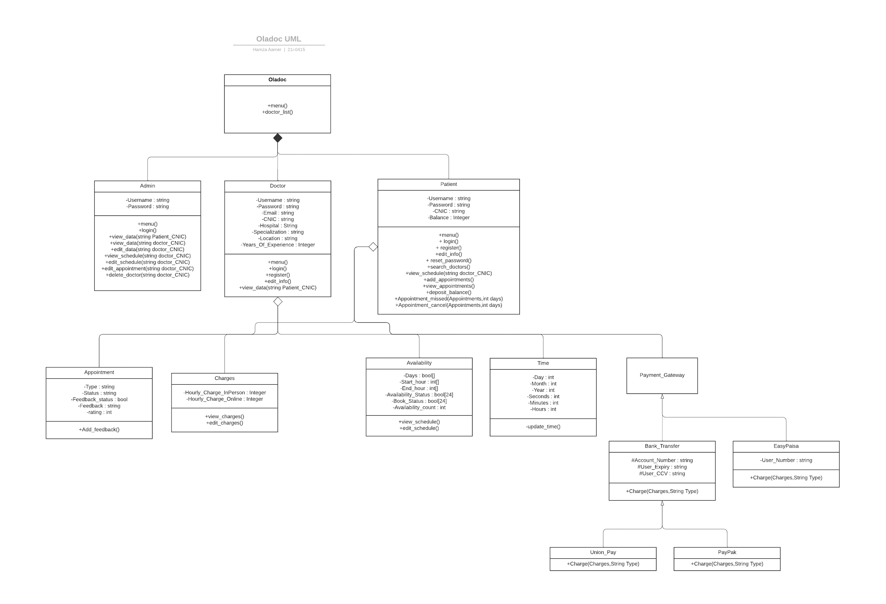
Oladoc UML Diagram:

Slide 5
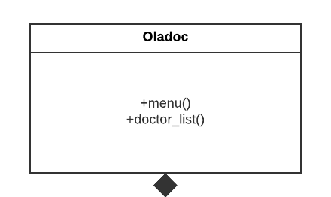
Oladoc Class
The highest base class linking to everything else.
Contains a basic menu which will give access to the main list of doctors and also provide other options.
This class however will not have access to user specific functions such as booking appointments, editing them, checking balance and anything that might relate to the functionality of one specific user.

Slide 6
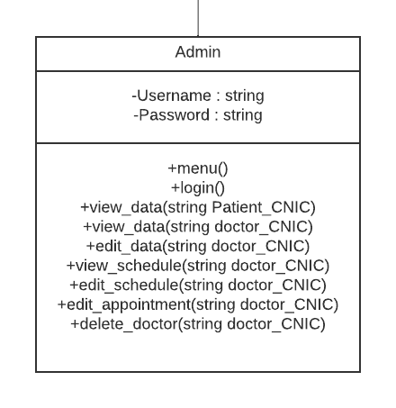
Admin Class
It is Composed from the Base Oladoc class
Contains the admin’s credentials as it is logged in which is previously hard coded within the passwords file.
The class contains a menu function on which polymorphism is implemented which would show us the Admin menu giving us the variety of admin options.
A view_data function is created to view the data of Patient and doctors through their CNIC, the CNIC will be used to search through all the data of doctors/patient and will be compared to each and every one to find the perfect match and then display the details of it. If not found then an error will be displayed.
An edit_data function is given to the admin to edit or update the date of the users present in the file, this will give admin the access to edit the doctor’s data such as Password,Email,Location,Speciality, and other aspects of the class.
→Continued on next slide→

Slide 7
An edit_schedule function is created which will have the ability to edit the availability schedule of the doctor which will be implemented using file handling as well and the same CNIC searching method which was previously mentioned.
An edit_appointment function is created which will give the admin the access to all the appointments of the doctors and be given the ability to edit the appointments as he/she pleases.This is implemented through the previously mentioned CNIC method.
Lastly, an delete_doctor function is created which would delete all the data of a specific doctor from the database including their login info, their appointments, their personal details. The whole class will be wiped out from the database. This will also be implemented through file handling and the CNIC method.
This class does not have any child class since it is the admin user and has access to everything in real time using file handling.

Slide 8
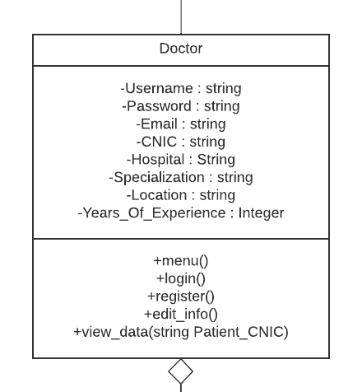
Doctor Class
It is also composed of the base clas Oladoc.
It contains a variety of Doctor’s personal information including his/her login credentials, their CNIC along with their doctor field related data such as the hospital they work in, its location, the specialization of the doctor,and how many years of experience they have.
The class contains a menu function on which polymorphism is implemented which would show us the Doctor menu giving us the variety of Doctor options.
A login Function is created, though the parameters are void, this is because the whole interface is created within the function which would be implemented as the function would ask for all necessary information from the user within the function itself.
→Continued on next slide→

Slide 9
The login function would look through the credentials and the user informations through file handling and after confirming that the account info is valid, it will give access to all other functions.
A Register function is created for users who do not already have an existing account and wish to create one, this function will include real time file handling updation, as soon as the registration is complete the credentials and doctor info will be saved in the respective files.
A edit_info function is created which will give the doctor the ability to edit their own editable info such as Hospital they work in, their location, etc.
A view_data function is created with patient’s CNIC taken as a parameter. With this function, the doctor will be given the ability to check the details of their patients simply through their CNIC. This will act as a helping function in various scenarios.
→Continued on next slide→

Slide 10
The class further acts as a parent class to multiple other classes.
The Different classes that have an aggregation based relationship with the doctor class include:
Appointment
Charges
Availability.
Since most of the functionality here is implemented in real time through the user interface, there is no need for the CNIC method to be implemented in this class except when viewing a specific patient’s data.
This class has multiple children including the following:
Appointment
Charges
Availability
Time
Payment Gateway

Slide 11
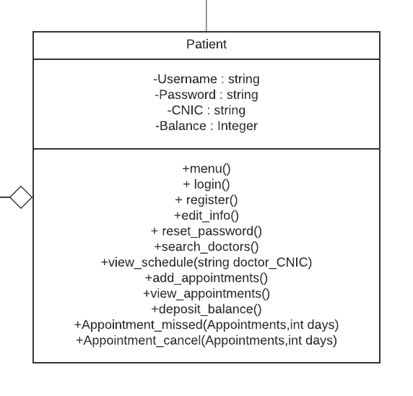
Patient Class
This class is the child class of Oladoc with the relation Composition.
This class contains all the personal information of the patient including its login credentials and its Balance.
The Balance in this class is updated in real time and the starting balance is set to 3500, a payment gateway is also provided which further help in receiving payments or giving refunds.
This class has multiple children including the following:
Appointment
Charges
Availability
Time
Payment Gateway
→Continued on next slide→

Slide 12
The class contains a menu function on which polymorphism is implemented which would show us the Patient menu giving us the variety of Patient options.
A login Function is created, though the parameters are void, this is because the whole interface is created within the function which would be implemented as the function would ask for all necessary information from the user within the function itself.
The login function would look through the credentials and the user informations through file handling and after confirming that the account info is valid, it will give access to all other functions.
A Register function is created for users who do not already have an existing account and wish to create one, this function will include real time file handling updation, as soon as the registration is complete the credentials and doctor info will be saved in the respective files.
An edit_info function will also be provided to give use the power to edit their personal details.
→Continued on next slide→

Slide 13
A reset_password function is created which will give the user the ability to change their password and update it in the password file through file handling.
A search_doctors function is given which will take the user to an interface asking which field it wants to search the doctor through, further after taking that input as a selection, a list of doctors matching the input will be displayed accordingly after being searched through the files through file handling.
A view_schedule function is created, this is used when a person has decided which doctor he wants to select after the search doctors function and wants to view the schedule of a specific doctor, this will use the previously explained CNIC method.
add_appointments and view_appointments functions are given to the patient to give him the ability to add appointments with specific doctors and view his current appointments.
A deposit_balance function is created which will redirect the user to the payment gateway and further take payment through the preferred method.
An appointment_missed and appointment_cancel function is created which will not be directly available to the patient however it will be used when a person wishes to cancel his appointment before or after the date has passed and preview separate algorithms accordingly according to the number of days and other parameters.

Slide 14
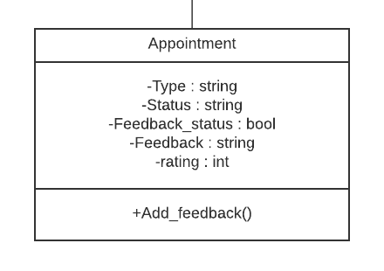
Appointment Class
This class is aggregated from the following classes:
Doctor
Patient
The class contains a list of details of each appointment including the following :
Type of appointment telling if its online/in person
A status showing whether its pending, in progress, cancelled or missed
A feedback status showing which will decide whether or not to prompt the feedback option. This will be updated after an appointment finishes.
Feedback and rating variables which will be updated when the user adds feedback after his appointment.
A Add_feedback function is created which will give the user the ability to add his feedback and rating after the appointment has finished and the feedback_status has been switched on.
This class does not have any child classes.

Slide 15
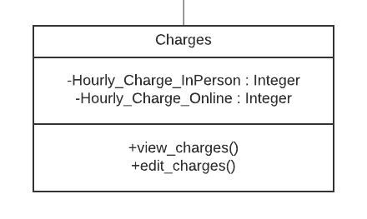
Charges Class
This class is aggregated from the following classes:
Doctor
Patient
This class will contain two integer variables:
One containing the hourly charges of the doctor if it is an in person appointment.
One containing the hourly charges of the doctor if it is an in online consultation.
A function is created to view the charges of the doctor, this will be accessible by both the doctor and the patient to either view their own charges or view the charges of a specific doctor to be used in the payment gateway.
A function is created to edit the charges of the doctor, this will only be accessible by the doctor and he will be able to edit his own hourly charges, this option will be available in the menu of doctor.
This class does not have any child classes.

Slide 16
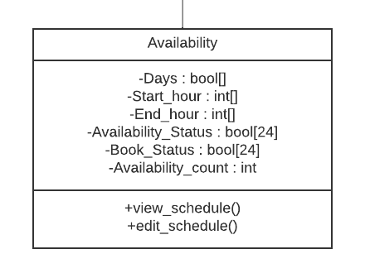
Availability Class
This class is aggregated from the following classes:
Doctor
Patient
This contains a variety of variables, all explained below:
A boolean array called Days which would show which days the doctor is available in. ie: the array would create 7 elements representing the 7 days of the week and each turned on or off would represent whether or not the doctor is available on that day.
A start_hour and end_hour integer array containing the starting and ending hours of the availability in the previously mentioned days that the doctor is available in.
An Availability_status boolean array representing the 24 hours of the day, this will represent which hour the doctor is available on and which he/she is not available on, this is for easy access instead of having to use start and end hour everytime.
A book_status boolean array representing the 24 hours of the day, which will represent the hours the doctor has the appointment already booked on which will be showed on schedule so we can know which are the remaining availability slots.
→Continued on next slide→

Slide 17
An Availability_count integer which will represent how many hours of the day the doctor is available which will also be viewed in the view_schedule option.
The following functions are created in the availability function with their explanations accordingly:
A view_schedule option is created to give both the doctor and user. The doctor will be able to use it to view their own schedule and the patient will be able to use it to view their own schedule.
A function is created to edit the availability of the doctor, this will only be accessible by the doctor and he will be able to edit his own hourly charges, this option will be available in the menu of doctor.
This class does not have any child class however.

Slide 18
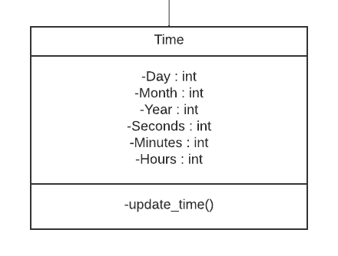
Time Class
This class is aggregated from the following classes:
Doctor
Patient
This class contains a variety of variables associated with time, all of these variables will be updated through the system time using the c_time library.
An update_time function is provided which will be run every time the time is fetched from the class so the times are always updated when being used.
This class does not have any child class whatsoever.

Slide 19
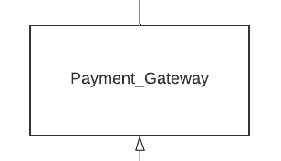
Payment Gateway Class
This class is aggregated from the following classes:
Doctor
Patient
This class does not have any variables present in it but it creates a direct relationship between the doctor/patient interface and the variety of payment options which will make everything a lot more convenient and secure.
The child further inherits into the following two classes:
Bank_Transfer
EasyPaisa

Slide 20
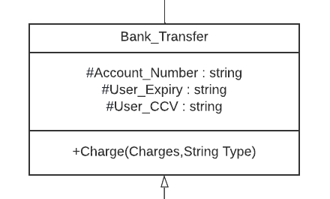
Bank Transfer Class
The bank_Transfer is one of the two classes inherited from Payment gateway.
This class is used in the case the person wants to do the payment using his bank account.
It contains a variety of variables containing the bank account details that would be used to deposit balance in the person’s Oladoc account.
It also contains a Charge function on which polymorphism is implemented, it will take you to a gateway where it will charge the user through basic bank transfer according to the Charges of the specific doctor and the type of appointment it is.
It further inherits in the following two classes:
PayPak
Union_Pay

Slide 21
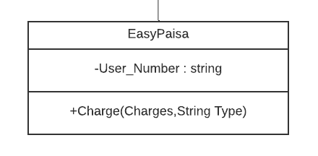
EasyPaisa Class
The EasyPaisa class is one of the two classes inherited from Payment gateway.
This class is created for a unique type of payment gateway where it does not require the user to add his own bank account for the payment and it can simply be done through the user’s EasyPaisa account.
It also contains a Charge function on which polymorphism is implemented, it will take you to a gateway where it will charge the user through EasyPaisa according to the Charges of the specific doctor and the type of appointment it is.
It only contains one variable which is the phone number of the user sending the money.
It does not have any further child class.

Slide 22
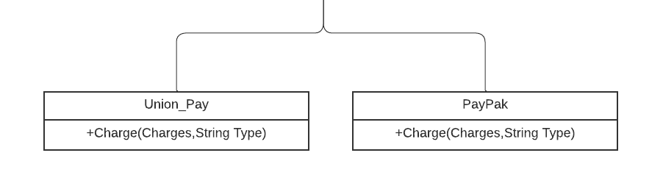
Union_Pay and PayPak Class
The two classes are both inherited from the Bank_Transfer class since both of them are used through the Bank account information of the person.
Both classes contain separate charge functions where polymorphism is implemented to redirect the user to separate gateways according to the type of payment method that the user has selected.
Either one of these classes do not have any child classes and stand at the bottom of the hierarchy since they are simply helping in forming a better organized interface.

Slide 23
File Handling In the Program:
The designed UML diagram heavily relies on file handling for a lot of its functions.
Separate Files will be created for separate parts of the system.
The Different Files that will be created are Listed Below:
Appointments:
This will include all the appointments of the doctors to be able to be accessed by admin and doctors.
Doctor Data:
This will include all the personal data of the doctor which can only be edited by admin but accessed by doctor as well.
Doctor Info:
This will include the availability, hourly charge, and other info of the doctor which can be edited by admin and doctor
Patient Info:
This will include the availability, hourly charge, and other info of the doctor which can be edited by admin and doctor.
Passwords:
This will contain all the account passwords of admins, doctors and patients along with their usernames.
Most of the File handling will be done through a unique CNIC search method which was previously mentioned in the previous slides.
The view doctor functions and listing functions will be done in a normal way where the data would be fetched from files and will be organized accordingly before being displayed.

Slide 24
The End!

