Slide 1
Applications
MULTI-PURPOSE Security alarm

Slide 2

Alert system for disconnected railway carriages

Slide 3
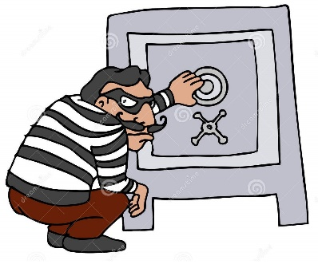
Locker security alarm

Slide 4

Avoids robbery in your house

Slide 5
Thank you

