Slide 1
FYP MEETING Science knowledgebase creation 181122 – Muhammad Huzaifa 181058 – Hamza Ali

Slide 2
MEETING OBJECTIVES
Extracted required information for specific topic from Wikipedia using Wikipedia API
Extraction of entity pairs from grammatical patterns from text using NLP library SpaCy
Knowledge graph
formed

Slide 3
ABOUT THE TASK
Scientific Knowledge base creation
Nodes represent entities and edges represent relationship among them
Extracted the required information from wikipedia using Wikipedia API
Extracted grammatical patterns of text using NLP library SpaCy, and neuralcoref
Formation of knowledge graph

Slide 4
PROJECT SCHEDULE
JULY
AUGUST
SEPTEMBER
OCTOBER
NOVEMBER
DECEMBER
PHASE 1
Task 1
Research
Task 2
knowledge graph creation
PHASE 2
Task 1
Task 2

Slide 5
PROJECT TIMELINE
01
02
03
04
PHASE 1 Project Idea finalized + documentation
PHASE 3 TESTING + deployment
PHASE 2 Knowledge graph creaion from wikipedia + other files
PHASE 4 Deployment

Slide 6
SCHEDULE
The project schedule is on track
RESOURCING
Resourcing is adequate
BUDGET
Project is within budget
RISKS
All project risks are under control
ISSUES
Project issues need to be solved
BENEFITS
Project benefits will meet the expectations
STATUS REPORT

Slide 7



WHERE WE ARE + WHERE WE WANT TO BE
WHERE WE ARE
Despite being red, Mars is a cold place, not hot
30 %
WHERE WE WANT TO BE
Mercury is the closest planet to the Sun

Slide 8
ABOUT THE TASK
Scientific Knowledgebase creation
Nodes represent entities and edges represent relationship among them
Extracted the required information from wikipedia using Wikipedia API
Extracted grammatical patterns of text using NLP library SpaCy, and neuralcoref
Formation of knowledge graph

Slide 9

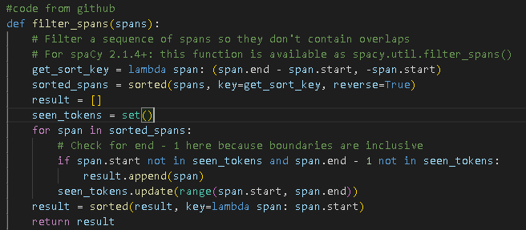
Getting entity pairs.py
Importing previous as well these libraries
Should add filter_spans because of spacy==2.1.0 (from spacy module)

Slide 10
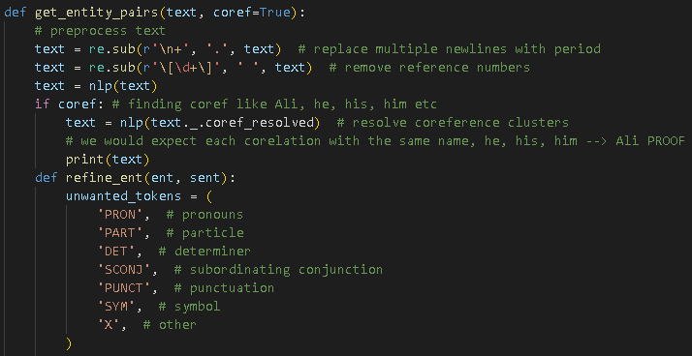
Getting entity pairs.py [cont.]

Slide 11
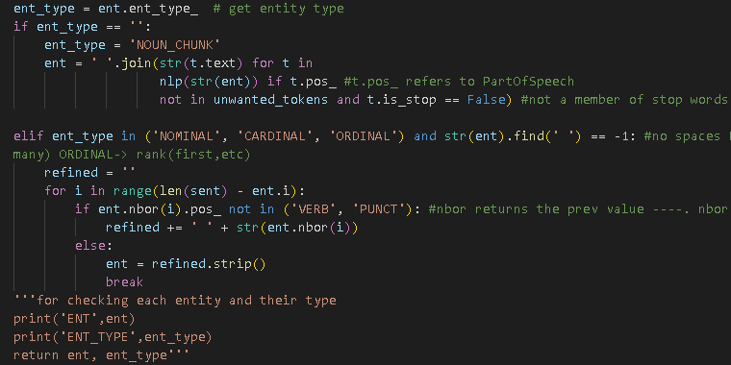
Getting entity pairs.py [cont.]

Slide 12

Getting entity pairs.py [cont.] Main Function

Slide 13
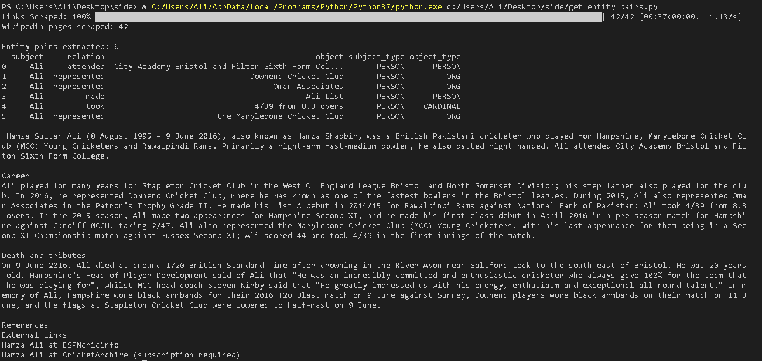
Output [get_entity_pairs.py]

Slide 14
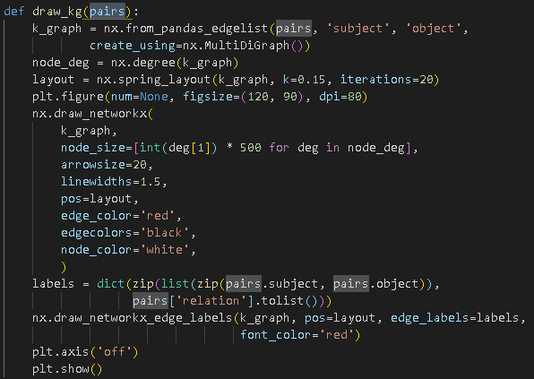
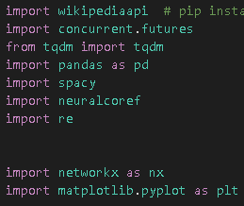
Getting Draw_kg.py

Slide 15
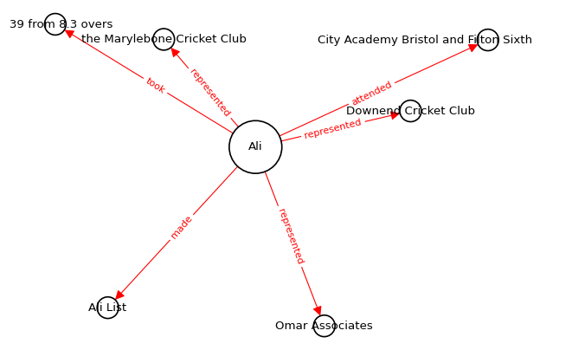
Output [Draw_kg.py]

Slide 16
THANKS
Any Questions ?
181058@students.au.edu.pk
181122@students.au.edu.pk

