Slide 1

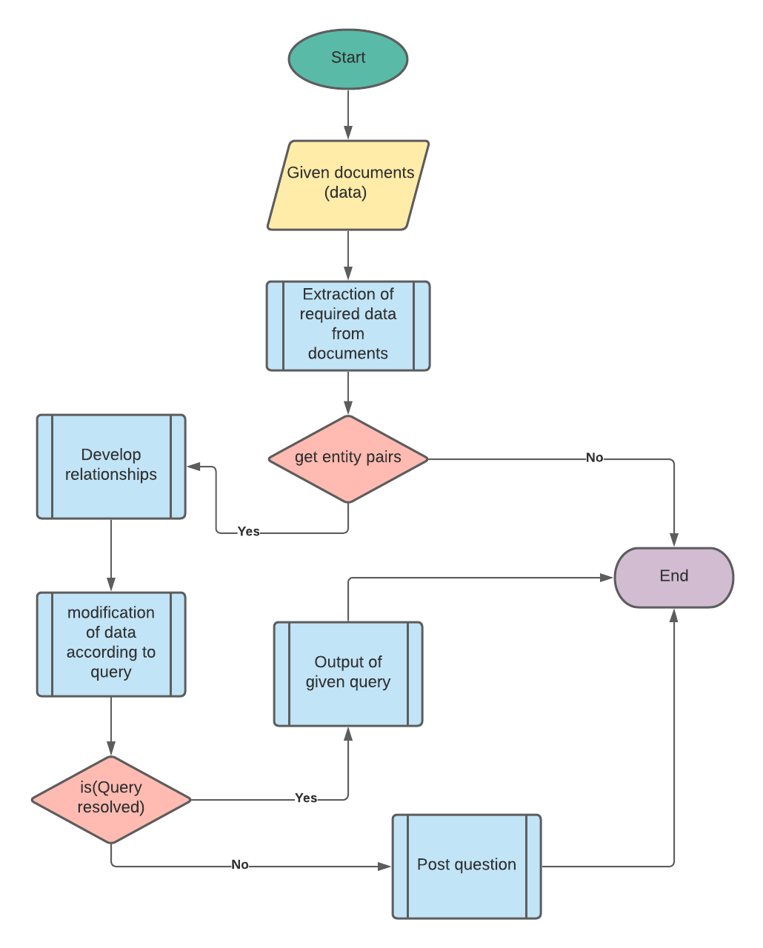
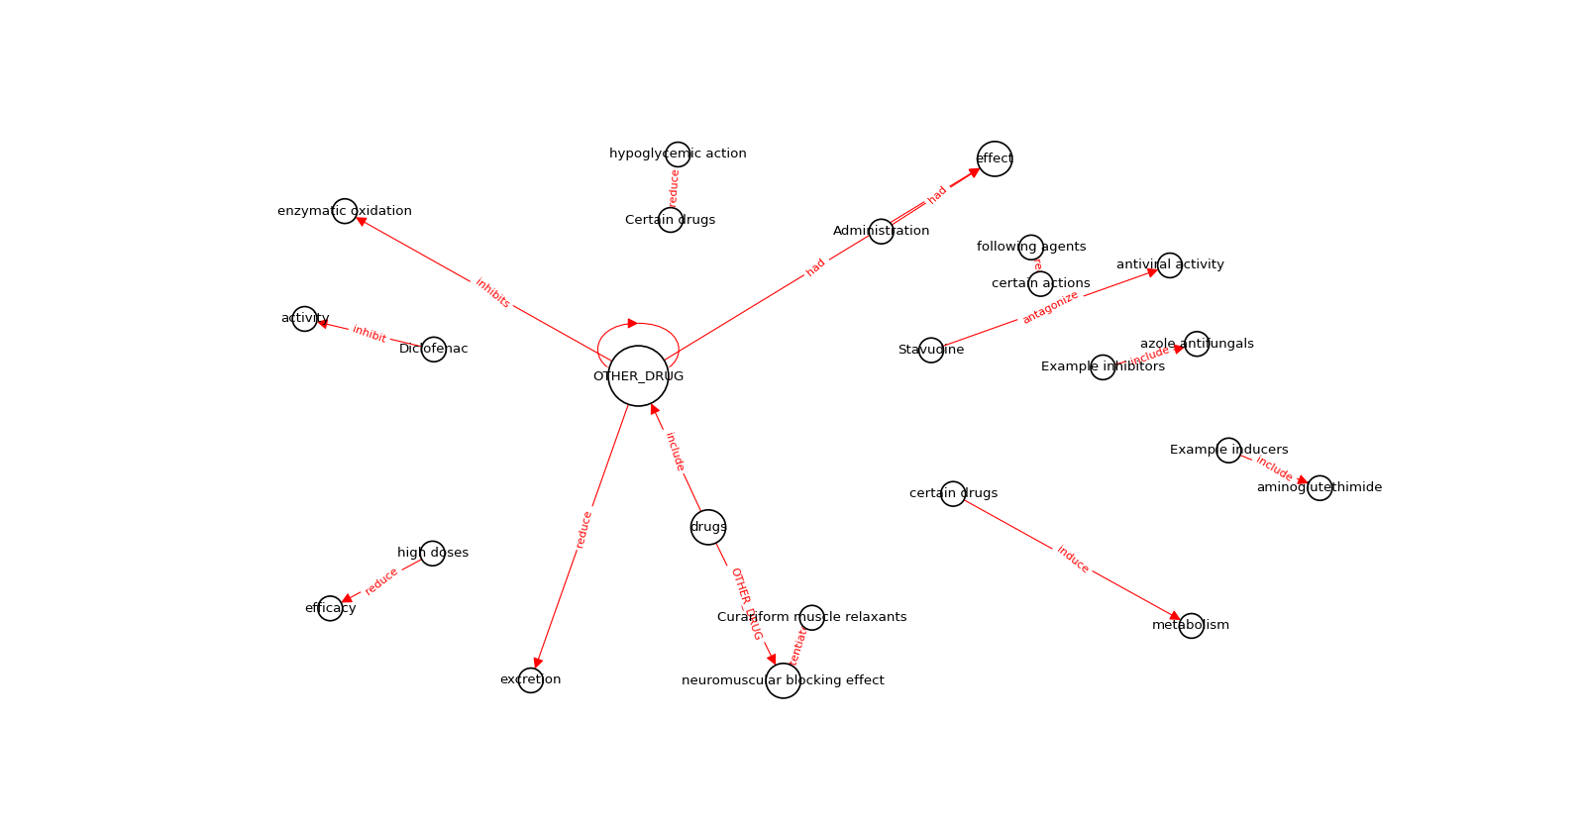
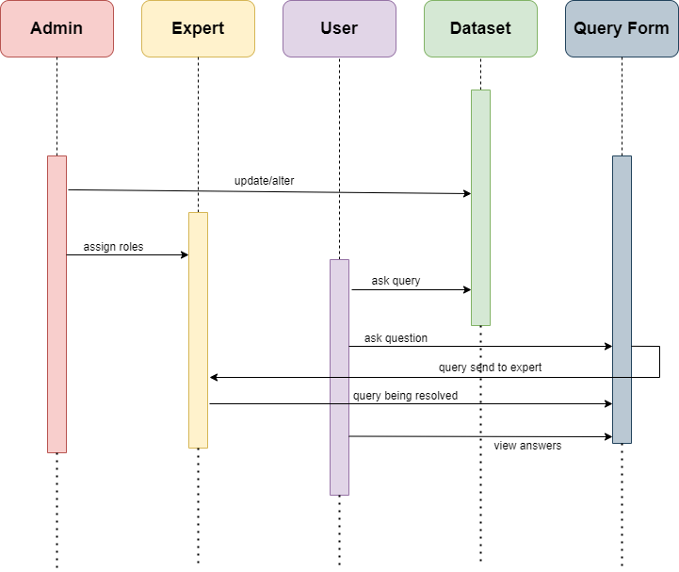
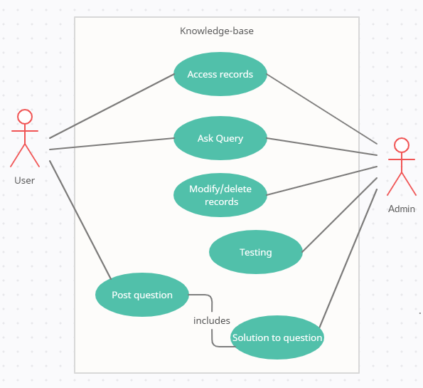
Scientific Knowledge Base Creation with Heterogeneous Data 181058,181122 (Hamza, Huzaifa), (Supervisor) Shoaib Malik FYP ID: CS-SP-21-29
Introduction
Flow Diagram
Results
We are developing knowledge base for scientific documents. A knowledge base allows you to create self-service customer support content around recurring topics, issues, and themes. For that, we would be using web crawling, NLP and numerous data processing python tools for giving authentic solutions for students, teachers and any other tech seekers.
Problem Statement
When we google our query, we may get unauthentic information or wrong data. Many sites owners uses fake tags to increase their ranking, due to which user can’t ensure the result to be useful. Therefore they rely on reputed authentic sites like stack overflow, Quora and many more. We are developing knowledge base that will rely on authentic sites and datasets for authentic and reliable answer to the given query.
We extracted required information for specific topic from Wikipedia using Wikipedia API which has scraped every available links, pages using topic. After that, we have created entity pairs from grammatical patterns using NLP and SpaCy library. We get different grammatical patterns / token from which unwanted tokens are removed. After subsequent steps, we get relationships among text and a knowledge graph.
Goals/Objectives
Main objectives are:
Create a knowledge base that entertain queries on the basis of provided documents.
Providing relevant and authentic output.
Sequence Diagram
Discussion
Our focus is to educate tech seekers to seek solutions for their tech-related problems. For starters, they don't know where to start; that's where we can help. All they have to do is post questions in our web-app, and let us handle the rest. On search, the relevant data to query will be shown to the user.. We'll scrape data from provided datasets and the web to answer, else experts will answer it for them.
Use Case Diagram
Conclusion
We are helping newer tech geek so they can seek solution to their tech-related problem. User just need to provide his query, and the solution will be provided in a matter of seconds. Many users don’t know the authenticity of certain sites due to fake metatags, but it’ll be solved by us, using reputed sites across the developers and other IT geeks. We aim to provide solutions, and if for some case, our KB fails to deliver solution, that query will be solved via our IT experts.
Dataset
For the datasets (DDI), we have utilised the help of web scraping, that will scrape the solution from provided dataset and internet. After that, it’ll create entities, and knowledge graph from it.

