Slide 1

Muhammad Huzaifa | 181122
Hamza Ali | 181058
FYP Semester: | II
FYP-ID: | CS-SP-21-29
Date: | 20-12-2021
Scientific knowledge-base
Creation from heterogenous data
Supervisor: | Mr. Shoaib Malik
Examiner: | Dr. Awais
Moderator: | Mr. Salman Masih

Slide 2
Table of Contents
Scientific knowledge-base Creation from heterogenous data
Introduction
Problem Statement
Requirement Analysis
SWOT Analysis / Business Plan
Gantt Chart for Project Progress
Use Case Diagram
Proposed Methodology (Flow Chart)
Class Diagram / Sequence Diagram
Implementation
Results
References

Slide 3
Introduction
Scientific knowledge-base Creation from heterogenous data
We are developing knowledge base for scientific documents. A knowledge base allows you to create self-service customer support content around recurring topics, issues, and themes. For that, we would be using web crawling, NLP and numerous data processing python tools for giving authentic solutions for students, teachers and any other tech seekers.

Slide 4
Problem Statement
Scientific knowledge-base Creation from heterogenous data
Users may get unauthentic or outdated information from google
We’re developing Knowledge base to provide Users authentic information
Our Knowledge base will rely on authentic datasets and sites to provide reliable answer to the given query
Users can also post their question for which they want answer from expert

Slide 5
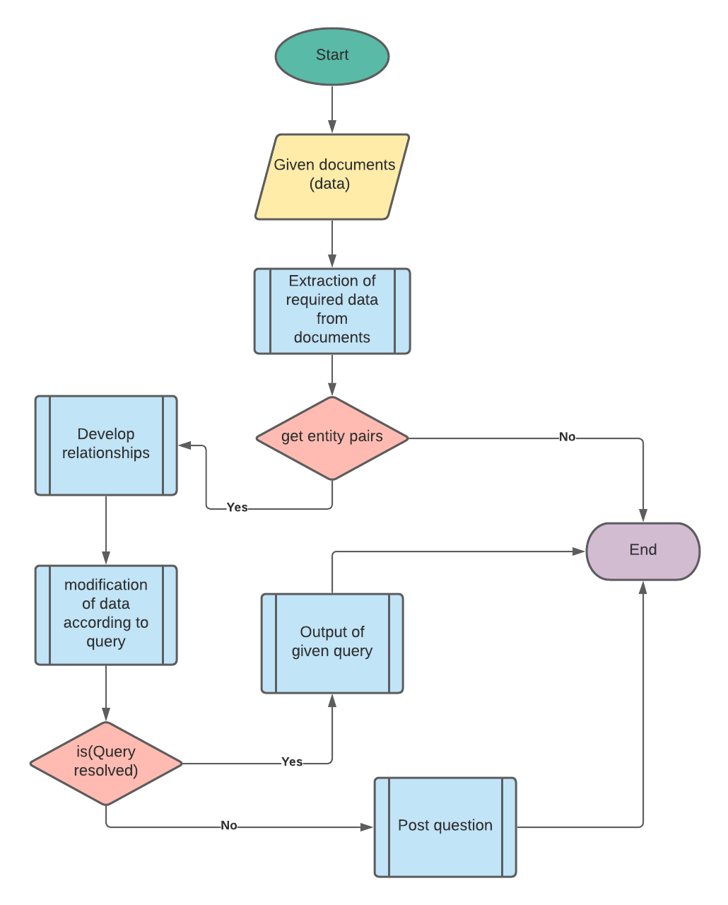
Requirement Analysis
Scientific knowledge-base Creation from heterogenous data
User needs to
Input the query
Select relevant categories from checkbox
And let the program handles the rest.

Slide 6
Business Plan
Scientific knowledge-base Creation from heterogenous data
Creation of an API, that queries data from available datasets
For implementation in business (other domain), one has to buy this API
Or we can create one for them

Slide 7
SWOT Analysis
Scientific knowledge-base Creation from heterogenous data
POSITIVE
NEGATIVE
STRENGTH
WEAKNESS
INTERNAL
Provide more accurate and reliable solution to user query on the basis of datasets.
Post your question and get answer from an Expert.
Efficient sites providing solution in an instant, but juniors don’t know about them
OPPORTUNITY
THREAT
EXTERNAL
New project with latest datasets, and relevant datasets unlike openKB.
SQL injection to reveal personal data of user or admin.
Security threats
Fig 1: SWOT analysis of the project

Slide 8
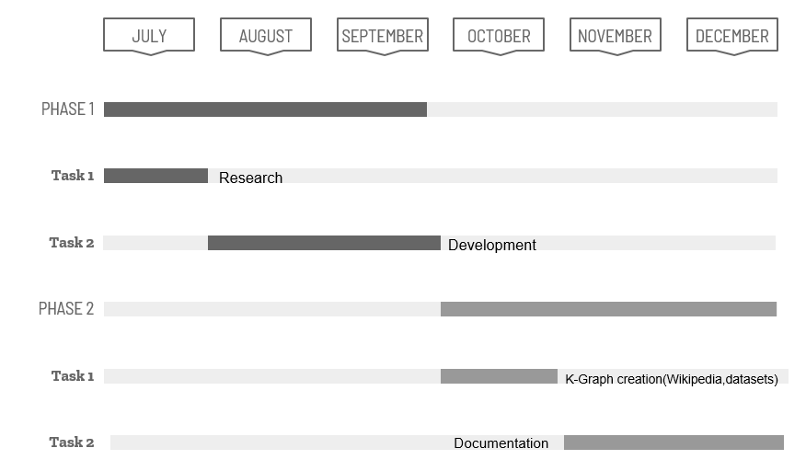
Gantt Chart
Scientific knowledge-base Creation from heterogenous data
Fig 2: Gantt Chart (Project Timeline) of the project

Slide 9
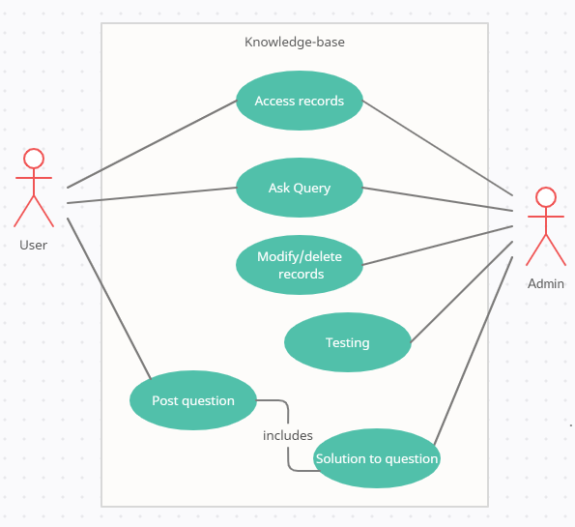

Use Case Diagram
Scientific knowledge-base Creation from heterogenous data
Fig 3: Flow diagram of the project

Slide 10
Flow Diagram
Scientific knowledge-base Creation from heterogenous data
Fig 4: Flow diagram of the project

Slide 11
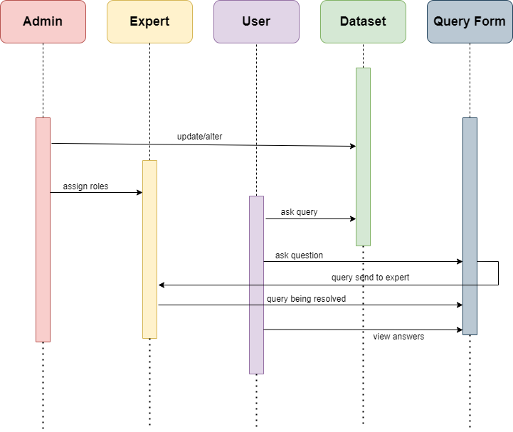
Sequence Diagram
Scientific knowledge-base Creation from heterogenous data
Fig 5: Sequence Diagram of the project

Slide 12
Proposed Methodology
Scientific knowledge-base Creation from heterogenous data
PHASE 1: Project Idea finalized + documentation
PHASE 2: Knowledge graph creaion from wikipedia + other datasets
PHASE 3: Frontend development and linking
PHASE 4: TESTING + deployment

Slide 13
Implementation
Scientific knowledge-base Creation from heterogenous data
We have uses certain datasets, i.e. Drug Detection for this project
Passing relevant columns for finding entities pairs.
Removal of lines / numbers
Removal of unwanted tokens ( Part of speech, stop words)
Creation of entities pairs
Finding subject, verb and object from these entities
Drawing relevant graph from those entities.

Slide 14
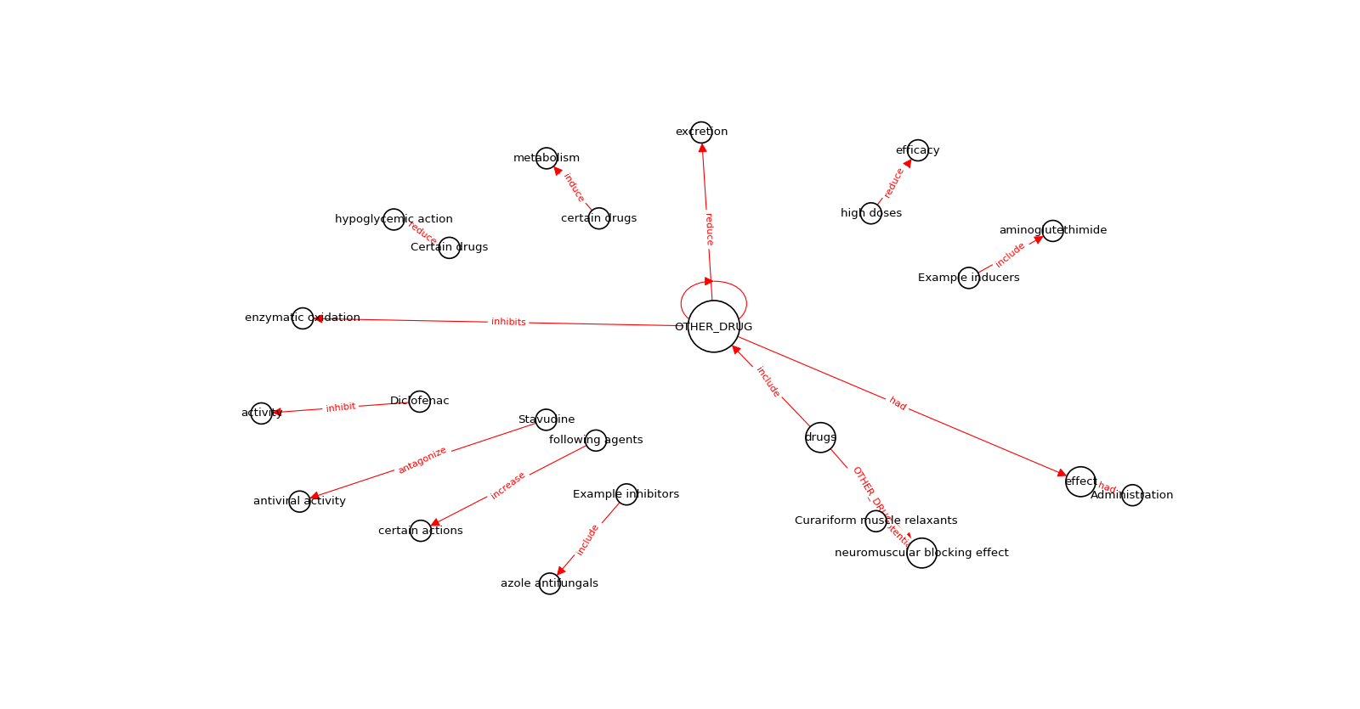
Results
Scientific knowledge-base Creation from heterogenous data

Slide 15
Tools and Technologies
Scientific knowledge-base Creation from heterogenous data
For the project, we have utilized specific python versions and its relevant modules
Python 3.7.0
Tqdm
Pandas
Spacy 2.1.0
Neuralcoref 4.0
Matplotlib
networkx

Slide 16
References
Scientific knowledge-base Creation from heterogenous data
https://towardsdatascience.com/auto-generated-knowledge-graphs-92ca99a81121
https://www.hubspot.com/knowledge-base
https://www.analyticsvidhya.com/blog/2021/06/text-preprocessing-in-nlp-with-python-codes/
https://neptune.ai/blog/web-scraping-and-knowledge-graphs-machine-learning

