Slide 1

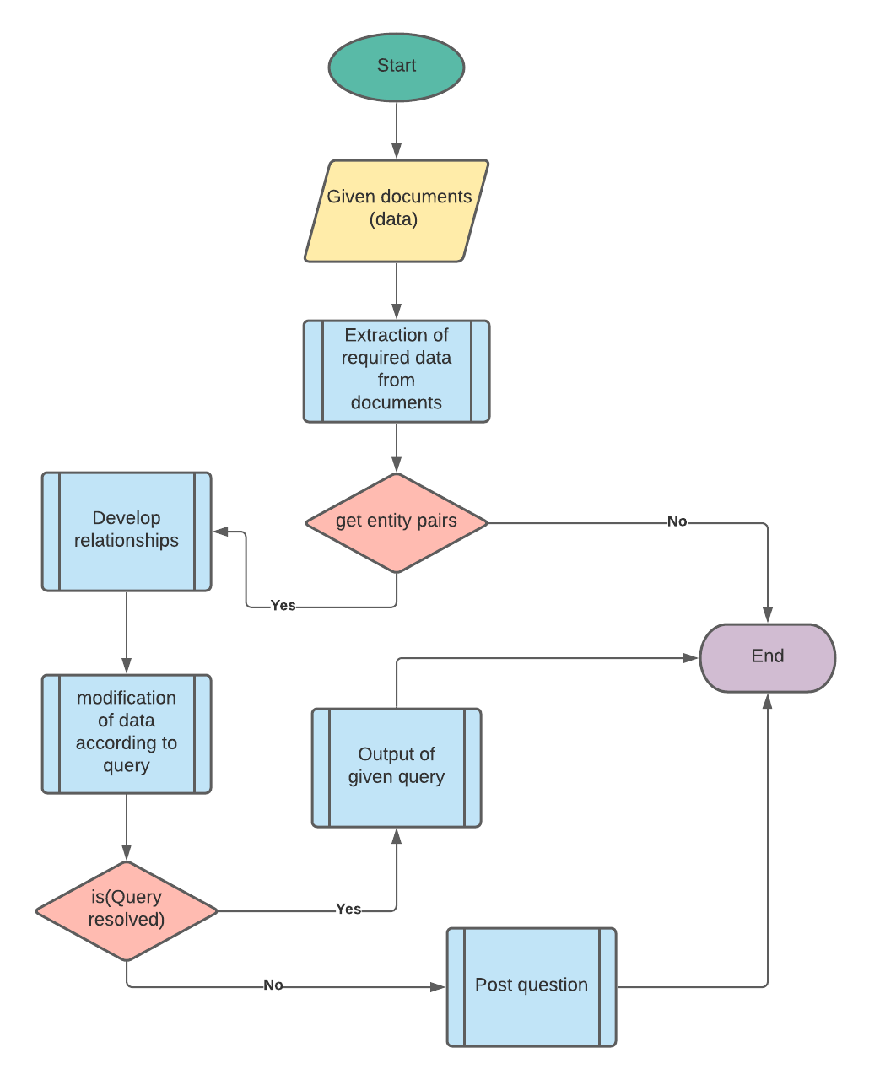
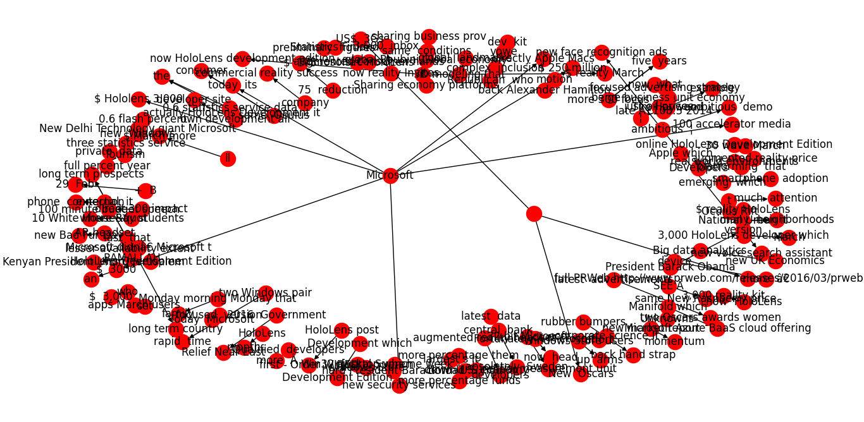
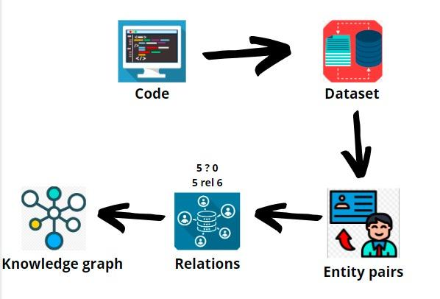
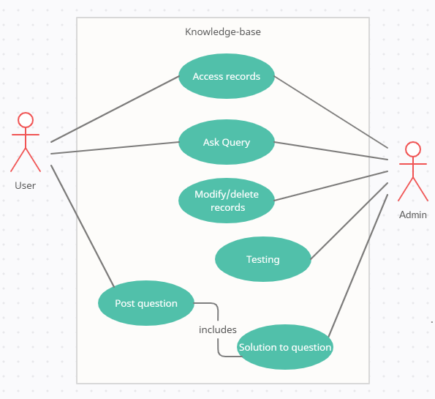
Scientific Knowledge Base Creation with Heterogeneous Data 181058_Hamza, 181122_Huzaifa, (Supervisor) Shoaib Malik FYP ID: CS-SP-21-29
Introduction
Flow Diagram
Results
Solving a user’s query has been tough since the use of internet. With internet, one can be benefited from it and at lost due to some spamming information and tags. For solution, one has to rely on google but modern sites uses fake tags that spams the solution. For that, we have created a knowledge base that would provide us with the knowledge graphs of academic datasets. For creating a knowledge graph, we have used web crawling, NLP, NLTK, and other data processing tools, from cleaning the data to its knowledge graph. This work can be expanded by using queries to solve the problem. It can further be enhanced to solve user’s queries using a simple web-app. Provided that the solution is available from queries, it’ll be shown as an output, else it’ll be posted to the authentic forums, like stack-overflow etc.
After using relevant data set, we have created entity pairs from grammatical patterns using NLP and SpaCy library. We get different tokens/ entities from which unwanted punctuation were removed. Then we have created relations among those entities. After subsequent steps, we get relationships among those entities, and thus, a knowledge graph is created.
Problem Statement
When we google our query, we may get spammed information. Many sites owners uses fake tags to increase their ranking, due to which user can’t ensure the result to be authentic. Unlike senior developer, they rely on reputed authentic sites like stack overflow, Quora and many more. As for the juniors, they don’t know building blocks when it comes to resolving their error. We are developing knowledge base that will rely on authentic sites and academics datasets for reliable answer to the given query.
Goals/Objectives
Methodology
Discussion
Main objectives are:
Using the relevant datasets for knowledge graph
Data pre-processing
Finding entities
Finding relations between those entities
Creating a relevant knowledge graph using those entities and relationship.
Our focus is to educate tech seekers to seek solutions for their tech-related problems. For starters, they don't know where to start; that's where we can help. This project can successfully create knowledge graphs, all that’s left is to apply queries and simple UI for searching solutions. All they have to do is post questions in our web-app, and let us handle the rest. On search, the relevant data to query will be shown to the user. We'll scrape data from provided datasets and the web to answer, else the query will be answer it for them.
Use Case Diagram
Conclusion
We are helping newer tech geek so they can seek solution to their tech-related problem. User just need to provide his query, and the solution will be provided in a matter of seconds. Many users don’t know the authenticity of certain sites due to fake met-atags, but it’ll be solved by us, using reputed sites across the developers and other IT geeks. We aim to provide solutions, and if for some case, our KB fails to deliver solution, that query will be solved via our IT experts.
Dataset
For the datasets (DDI), we have utilised the help of web scraping, that will scrape the solution from provided datasets and the internet. After that, it’ll create entities, relationship and, finally, knowledge graph from it.

